Slide 1

Drug Demand Reduction (DDR)
Administrative Process
SSG Jason Sanchez
Paralegal
Office of the Staff Judge Advocate (OSJA)
(787) 707-2022 / 2150

Slide 2
ROAD MAP:
Required steps to prepare a DDR packet
Questions?

Slide 3
POLICIES AND REGULATIONS:
AR 135-175 Separation of Officers
AR 135-178 Enlisted Administrative Separations
AR 600-85 The Army Substance Abuse Program
AR 635-200 Active Duty Enlisted Administrative Separations
AR 600-8-2 Suspension of Favorable Personnel Actions (Flag)
AR 635-8 Separations Processing and Documents
DA PAM 600-85 Federal Drug-Free Workplace Procedure Guidance
PM 22-18 – 1st MSC Alcohol and Drug Abuse Prevention

Slide 4
Drug Demand Reduction (DDR)
Program Separation Actions Procedures

Slide 5
Drug Demand Reduction (DDR) Program
AR 135-178, Chapter 11 paragraph 11-1(d) – Misconduct:
  Abuse of illegal drugs or alcohol. Illegal drug use is serious misconduct. Under UCMJ wrongful use of Marihuana/THC imposes the following maximum punishment:
    DD, BCD (Punitive Discharge) - 5-year confinement - Total Forfeiture
  Commanders will process for separation all Soldiers who—
  (a) Test positive for illegal drug use.
  (b) Are involved in two serious incidents of alcohol-related misconduct within a 12-month period, in accordance with AR 600–85.
  (c) Are involved in illegal trafficking, distribution, possession, use, or sale of illegal drugs.
  (d) Convicted of driving while intoxicated or driving under the influence a second time during their career.
  (e) Have not been referred to a court-martial authorized to impose a punitive discharge.

Slide 6
PREPARE ASAP/DDR PACKET
1st MSC Table of Content for DDR Packets
  Unit Level Required Documents
    DA 268, DA 5248-R, ARB, PQR, DD214, TL History, DA 5016
    Notification of Separation Packet (S: 30/45 Days) - Sharp Memo, DA 4856, Election of Rights, Conditional Waiver, Trial Defense Services Sheet, Acknowledgment of Receipt
    Commander’s Report – After Suspense Date
  BN Commander’s Recommendation
  BDE Commander’s Recommendation

Slide 7
PREPARE ASAP/DDR PACKET
OPITION 1
Face to Face Notification

Slide 8
Required Steps to prepare ASAP/DDR packet
Option 1 - Face to Face
Unit Phase I
Unit Phase II
If Soldier responds within the given 30-day timeframe. Complete packet with the Commander’s Report and all Enclosures.
If Soldier do not respond within the given 30-day timeframe. Complete packet with the Commander’s Report, all Enclosures and Lack of Response Memorandum.
Unit Initiate Packet in ePAT (using RCMS/ eAction system)
Create Packet following PAG Checklist T-3-A-1 Enlisted
Give Soldier Notification of Separation with all Enclosures and give Soldier 30 days to respond.
Submit Completed packet to Battalion thru ePAT for review and further process.
Submit Action thru ePAT (RCMS/ eActions) to Battalion for tracking purpose.
Contact CID and Schedule an Appointment for Soldier and Commander.
FLAG Soldier (Personnel system) with Code U and change deployability code to LD. (DA Form 268)

Slide 9
Required Steps to prepare ASAP/DDR packet
Option 1 - Face to Face
Battalion
&
Brigade
Review and verify all documents for any discrepancy.
Final Process
Complete Chain of Command Recommendation Memorandum.
Submit Action thru ePAT (RCMS/ eActions) to Battalion for tracking purpose.
Submit Completed packet to next Level thru ePAT for Review and further process. (Battalion will send to Brigade / Brigade will send to SJA at 1MSC Level for Review.)
CG Determinations: Separation, Suspended Separation or Board Referral
Remove FLAG using code D after 12-month probation completion, discharge orders are published, or Retention Memorandum has been received.
Suspended Separation - Once received 12-month probation Memorandum signed by Commanding General continue with a monthly collection using code RO.

Slide 10
OPITION 2
Mail Certified Return Receipt Notification

Slide 11
Required Steps to prepare ASAP/DDR packet
Option 2 - Mail Certified Return Receipt
Unit Phase I
Upon receipt of lab results, FLAG Soldier (Personnel system) with Code U and change deployability code to LD. (DA Form 268)
Unit Phase II
If Soldier responds within the given 30/45-day timeframe. Complete packet with the Commander’s Report and all Enclosures.
If Soldier do not respond within the 30/45 days, complete packet with the C. Report, all Enclosures and Lack of Response Memorandum.
Initiate Packet in ePAT (using RCMS/ eAction system)
Create Packet following PAG Checklist T-3-A-1 Enlisted
Notarized Affidavit and add to packet.
Give Soldier 45 days to respond.
Submit Completed packet to Battalion thru ePAT for Review and further process.
Submit Action thru ePAT (RCMS/ eActions) to Battalion for tracking purpose.
Contact CID and Schedule an Appointment for Soldier and Commander.
Mail Notification of Separation with all Enclosures to address on Soldier’s DA Form 2A / PQR

Slide 12
Required Steps to prepare ASAP/DDR packet
Option 2 - Mail Certified Return Receipt
Battalion
&
Brigade
Review and verify all documents for any discrepancy.
Final Process
Complete Chain of Command Recommendation Memorandum.
Submit Action thru ePAT (RCMS/ eActions) to Battalion for tracking purpose.
Submit Completed packet to next Level thru ePAT for Review and further process. (Battalion will send to Brigade / Brigade will send to SJA at 1MSC Level for Review.)
CG Determinations: Separation, Suspended Separation or Board Referral
Remove FLAG using code D after 12-month probation completion, discharge orders are published, or Retention Memorandum has been received.
Suspended Separation - Once received 12-month probation Memorandum signed by Commanding General continue with a monthly collection using code RO

Slide 13
Required DDR packet quality checks before and after the Soldier is counseled
Carefully review the Notification of Separation Proceeding
under AR 135-178

Slide 14
1ST MSC OSJA - Separation Action DDR Packet
1. USARC Delegation Memo to CG 81st RD
2. ARB, PQR, SHARP Memo
3. DA Form 268, DA Form 4856 (FLAG)
4. HQ, 1st MSC Recommendation
5. Battalion’s CDR Recommendation
6. BDE/RSG’s CDR Recommendation
7. Commander’s Report
8. Notice for Separation
9. Acknowledgment of Receipt, Election of Rights, C. Waiver
10. Soldier Written Statements and Letters of Recommendations
11. ADCO Notification for Commander Drug Positive Results
12. Law Enforcement Report
13. Admin Documents–Report of Unfavorable Information for Security Determination (DA Form 5248R), Chronological Statement of Retirement Points, (DA Form 5016), TL History, DD Form 214, Drug Results History

Slide 15
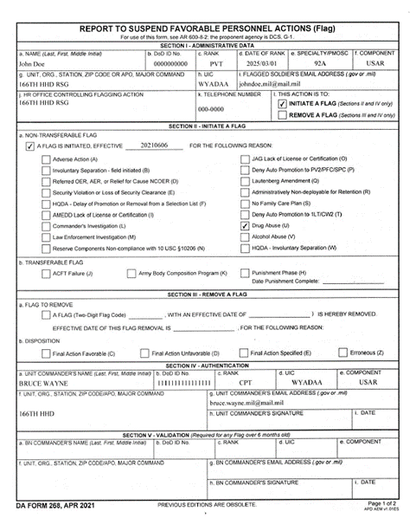
DA 268 Report to Suspend Favorable Personnel Actions (FLAG)

Slide 16
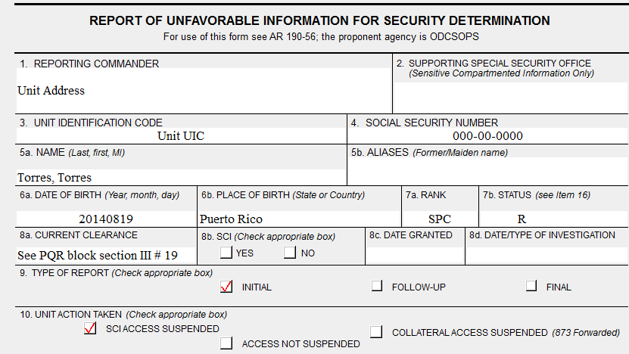
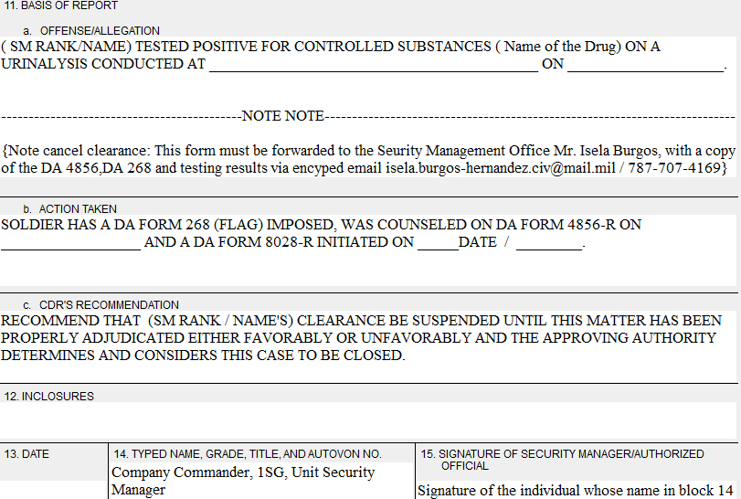
DA 5248R-Initiate Security Clearance Suspension
Forward this form to the Security Manger office Mrs. Burgos with copies of DA 4856; DA 268 and testing results.

Slide 17
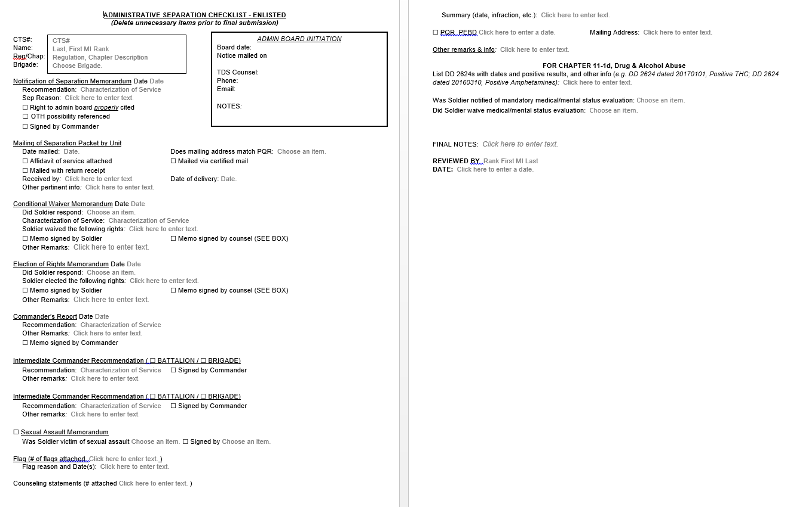
UPDATED Checklist Enlisted T-3-A-1

Slide 18
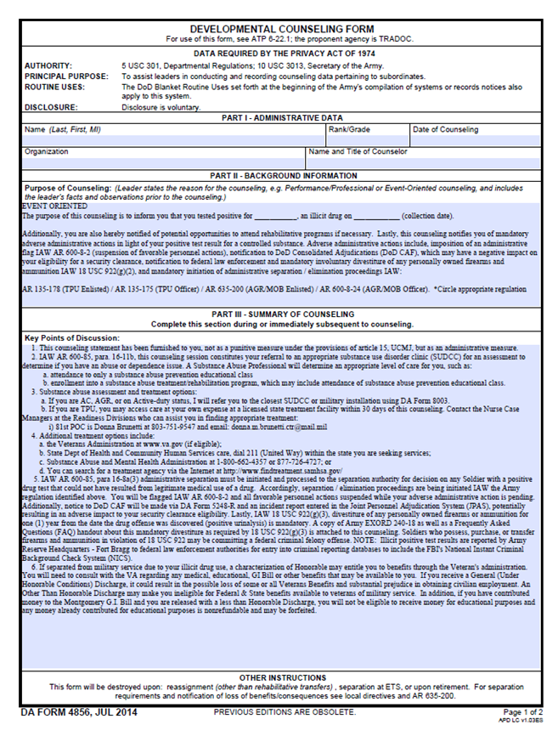
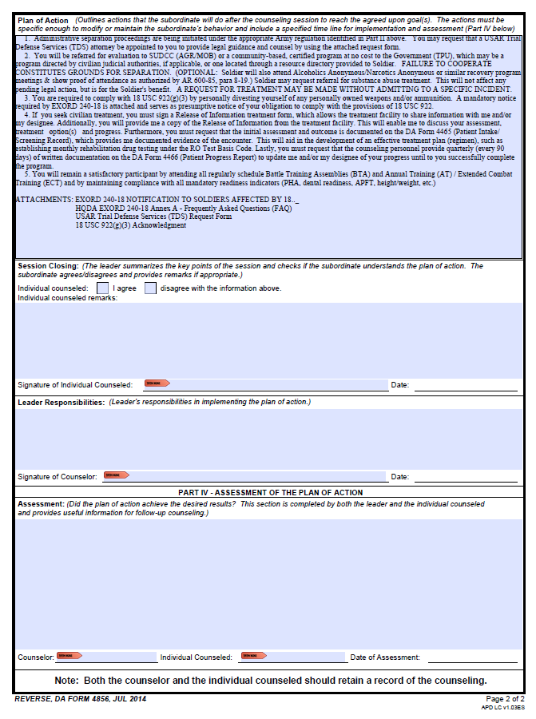
DA 4856 – Developmental Counseling Form

Slide 19
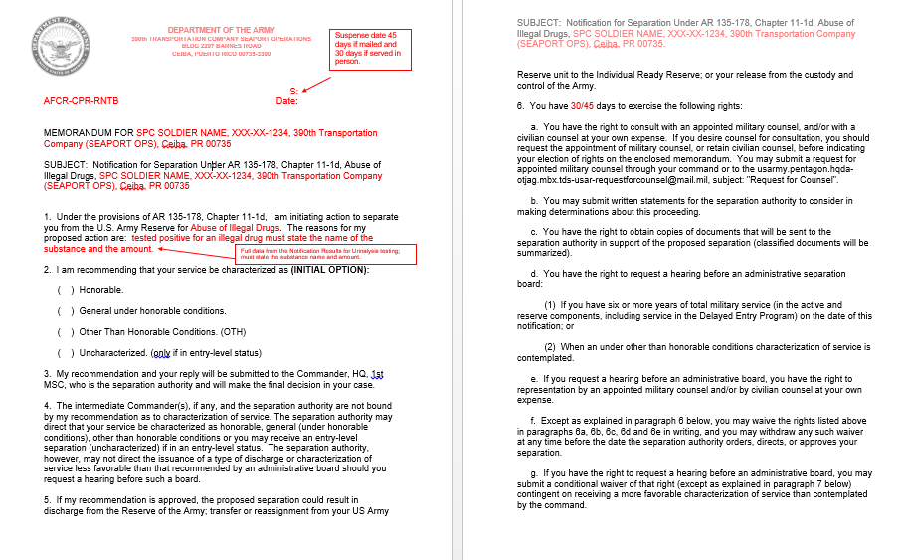
A- NOTIFICATION OF SEPARATION

Slide 20
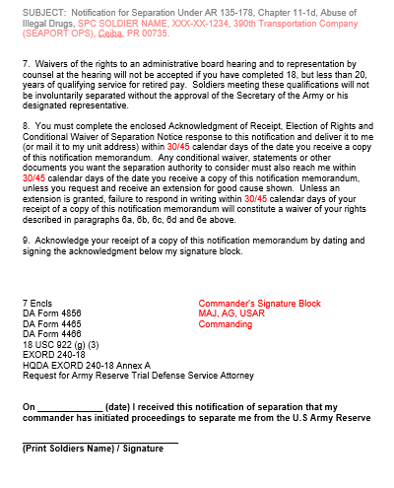
A- NOTIFICATION OF SEPARATION (continued)

Slide 21
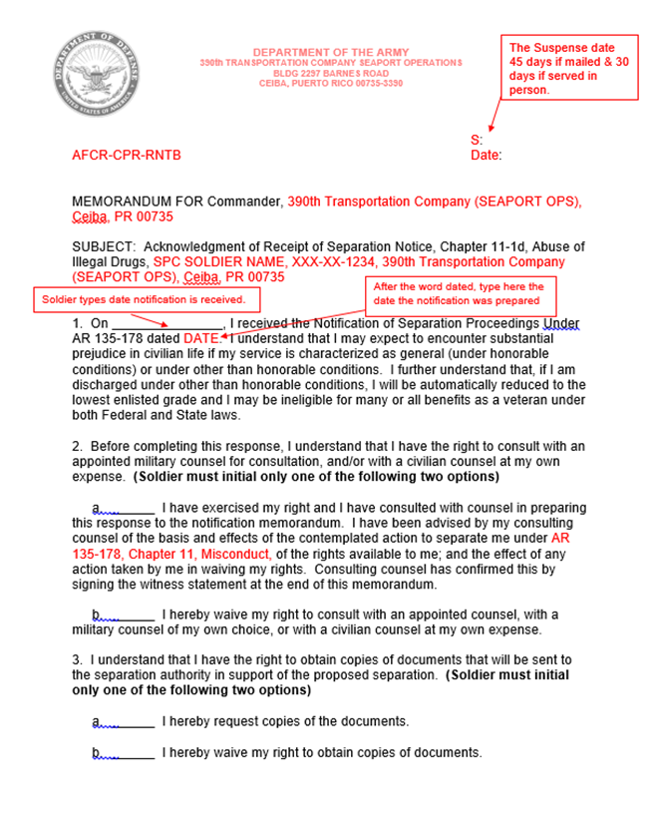
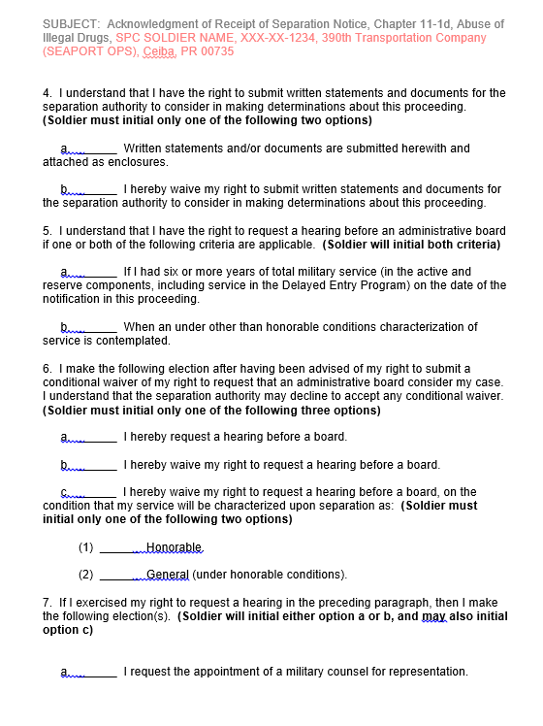
B- Acknowledgement of Notification of Separation

Slide 22
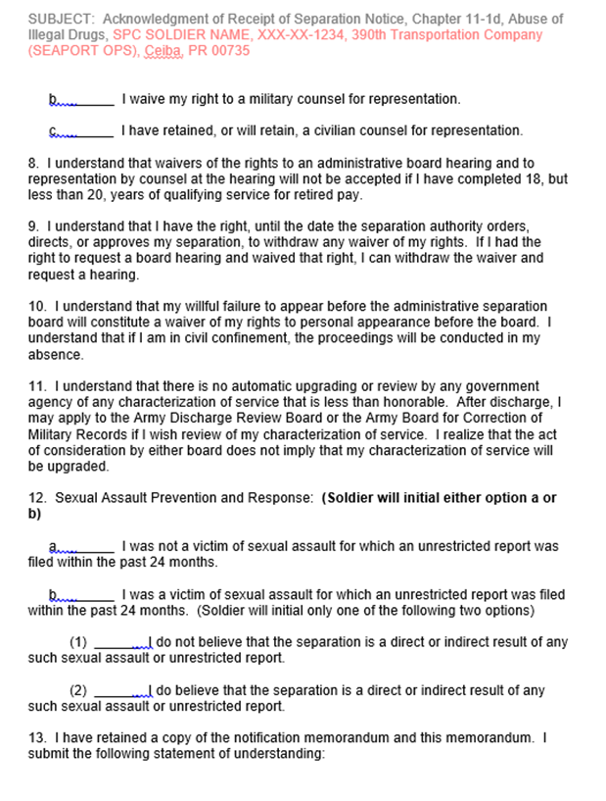
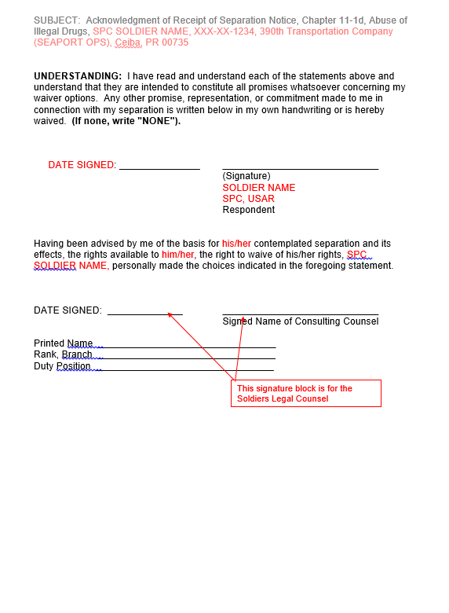
B- Acknowledgement of Notification of Separation
(continued)

Slide 23
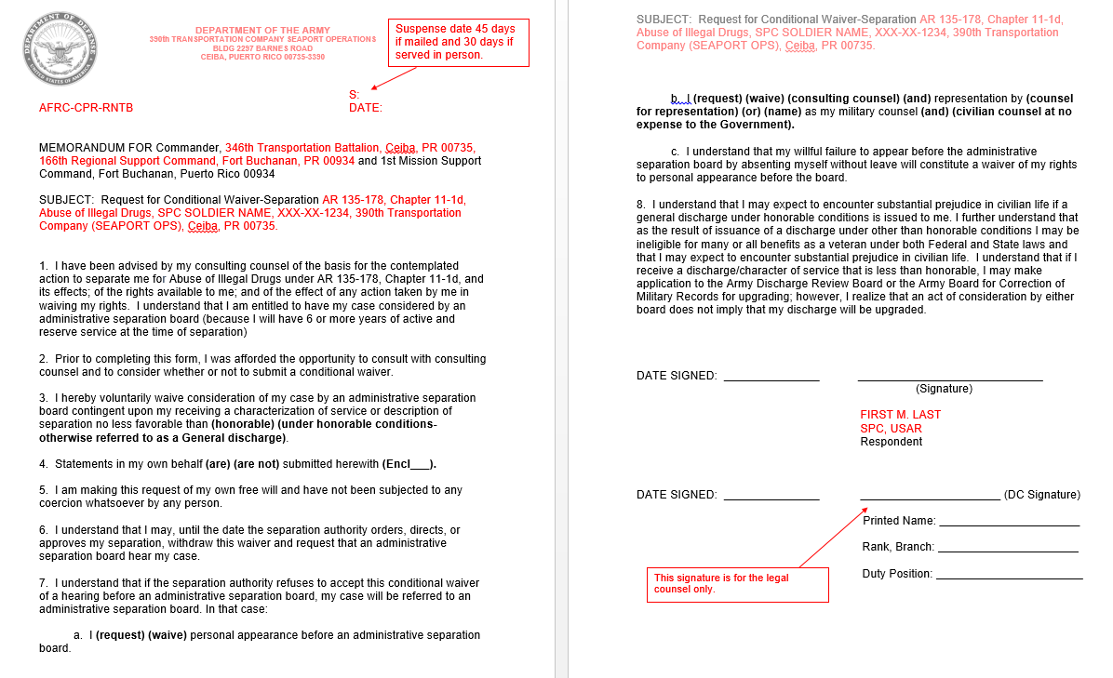
C- Conditional Waiver Memorandum

Slide 24
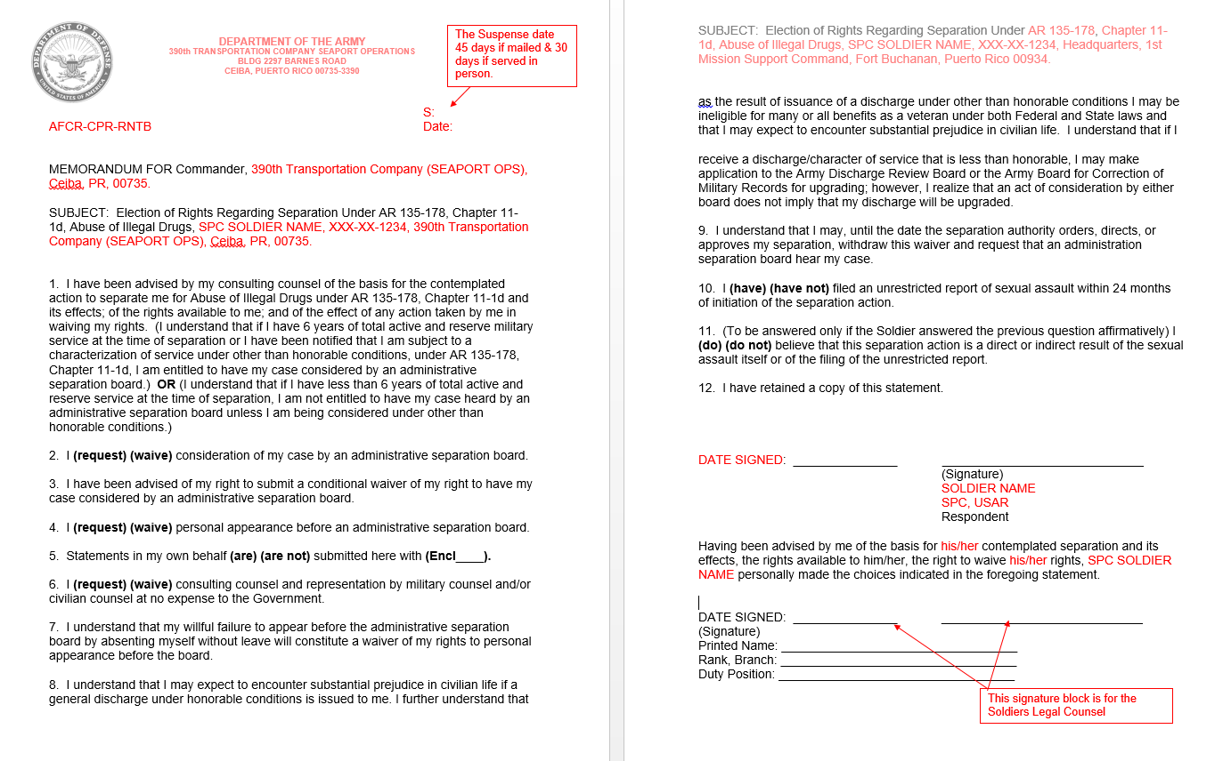
D - Election of Rights Memorandum

Slide 25
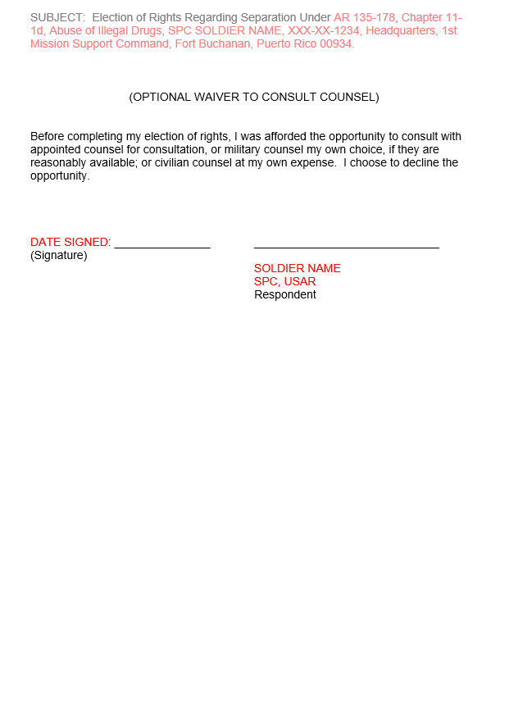
D - Election of Rights Memorandum (continued)

Slide 26
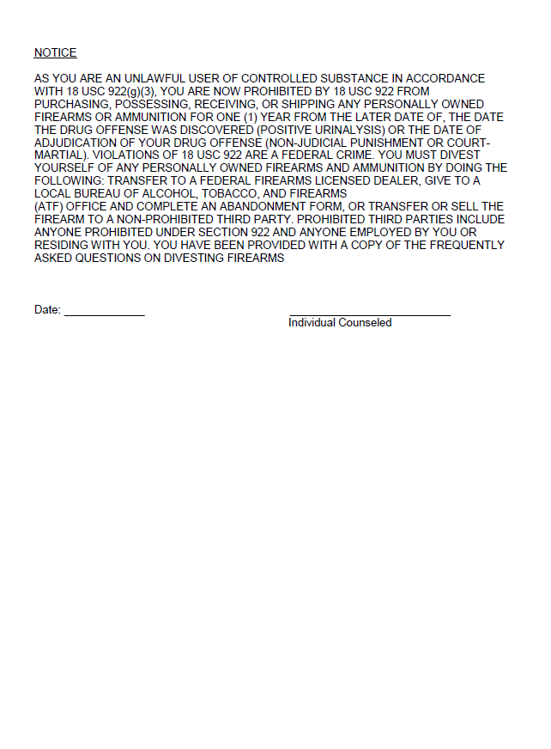
REVIEW NOTIFICATION OF SEPARATION (Encls)

Slide 27
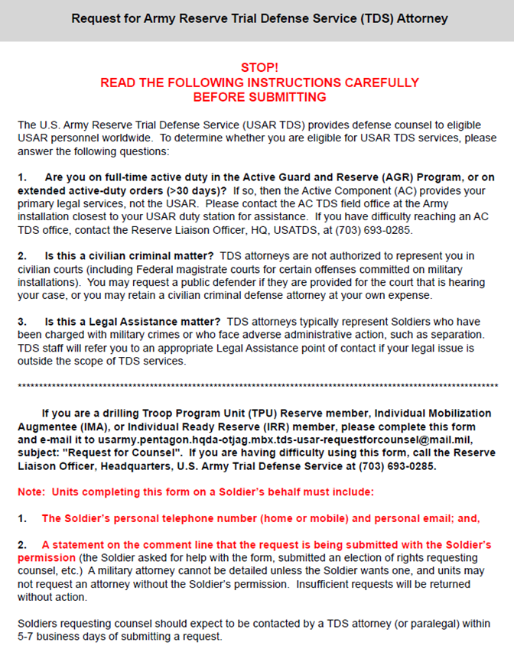
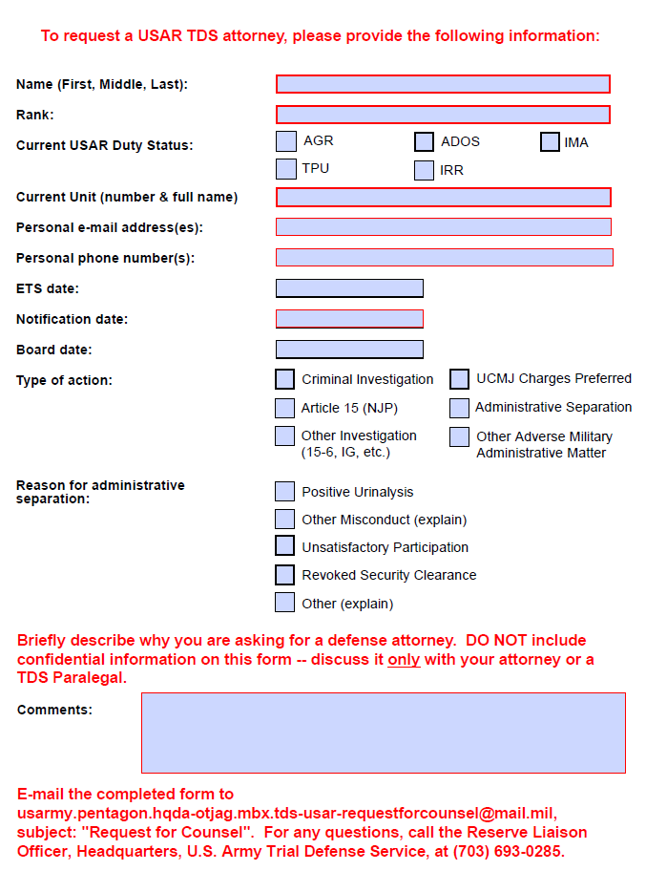
NOTIFICATION OF SEPARATION (Encls) (continued)

Slide 28
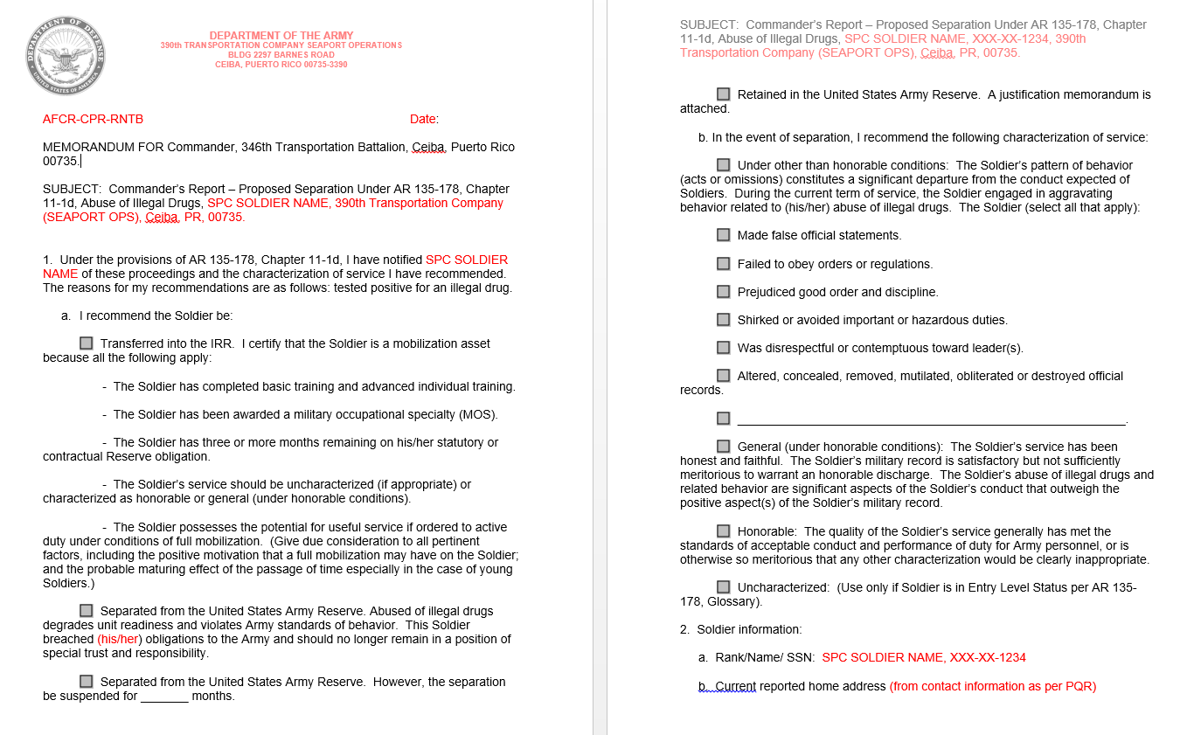
E - Commander’s Report

Slide 29
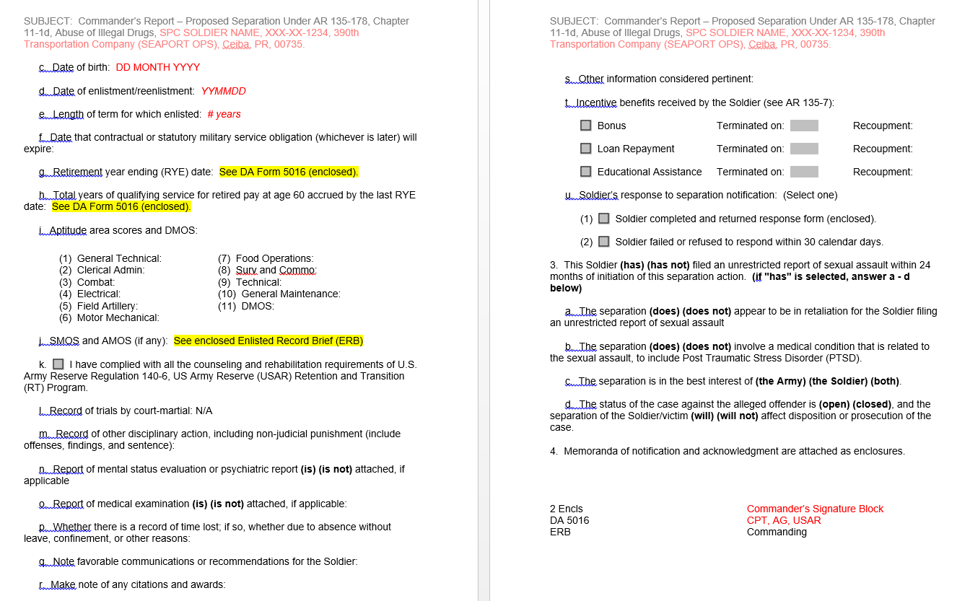
E - Commander’s Report (continued)

Slide 30
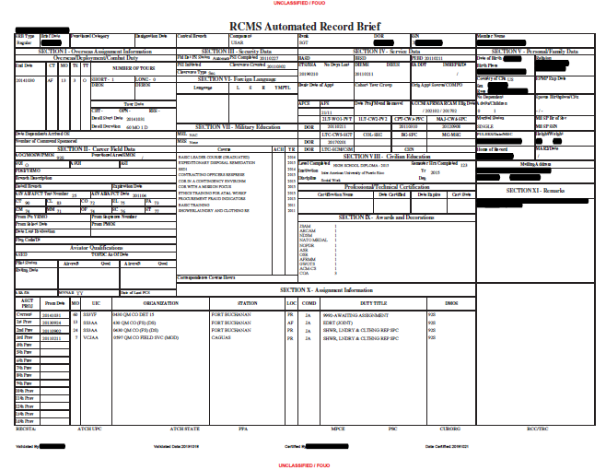
E - Commander’s Report (Encls) (continued)

Slide 31
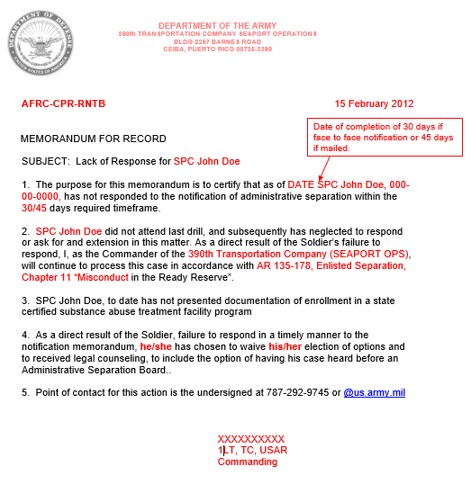
Commander’s Statement / Lack of Response Memorandum
(If applicable)

Slide 32
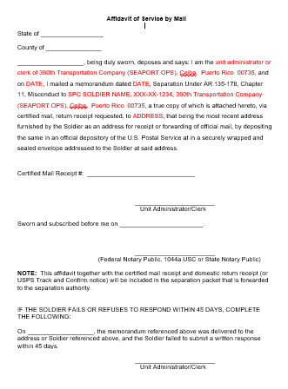
Affidavit of Service Mailing
(Use only for Mailed Certified Return Receipt Notification of Separation)

Slide 33
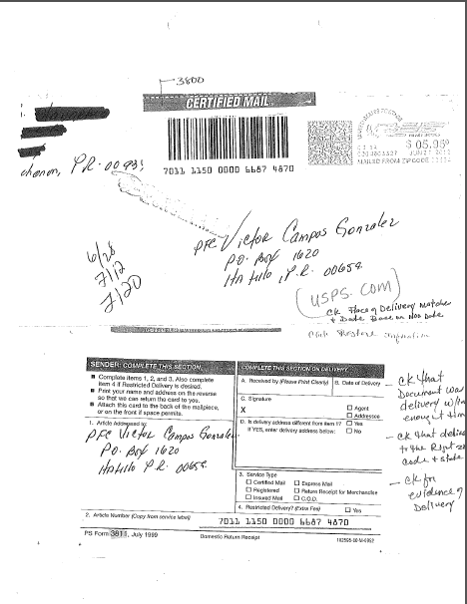
Example: Copy Certified Return Receipt
PS Form 3800 & 3811 showing delivery/attempt delivery

Slide 34
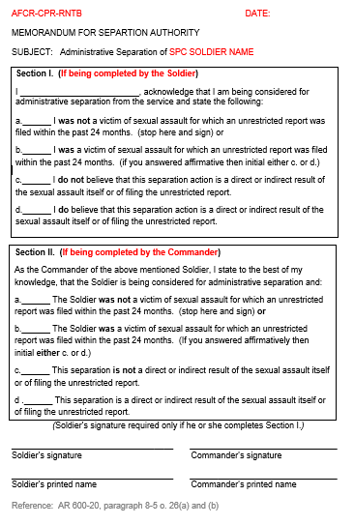
Sexual Assault Statement

Slide 35
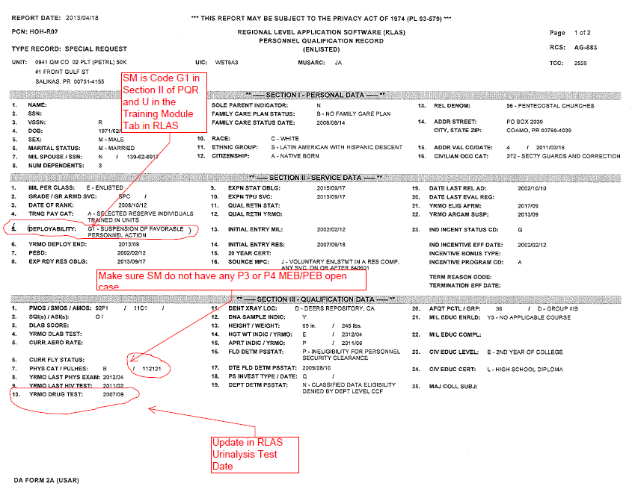
DA From 2A Personnel Qualification Record (PQR)

Slide 36
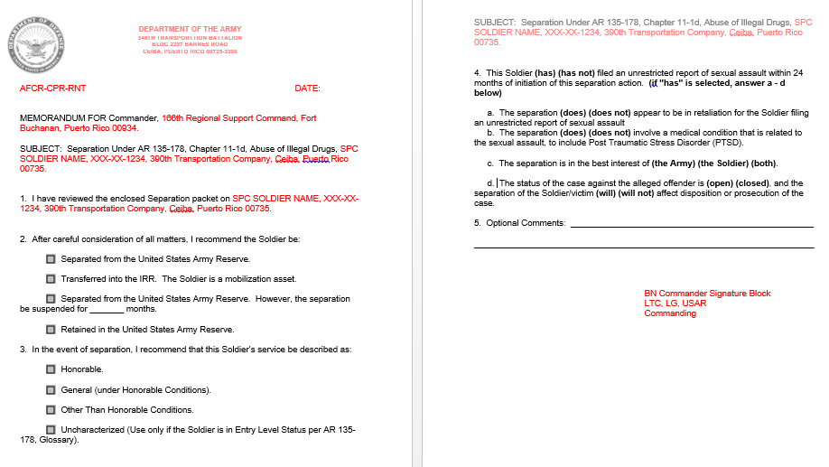
G - Chain of Command Recommendation
(Use same template for both Battalion and Brigade)

Slide 37
Commander’s Official Notification Results for Urinalysis Testing

Slide 38
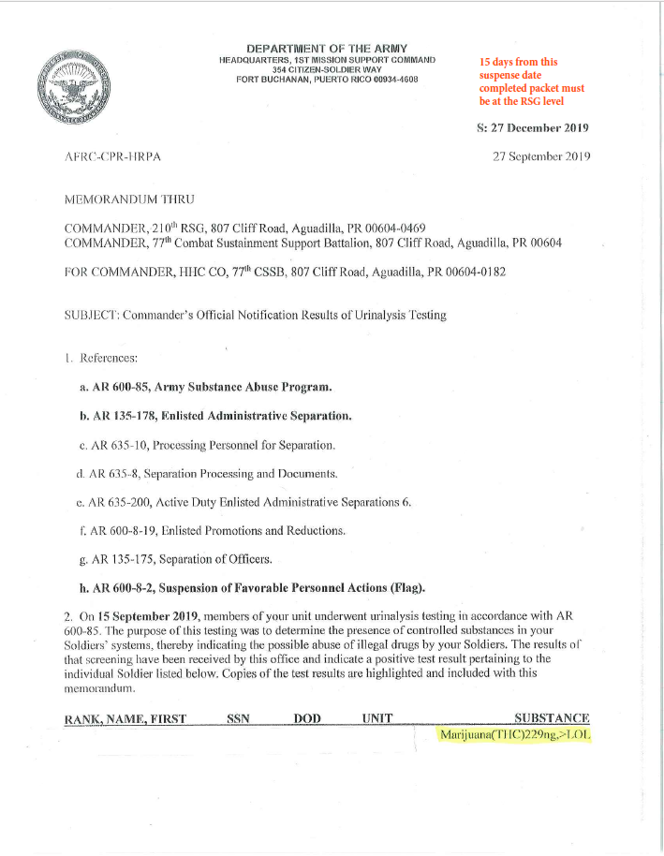
Commander’s Official Notification Results for Urinalysis Testing

Slide 39
Commander’s Official Notification Results for Urinalysis Testing

Slide 40
Commander’s Official Notification Results for Urinalysis Testing

Slide 41
Commander’s Official Notification Results for Urinalysis Testing

Slide 42
Considerations as part of Commander’s Separation Recommendation :
Rank and Years of Services
SM’s Age
Previous Deployments
Prior Negative Urinalysis
Post Negative Urinalysis
Acceptance of Responsibility (SM’s Matters)
Letters of Support
Type of Drug and Quantity
Previews Incidents of Misconduct
SM’s MOS
Findings of CID investigation
Whether SM is entitled to a Separation Board
  6 years of service or more includes AD, Reserve, IRR = Entitled to Board
  Soldier Notified for OTH is entitled to board
Suspended up to 12 months is an option for rehabilitation purposes.

Slide 43
CHARACTERIZATION OF SERVICE
Honorable
• “[A]ppropriate when the quality of the Soldier’s service generally has met the standards of acceptable conduct and performance of duty for Army personnel…” . .
General Under Honorable Conditions
• “[M]ilitary record is satisfactory but not sufficient to warrant an honorable discharge.”
• “If an enlisted Service member’s service has been honest and faithful, it is appropriate to characterize that service as general (under honorable conditions). Characterization of service as general (under honorable conditions) is warranted when the positive aspects of the enlisted Service member’s conduct or performance of duty outweigh negative aspects of the enlisted Service member’s conduct or performance of duty as documented in their service record.”
Reminder: Suspended up to 12 months is an option.

Slide 44
CHARACTERIZATION OF SERVICE
Under Other than Honorable Conditions (OTH):
• Authorized under certain chapters for a pattern of behavior or an act/omission constituting a significant departure from conduct expected of Soldier
• OTH is “normally appropriate” for Misconduct & Unsatisfactory Participation
• Soldier recommended for OTH is entitled to board
Note: Bad Conduct Discharges and Dishonorable Discharges are only available at court-martial
Reminder: Suspended up to 12 months is an option.

Slide 45
Commander’s Considerations for Recommendation of Characterization of Service per Regulation:
Rank and Years of Services
SM’s Age
Aptitude
Physical and Mental conditions
Standard of acceptable conduct
Performance of Duty
Limitations on Characterization: Characterization will be determined solely by the SM’s military record, which includes the Soldier’s behavior and performance of duty during the current enlistment or period of service to which the separation pertains.
Note: The characterization of service is of great significance to the SM and must accurately reflect the nature of service performed to preserve Veteran’s Benefits, Education, Civilian Employment, Reentry into the Military

Slide 46
KEY NOTES
Verify if the Soldier is undergoing an MEB Process
The Separation Process and MEB Process can go parallel but both packets need to be presented to the separation authority.
If the Soldier is undergoing an MEB process and he/she is referred to a separation board the proceedings will be place in suspense until the MEB process if finished.
When the Soldier has a Board, he needs to be in uniform and on a pay status.
If the Soldier acquires legal representation and request an extension to respond it will not probably delay the course of the process.
If the Soldier submits a Conditional Waiver different from the one provided on the packet, it must be added in order to reach the separation authority for his evaluation.

Slide 47

QUESTIONS?

