Slide 1
Improving your Command Climate
LTC Luis Santiago

Slide 2
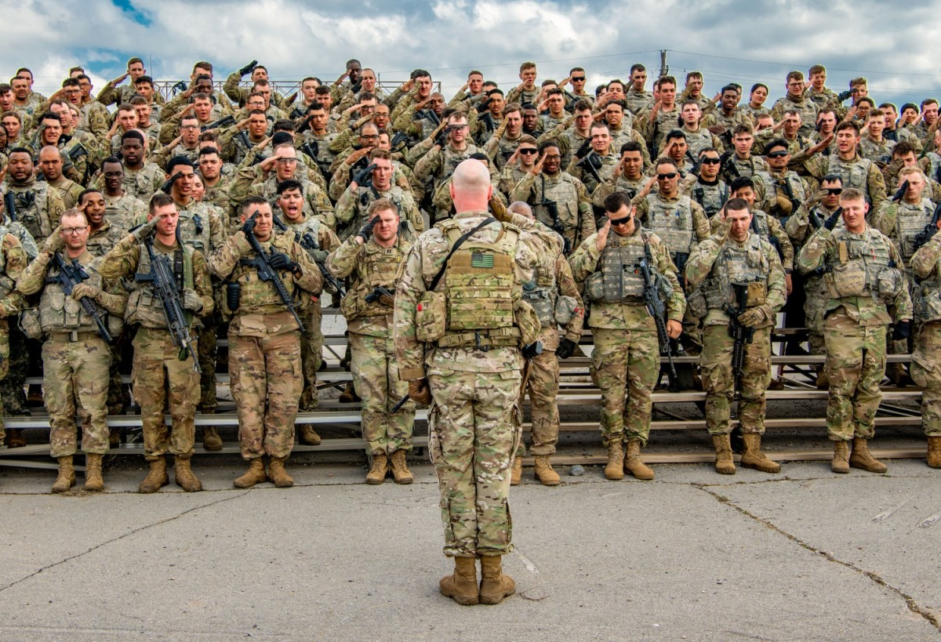
Command Climate
What Is Command Climate & Why Is It Important?
Climate refers to how members think and feel about their organization on a day-to-day basis. Climate is based on shared perceptions and attitudes across an organization, with its current state demonstrated in the behaviors and performance of its members and units. As a leader, you set the tone for the organization through the behaviors you demonstrate, those you encourage and reward, as well as those you ignore.

Slide 3
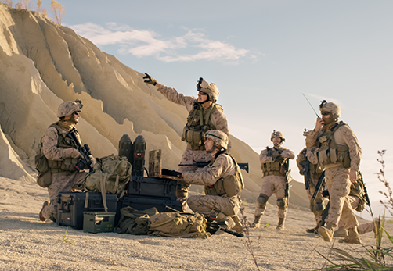
My responsibilities
Commander’s Responsibilities
As per AR 600-20 Commanders are responsible for sustaining a positive EO climate within their units.
Commanders and organizational leaders will foster and maintain positive command climates.
According to ADP 6-22 and AR 600-100, all members of an organization are responsible for contributing to a positive climate.
As an Army leader, you are responsible and have specific requirements to assess, develop, and maintain a positive climate.
You can use this tool to better understand feedback you’ve received from other climate assessments (e.g., DEOCS, pulse surveys, etc.) or to be proactive and take a preventative approach to create an environment where members perform at a high level, trust and support one another, treat each other with respect, do the right things the right way, and prevent harmful behaviors.

Slide 4

Leaders Requirements
What do I bring to my Troops?
Clear intent( Counseling's, Mission Orders, Policies Verbal etc.)
Awareness( Self and your unit’s)
Camaraderie
Energy
Innovation
Care
Communication
Trust
Delegate tasks – not responsibility
Creativity
Cohesion
Emotional intelligence
Make honest mistakes and learn
Candor

Slide 5
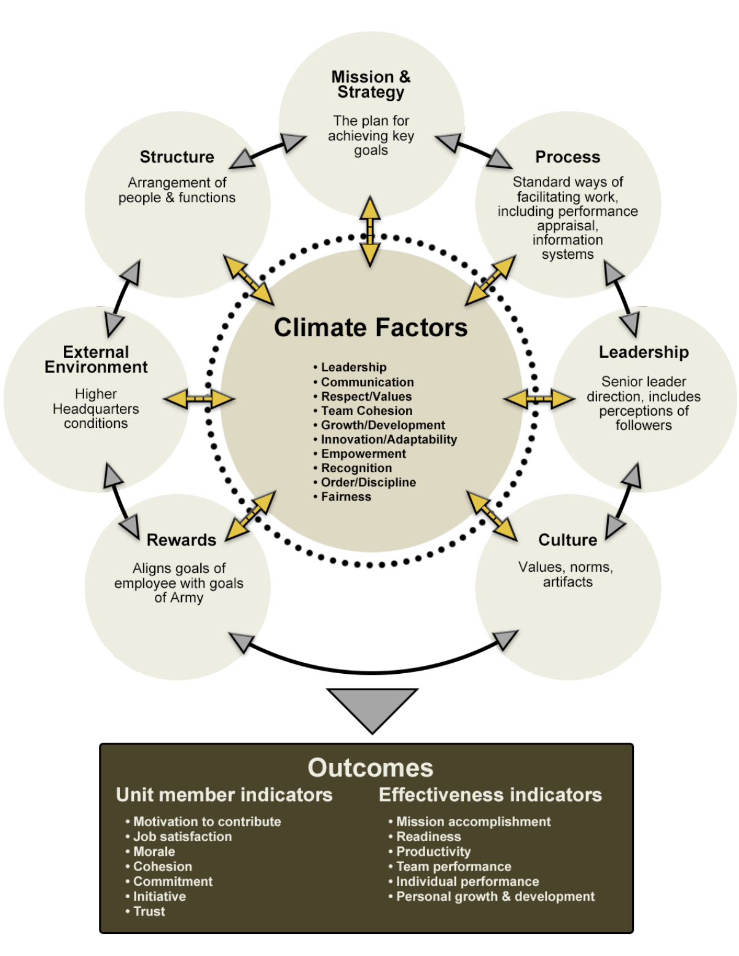


Command Climate Navigator
https://www.capl.army.mil

Slide 6
Implement Mission Command
"Mission command is the exercise of authority and direction by the commander using mission orders to enable disciplined initiative within the commander's intent to empower agile and adaptive leaders in the conduct of unified land operations."
Effective commanders understand that their leadership guides the development of teams and helps to establish mutual trust and shared understanding throughout the force. Commanders allocate resources and provide a clear intent that guides subordinates’ actions while promoting freedom of action and initiative. Subordinates, by understanding the commander’s intent and the overall common objective, are then able to adapt to rapidly changing situations and exploit fleeting opportunities. When given sufficient latitude, they can accomplish assigned tasks in a manner that fits the situation. Subordinates understand that they have an obligation to act and synchronize their actions with the rest of the force. Likewise, commanders influence the situation and provide direction, guidance, and resources while synchronizing operations. They encourage subordinates to take bold action, and they accept prudent risks to create opportunity and to seize the initiative.
The six principles of mission command are:
Build cohesive teams through mutual trust
Create shared understanding
Provide a clear commander’s intent.
Exercise disciplined initiative
Use mission orders
Accept prudent risk

Slide 7
Sources
https://www.capl.army.mil
CJO Home - The Center for Junior Officers (army.mil)
Understanding mission command | Article | The United States Army
ADP 6-22
ADP 6-0
FM-6-0
AR 600-20

Slide 8
FY24 Junior Leaders Forum
Military Equal Opportunity (MEO) Overview for Company Commanders
LTC Luis Santiago

Slide 9
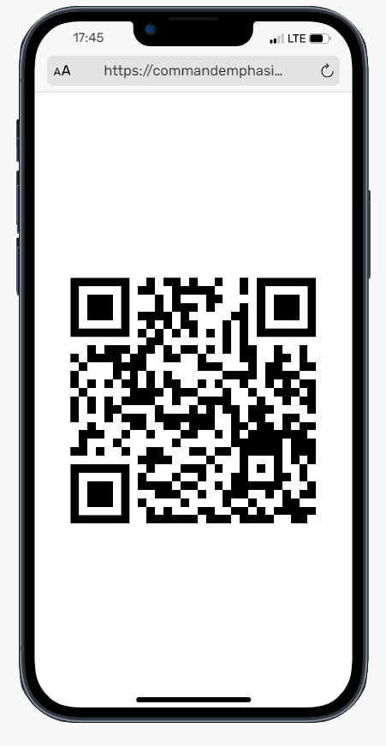

Slide 10
Agenda
EO Program Overview
Commanders Responsibilities
Complaint Process
Complaint Timelines
Formal Complaints
Informal Complaints

Slide 11
MEO Program
Purpose:
The MEO Program formulates, directs, and sustains a comprehensive effort to maximize human potential and to ensure fair treatment for all Soldiers based solely on merit, performance, and potential in support of readiness. MEO philosophy is based on fairness, justice, and equity.
Specifically, the goals of the MEO Program are to:
Build and maintain a cohesive, combat ready Army which is focused and determined to accomplish its mission
Provide support to Soldiers, both on and off-post, and within the limits of the laws of localities, states, and host nations.
Ensure MEO exists for all Soldiers
Ensure every Soldier is treated with dignity and respect
Support commanders at all levels and MEO professionals (EO PMs, EO SGMs, EO advisors; and EO specialists (RA/USAR)) and EO Leaders (EOLs) who are responsible for the execution of MEO policies in their units organizations, and agencies

Slide 12
MEO Program
EO Mission
To assist the 1st MSC Commander in promoting a command climate of dignity, mutual respect and inclusion where there is fair treatment for Soldiers and family members without regard to race, color, sex, religion, national origin, (gender identity) or sexual orientation.
EO Vision
To provide an environment free of unlawful discrimination and offensive behavior which impedes unit cohesiveness and overall mission readiness.

Slide 13
Commander’s Responsibility
Commander’s Responsibilities:
Commanders are responsible for sustaining a positive EO climate within their units.
Commanders and organizational leaders will foster and maintain positive command climates.
Commanders are also responsible for the DA Civilian Equal Employment Opportunity (EEO) Program which provides equal opportunity in employment for all DA Civilians and prohibits discrimination in employment because of race, color, religion, sex, national origin, age, disability, genetic information, or reprisal.
Meet the timeframes for the complaint processes
Ensure your Soldiers receive the Mandatory EO Briefing
Ensure to request and Conduct Defense Organizational Climate Survey(DEOCS) annually.

Slide 14
Commander’s Responsibility
Commander’s Responsibilities:
Per AR 600-20, all Commanders must have at least One Primary EOL and One Alternate EOL, for those unit with more than 25 Soldiers or more.
All Soldiers assigned to a unit EOL position must attend the EOLC and successfully graduate from the course.
Have all units comply with the DEOCS (those that are required) and assist the Commander in implementing the Plan of Action (POA).
Provide EO mandatory training, at least once a year.
EOL’s must attend the Quarterly EOL Community Meeting

Slide 15


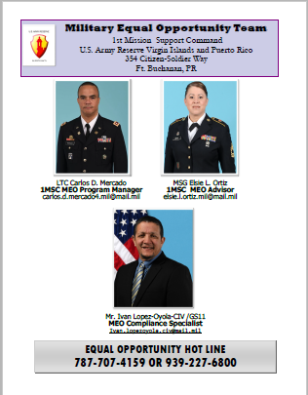
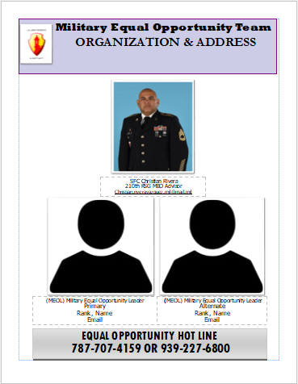
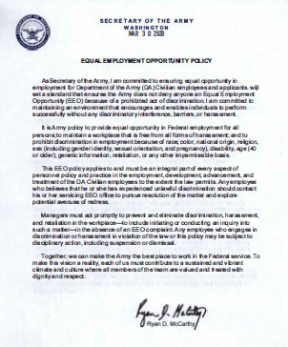




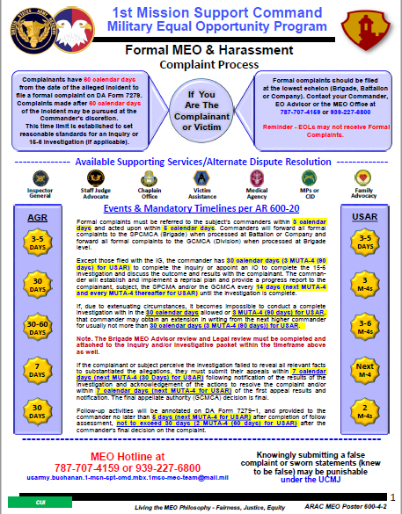

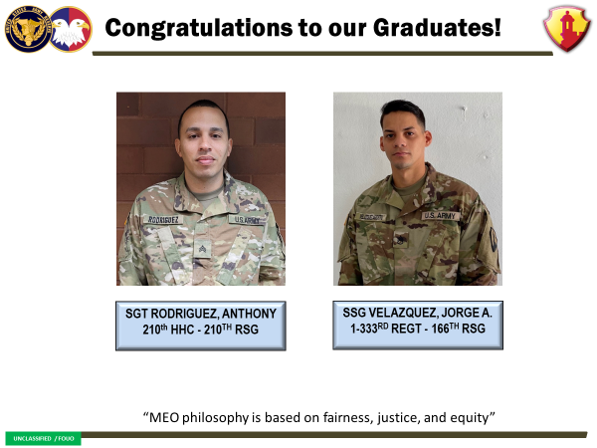
Military Equal Opportunity Bulletin Board
Unit’s policies plus 1 to 2 levels up
Company & BN Open Door policy EOL/S1 to provide | Company & BN EO policy EOL/S1 to provide | EO Command Team Poster EOA/EOL Poster w/ Hot Line EOA to provide | EEO Program Policy EOA to provide | DEOCS Commander/S1
Story Board EOA | EO Complaints Poster EOA | Ethnic Observance Poster DEOMI.org | Presentation For Current Observance DEOMI.org | Anti Hazing and Bullying Poster DEOMI.org

Slide 16
Commander’s Respons6abilities:
AR 600-20 CH-6
Basis for Discrimination:
The U.S. Army will provide EO and fair treatment for military personnel and Family members without regard to
Race
Color
Sex (including gender identity),
Religion
National Origin
Sexual Orientation
and provide an environment free of unlawful discrimination and offensive behavior.

Slide 17
1st MSC Policies
Policy Memorandum 22-13 - 1st Mission Support Command, Command Climate Assessment
Policy Memorandum 22-14 - 1st Mission Support Command Extremist Organizations and Activities
Policy Memorandum 22-15 - Military Equal Opportunity Complaint Procedure
Policy Memorandum 22-16 - Hazing and Bullying
Policy Memorandum 22-29 - 1st Mission Support Command Military Equal Opportunity Program
Notes:
Inspectable Items

Slide 18
EOA DUTIES
EOAs are proponents for change and act as the eyes and ears for the commander.
1) Advisor: An EOA provides advice to commanders on the EO program, its policies, procedures, and issues that affect the EO climate of a unit. 2) Trainer and Educator: An EOA trains and educates commanders, leaders, and service members on the EO program, policies, procedures, and issues that impact the EO climate and unit readiness. 3) Assessor: An EOA assists commanders and other leaders on assessing the EO climate of a unit or organization including determining whether the climate is healthy and positive. 4) Change Agent: An EOA is the commander's change agent for implementing changes to the EO program and other related areas that affect the command climate of the organization.
Organizational Structure
EO Program Manager LTC Santiago
1st MSC MEO Specialist Mr. Ivan Lopez
1st MSC MEOA SFC PAGAN
166th RSG MEOA MSG Rodriguez | 210th RSG MEOA SFC Rivera

Slide 19
EOL DUTIES
Assist commanders in the recognition of detractors from a healthy unit EO climate.
Prepare and assist the Commander in the conduct of EO training.
Establish and maintain liaison with other EOLs and with your BDE EOA.
Assist the Commander and assigned project officers in preparing and conducting ethnic observances and special commemorations.
Maintain an accurate EO Training roster and provide copy to EOA.
Encourage Unit Soldiers to complete the DEOCS Survey.
Preparation, and update of EO Bulletin Board.
Organizational Structure
166th EOA MSG Rodriguez | 210th RSG EOA SFC Rivera
166th EOL (2) Per Co. | 210th RSG EOL (2) Per Co.
Company/ Detachment Level | Company/ Detachment Level

Slide 20
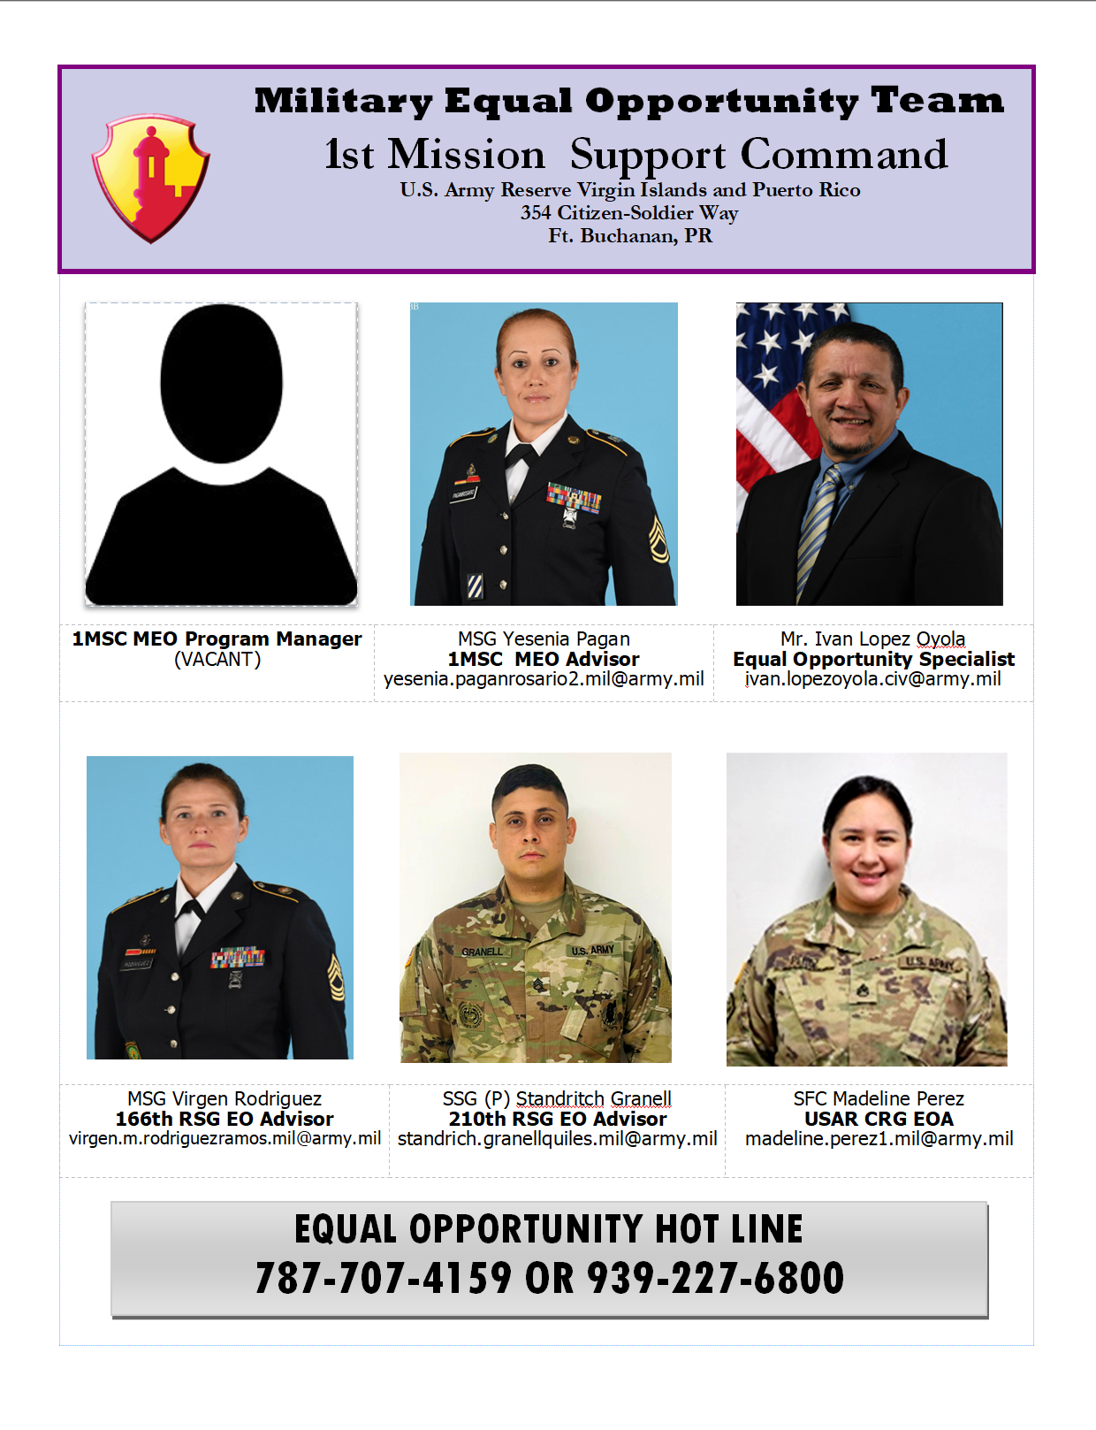
EO Team

Slide 21
Complaint Process

Slide 22
Intake Form
Ensure complaint does not involve sexual assault or sexual harassment
Complainant information
Subject Information
Confidentiality
Basis of discrimination and/or harassment
Date of most recent incident
Summary of incident
Identify witnesses
Requested remedy
Offer courses of action
Differences with informal and formal complaints
Explain reprisal

Slide 23
Types of Complaints
Informal
Not filed using DA Form 7279
Should be filed within 60 days of alleged incident
Should be resolved within 60 calendar days
May be taken by the Equal Opportunity Leader, Commander or MEO professional
The commander will inform the MEO professional within three calendar days of the receipt of the informal complaint and subsequent resolution efforts
Prepare memorandum for record (MFR) and keep at the unit level for 15 years from date complaint receipt
Forward a copy to the full time EOS/EOA for visibility and accountability
MEO professional will input information MEO database
If the complaint is not or cannot be resolved or the complainant is not satisfied with the outcome, the complainant may file a formal complaint

Slide 24
Memorandum for Record- Informal
(1) UIC
(2) Name
(3) Rank
(4) REDCAT (Race/Ethnicity Category)
(5) Sex
(6) Position
(7) Specific Allegation of Discrimination
(8) Complaint Processing Actions
*Keep for 15 years. Ensure FTUS EOS/EOA has a copy

Slide 25
Types of Complaints
Formal
Complainant files on a DA Form 7279 and swears to the accuracy of the information
Complaint filed within 60 calendar days from date of the alleged incident
Only taken by an MEO professional or commander
Complaint should be filed at the lowest echelon of command
Timelines:
  Army Reserve Soldiers on active duty are subject to the active-duty complaint timelines.

Slide 26
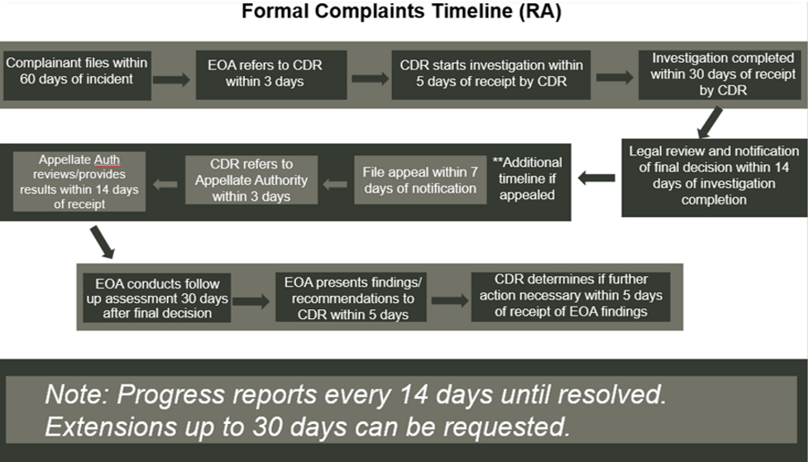
Active-Duty Timelines

Slide 27
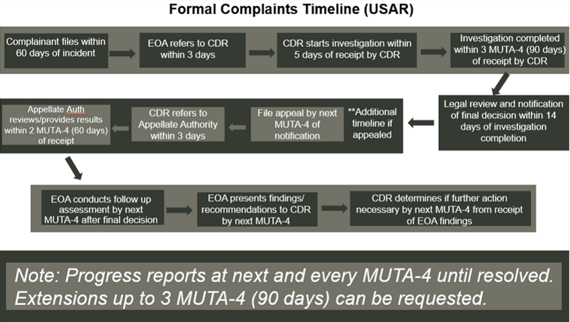
USAR Timelines

Slide 28
USAR Timelines
- complaint received
+3 days- notify commander
+5 days - commence investigation
+90 days- IO has three MUTAs to conduct investigation
+90 days- Extension request. IO can’t complete investigation within three MUTAs (includes 14 days for legal review)
+90 days- Extension request. Extreme circumstances, investigation gets another three MUTAs (includes 14 days for legal review)
+10 days for rebuttal
+30 days to appeal
+ 14 days for appeal to be complete
270 days or more- Subject is flagged

Slide 29
Formal Complaint Process
MEO Professional Role
Explain the investigation process to the complainant
Ensure DA 7279 is clear and signed by the Soldier
Assemble the complaint documentation for provision and briefing
Within 3 calendar days of complaint receipt, refer complaint to the appropriate commander
MEO professional taking complaint will notify commander at their level (complaint is referred to lowest level)
Prepare the reprisal plan
Draft recommended questions with the investigating officer (IO)
Enter complaint information into the database
Monitor the progress of the complaint
Complete an MEO review
Keep complaint for 15 years from date of initial filing

Slide 30
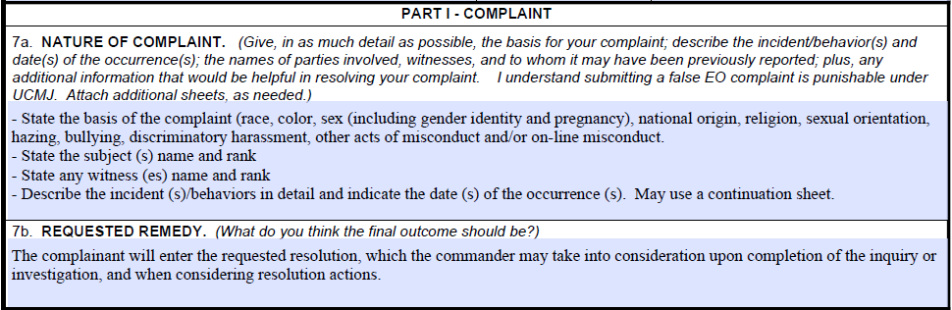
7a and 7b of the 7279
Equal Opportunity and Harassment Complaint
*Ensure block 7a clearly states the basis of the complaint and who the complaint is against

Slide 31
Formal Complaint Process
Commander’s Role
Ensure that the complainant has been sworn to the complaint (DA 7279)
Complete and acknowledge receipt of DA Form 7279
Commence, or cause the commencement of the investigation of the complaint within 5 calendar days of receipt
Inform the complainant and subject of the commencement of the investigation
Conduct the investigation within prescribed timelines
Provide a progress report to the complainant and subject every 14 days
The entire complaint process will be completed within 60 days
Advise complainant and subject (in writing) of outcome and appeal process.

Slide 32
Extensions
If, due to extenuating circumstances, it becomes impossible to conduct a complete investigation within the prescribed timelines, that commander may obtain an extension in writing from the next higher commander for usually not more than 30 calendar days (three MUTA (90 days) for USAR).
Under extreme circumstances a commander may obtain an additional extension in writing from the GCMCA not to exceed 30 calendar days (three MUTA (90 days) - for USAR).
Commanders of Army Command’s (ACOM’s), Army Service Component Command (ASCC), or Direct Reporting Unit’s (DRU’s) (only) may delegate extension approval authority to ACOM, ASCC, DRU Deputy Commanding General, Chief of Staff, or subordinate general officer.
Upon receipt of an approved extension, the commander must inform the complainant and subject of the extension, its duration, and the reasons for which it was requested.
Failure to adhere to prescribed timelines will result in automatic referral of the complaint to the next higher echelon commander for investigation and resolution.

Slide 33
MEO Review
Prior to submission of the report the legal advisor, the investigative officer and the MEO professional will meet and conduct an administrative review of the report.
Conduct MEO review on an MFR:
  Use unit letterhead (include office symbol and date)
  State the purpose of the investigation
  Give background (names, dates, allegations of discrimination/harassment)
  Provide an analysis
    Review the entire report (use the checklist)
    Provide references
    Note any missing information, ask the IO to provide it. If the IO doesn’t have it, have the IO document the reason why

Slide 34
Investigative Report
(a) DA Form 1574–1 (Report of Proceedings by Investigating Officer).
(b) Appointing order.
(c) Copy of the DA Form 7279 with attached continuation sheets.
(d) List of questions developed with MEO professional.
(e) Copy of the completed/initialed commander's reprisal plan.
(f) Exhibits (with an index) of statements/synopses of interviews with complainant, subject, named witnesses (with DA DA 3881, if necessary), chain of command, and third-party personnel.
(g) Description/assessment of unit policies
(h) Written approval from the appointing authority for any approved extensions
Written explanation of extenuating circumstances that prevented the investigating officer from interviewing any complaints, subjects, named witnesses, chain of command, or third-party personnel.
(j) Written review by the MEO professional
The investigating officer will submit the completed investigation to the servicing SJA or legal advisor for legal review. Once the legal review is complete the IO will submit the final investigation to the command for final disposition

Slide 35
Substantiated Complaint
The finding is annotated on DA 7279 and documented on an MFR advising the Soldiers of their appeal rights.
The commander must decide what corrective action to take, whether administrative of punitive.
Subjects of a substantiated complaint, will, as a minimum, undergo counseling by a member of the chain of command.
Commanders have the full range of administrative actions available to them to deal with violators of the Army MEO and harassment policies.
* Substantiated issues or incidents regarding Army performance of objectives and/or command special interest items during the rating period will include such information on evaluation reports (AR 623-3, Evaluation Reporting System, Chapter 3-5)
Notes:
Commanders have the full range of administrative actions available to them to deal with violators of the Army MEO and harassment policies.
Violators of Army policies on MEO and harassment, whose conduct violates a punitive article of the UCMJ, may be charged and prosecuted.

Slide 36
Unsubstantiated Complaint
The commander will notify the complainant and subject in writing (DA 7279).
Commanders will inform complainants and subjects of the availability of a final investigative report and their right to request a copy of the final investigative report.

Slide 37
Appeals Process
The Commander will provide both the complainant and subject with a memorandum that summarizes the results of the investigation. Subjects and complainants will annotate receipt by signing DA 7279.
The complainant and subject had the right to file an appeal if the complainant or subject perceives the investigation failed to reveal all relevant facts to substantiate the allegations.
The first level of appeal will be at least two organizational levels above the level at which the appellant is assigned, when applicable (DODI 1350.02).
The second and final appeal will be forwarded to the Army Command (ACOM), Army Service Component Command (ASCC), or Direct Reporting Unit (DRU) commander with GCMCA (AR 600-20).
Notes:
After the Commander informs the complainant and the subject of the complaint of their right to appeal, The Complainant and subject will sign and date the DA form 7279, Part III, to acknowledge receiving this information.
Consistent with the limitations of the Privacy Act and other applicable statues, the Commander will provide both the complainant and subject with a memorandum that summaries the results of the investigation including whether the allegations were substantiated.
If the complainant or subject perceives the investigation failed to reveal all relevant facts to substantiate the allegations, or that the actions taken by the command on their behalf were insufficient to resolve the complaint both the complainant and the subject have the right to submit an appeal. The complainant may not appeal the actions taken against the subject if any were taken.

Slide 38
Appeals Process (Continued)
The first and second appeal request must be presented within 30 calendar days (DODI 1350.02).
Once the first or second appeal is initiated by the complainant /or and subject, the commander has 3 calendar days to refer the appeal to the appellate authority.
The first and second appellate authorities have 14 calendar days (two MUTA (60 days)–4 for USAR) to review the case, act on the appeal and provide written feedback, consistent with Privacy Act and FOIA limitations, to the complainant or subject on the results of the appeal. The final appellate authority decision is final.
Notes:
The complainant or subject must provide a brief statement that identifies the basis of the appeal on DA 7279.

Slide 39
Closing Out a Formal Complaint
Uses DA 7279-1, Equal Opportunity and Harassment Complaint Resolution Assessment Form.
Complainants and subjects should be contacted, not to exceed 30 days (two MUTA for USAR (60 days)) after the commander’s final decision on the complaint.
MEO professional will file the entire complaint packet by the MEO database case number.
Retain file for 15 years from the date of the commander signing the DA 7279-1.
Will retain in addition:
  Complete report of investigation
  Status or results of any judicial action, nonjudicial punishment or other actions taken to resolve the case.
  Send information to USARC EO directorate within 30 days of final action taken by commander.

Slide 40
Anonymous
Types of Complaints
Commander determines if sufficient information is provided by the complainant to proceed as either an informal or formal complaint.
If the complaint is processed as an informal complaint, the commander will determine if informing the entire command or part of the organization of the actions taken is appropriate.
If the complaint is processed as formal, the Commander will be identified as the complainant
If at any time, the identity of the actual complainant is revealed, the complainant’s name will be edited in the MEO database, and the actual complainant will be provided the requisite follow- up actions.

Slide 41
Memorandum for Record- Anonymous
(a) Date and time the information was received
(b) A detailed description of the facts and circumstances included in the complaint
(c) Date the complaint was closed and by whom
(d) Any other pertinent information
Notes:
Commanders or MEO professionals will prepare an MFR, which will include information indicating the nature of the complaint and identifying pertinent information to assist in the identification of the organization’s command climate

Slide 42
References
AR 600-20 Army Command Policy, dated 24 July 2020
DoD Instruction 1350.02, Department of Defense Military Equal Opportunity (MEO) Program
DoD Instruction 1020.03 w/change 2, Department of Defense Harassment Prevention and Response in the Armed Forces

