Slide 1

In brief for Commanders

Slide 2
Disclaimer
We will discuss sexual harassment and sexual assault using language, themes, and scenarios that could invoke strong emotions.
DoD Safe Helpline: 877-995-5247

Slide 3
“When it comes to sexual harassment and sexual assault, our primary focus is prevention. But in the unfortunate event someone is harmed in this way, we owe it to our victims that the response is quick, compassionate, and comprehensive.”
– Secretary Christine E. Wormuth
The Army holds Commanders accountable for their unit climates, for protecting their people from sexual harassment and sexual assault, and for protecting survivors from retaliatory actions.

Slide 4
Agenda
Staffing
Trends & Metrics
SH/SA Continuum of Harm
Commander’s Initial Responsibilities
Commander’s Roles in Prevention
Leaders at all levels
Training
Sexual Harassment Complaints
Commander’s Response to Sexual Assault
Sexual Assault Reports
MRE 514
Confidentiality
Expedited Transfers
CCIR
SAIRO
Retaliation

Slide 5
Staffing
1st MSC Full Time Staff
CMD SHARP Program Manager/SARC
Ms. Evelyn M. FrancoMarrero
CMD SHARP (CD) SARC (ADOS)
MAJ Amy B. Flores
SARCs:
One (1) Per BDE/BN
Full Time
SFC or Higher, MAJ/CW3 or Higher,
GS-11 or Higher
VAs:
One (1) Per BDE/BN
Full Time
SSG or Higher, 1LT/CW2 or Higher, GS-9 or Higher
Proposed changes from the HQDA EXORD 269-22 do away with all Collateral Duty SHARP positions & 1st MSC SARC will report to the 81st Lead SARC.
Prior staffing authorizations were never generated nor funded.

Slide 6
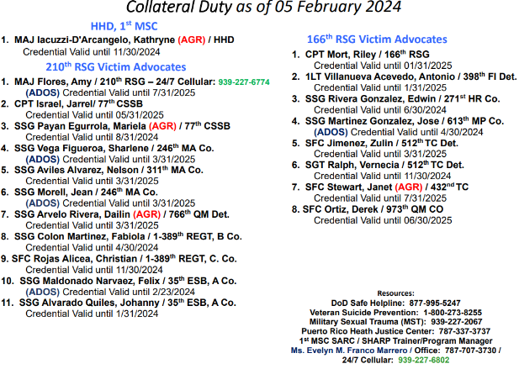
1st MSC Credentialed Victim Advocates

Slide 7
Command Trends & Metrics
Providing ongoing support for 13 Sexual Harassment Complainants and Sexual Assault Victims
For FY 23: 9 SA Case Reported / 6 SH Reports
5 Restricted / 4 Unrestricted
For FY 24: 2 SA Cases Reported
3 Restricted / 1 Unrestricted

Slide 8



SH/SA Continuum of Harm
Sexual harassment/assault reduces a unit’s overall mission readiness by destroying trust, teams, and unit cohesion
Healthy Work Environment
Early
Warning Signs
Engaged Leadership
Army Values
Sexual
Harassment
Good Order & Discipline
Excessive Flirting
Toxic Atmosphere
Sexual
Assault
Inappropriate Jokes / Comments
Dignity & Respect
Disparaging Comments on Social Media
Ethical Standards
Inappropriate Work Relationships
Sending Unsolicited Naked Pictures
Unsolicited Touching
Accountability
Unsolicited Kissing
Sexting
Indecent Exposure
Safe Environment
Cat Calls
Indecent Viewing
Rape
Sexual Innuendo
Bullying
Forcible Sodomy
Warrior Ethos
Cornering Blocking
Stalking
Abusive Sexual Contact
Civilian Creed
Sexually Oriented Cadence
Hazing
Unsolicited Sexually Explicit Text/Email
Aggravated Sexual Contact
Leader Engagements & Intervention Opportunities Occur Throughout the Continuum
Report Incidents of Sexual Harassment/Assault to a SARC / VA

Slide 9
Commander’s Initial Responsibilities
Publish SHARP Policy Letter
In-Brief with SARC/VA within 30 days of taking command
SHARP Board/Area
Commitment to SHARP Program
Victim rights
Definition of sexual harassment and sexual assault
Sexual harassment and sexual assault are not tolerated in the Army
Addresses retaliation and reprisal to include definition
Sexual assault and sexual harassment are punishable under UCMJ, other federal and local civilian laws and are incompatible with Army Values
SARC and VA contact information to support victims
Training statistics
Reporting process and requirements
SARC/VA duties and responsibilities
SARC and VA manning status
SHARP Program assessment
SHARP Resources
Ensure SHARP Board/Area established and maintained with updated SHARP information and resources

Slide 10
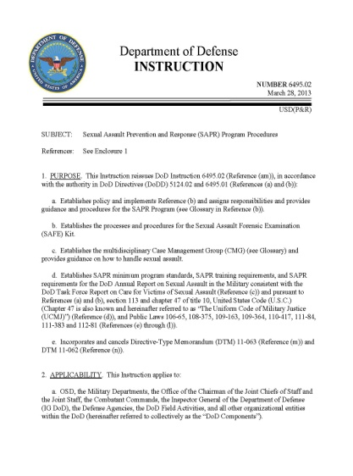
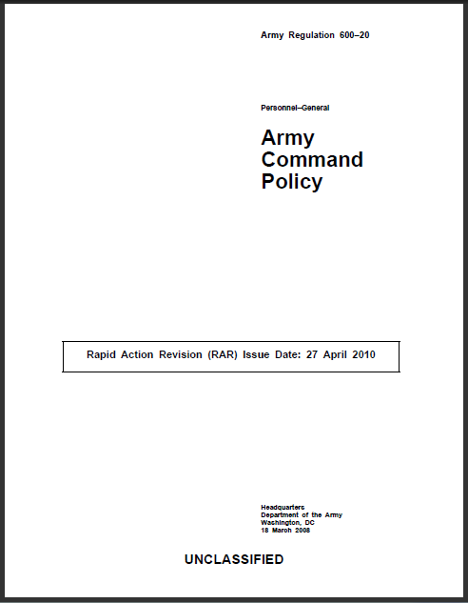
Commander’s Roles in Prevention
Commanders must promote a climate where Soldiers
  Treat one another with dignity and respect
  Are empowered to intervene, act, and motivate
  Soldiers, Family members, and Civilians feel comfortable reporting sexual harassment and sexual assault incidents
Commanders must maintain a quality SHARP Program
  Ensure selection of highly qualified SARC/VA SHARP Professionals and appoint by appropriate approving official (VA-COL/SARC-GO) after D-SAACP approval
  Support Sexual Assault Awareness/Prevention events
  Be present and ensure unit leaders provide the training with the assistance of a credentialed SARC or VA; set the standard

Slide 11
Leaders at all levels
Don't
Do
Give SHARP Training to “check the block”
Be part of the “problem” (alcohol, hostile environment, quid pro quo, retaliation, online chats, jokes, sexting)
Justify the situation (He/She is like that.., he/she was wearing…)
Make assumptions
Blame victim (crush reputation/credibility, judge)
Hide or “cover” the situation (You will also be investigated for omission)
Make a transfer without consulting the victim
Put Victim automatically on Split (Re-victimization)
Talk about situation to personnel who don't have a “Need to Know”
See SHARP Program/Personnel as the enemy, WE ARE YOUR ALLY
Coordinate training with SHARP Program
Assess Hostile Environment and intervene
Schedule remedial training as soon as a situation rises up
Be present / Active Listening / Connect
Believe the Victim (Not alleged)
Have policy and SHARP POC updated and available to SMs
Execute Expedited Transfers immediately
Let SM continue with training and/or career progression
Keep Confidentiality
Allow Soldier Member to visit the SHARP Program without retaliation

Slide 12
Unit Mandatory Training (UMT)
Army Directive 2018-23 remains applicable regarding training delivery that is “leader led with the assistance of a credentialed SHARP professional.”
There are five (5) training modules (prevention, bystander intervention, sexual harassment, sexual assault, and retaliation) that is needed to complete the annual training requirement and can be found at https://www.sharplearningportal.army.mil/.
Commanders must ensure training is properly capture in Digital Training Management System (DTMS) task id: 328081 (150S-SHA-0100)
FY24 training milestones to achieve:
  1st QTR – 40%
  2nd QTR – 70%
  3rd QTR – 90-100% (Ideally)
  4th QTR – Alibis
  SHARP Annual Training Matrix: (Green - 100%) (Amber – 85%-99%) (Red - <85%)

Slide 13
Sexual Harassment Complaints
Commanders should be familiar with the complaint process
Accurate and timely response builds trust in the command and SHARP Program
Soldiers, Family members, and DA Civilian employees have the following:
RIGHTS
  Present complaint without fear of intimidation, reprisal, or harassment
  Communicate with commander concerning complaints
  Receive assistance with complaints
  Receive training on complaint and appeals process
Responsibilities
  Advise command of sexual harassment incidents
  Provide command with opportunity to take action/ resolve issue
  Submit only legitimate complaints
  Exercise caution against unfounded/ reckless charges

Slide 14
Sexual Harassment Complaints Update
Reforms To Counter Sexual Harassment/Sexual Assault in the Army:
Sexual harassment complaint investigations. Effective immediately, if sufficient information exists to permit the initiation of an investigation, commanders will appoint investigating officers (IOs) from outside the subject’s assigned brigade-sized element to conduct sexual harassment complaint investigations under Army Regulation (AR) 600–20, chapter 7.
Involuntary Separation Policy. Commanders will initiate involuntary administrative separation proceedings for all Soldiers against whom there is a substantiated complaint of sexual harassment unless the Soldier is otherwise punitively discharged or dismissed from the Army as part of a court-martial sentence. Separation proceedings will be processed through the chain of command to the separation authority for appropriate action.
Military Protective Orders (MPOs). Effective immediately for all sexual harassment and sexual assault complaints, the first O-6 in the subject’s chain of command will implement mechanisms to protect complainants of sexual harassment and victims of sexual assault. As soon as possible, but no later than 6 hours after determining an MPO is warranted.
Army Directive 2022-13, 20 September 2022

Slide 15
Sexual Harassment Checklist
Key Questions:
Is the behavior sexual in nature?
Is the behavior unwelcomed?
Would a reasonable person find the behavior inappropriate?
Does one or more of the following exist?
Power, control, or influence
Hostile or offensive environment

Slide 16
Sexual Harassment Complaints
Anonymous
  DA 7746 (Full time SARC)
  If there is enough information conduct a 15-6
  MFR
  Input into ICRS
Formal
  DA 7746 (Full time SARC)
  Notify the CDR on the complaint and the processes
  Input into ICRS
Informal
  Handled at the Lowest level
  If Full time SARC is aware, must document on MFR and input into ICRS
  MFR

Slide 17
Anonymous Complaints
Actions taken regarding anonymous complaints will depend upon the extent of information provided by complainants. If an anonymous complaint contains sufficient information to permit the initiation of an investigation, the investigation will be initiated by the commanding officer or supervisor. If an anonymous complaint does not contain sufficient information to permit the initiation of an investigation, the information should be documented in a Memorandum for Record (MFR) and maintained on file in accordance with disposition instructions and the SARC is responsible for processing harassment complaints. The MFR should contain the following information, if available:
Date and time the information was received
A detailed description of the facts and circumstances included in the complaint;
Date and time the complaint was resolved and by whom; and
Any other pertinent information
The anonymous complaint will also be entered into the Integrated Case Reporting System (ICRS) as an anonymous complaint.
References AR 600-20 Army Command Policy 24 July 2020
DoDI 1020.03. Harassment Prevention and Response in the Armed Forces
Change 1 Effective 29 December 2020

Slide 18
Formal Complaints
Brigade Commander’s Responsibilities—
Acknowledge receipt of complaint using DA Form 7746
Notify the GCMCA IAW timelines
Establish a retaliation/reprisal plan for all parties
If warranted, ensure MPO is issued within 6 hours
Appoint an Investigation Officer (IO) from outside the subject’s assigned brigade
Ensure IO receives briefing and assistance from SARC and Legal thru the process
Ensure the complaint is resolved within 14 calendar days of receipt of complaint IAW AR600-20
update complainant(s)on the progress of the investigation every 14 days from the date of complaint receipt until the case is closed
Provides outcome of the investigation (substantiated or unsubstantiated investigation)
Inform the right to appeal the process (Complainant or Subject)

Slide 19
Sexual Harassment Filing Process Timeline
Commander submits final or progress report of the investigation to GCMCA Commander. If investigation not complete within 20 C-days, must submit progress report to GCMCA every 14 days until complete
Appeal referred to higher Commander with GCMCA
Commander initiates an investigation & notifies GCMCA
SARC follow-up assessment
Incident
72 hours | 14 C**-Days | 20 C**-Days | 7 C*-Days (Next MUTA-4) | 3 C*-Days (1 MUTA-4) | 14 C*-Days (2MUTA-4) | 30-45 C*-Days
Complainant encouraged to file complaint within 60 C*-days
Investigation Complete and Commander makes decision
Complainant and/or Subject appeals after notification of finding
GCMCA approves appeal, or disapproves, appeal, or conducts additional investigation
Note: The BDE CDR will provide written feedback to the complainant and subject on the progress of the investigation every 14 days from the date of complaint receipt until the case is closed.
C*- Calendar
C**- Calendar days from initiation
Reference AR 600-20, Army Command Policy, 24 July 2020

Slide 20
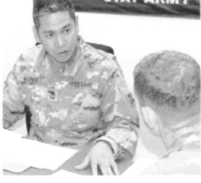
Informal Complaint and the MFR
The MFR is used in multiple areas for different purposes:
Program management
  To evaluate complaint resolution and effectiveness
Prevention
To identify trends and design outreach events
Response
To document the complaint
Training
To identify potential training areas

Slide 21
Commander’s Response to Sexual Assault
Commanders have significant leadership responsibility for actions after a report of sexual assault. The victim’s commander will ensure the following actions are taken in response to an unrestricted report of sexual assault—
Ensure the physical safety of the victim—determine if the subject is still nearby and if the victim needs protection.
Determine if the victim needs or desires emergency medical care.
Notify the SARC and USACIDC as soon as the victim’s immediate safety is ensured.
Advise the victim of the need to preserve evidence (for example, by not bathing, showering, or washing clothing).
Make appropriate administrative and logistical coordination for movement of victim to receive care. (Involve the minimum number of personnel possible and only on a need-to-know basis.) If needed, assist with or provide immediate military transportation for the victim to the hospital or other appropriate treatment facility.
Ask if the victim needs a support person (for example, a personal friend or Family member, SHARP VA, chaplain) to immediately join the victim. Ensure the victim understands the availability of victim advocacy and the benefits of accepting advocacy and support.
Army Regulation 600–20, 24 July 2020

Slide 22
Cont. Commander’s Response to Sexual Assault
Notify the chaplain if the victim requests pastoral counseling or assistance.
Advise the victim that he or she may be eligible for a Special Victim Counsel(SVC).
Notify military police, installation provost marshal (see AR 195 – 2), the servicing legal office, and commanders
Ensure the victim is made aware of, and encouraged to exercise, their options during each phase of the medical, investigative, and legal processes.
Ensure USACIDC notifies victims and witnesses of their rights through a completed DD Form 2701. (See AR27 – 10).
Provide emotional support to the victim
Protect the victim’s legal rights.
Army Regulation 600–20, 24 July 2020

Slide 23
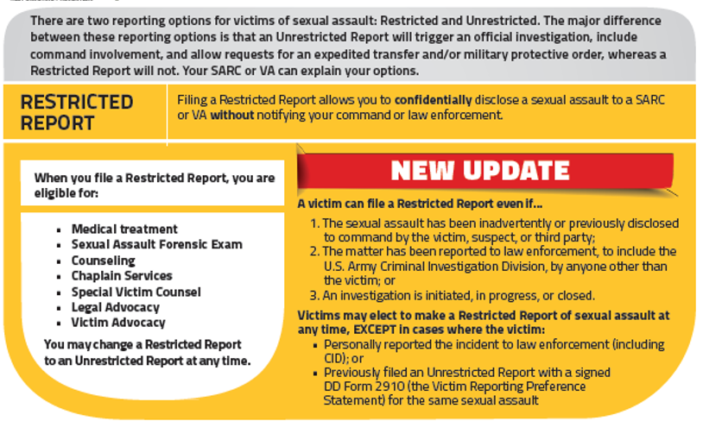
Sexual Assault Reports Update

Slide 24
Sexual Assault Reports
Restricted Report | Unrestricted Report
Benefits Access to medical, advocacy, legal, and counseling services Receive the Sexual Assault Forensic Examination (SAFE) Control the release of personal information Can change to Unrestricted Report at any time Special Victims’ Counsel | Benefits Access to medical, advocacy, legal, and counseling services Receive the SAFE Alleged offender may be held accountable Command support Can receive protective order (Military Protective Order [MPO] or Civilian Protective Order [CPO]) Special Victims’ Counsel
Limitations The alleged offender will not be held accountable Ineligible for expedited transfer or reassignment No command support Cannot receive a protective order | Limitations More people will know about the sexual assault Investigation may require discussion of personal matters Cannot change to Restricted Report

Slide 25
Sexual Assault Reports Cont.
Restricted Report | Unrestricted Report
Who can accept a report: Sexual Assault Response Coordinator (SARC) SHARP Victim Advocate (VA) Healthcare Personnel | Who can accept a report: Commander CID JAG IG SARC VA Healthcare Personnel
Limitations Chaplains and Special Victim Counsel – cannot take a report, but information shared remains confidential | Limitations More people will know about the sexual assault Investigation may require discussion of personal matters Cannot change to Restricted Report
*If a sexual assault is reported to the CDR, he/she will call the 1st MSC SARC, SJA, and CID as required, but the victim may still be eligible to file a restricted report if they do not give a statement to CID

Slide 26
Commander’s 30-day checklist
The sexual assault response checklist is intended to serve as a baseline for the first 30 days for the commander’s response to adult sexual assault victim(s), alleged offender(s), and unit in the event of an Unrestricted Report of sexual assault. The checklist may be expanded to meet Military Service specific requirements and procedures. These checklist items do not represent all of the responsibilities assigned to commanders for the entire Sexual Assault Prevention and Response (SAPR) program.
SAPR Policy Toolkit available for Command Teams at:
SAPR Policy Toolkit for Command Teams | SAPR

Slide 27
MRE 514
A victim has a privilege to refuse to disclose and to prevent any other person from disclosing a confidential communication made between the victim and a victim advocate, in a case arising under the UCMJ, if such communication was made for the purpose of facilitating advice or supportive assistance to the victim.
“Confidential communication” also applies to records the Sexual Assault Response Coordinator (SARC)/SHARP and Victim Advocate (VA)/SHARP Specialists maintain pertaining to communications with the victim. These communications with SARC/SHARP and VA/SHARP Specialists and their associated records are considered privileged and are not to be released to others, including to commanders or law enforcement personnel.
Reference: MRE 514, Manual for Courts-Martial (MCM), United States (2019 Edition)

Slide 28
Confidentiality
Commander’s responsibility
Assuring privacy and providing a confidential disclosure option for sexual assault victims is critical to discharging our commitment. Sexual assault is the most under reported violent crime in both our society and the military. Although the victim’s decision to report is a crucial step following a sexual assault, reporting is often precluded by the victim’s desire for no one to know what happened.
Commanders have a responsibility to ensure community safety and due process of law, but they will also recognize the importance of protecting the privacy of victims under their command. Subject matter experts agree that a system that promotes privacy/confidentiality can have a positive impact in bringing victims forward to provide information about being assaulted.

Slide 29
Expedited Transfers
Sexual assault victims who file an unrestricted report can request an expedited transfer/reassignment from their current unit
The request must be submitted in writing using DA Form 4187
Commander (battalion or above) has 72 hours to recommend approval or disapproval of the request if he or she cannot otherwise approve the request
Do not stop the progress of an expedited transfer request
The transfer or reassignment may be:
  Another unit at a different location
  Another company within the same battalion / Another battalion within the same brigade
  Another brigade within the same division / Another division within the same command
  RST / consider transferring the subject

Slide 30
SHARP CCIR Criteria
Any sexual assault / sexual harassment incidents that meet the below listed criteria must be reported through SHARP Channels ONLY within 18 hours or less:
Category 1
Category 2
Category 3
Category 4
Commanders O-5(P) or higher
E-9 / CSMs
Senior Civilian Supervisors (GS-15 / SES)
Appointed SHARP Professionals (SARC, VA)
SHARP Staff members
Special Victims Counsel (SVC), Special Victim’s Prosecutor(SVP), USACIDC Sexual Assault Investigator, or Special Victim Witness Liaison(SVW)
Drill Sergeant
Chaplains
Sexual Assault Nurse Examiners and Sexual Assault Medical Forensic Examiners.
Multiple reports originating from single unit or organization
Pattern of reports that suggests a serial offender
Extreme violence
Other abnormal situations
Cases expected to attract high media or Congressional attention
Army Regulation 600–20 Appendix J
Notes:
Appendix J on AR 600-20
1 - Any Sexual Assault or Sexual Harassment incident that meets the following criteria:
Category 1 – Commanders O-5(P) and above, E-9 CSMs, or Senior Civilian Supervisors (GS-15 / SES).
Category 2 – Subject falls within one of the following categories:
• SHARP Professionals (Sexual Assault Response Coordinators (SARC), Victim Advocates (VA), or Victim Representatives (VR) currently serving or with an active D-SAACP certification, regardless if currently serving in the position)
• SHARP Staff Members (Program Managers (PM), SHARP Trainers, members of the HQDA or Command SHARP Offices currently serving or with an active D-SAACP certification, regardless if currently serving in the position)
• Special Victims Counsel, Special Victims Prosecutor, CID Sexual Assault Investigators, or Special Victims Witness Liaison
• Drill Sergeants, Advanced Individual Training (AIT) Platoon Sergeants, or Recruiters
• Chaplains
• Sexual Assault Nurse Examiners and Sexual Assault Medical Forensic Examiners
Category 3 – Curious Cases. Including, but not limited to the following:
• Multiple reports originating from a single unit or organization within a time period defined by a Lead SARC or PM that would warrant informing the Army G-1 and/or Army Senior Leaders
• A pattern of reports recognized by a Lead SARC or Program Manager that suggests a serial offender and would warrant informing the Army G-1 and/or Army Senior Leaders
• Extreme violence (victim requires hospitalization, robbery, murder, etc.)
• Other abnormal situations that may warrant informing the Army G-1 and/or Army Senior Leaders
Category 4 – Cases expected to attract high media or Congressional attention.

Slide 31
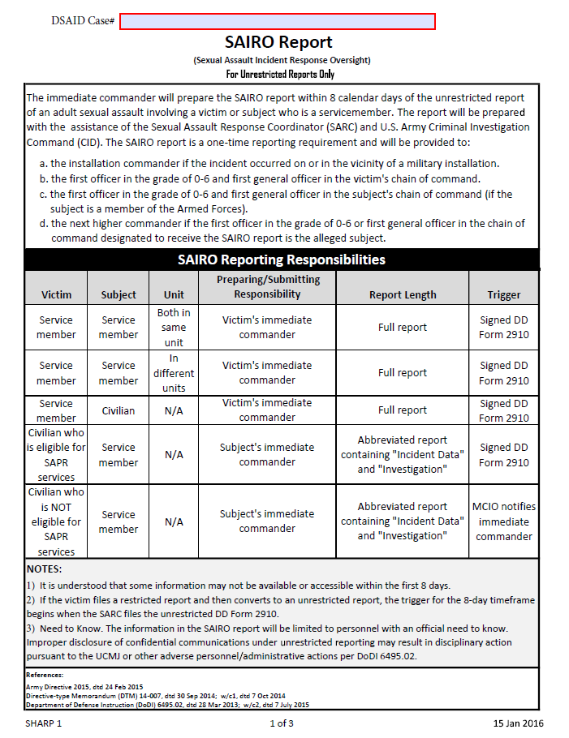
(SAIRO) Overview
SAIRO report is not prepared for restricted reports or those perpetrated by a spouse or intimate partner Family Advocacy Program Manager (FAPM)
Must be submitted to 1st GO within 8 calendar days
SAIRO report will not delay immediate reporting of the incident to Military Criminal Investigation Organization (MCIO)
Only identify the victim as “PI” for Protected Identity
Only released to personnel with an official need to know
Input information assistance from SJA, SARC, and MCIO or law enforcement
Army Regulation 600–20 Appendix K
Notes:
AR 600-20 Appendix K

Slide 32
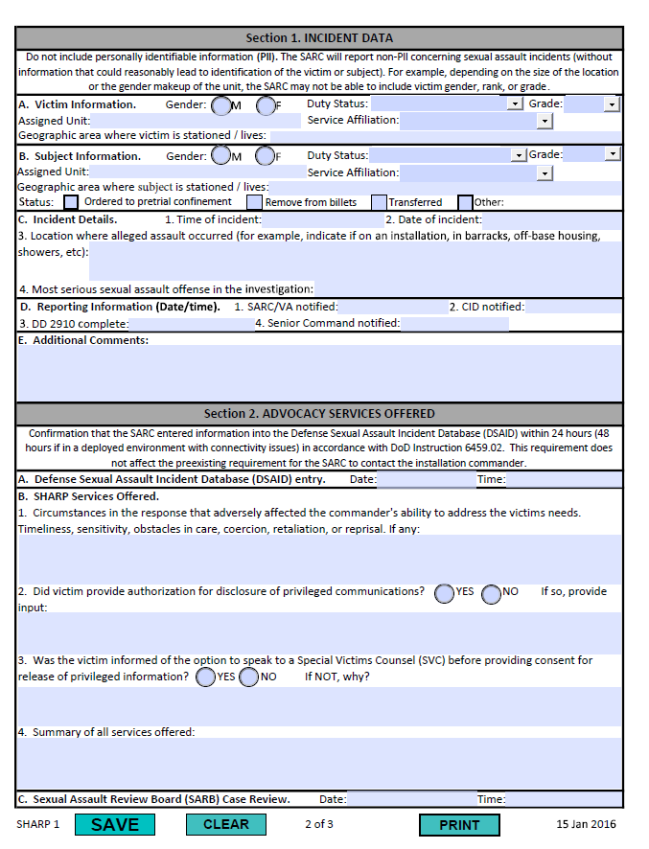
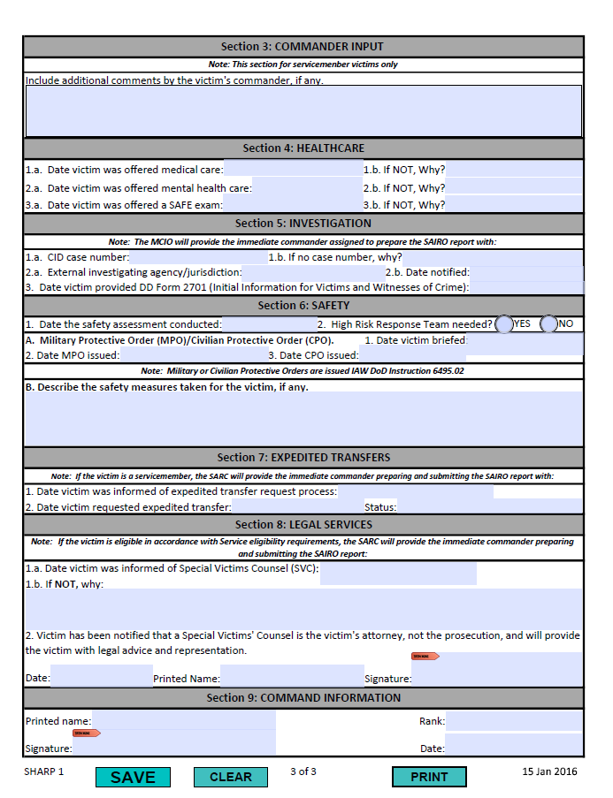
Preparing a SAIRO Report
What is included:
What’s NOT included:
Incident Data
Advocacy Services Offered
Victim’s Commanders Input
Healthcare
Investigation
Safety
Expedited Transfer
Legal Services
Personally Identifiable Information (PII)
Victim photographs
Health information protected under DoDI 6025.18-R
Any demographic or incident information that could reasonably lead to personal identification of the victim or the subject for both unrestricted reports and independent investigations

Slide 33
Retaliation
No Soldier may retaliate against a victim, an alleged victim, or another member of the Armed Forces based on that individual’s reporting or planning to report a criminal offense or discourage the individual from reporting a criminal offense.
“Retaliation” is defined as: (a) Any person subject to the UCMJ who wrongfully takes or threatens to take an adverse personnel action, or wrongfully withholds or threatens to withhold a favorable personnel action with the intent to discourage or retaliate against any person for reporting or planning to report a criminal offense, or making, or planning to make a protected communication. (See Article 132, UCMJ (2019).)
(b) Acts of cruelty, oppression or maltreatment (as these terms are described in UCMJ, Art. 93) committed against a victim, an alleged victim or another member of the Armed Forces by peers or other persons, because the individual reported a criminal offense or was believed to have reported a criminal offense.

Slide 34
Response to Retaliation
If a victim comes to a SARC to speak about retaliatory behavior, the SARC will —
Discuss what the individual is experiencing in regards to retaliatory behavior.
Explain the different types of retaliatory behavior and the investigative entities (IG, law enforcement, USACIDC, and commanders) by providing an informational sheet.
Explain that the victim can go to an IG at any time during the process. Visits to the IG may range from consultation to filing a complaint.
Offer support throughout the process, to include providing referrals (for example, SVC or legal assistance for legal advice) and accompanying the victim to meetings with command, investigators, and other first responder personnel, if requested.
Write an MFR to record date of discussion, any referrals given, and the point of contact associated with the referrals. These referrals will be documented in DSAID.
Prior to engaging an investigative entity or seeking alternative means for resolving the retaliatory behavior, discuss with the victim the options to consult with an IG, SVC, or a legal assistance attorney concerning retaliatory behavior, reporting options, and the investigative and military justice processes, as appropriate.
Follow-up with the victim to ask if the individual proceeded with making a retaliation report after speaking with the SVC or legal assistance attorney (if the individual elected to speak with an SVC or legal assistance attorney) or if the victim wants the retaliatory behavior to be discussed at SARB instead of going directly to an investigative
Army Regulation 600–20, 24 July 2020

Slide 35
Reminder: If You Need Help
DoD Safe Helpline: (877) 995-5247
1st MSC SARC, Ms. Evelyn Franco:
(939) 227-6802
1st MSC VA, MAJ Amy Flores
(939) 227-6774

