Slide 1
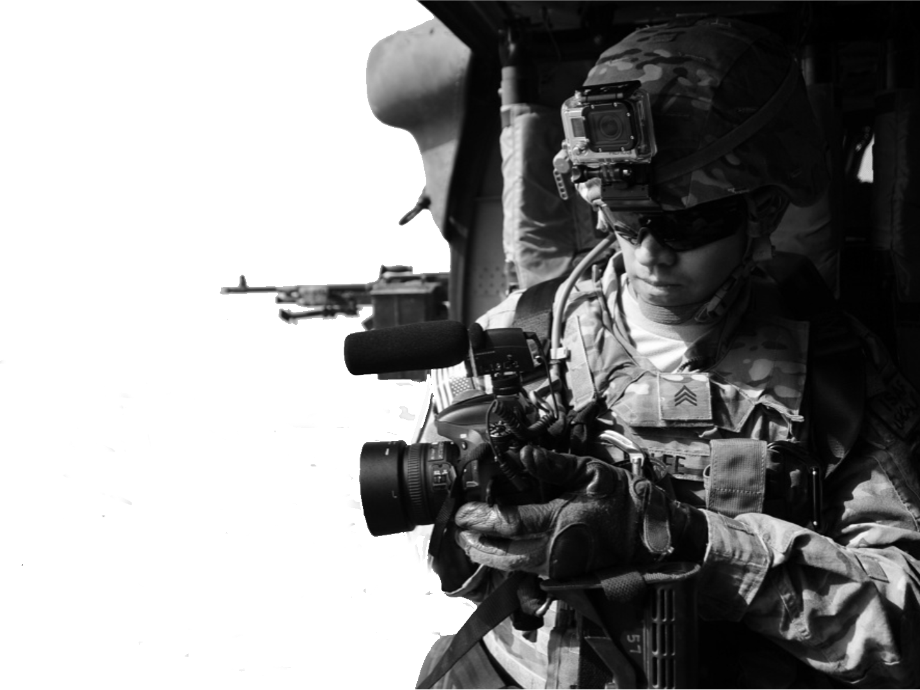
Unit Public Affairs Representative (UPAR)
UNCLASSIFIED

Slide 2
UPAR Training
Provided by:
Army Public Affairs Center
Current as of 4/06/2022

Slide 3
What DOES a UPAR do?
Provide photos with captions to higher level public affairs for release
Have an active and current DVIDS profile
Assist higher HQ PAO with PA requirements
Provide suggestions for PA coverage
Act as a PA liaison for the UPAR’s commander and command team
Augment organically-assigned content creators

Slide 4
What does a UPAR NOT do?
Advise the commander on public affairs strategy or operations
Engage the media without consultation from higher PAO
Respond to questions from the media
Release products or information (social media)
Conduct PA training

Slide 5
What does a UPAR NOT do?
Conduct interviews
Conduct media relations
Advise commanders
Conduct media prep

Slide 6
Agenda
Command Information
Policy
PA Doctrine and Regulation
Principles of Information
Guidelines for the Release of Information
Photography and Caption Writing
DVIDS
Social Media

Slide 7
Command Information
1

Slide 8
Agenda
What is command information?
Who produces it?
Why is it important?

Slide 9
Command Information
Provides the commander a primary method of communicating important information to members of the command
Aids with internal command cooperation and mission performance
Keeps members of the command informed, helps improve quality of life, promotes morale and esprit de corps and fosters career retention
Command information products may also be released via external communication methods

Slide 10

Command Information
Who produces it?

Slide 11
Command Information
CI is one of the most important PA functions
Helps build a sense of teamwork and respect
Tells our Soldiers’ story
Well-informed teams result in good spokespersons and advocates
Quells ‘rumor mill’
Garners family and community support
Addresses key topics based on CG’s guidance
Situational awareness

Slide 12
Command Information
The commander’s primary method for communicating important information to the command and family members; promotes esprit de corps and retention
Social media is a popular platform to distribute CI
Provides information about organizational goals, operations and significant developments in unit
Used for internal command coordination and counters misinformation

Slide 13
Examples
Meeting community leaders about upcoming Veteran’s Day Parade, Memorial Day speaker, etc.
Family briefings pre- and post-deployment
Units sending letters/info to families about upcoming family day activities

Slide 14
AR 360-1
Published Oct. 8, 2020
“The Army defines the PA Program as the guide to conducting public communication strategy for information, command information, leader engagements, and community outreach activities directed toward both the external and internal publics with interest in the Department of Defense (DoD).”
– Chapter 1-6

Slide 15
FM 3-61
On-going updates:
“Army public affairs is public information, command information and community engagement activities directed toward both the external and internal publics with interest in the Department of Defense. The mission of Army public affairs is to inform internal and external publics, and fulfill the Army’s obligation to keep the American people and the Army informed as established in Title 10, United States Code.”
– Chapter 1-1

Slide 16
Communication Tools
Email- alerts, important developments and situational awareness on events or training
Flyers and posted bulletins- military benefits, tools, events, recruiting campaigns
Newsletters, story boards
Social media- stories and information for general public and command personnel
Town halls

Slide 17
Communication Tools
Unit publications- newsletters, storyboards
Social media- stories and information for general public and command personnel
Town Hall

Slide 18
Additional Tools
Meetings with community leaders
Business lunches (retired Soldiers, community organizations)
Chain of Command
TOOLS MUST BE EFFECTIVE AND REACH AUDIENCE

Slide 19

Additional Tools
Internal communication tools need to be effective and reach audience
  Infographics, SHARP cards, etc.
  Post in places easily accessible

Slide 20
Conclusion
The chain of command is the most important avenue; we must ensure the internal audience is kept informed of initiatives, priorities, etc.
Information is empowering
Pride in what we do
Effective communications can improve Soldier productivity, morale and family support (engaged leadership)

Slide 21
Policy
2

Slide 22
Agenda
DoD Policy
SAPP
OPSEC
Privacy Act and PII
HIPAA
Accidents/Incidents
Criminal matters/Investigations

Slide 23
DoD Policy
Information will be withheld only when disclosure would adversely affect national security, threaten safety or privacy of the Armed Forces, or otherwise directed by law or regulation
DoD’s obligation to provide the public with information on major programs may require detailed public affairs planning and coordination within the DoD and other agencies
Expedite the flow of information

Slide 24
DoD Policy
Information will be made fully and readily available, consistent with statutory requirements, unless material is classified. Provisions of the Freedom of Information Act will be supported
A free-flow of general and military information will be made available without censorship or propaganda
Information will not be classified or otherwise withheld to protect the Government from criticism or embarrassment

Slide 25
DoD Policy
Propaganda has NO place in DoD public affairs
DoD’s obligation to provide the public with information on major programs may require detailed planning and coordination within the DoD and other government agencies
Sole purpose of such activity is to expedite the flow of information to the public

Slide 26
Check on Learning
Information in all but one of the following categories of information should not be revealed because of potential jeopardy to future operations, risk to human life, possible violation of host nation and/or allied sensitivities, or the possible disclosure of intelligence methods or sources:

Slide 27
Check on Learning
A- Specific numerical information on troop strength, equipment and supplies
B- Battle damage assessments
C- The arrival of U.S. units in the operational area once officially announced by the DoD or other command
D- Rules of Engagement

Slide 28
DoD Policy
Standalone or combined portions of classified and unclassified information have the potential to compromise classified information or disclose operations security
Critical that information intended for public release is first cleared via a security and policy review, usually conducted by Public Affairs

Slide 29
DoD Policy
DoD personnel, in a private capacity not connected to official duties, have the right to prepare information for public release through non-DoD forums or mediums
Must meet criteria in DODI 5230.29
  Clearance of DOD Information for Public Release

Slide 30
DoD Policy
A PA security and policy review is required when any of the following DoD personnel seek to provide duty-related information for release:
  Any DoD civilian officer or employee of any DoD component
  Any active duty regular or reserve military officer, warrant officer or active duty enlisted member of the Army, Navy, Air Force, Marine Corps, Coast Guard, Space Force
  Reserve or National Guard Soldier on active duty under issues pursuant to Title 10, U.S.G.

Slide 31
DoD Policy
Continued:
  Reserve or NG Soldier performing official duties, including while on active duty for training or while earning retirement points, or while engaged in any activity related to the performance of a federal duty
  Faculty members in civil service position and any student of an academy, college, university or DoD school
  Foreign nationals working for DoD component, except those hired in a defense contract, consistent with laws

Slide 32
Check on Learning
You are halfway through your career with the U.S. military. You have had some experiences that you think others might find interesting, so you decide to compile your stories, based on military events, into a book. Your friends, who have read drafts of your work, think it is worthy of publication. What is your next step?

Slide 33
DoD Policy
Successful organizations develop and maintain a mutually supportive relationship with the public, Congress and news media
Relationship is essential in gaining trust and confidence
PA must effectively communicate with the public through an accurate and timely flow of information
Effective communication is required at the core of all government organizations

Slide 34
“...I say to you: That we are in battle, and more than half of this battle is taking place in the battlefield of the media. And that we are in a media battle in a race for the hearts and minds of our enemy…”
Ayman al-Zawahiri to
Abu Musa al-Zarqawi, 2005

Slide 35
DoD Policy
PA professionals must acquire accurate information from a variety of sources in a timely manner
Must disseminate the information to the intended audience
Increases public awareness to the organization’s mission, goals, policies and programs
Helps foster good community relations and builds respect

Slide 36
DoD Policy
Must monitor current and ongoing events within the information environment
Must ensure credibility of the information and deliver to internal and/or external audience
Release of accurate information must be done expeditiously and through a variety of mediums
Constitution guarantees its citizens that our government is by, of and for the people; therefore we are the American public’s Army, Air Force, Marines, Navy, Coast Guard and Space Force

Slide 37
DoD Policy
Taxpaying citizens willingly support government with resources
They expect and deserve to be told how their money is being spent
We are accountable to tax payers and rely on their support
Public has a right to know if elected officials and military leaders are acting on behalf of their best interests

Slide 38
DoD Policy
Timely, truthful, accurate information
  PA must distribute information that is timely, truthful and accurate, regarding U.S. intentions and actions to counter adversary and enemy misinformation, disinformation and propaganda, and deter adversary and enemy actions
Need to know
  Potential enemies could benefit from disclosed information
  Need for some means of governmental classification in the interest of national defense and security, the public has the right to know some things

Slide 39
DoD Policy
Freedom of Information Act (FOIA)
  FOIA requests are generally handled through legal
  FOIA is to release, not withhold information
  A government agency cannot make a FOIA request to another government agency

Slide 40
SAPP
Security
  Is there an OPSEC concern? Protect your team
Accuracy
  Is the information correct and true? Don’t spread misinformation
Propriety
  Is it in good taste? Be professional and respect privacy rights
Policy
  Do not violate DoD policy; if you don’t know, ASK

Slide 41
SAPP
Security, Accuracy, Propriety and Policy (SAPP)
  Goes hand-in-hand with operations and personnel security
  Print media, television, social media- we must monitor the information environment and balance release to public with operational and personnel security

Slide 42
OPSEC
Adhering to security, accuracy, propriety and policy is essential when analyzing the suitability of information for release in today’s operational environment
Not following proper operational security procedures will cause missions to fail and jeopardize lives
Overall security program related to mission accomplishment

Slide 43
OPSEC
Prevents unauthorized disclosure of information that could degrade operational effectiveness
Information is any knowledge that may be communicated or documentary material, regardless of physical form or characteristics that is owned by, produced by or for, or is under control of the DoD
Unauthorized disclosure is defined as communication or physical transfer of classified or controlled information to unauthorized recipient

Slide 44
OPSEC
Common OPSEC vulnerabilities:
  Operations- as simple as discussing mission operations that do not change frequently
  Procedures- includes releasing information to someone without the proper clearance or need-to-know
  Communication- vulnerabilities exist when you do not consider what we communicate or the pitfalls of the various communication platforms

Slide 45
OPSEC
Do not discuss:
  Routine schedules, working hours, shift changes
  Personnel movement schedules, such as flights, convoys, etc.
  Processes or procedures that are sensitive or may require proper security clearance or need-to-know vulnerabilities
  Capabilities, vulnerabilities and limitations are sensitive information

Slide 46
OPSEC
All DoD employees must practice security at the source
All personnel must be aware of OPSEC and be responsible for safeguarding sensitive information
Official information and imagery must be approved prior to public release
OPSEC applies to media interviews and sharing information and imagery with family and friends, including email and social media platforms

Slide 47
Check on Learning
Your coworker, fresh from training, has been updating her friends about her Army deployement. She has created a chart and map detailing planned visits
She has included specific dates and cartoon clues to where she will be going
She shares her artwork with you and indicates she intends to share the chart with family and friends
What should you do?

Slide 48
Check on Learning
A- Encourage her to make multiple copies for all members in the unit so everyone can enjoy decoding the map and sharing it– good for morale
B- Announcement of port visits must first come from DoD– it would be wrong to share even though it is just a cartoon. This represents a potential security violation
C- Have her remove all of the date information, keeping only the location so cities can be known

Slide 49
Check on Learning
A- Encourage her to make multiple copies for all members in the unit so everyone can enjoy decoding the map and sharing it– good for morale
B- Announcement of port visits must first come from DoD– it would be wrong to share even though it is just a cartoon. This represents a potential security violation
C- Have her remove all of the date information, keeping only the location so ports can be known

Slide 50
OPSEC
Security at the source
  Everyone must practice security at the source
  Awareness of OPSEC and responsibility for safeguarding sensitive information is vital
  It is important that official information and imagery be approved prior to public release
  OPSEC applies to media interviews and sharing of information and imagery with family and friends

Slide 51
Privacy Act and PII
PA professionals have access to a great deal of information about a unit’s mission, operations and individual service members
We are expected to protect privacy rights of service members while also providing the public with information
Concept of “maximum disclosure” may collide with the rights of an individual’s privacy; weigh competing factors

Slide 52
Privacy Act and PII
Releasable (routine) information:
  Name
  Rank/pay grade
  Time in service
  Time on station
  Military Occupational Specialty
  Military awards

Slide 53
Privacy Act and PII
Although paygrade and salary are releasable, other pay-related information (allotments, court orders or letters of indebtedness) are protected under Privacy Act
When dealing with multi-service environments, check regulations and guidelines before releasing information

Slide 54

Privacy Act and PII
Protected information (via Privacy Act):
  Medical records
  Pay records
  Age
  Race
  Sex/gender and family background

Slide 55
HIPAA
Health Insurance Portability and Accountability Act
Specifies the purposes for which health information may or may not be released without authorization from a patient
Requires a patient be advised of their privacy rights
HIPAA only applies to medical personnel
  Asking for proof of COVID vaccine is not a HIPAA violation
    A PCM releasing it without your consent is

Slide 56
HIPAA
Gives all patients the right to access their own medical records, correct errors or omissions and be informed by their provider of how personal information is shared or used
Especially important when dealing with release of medical information on status of service members who have been killed, injured or become seriously ill
Casualty information of ill and injured may not be released without consent of individual

Slide 57
HIPAA
Outlines the purposes for which health information may or may not be released without authorization from patient
Do not release recognizable photos of U.S. citizens being treated by DoD personnel
Regardless of reason for treatment, patients’ medical status and treatment is protected by law
Humanitarian and IRT missions are subject to different guidelines- work with higher PAO

Slide 58
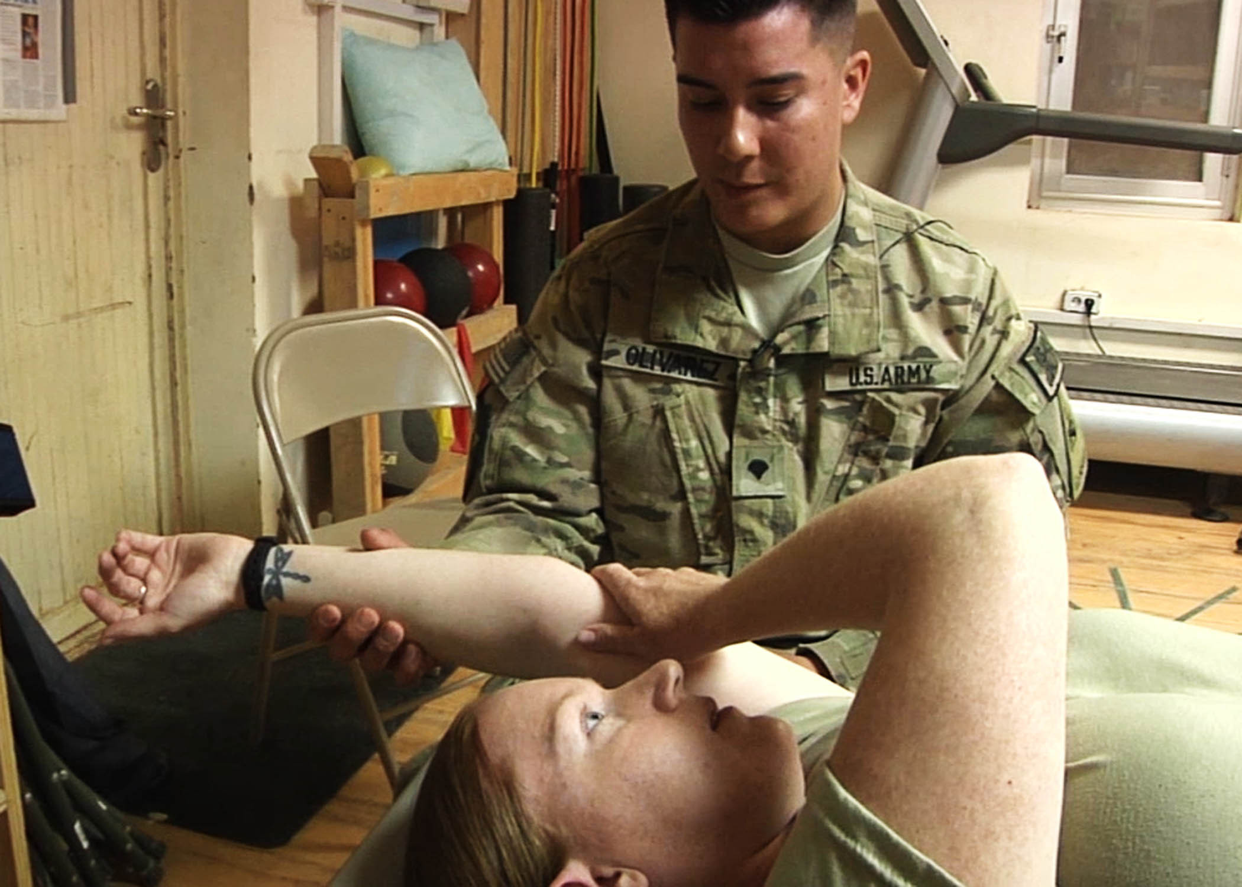
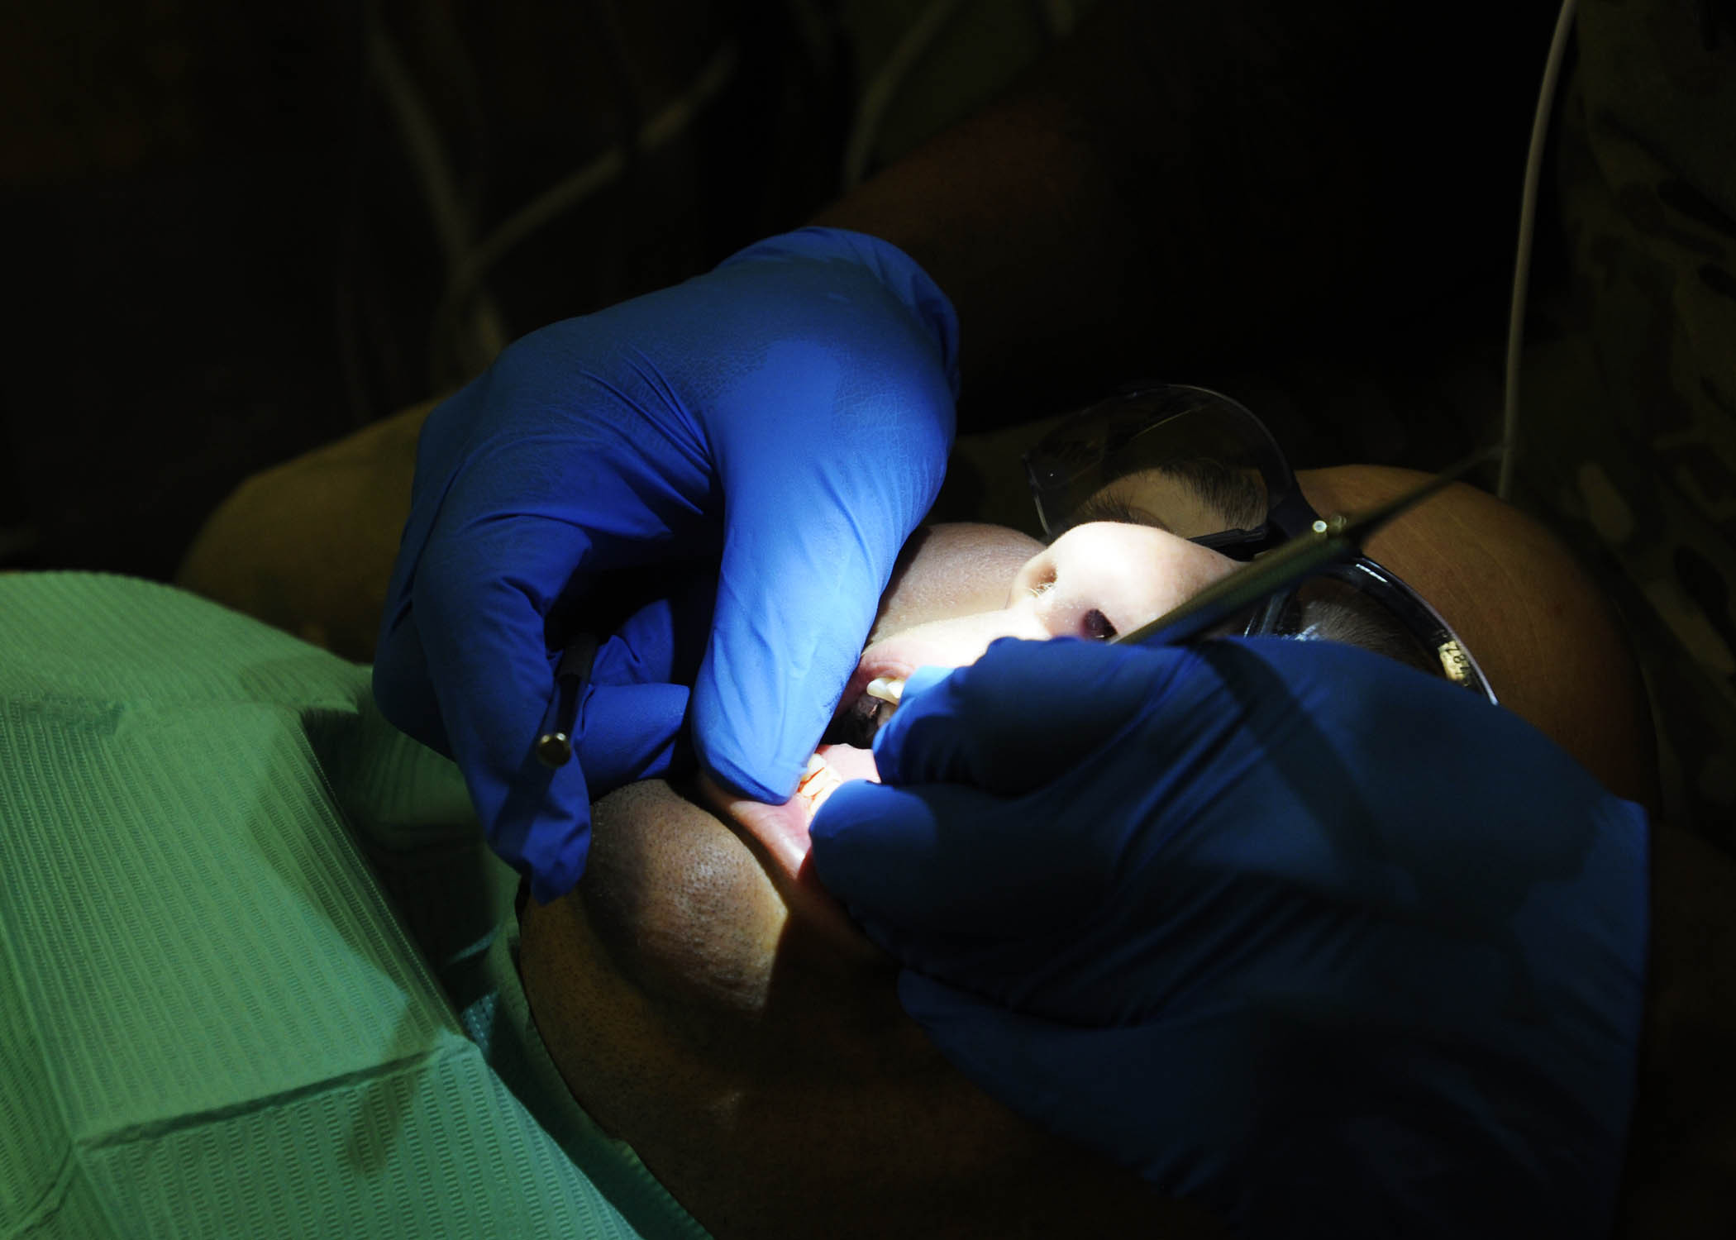
HIPAA
Examples of releasable images:

Slide 59
Check on Learning
You are overseas and your unit has seen some action
Some of your best buddies were wounded in a firefight
Paperwork detailing their injuries and current medical condition has crossed your desk
Can you share this information?

Slide 60
Check on Learning
A- Yes, keep friends and families informed
B- No, the Health Insurance Portability and Accountability Act of 1996 rules protect the privacy of individually identifiable health information; DoD is responsible for casualty notifications

Slide 61
Check on Learning
A- Yes, keep friends and families informed
B- No, the Health Insurance Portability and Accountability Act of 1996 rules protect the privacy of individually identifiable health information; DoD is responsible for casualty notifications

Slide 62
Accidents/Incidents
The following information is normally releasable by respective PA release authority to help properly identify service members killed or injured:
  Name- releasable 24 hours after next-of-kin (NOK) have been notified
  Rank and unit- releasable to help properly identify the individual service member
  Home of record- no general rule across the services, but in most cases hometown and state are releasable
Although handled by PAO, UPARs may be asked to assist in gathering information

Slide 63
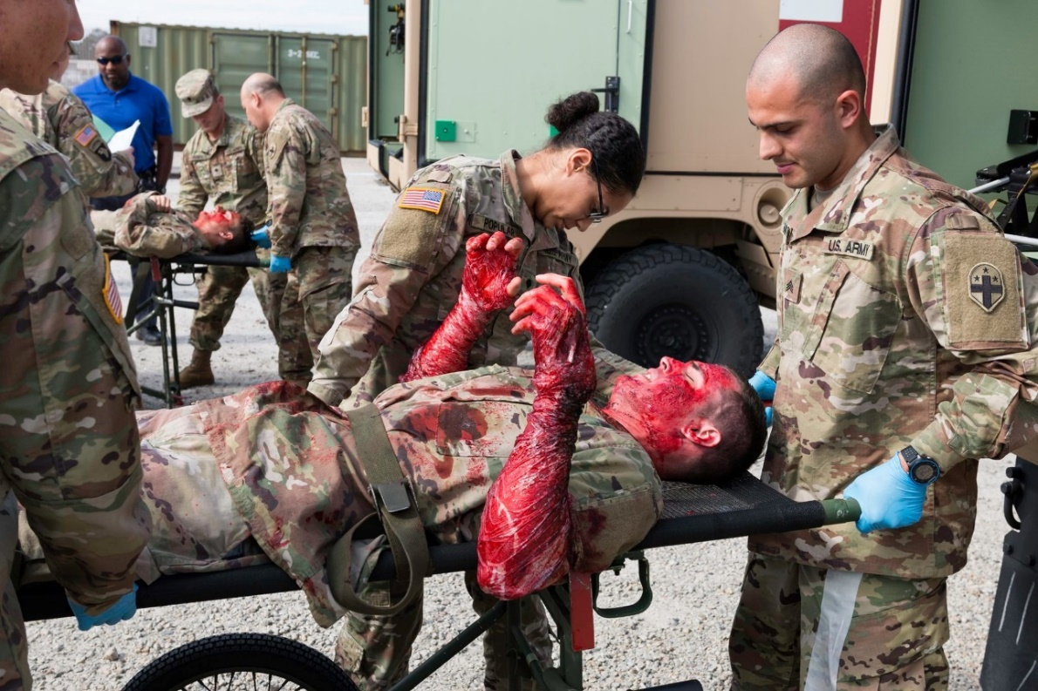
Accidents/Incidents
Do not post photos of accidents or events that may end in an investigation or bring undo attention

Slide 64
Accidents/Incidents
Holding statements: “I do not have any information regarding that topic at the moment; I will look into that and get back to you.”
Do not panic; start with conversation
Get information and complete media query to provide to PAO

Slide 65
Check on Learning
Casualty information on ill or injured military members and DoD civilians may not be released without consent of the individual, unless otherwise authorized under the Privacy Act?
  True/False

Slide 66
Check on Learning
Casualty information on ill or injured military members and DoD civilians may not be released without consent of the individual, unless otherwise authorized under the Privacy Act?
  True/False

Slide 67
Check on Learning
Specify the time period required before casualty information on deceased military members or DoD civilians may be released to the media or general public

Slide 68
Check on Learning
A- Immediately after notification of next-of-kin
B- In conjunction with notification of next-of-kin
C- 24 hours after notification of next-of-kin
D- Only after next-of-kin authorization

Slide 69
Check on Learning
A- Immediately after notification of next-of-kin
B- In conjunction with notification of next-of-kin
C- 24 hours after notification of next-of-kin
D- Only after next-of-kin authorization

Slide 70
Criminal Matters and Investigations
Reporters may call unit for information about a person who may be suspected of, or charged with, committing a crime
The event may or may not involve the military or the person’s affiliation with the military
You will need to work quickly and carefully to alert your higher headquarters’ PAO

Slide 71
Criminal Matters and Investigations
The rights of a person accused of a criminal offense must be carefully guarded
This applies whether you are issuing a statement or responding to a query
You must not provide any information that would interfere with an accused person getting a fair trial
Although normally handled by PAO, UPARs may be asked to assist in gathering information

Slide 72
Criminal Matters and Investigations
If you have received permission to release information, do not release anything except VERIFIED FACTS
Do not comment on an accused person’s character or behavior before, during or after the start of an investigation or arrest
Do not comment on evidence
Do not offer any opinion about the guilt of the accused

Slide 73
Criminal Matters and Investigations
Names of deceased or injured victims must not be released until 24 hours after NOK notification
Before release, check with higher headquarters to ensure NOK has been properly notified
If unsure, state, “The names of the victims are being withheld pending notification of next-of-kin.”
Do not speculate about circumstances surrounding a criminal matter or accident- an investigation will determine the cause

Slide 74
Conclusion
What happens if there is an inadvertent release of information?
DoD personnel responsible for serious security incidents will be held accountable as appropriate:
  Criminal proceeding
  Civil judicial action
  Disciplinary or adverse administrative action
  Other administrative action authorized by federal law

Slide 75
Conclusion
The compromise of classified information presents a threat to national security and may damage intelligence or operational capabilities
Lessens the DoD’s ability to protect critical information, technologies and programs, or reduce the effectiveness of DoD management
Once a compromise is known to have occurred, seriousness of damage must be determined and appropriate measures taken to negate the effects

Slide 76
Conclusion
When possible, action will be taken to regain custody of documents or material that are compromised
Security management must take appropriate action to identify the source and reason for the suspected or actual compromise and take remedial action
Any person working for the DoD who becomes aware of the loss or potential compromise of classified information will immediately report it

Slide 77
Defense
Public Affairs
3

Slide 78
Agenda
Public Affairs Mission
Doctrinal Mission
Fundamentals of Information
Proactive versus Reactive
Military History

Slide 79
Doctrinal Mission
PAOs provide advice to the commander on media events and operations
  UPARs do not provide advice, but may assist in gathering information
Help with development and dissemination of command information message
Enforces OPSEC
Plans and assists U.S. military support to media

Slide 80
Doctrinal Mission
“It is the responsibility of the Department of Defense to make available timely and accurate information so the public, Congress and news media may assess and understand facts about national security and defense strategy.” – DOD Principles of Information
There are several fundamentals of information that guide commanders for effective employment of public affairs operations and for an appropriate relationship with the media.

Slide 81
Fundamentals of information
Honesty
  PAOs will only release truthful information
Timely information
  Commanders should be prepared to release timely, coordinated and approved information about military operations
Security
  All DoD personnel are responsible for safeguarding sensitive information

Slide 82
Fundamentals of information
Consistent information
  Commanders should ensure that DoD PA operations put forth a consistent message
  Information should be appropriately coordinated and in compliance with DoD and supported command guidance
Tell the DoD story
  All DoD members help provide accurate information about Armed Forces and national defense operations to the public
  Commanders should educate and encourage military and civilian employees to tell the DoD story
Notes:
Shorten bullets in consistent information

Slide 83
Proactive versus reactive
Proactive
  Seeking to build strong relationships with internal and external audiences through frequent communication
  Press releases, media invites, press kits
Reactive
  Fighting to catch up or counter negative or misleading information after it has already been published/broadcast
  Noise complaints, response to query, contacting editor/station manager

Slide 84
Military history
PA and military history are symbiotic
UPARs are responsible for:
  Deployment reports
  Unit photos
  CI archives
  Digital news screenshots
UPARs should assist with:
  Static displays
  Heritage month
  Unit histories

Slide 85
Principles of Information
4

Slide 86
Agenda
Parental Permissions
Copyright

Slide 87
Parental Permissions
Photos of children during family day or community day events must have parental permission prior to releasing
  Ask en-masse prior to photographing for those opposed to inform you, easier to identify those who don’t approve
Humanitarian and IRT missions may be subject to different guidelines; higher PAO will provide guidance
Photo/video release form can be obtained from PAO office

Slide 88
Copyright
Copyright is a form of protection provided by the laws of the United States (Title 17 of the United States Code) to the authors of original works of authorship, including literary, dramatic, musical artistic and certain other intellectual works
Copyright protection is automatic when an original work is fixed in a tangible medium of expression

Slide 89
Copyright
It does not require that a copyright notice be placed on the work, that it be published, or that it is registered with the Copyright Office
Copyright protection does not pertain to ideas and facts, only manner of expression

Slide 90
Copyright
Fair Use
  Sometimes copyrighted material can be used, but it must fall under ‘fair use’ rule
  Fair use limitation identifies four factors that should be evaluated on a case-by-case basis in order to determine if a specific use is fair
  To ensure broad use of a product, use non-copyrighted materials or provide raw video and collaborate with PAO on your project
What are some examples of fair use vs. copyright?
Notes:
What to do, what not to do… give examples of what would be copyright vs fair use

Slide 91
Copyright
Government Exception
  Works prepared by government employees as part of their official duties are NOT subject to copyright protection
  If you are a service member, working with government equipment, and/or on government time, you cannot copyright your work- it belongs to the government
  17 U.S. Code § 105 - Subject matter of copyright: United States Government works
Notes:
Add in regulation statement

Slide 92
Check on Learning
This act allows a member of the public who follows the rules established by proper authority in the Department of Defense to request a record without it being withheld in whole or part unless the record is exempt from mandatory partial or total disclosure?

Slide 93
Check on Learning
A- Privacy Act
B- Freedom of Information Act
C- Fair Use
D- Health Insurance Portability and Accountability Act
Notes:
Put in answer slide

Slide 94
Check on Learning
A- Privacy Act
B- Freedom of Information Act
C- Fair Use
D- Health Insurance Portability and Accountability Act
Notes:
Put in answer slide

Slide 95
Guidelines for the Release of Information
5

Slide 96
Agenda
Release Authority
Media Advisory
News Releases
Public Service Announcements
Key Information/Checklist
Write an Advisory, Release, PSA

Slide 97
Release Authority
Public Affairs Office/Theater PAO has release authority on EVERYTHING
UPARs will immediately notify PAO of any issues that might gain national or international media attention (accidents/investigations)
Units must submit any proposed public announcements on missions through respective PAO
Ensure all Soldiers receive the Public Affairs brief during premobilization
Notes:
Reference: battalion pages are not authorized, so if a UPAR wants to submit an event on a BN page, those are not authorized

Slide 98
Media Advisory
Invitation for media to attend an activity or event
  Opening of a community center, Fleet Week, Air Shows, open house…
Usually to inform media of an upcoming newsworthy media event
  Mobilization, overseas exercise, return from deployment…
Sent out a week to 10 days prior to the event, depending on logistical considerations and lead time
  Proposed information should be to PAO at least 14 days out

Slide 99
News Release
Provide information to the media
Usually includes quotes
A ‘hard news’ story
Formatted so it can be placed in a newspaper as a news article
Most important information goes at the beginning

Slide 100
Public Service Announcements
Gives public notice of events that directly impact them
Good way to promote activities
  Armed Forces Day, parades…
Could include important information about road moves, convoys, training exercises…
Must be sent out about two weeks in advance

Slide 101
Key Information
Media products should include the following:
  Who- number of Soldiers, units, duties
  What- what the activity is and its significance
  When- date, time
  Where- address, directions
  Why- reason for the training/event
  How- method of completing the mission
Provide contact information for the PAO, UPAR and unit
Provide website if available
Notes:
**something to change subject to OPSEC/ deployment status

Slide 102
Checklist
Who will you send the news advisory/release to?
Is the subject newsworthy?
Does the release conform to the Associated Press Stylebook?
Does it answer the 5 Ws and provide a ‘so what’ to the reader?
Is it concise?
Is the information presented in a descending order of importance?

Slide 103

Key Information
IMMEDIATE RELEASE
Force Health Protection Guidance (Supplement 20) – Department of Defense Guidance for Personnel Traveling During the Coronavirus Disease 2019 Pandemic
Today, the Department of Defense released the memorandum for Force Health Protection Guidance (Supplement 20) – Department of Defense Guidance for Personnel Traveling During the Coronavirus Disease 2019 Pandemic. This memorandum supplements requirements in references (a) through (c) and rescinds and replaces Under Secretary of Defense for Personnel and Readiness Memorandum “Force Health Protection Guidance (Supplement 14) – Department of Defense Guidance for Personnel Traveling During the Coronavirus Disease 2019 Pandemic, December 29, 2020.
This memorandum applies to official and unofficial travel and proves updated pre- and post-travel guidance for purposes of force health protection (FHP) for Service members, DoD family members, DoD civilian employees, and DoD contractor personnel, as well as fully vaccinated individuals.
The Secretaries of the Military Departments, heads of OSD Components, and Commanders of the Geographic Combatant Commands may implement more restrictive guidance and additional FHP measures based on mission requirements and local risk assessments, in consultation with their medical staffs and public health authorities.
The memo for Force Health Protection Guidance (Supplement 20) – Department of Defense Guidance for Personnel Traveling During the Coronavirus Disease 2019 Pandemic can be found here.
Notes:
Use better example

Slide 104
Lead
Lead
  Opening paragraph
  Most important part of a news story
  Attention-grabber for those who need interest
  Includes who, what, where, when, why, how

Slide 105
Exercise- Scenarios
Write a lead:
  An MWR concert
  9 p.m.
  Tonight
  Free and open to the public
  Free hotdogs and popcorn
  Fort George G. Meade, Maryland, parade field
  Metallica, Pantera and Phil Collins will perform
  Master Sgt. Ernie Bilko will introduce the acts

Slide 106
Bridge
Bridge
  Links one idea to another
  Create a smooth transition between ideas
  Topic sentence that coveys reader from old paragraph to new paragraph
Notes:
What is a bridge?

Slide 107
Exercise- Scenarios
Write a lead and bridge:
  All are welcome
  Free
  Eight World Wrestling Federation members
  Post fitness center from 7-9 p.m.
  Autographs
  Hulk Hogan will attend
  WWF are on a tour of Baltimore schools to discuss drugs
  Friday
  Open to the public
Notes:
What is a bridge?

Slide 108
Scenarios
Write a PSA:
The sixth annual Fort Bragg Community Fair runs from July 1 to July 5 this year at the Main Post Parade Field. The fair is free and open to the public. Gates open at 2 p.m. and close at midnight each day.
The Golden Knights parachute demonstration team will do a pair of shows on Independence Day at 2 p.m. and 5 p.m.
Daily musical acts include the U.S. Army Field Band, country and western act The Mudslingers and local rockers Nobody’s Dog. Schedules for each act are available on Ft. Bragg’s website. More than 30 rides, including pony rides for the kids, along with 40 food and game booths will be on site.

Slide 109
Check on Learning
What are the 5 W’s that are critical to the story?
Where do they belong in a story?
Who should you coordinate with prior to sending media advisories or press releases?
Notes:
Answer key

Slide 110
Photography and Caption Writing
6

Slide 111
Agenda
Fundamentals of Photography
Basic Compositional Techniques
SAPP
Image Requirements
Tips for Success
Caption Writing
Resources

Slide 112
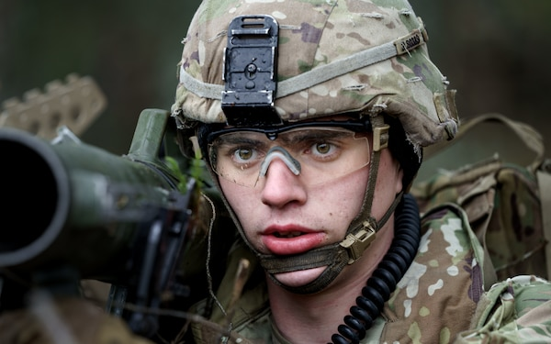
Fundamentals of Photography
1. Fill the Frame
  You are responsible for everything that is or is not in the image
  Helps draw attention/place emphasis on subject(s)
  Avoid wasted or dead space

Slide 113
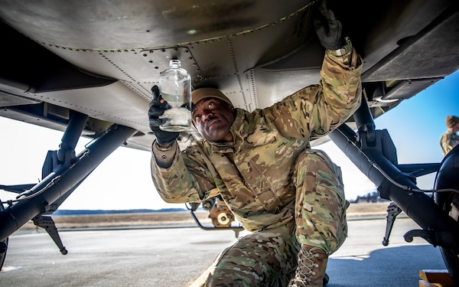
Fundamentals of Photography
2. Control the Background
  If background elements don't add anything to the image then don't include it
  Avoid distracting elements:
    Signs, poles, trash, porta-johns, etc.
  Control by changing your angle, position, or depth of field (if using DSLR or mirrorless system)

Slide 114
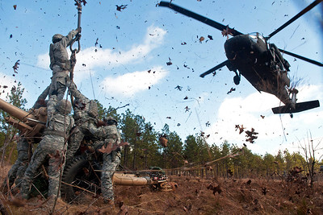
Fundamentals of Photography
3. Wait for the Moment
  Good imagery doesn't "just happen" by accident
  Exercise patience and wait for the action to develop
    This often requires you to anticipate what is going to happen – be prepared!

Slide 115

Basic Compositional Techniques
Center of Interest
  This is what your image is about (subject)
  Strongest images have a CLEAR center of interest
  Remember: you're capturing imagery for more than a military audience

Slide 116
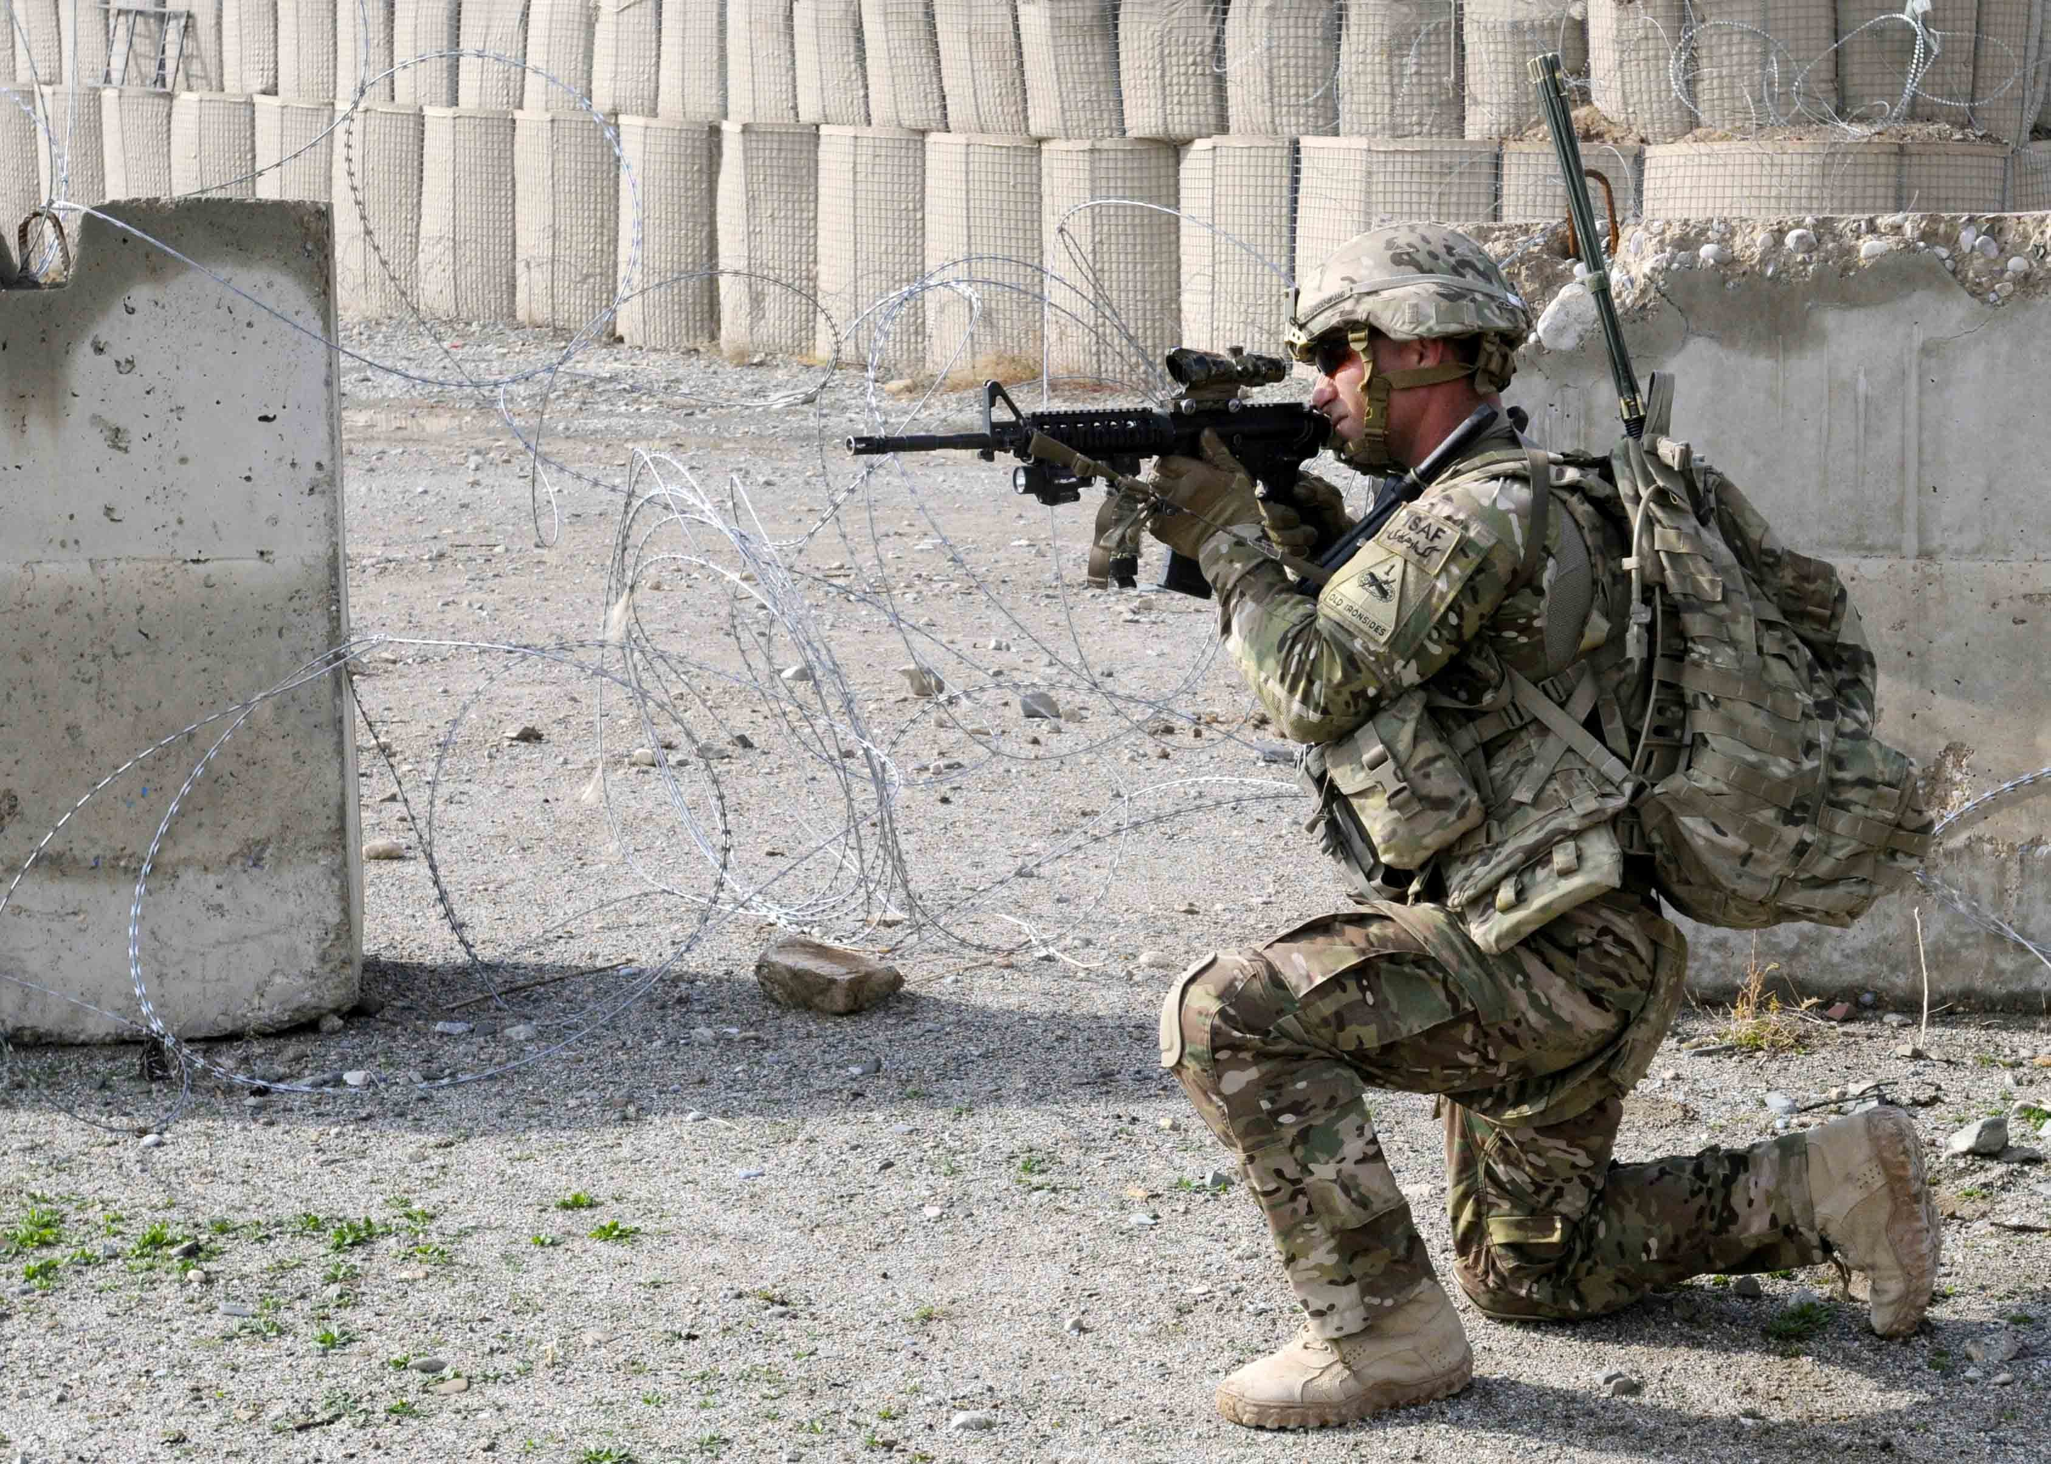
Basic Compositional Techniques
Rule of Thirds
  Created by dividing image into thirds horizontally and vertically
  Important elements should fall along these lines OR on the intersections
  Works with horizontal and vertical images

Slide 117
Basic Compositional Techniques
Motion
  When showing motion, leave room for subject to move into the frame (not out of)
  The direction a person is looking is considered an implied movement
    Viewers tend to follow the direction the subject is looking

Slide 118
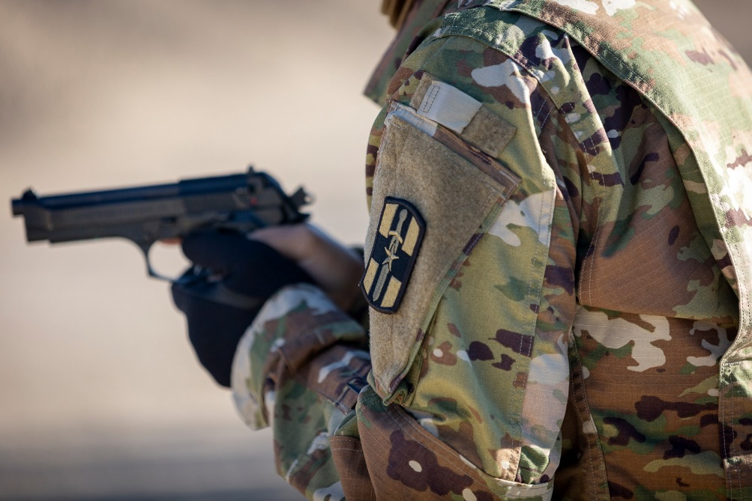
SAPP
Security
  Is there classified materials?
  OPSEC (maps, documents, certain equipment, etc.)
  Flight lines, ECPs, controlled areas, etc..
Accuracy
  Have you misled the viewer?
  Are you accurately conveying the nature of the subject, environment, and action?

Slide 119
SAPP
Propriety
  Is it in good taste?
  Can anything in the image be taken out of context?
  Do not take photos that put your unit or the Army in an unfavorable light:
      Smoking
      Drinking Alcohol
      Spitting/Dipping
      Compromising positions / facial expressions, hand gestures or hand signs, etc.

Slide 120
SAPP
Policy
  Does anything in the image violate Army policy?
    AR 670-1 is the biggest violation in images
      Make sure Soldiers are in proper uniform and wearing proper PPE
    Includes all Army policies and regulations
      You may have to inquire with PAO or appropriate staff offices to clarify things outside of your knowledge

Slide 121
Image Requirements
VISION ID
  "...all photographers, videographers, graphic artists, photojournalists, broadcasters, public affairs, and other personnel involved in the creation of official DoD imagery shall be assigned a VISION ID." - DoDI 5040.02, Enclosure 7
  Do not make up a VISION ID if you do not have one, nor shall one person’s unique VISION ID be used for another person’s work.
    BLUF: Your HHQ PAO should not be using their VISION IDs to label and upload your imagery
Notes:
75th Anniversary of D-Day/

Slide 122
Image Requirements
VIRIN
  The Visual Information Record Identification Number (VIRIN) uniquely identifies every piece of Visual Information created by DoD photographers and is a crucial component of the DoD Visual Information archiving system.
    VIRINs will be how you name your image files
    A VIRIN consists of 16 alphanumeric characters separated by hyphens into four fields organized in the alpha numeric format.
Notes:
75th Anniversary of D-Day/

Slide 123
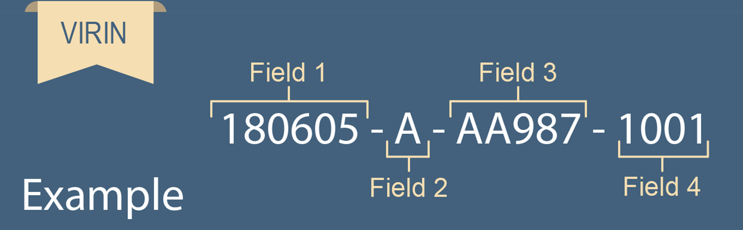
Image Requirements
Field 1
  Date the image was taken, not when it was downloaded
  YYMMDD Format
Notes:
75th Anniversary of D-Day/

Slide 124
Image Requirements
Field 2
  The Service affiliation or status of the acquirer or originator
  All UPARs will use "A" for Army affiliation
Notes:
75th Anniversary of D-Day/

Slide 125
Image Requirements
Field 3
  Photographer’s VISION ID, which provides official attribution to the individual who created the unique imagery
Notes:
75th Anniversary of D-Day/

Slide 126
Image Requirements
Field 4
  The final four digits are used to create a unique VIRIN for each photo or video file uploaded.
Notes:
75th Anniversary of D-Day/

Slide 127
Image Requirements
Assignment/Event #
(For the Day)
-1 0 0 1
Image Sequence #
001-999
Field 4
  The final four digits are used to create a unique VIRIN for each photo or video file uploaded.
Notes:
75th Anniversary of D-Day/

Slide 128
Image Requirements
Image Quality
  UPAR access to DSLR or mirrorless camera systems is usually few and far between
  Ensure you are capturing imagery at the highest quality your specific equipment is capable of shooting
  Don't send images in a Word document or PowerPoint slide
    Make sure you're using or sending a copy of the original image
Notes:
75th Anniversary of D-Day/

Slide 129
Image Requirements
Prohibited Alterations
  "...“The alteration of official DoD imagery by persons acting for or on behalf of the DoD is prohibited. Prohibited alterations include the addition, removal, or changing of photographic details. Examples of prohibited alteration include the addition, changing, or removing of individuals, equipment, scenery, or the unrealistic changing of color or light.” - DoDI 5040.02, Enclosure 10
***This includes alterations, including the addition, changing or removal of uniform (rank, patches, etc.) or background items (flags, guidons, etc.), to official photos or command photos, such as those posted in public spaces or displayed on a Department of Defense website or social media platform.***
***Check with your HHQ PAO for guidance on authorization to edit any of your captured imagery.***
Notes:
75th Anniversary of D-Day/

Slide 130
Tips for Success
Avoid capturing the backs of heads or profiles
  Make sure to show your subject's face and clear action of their hands (if doing an action)
Avoid imagery of access badges, maps, CACs, etc.
Don't be afraid to get close
  Just don't interfere with training, the mission, or safety
Be part of the rehearsal process
  Know what and how it's going to happen before execution
Notes:
75th Anniversary of D-Day/

Slide 131
Tips for Success
Do NOT stage any of your imagery
  Trust of the American public is paramount. You are there to create a record of the subject matter, do not tell someone what action to perform or alter the environment/setting.
Exercise utmost caution when capturing imagery of children or minors
  Individuals under the age of 18 years old cannot give consent; you must obtain it from their parent or legal guardian.
  When acquiring parental consent, it is best to get it in writing using a release waiver and keeping it on file.
Notes:
75th Anniversary of D-Day/

Slide 132
Tips for Success
Exercise caution when capturing imagery in medical treatment facilities
  Individuals have certain rights to their medical status and information – do not capture imagery without first getting consent of patient.
Coordinate with S6 for exceptions to external storage (cameras) for downloading and transmission of imagery on NIPR systems, if applicable
When in doubt, always request further guidance from your HHQ PAO
Notes:
75th Anniversary of D-Day/

Slide 133
Caption Writing
Captions supplement your imagery with details to help describe and enhance information
Consists of two sentences and a credit line
Includes all the relevant 5Ws
Required for all released imagery

Slide 134
Caption Writing
ABCs of Caption Writing
  Accuracy
    Verify all information is factually and grammatically correct
    Ensures that imagery is newsworthy and of historical value
  Brevity
    You must convey a lot of information in two sentences so be concise
  Clarity
    Use language that any reader can understand, including non-military personnel
    Avoid jargon or other "military speak"

Slide 135
Caption Writing
First Sentence
  Includes the who, what, when and where
  Who:
    Who or what is the subject of the image?
      If there are three or fewer people, each of the identifiable persons must be included
      Must have service, rank, full name, title, and military unit
        List units from smallest to largest
      Do not identify by using "U.S. Army Soldier"
        You must get the necessary information.

Slide 136
Caption Writing
  What:
    Describe the action captured by the imagery
    Use active voice and historical present tense
      Written as if action is happening as you're reading it
    Don't over-describe the images; remember brevity
ACTIVE vs. PASSIVE VOICE
Active: U.S. Soldiers attack the objective.
Passive: The objective is attacked by U.S. Soldiers.

Slide 137
Caption Writing
  When:
    Includes the date the image was captured
    Written differently than typical Army fashion
      Correct Example: Aug. 16, 2022
      Incorrect Example: 16 AUG 22
  Where:
    Include the installation, city, state, and country if other than U.S.
    Give a region or general area if there is no city or location must remain undisclosed
Spell out these Months:
March
April
May
June
July

Slide 138
Caption Writing
Example of a correctly formatted first sentence:
U.S. Army Staff Sgt. James Smith, left, and Spc. Mike Thomas, right, both cavalry scouts assigned to 1st Squadron, 7th Cavalry Regiment, 1st Armored Brigade Combat Team, 1st Cavalry Division, conduct driver training Feb. 18, 2022, at Fort Hood, Texas.

Slide 139
Caption Writing
Second Sentence
  This is the background or "why" of the image
  Why:
    Briefly explain the purpose of the event, exercise, or operation depicted in the image.
    Gives the viewer context for why image matters
    Do not include quotes

Slide 140
Caption Writing
Example of a correctly formatted second sentence:
U.S. Army Staff Sgt. James Smith, left, and Spc. Mike Thomas, right, both cavalry scouts assigned to 1st Squadron, 7th Cavalry Regiment, 1st Armored Brigade Combat Team, 1st Cavalry Division, conduct combat life-saver training Feb. 18, 2022, at Fort Hood, Texas. The medical refresher was part of a weeklong train-up for the installation's Best Warrior Competition, which will take place March 4, 2022.

Slide 141
Caption Writing
Credit Line
  Provides information for the individual who captured the image
  Immediately follows second sentence in parentheses
  Includes:
    The phrase "U.S. Army photo by..."
    Rank and Full Name

Slide 142
Caption Writing
Example of a correctly formatted credit line:
U.S. Army Staff Sgt. James Smith, left, and Spc. Mike Thomas, right, both cavalry scouts assigned to 1st Squadron, 7th Cavalry Regiment, 1st Armored Brigade Combat Team, 1st Cavalry Division, conduct combat life-saver training Feb. 18, 2022, at Fort Hood, Texas. The training was part a week-long train up for the installation's Best Soldier Competition, which will take place March 4, 2022. (U.S. Army photo by Pfc. James Schmidt)

Slide 143
Resources
DoDI Visual Information Style Guide
https://www.dimoc.mil/VI-Training/DoD-VI-Style-Guide/
DoDI 5040.02, Visual Information
https://www.dimoc.mil/References/DoD-Instruction-504002/
Go-to resource for caption writing
DINFOS PAVILION
https://pavilion.dinfos.edu/
VISION ID
https://www.dimoc.mil/Submit-DoD-VI/Digital-VI-Toolkit-read-first/VISION-ID/
Search For:
  Photography
  Composition
  Captions
VIRIN
https://www.dimoc.mil/Submit-DoD-VI/Digital-VI-Toolkit-read-first/Create-a-VIRIN/

Slide 144
Defense Visual Information Distribution Service
(DVIDS)
8

Slide 145
Agenda
Defense Visual Information Distribution Service (DVIDS)
Uploading

Slide 146
DVIDS
DVIDS is under the direction of Defense Media Activity
Enables media organizations to request products, conduct interviews and receive images, video footage and stories from distribution hub
Digital platform
THE archiving and publishing location for military media

Slide 147
DVIDS site
Website
  https://www.dvidshub.net/
App can be downloaded to smartphones
Does not require CAC login

Slide 148
Uploading
All users must be registered on DVIDS
Everyone can access and download media from DVIDS, as long as they create an account
Civilian media often retrieve military media from DVIDS
(Requires Account) All training can be found at:
  https://cms.dvidshub.net/training/videos

Slide 149
Introduction to Social Media
9

Slide 150
Agenda
Social Media Facts
YouTube
Capturing Video for Social Media
Social Media Policy
Notes:
Rearrange slides

Slide 151
Social Media Facts
Daily Active
Social Media users
Facebook is the
market leader
Social Media users
by generation
Time spent
on social media daily

Slide 152
YouTube
YouTube augments, but does not replace, traditional military publishing methods (DVIDS)
YouTube videos show up in major search engine results, but cannot always be viewed on government networks
Military YouTube channels are receiving tens of thousands of views
YouTube may or may not be blocked on government computers

Slide 153
Social Media Facts
Influence
helps build trust
Instagram
user statistics
Social media users
via mobile

Slide 154

Capturing Video for Social Media
AVOID vertical video
  Quality video can be filmed on a smart phone, but directionality is essential

Slide 155
Social Media Policy
ALL official social media presence MUST be approved by unit PAO
  Battalion and below social media pages are NOT authorized
Official use of social media is to provide a communication resource for the organization to reach and interact with the public
Risks can be mitigated through leadership, risk management and public affairs social media training
Notes:
If units below brigade level want social media presence, it must be a closed GROUP (not page).

