Slide 1

Capturing Your Community
With One Splash
JaneMarie Borger, Recreation Coordinator
City of Greeley, Colorado

Slide 2
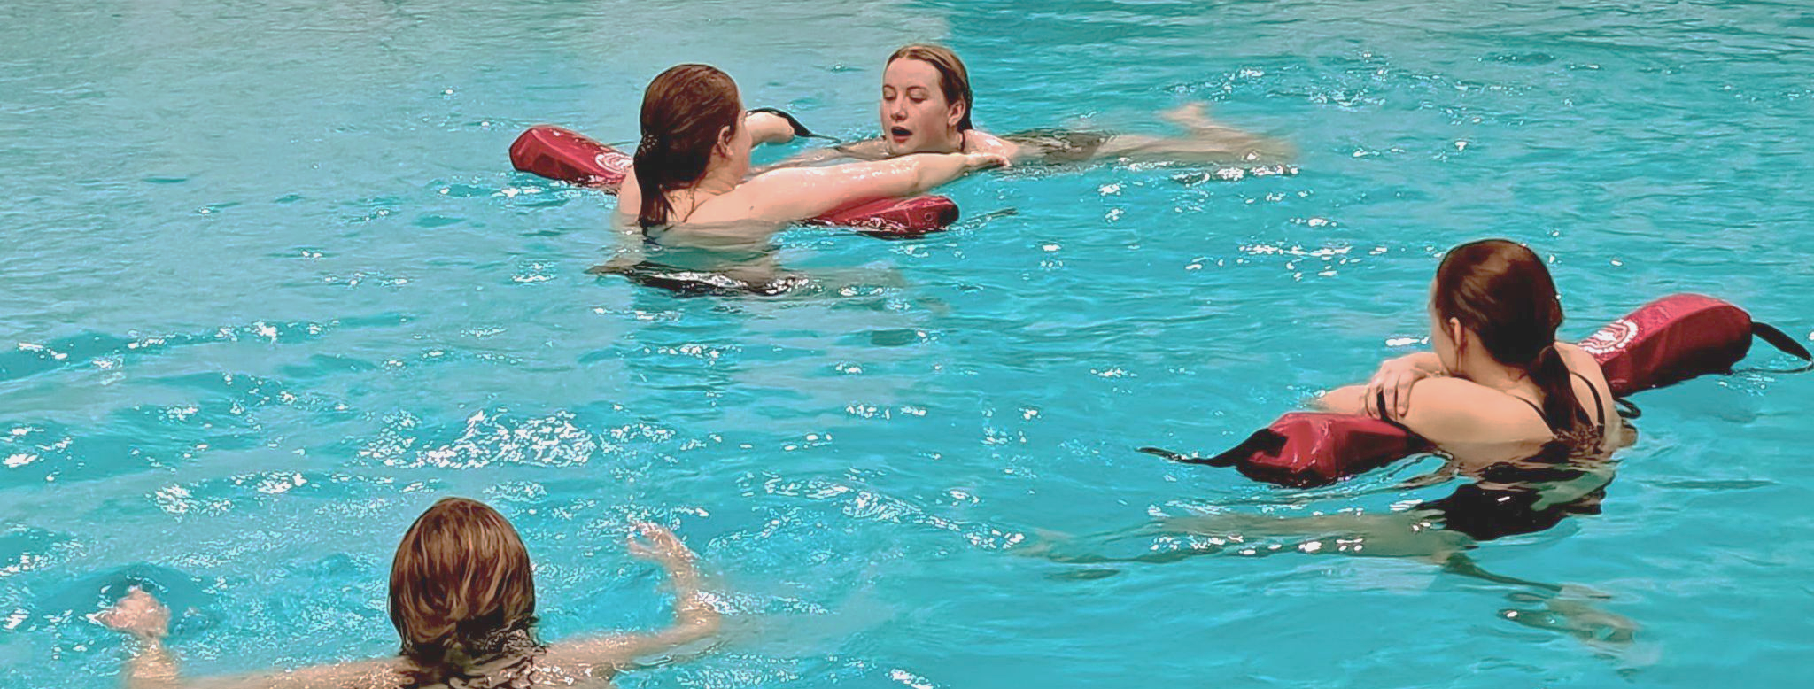
What’s My Background?
LGIT, WSIT, Swim Angelfish Adaptive
20+ years working in aquatics instruction
20+ years in marketing, PR & community engagement
Masters of Business Administration
Recreation Coordinator in Aquatics

Slide 3
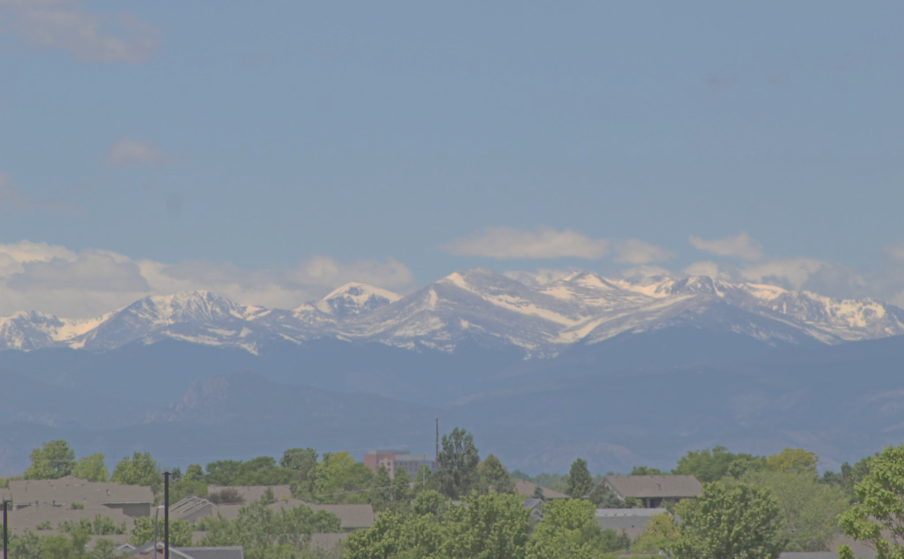
Where Is Greeley?
Part of Front Range Urban Corridor
Northern Colorado city with 109,000 residents
Bedroom community of Denver
Fourth fastest growing metro area in the U.S. (2010-2020)
Major industries include agriculture & food processing, energy, aerospace, and healthcare
Ethnicity includes 53% White, 40% Hispanic/Latino, 2% Black

Slide 4
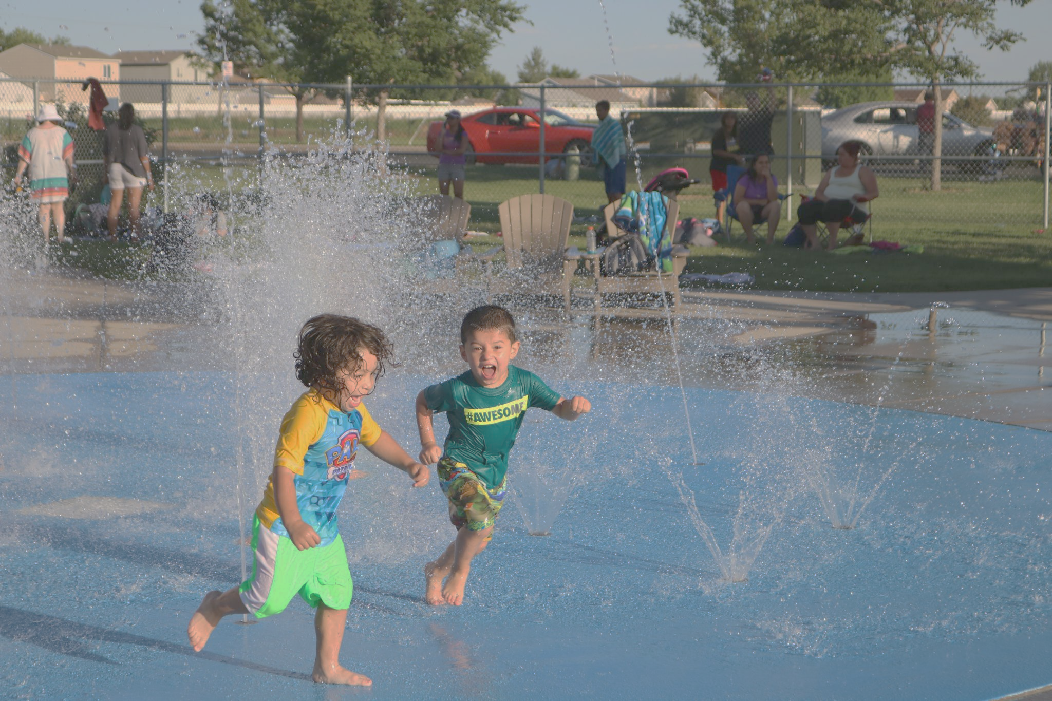
Who Is City of Greeley CPRD Aquatics?
Operate 2 outdoor pools, 2 indoor pools, 2 splash pads
Work with more than 90 part-time employees
Taught 500 swimming lessons 2023
Enrolled 2,420 swimmers
Employ 25 swim instructors

Slide 5
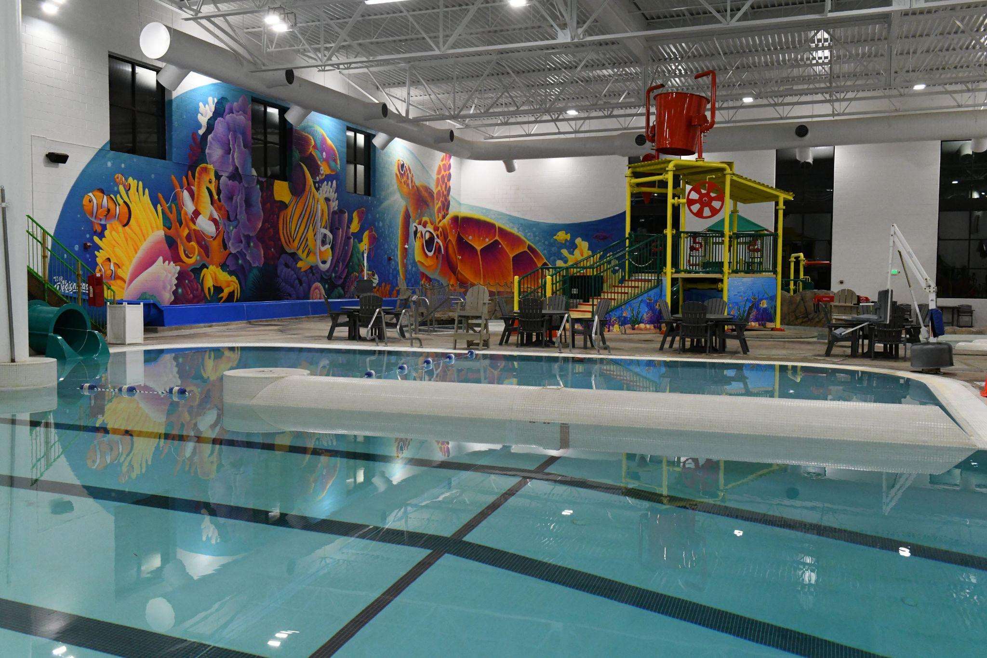
The Challenge
How do we increase aquatics participation among our underserved communities?

Slide 6
The Solution
Develop partnerships and programs welcoming our neighborhoods, seeking their input, listening to concerns while teaching each participant a life skill.

Slide 7
Steps to Success
Step 3
Step 1
Step 2
Who do we know in the community? How will we establish trust?
Time to plan. Commit to expanding our target audiences.
Identify when teach each special group and in what facility.

Slide 8
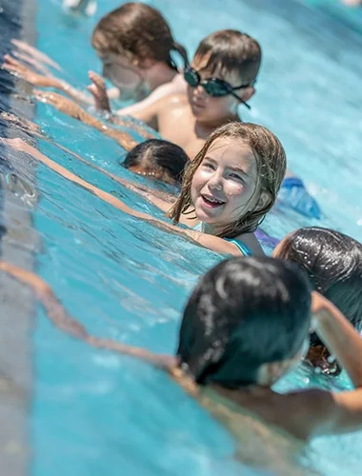
Conversation
A. Who are potential partners in your community?
B. What do partners expect?
C. When is best time to connect with them?

Slide 9
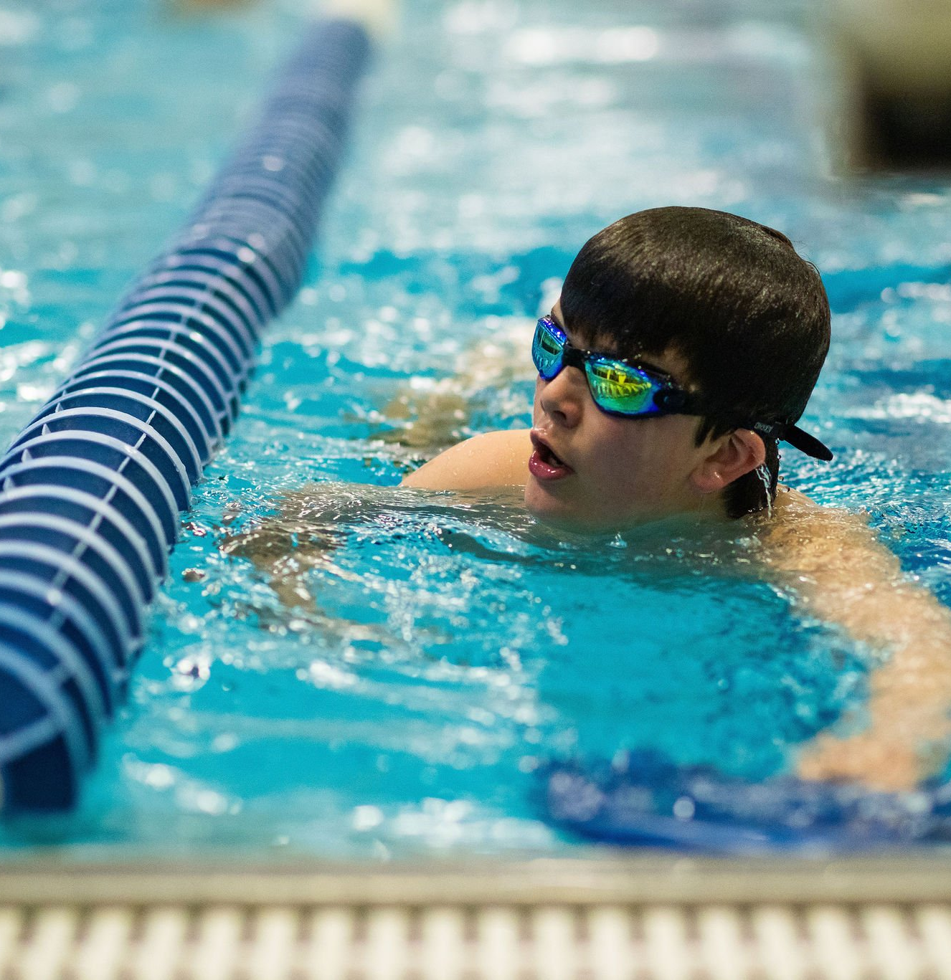
SHARE
A. Who are potential partners in your community?
B. What do partners expect?
C. When is best time to connect with them?

Slide 10
POV: Partner Expectations
Clean Facility
Available Hours
Certified Instructors
Teach Multiple Levels
If Enrolled Would
Complete Class
This is what WE thought they wanted…

Slide 11
Partner ACTUAL Expectations
Sense of Belonging
Treated the Same
Understand Why Fearful
These were what they shared they wanted…

Slide 12
How We Can Deliver?
Develop Trust
Pool Space/Availability
Instructors
Identify how we will go above and beyond to serve our community. Find ways to provide highest level of customer service possible.

Slide 13
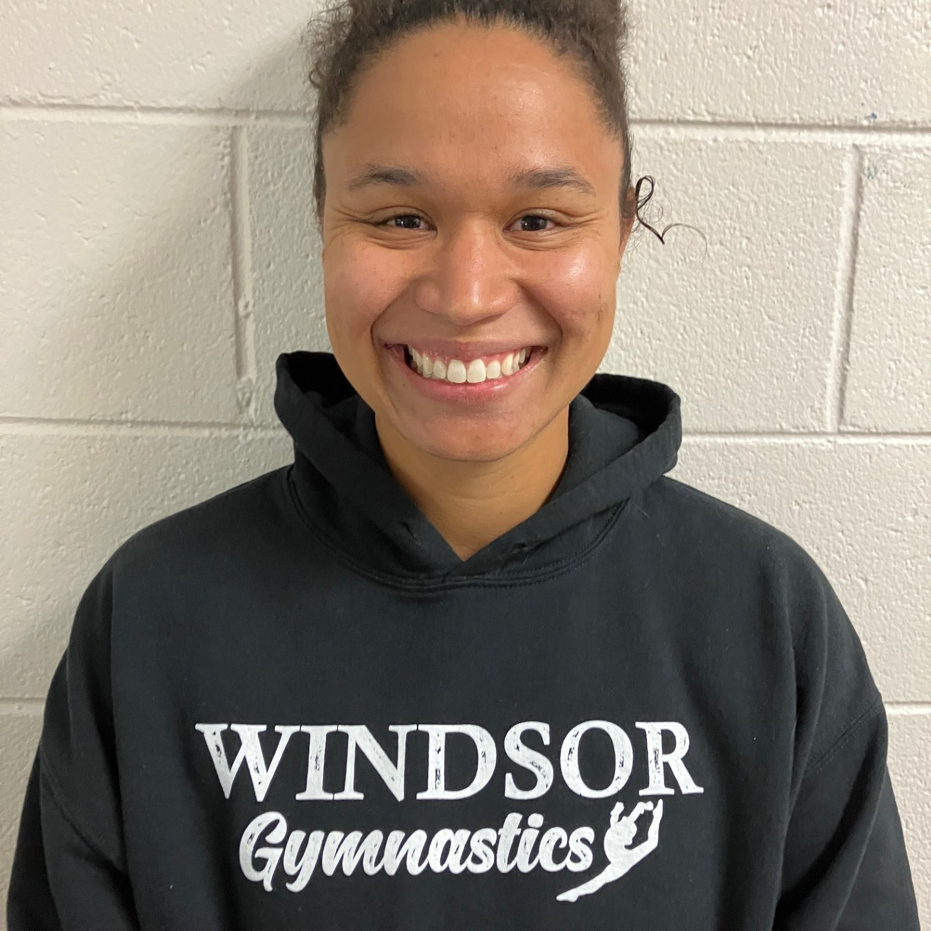
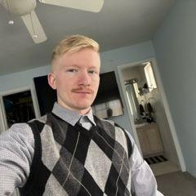
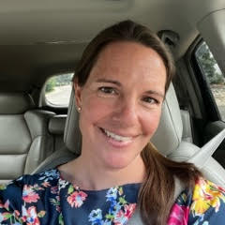
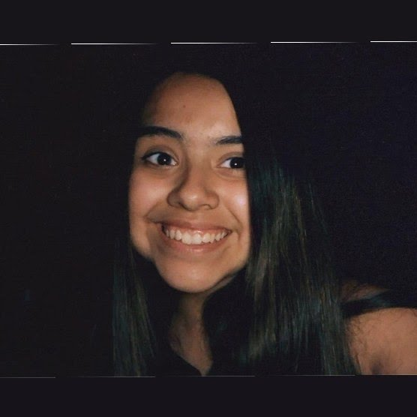
Dream Team
Each instructor was a great fit for our community groups.
Madeleine
Thomas
Jeanette
Alin
Mom whose children are in school so has mornings free to teach Homeschool Network
Moved to CO from TX and worked well with our Mom’s on teaching Parent/Child Classes
Tenured instructor who enjoys working with adults and adaptive swimmers working evenings and Saturdays
Multi-lingual instructor likes working with younger swimmers. LG Manager teaches in summer months

Slide 14
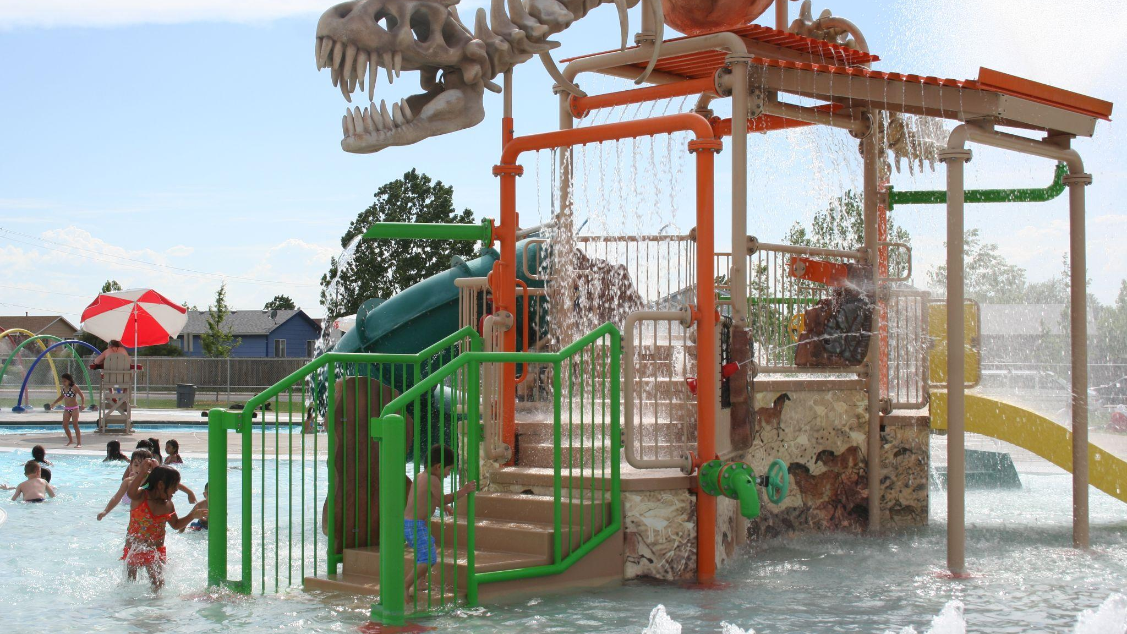
RODARTE
BOCES
Homeschoolers
WSI Aide
Junior Lifeguarding
ADULT
ADAPTIVE

Slide 15
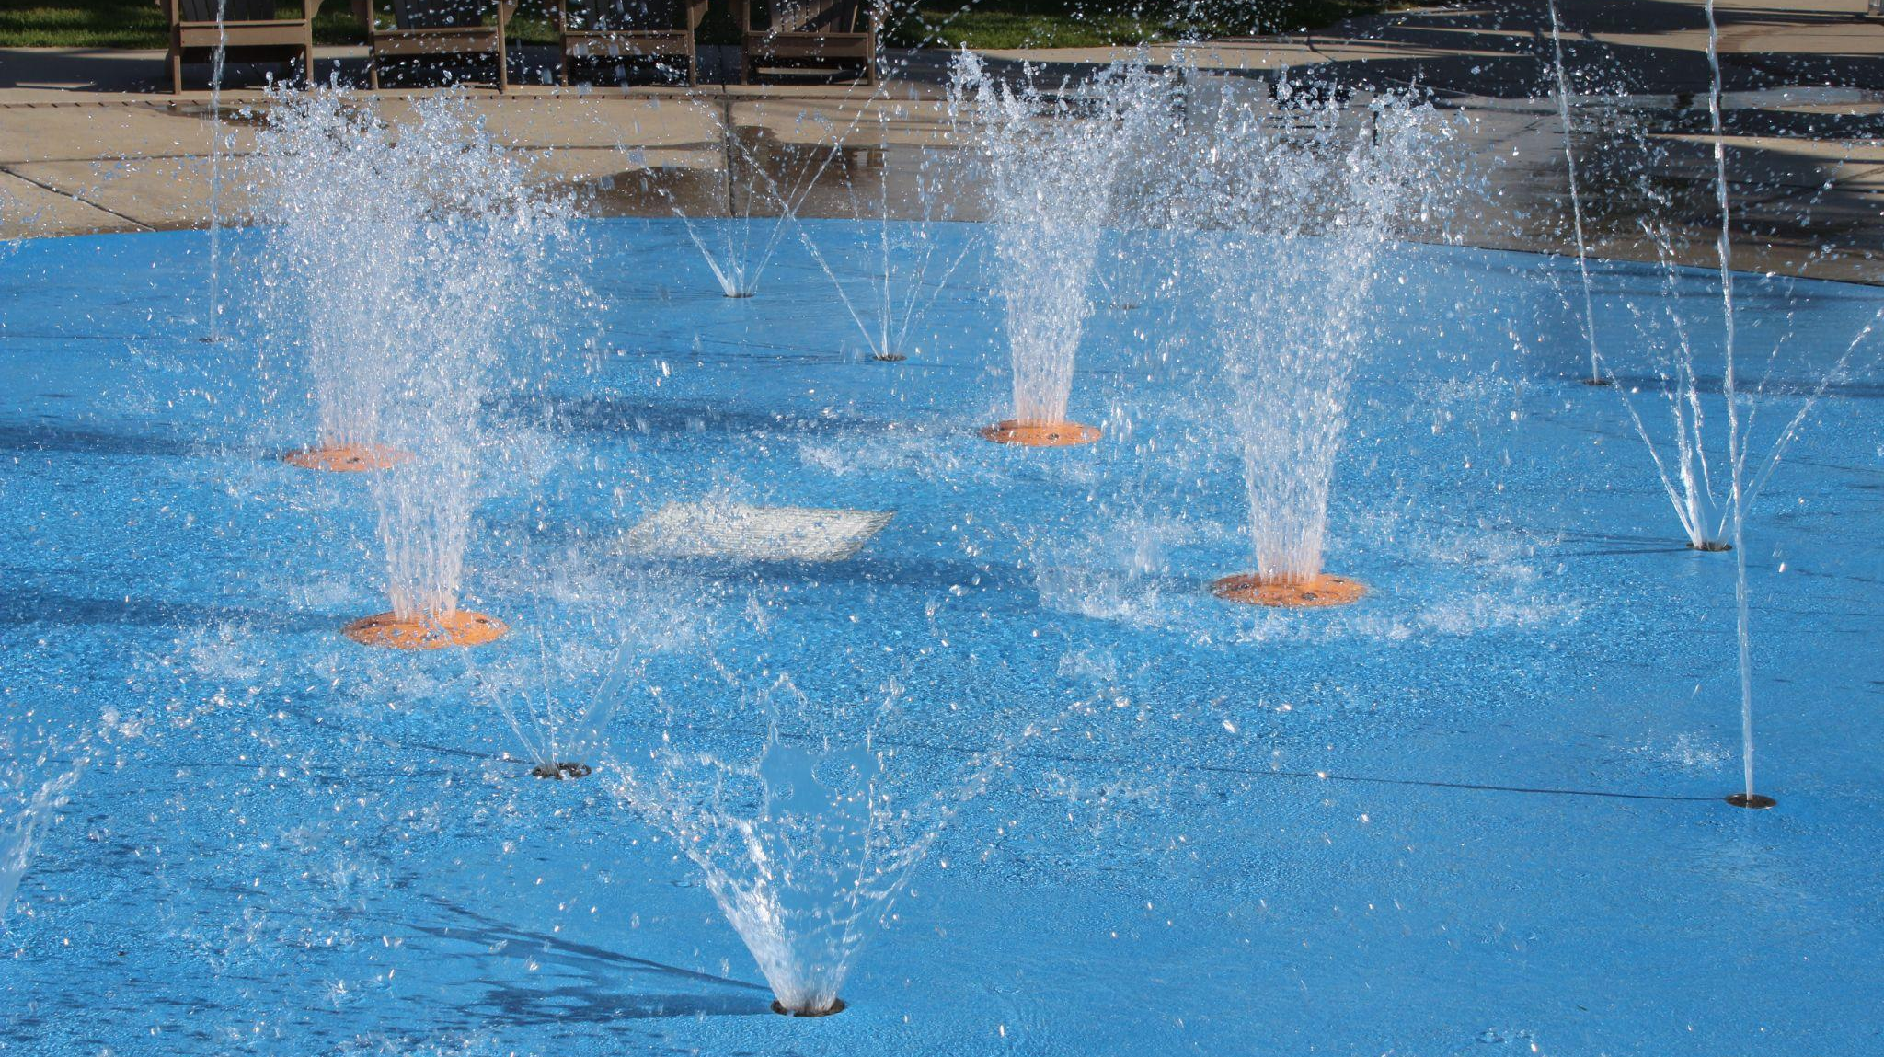
Where can we host each community group?
Indoor Pool- Homeschoolers, WSI Aide
Shallow/Deep - Adult, Adaptive
Warm Water - BOCES Families
Outdoor - Rodarte, Junior Lifeguarding

Slide 16
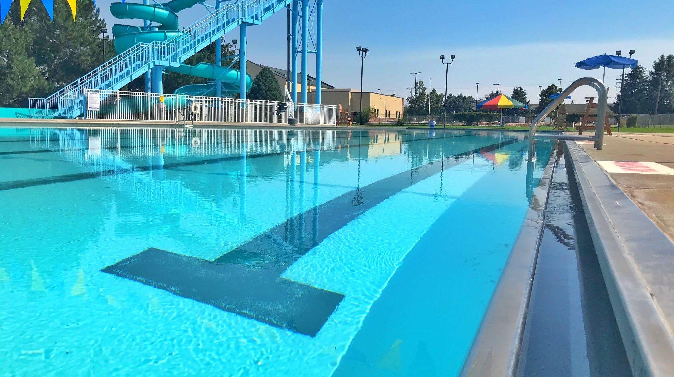
When is the best time to market to partners?
Fall - Homeschool Network
Winter - Adult, Adaptive
Spring - BOCES, WSI Aide
Summer - Rodarte, Junior Lifeguarding

Slide 17
When is the best time to schedule partners and programs?
January 2023
May 2023
August 2023
March 2023
June 2023
October 2023
Adult and Adaptive Lessons
WSI Aide
Junior Lifeguarding
Jan | Feb | Mar | Apr | May | Jun | Jul | Aug | Sept | Oct | Nov | Dec
BOCES Families
Rodarte Summer Program
Homeschool Network

Slide 18
Building Trust and Positive Interactions
Building Relationships Learning Water Safety
Expanding into New Markets
Recruitment/Hiring Pipeline
Why is it important
to make these connections?
What does the partner get?
What do we gain?

Slide 19
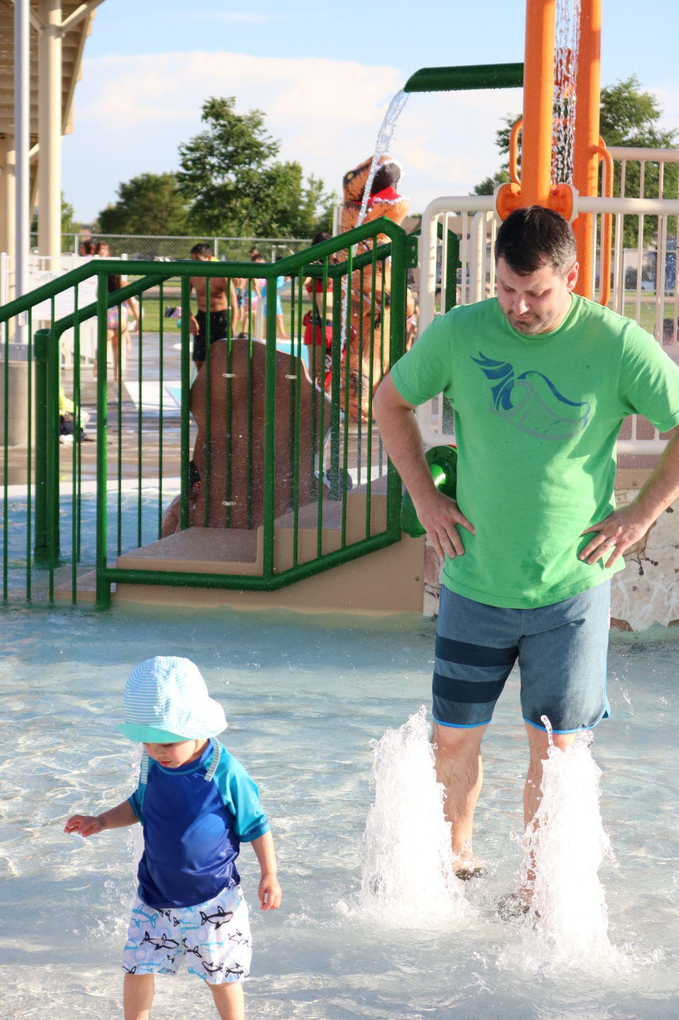
CONVERSATION
A. What resources are needed to meet expectations?
B. Marketing tools to introduce lessons?
C. Are you using your database to its full potential?

Slide 20
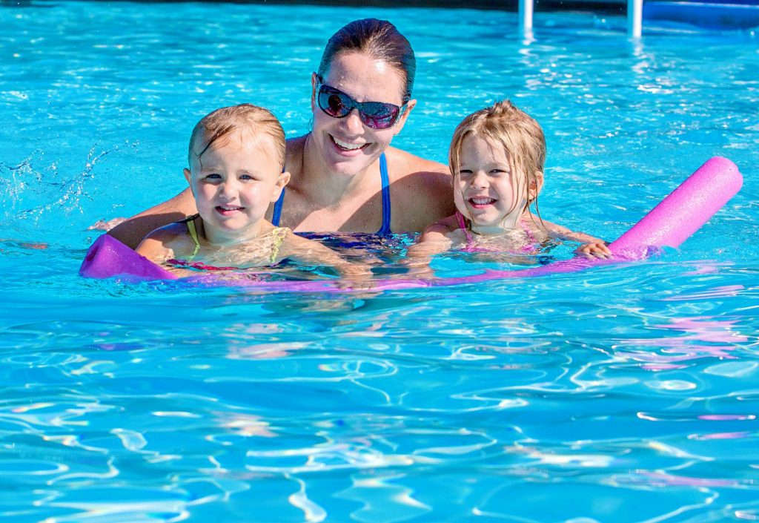
SHARE
A. What resources are needed to meet expectations?
B. Marketing tools to introduce lessons?
C. Are you using your database to its full potential?

Slide 21
Resources Needed to Meet Expectations
Seek funding sources such as grants and sponsorships
Cross collaborate with departments
Develop new ways to host
Ask for referrals and feedback

Slide 22

Marketing Toolkit
Post social media
Create Flyer template
Design Newsletter template
Start Email messaging
Develop Evaluation and Recruitment forms
https://swimwithjaimee.com/AOAP-Toolkit

Slide 23
Optimize Your CRM
Tap into past, current and prospective families
Schmooze your new ambassadors
Connect before, during, after lessons
Ask for referrals and feedback

Slide 24
Diversity. Equity. Inclusion
Are instructors mirroring participants
Actively sharing scholarship opportunities
Offering the same classes at each facility
Telling your story
Monitoring toys, equipment, visuals

Slide 25
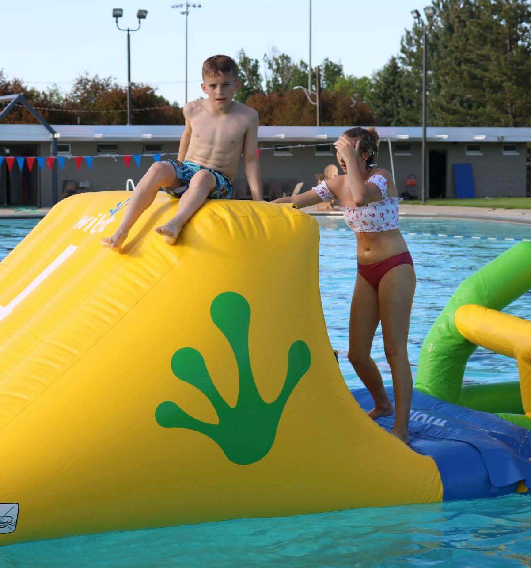
Outside of the Box
Offer classes in other languages
Merge cross-over classes (Aqua Aerobics/Preschool)
Provide class times fit attendee schedule
Offer other services they would like
Move forward with changes

Slide 26
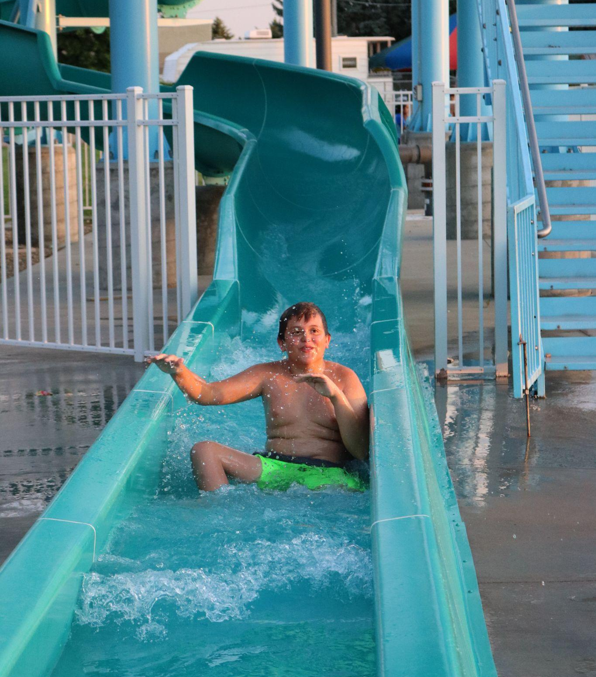
Ask. Evaluate. Learn.
Use survey/evaluation tool
Generate small group discussions
Follow-up
Try alternatives
Put dates on calendar

Slide 27
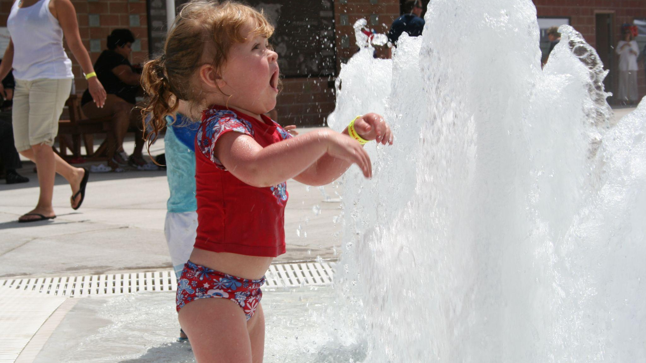
QUESTIONS?

Slide 28
Thank you for your attending
jaimee.borger@greeleygov.com
Cell 970-381-1380
Swimwithjaimee.com

