Slide 1

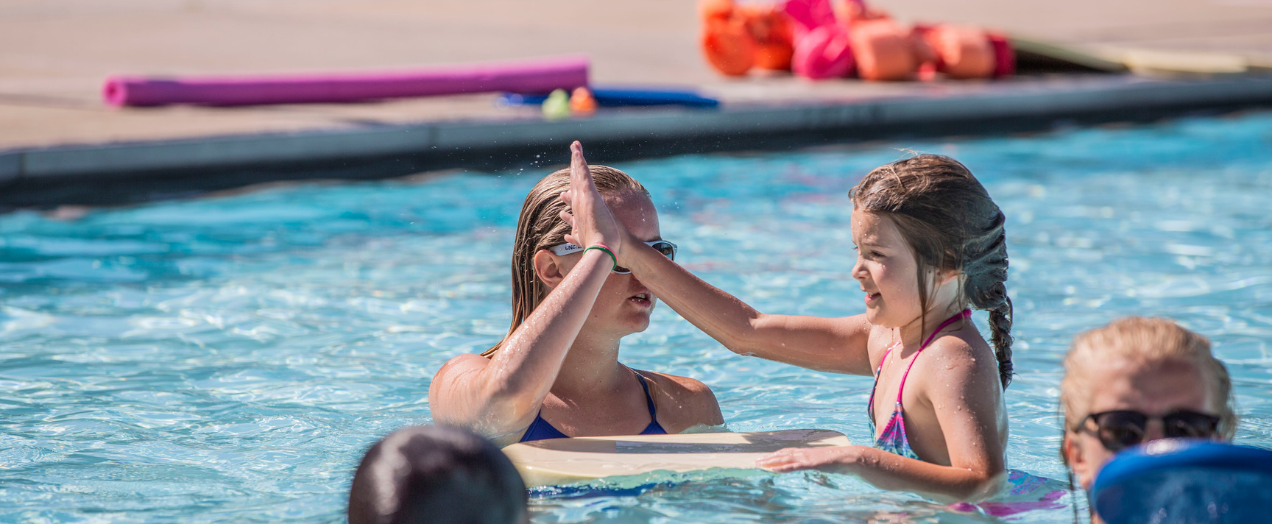


January 2024
Swimming and Water Safety News
Welcome to the Learn-to-Swim Program!
Rash Guards Are A Wise Choice
Formal swimming lessons offered through the City of Greeley reduce your child’s risk of drowning. Our certified Water Safety Instructors teach our community how to swim using the American Red Cross curriculum and methodologies. Learning how to swim is a basic life skill we want to help your family achieve.
It’s never too late to learn to swim! We have group lessons for children ages 6 months to 15 years. There are adult group lessons and private lessons available as well. Our staff will help swimmers of all ages and abilities with water adjustment and stroke development. The City also offers adaptive swim lessons for swimmers needing more specialized assistance. Check out our website for more information about the swimming lesson program.
Our pools serve multiple groups. Our air and water temperatures vary depending on the group. That is why we recommend rash guards for lessons. When your child is in the water remind them to keep their shoulders under the water to keep their core warm. A rash guard also helps to provide a layer of insulation of water between their skin and the fabric. This serves a warming layer. We want all swimmers to be comfortable in the water. Rash guards help!
Parent support is paramount
Children get their cues from their parents or guardians. If you smile and nod your head yes, your son or daughter will most likely do the same thing. When you are visible to your child during lessons, he or she wants your attention and praise. Please watch what we are doing in class so you can reinforce skills at home.
We want to encourage your child to progress through the swimming lesson levels. The more practice your son or daughter has outside of lessons, the better for their development. You can come to the pool during non-lesson hours and use the same equipment we use during lessons. If your child likes the pool noodle, please have him or her practice kicking, arm movements or jumping in using the pool noodle. (Please ask a lifeguard to borrow one if you don’t own one.)
We are grateful to have this time with your son or daughter in the water. Knowing you support their swimming lesson growth has positive implications. When you allow them to experience uncomfortable stages of learning, they grow as a person.
To Goggle or Not

Slide 2
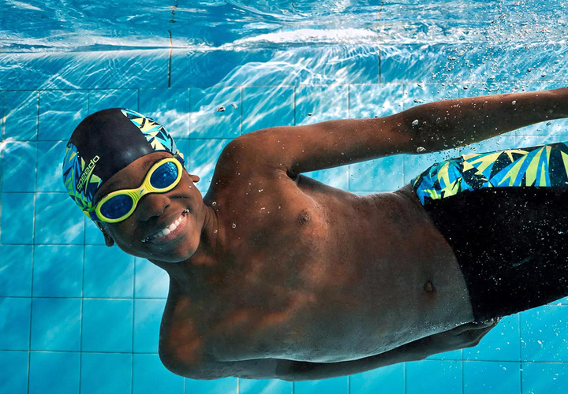
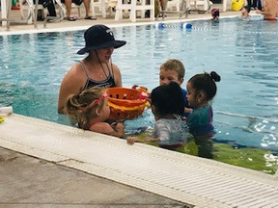
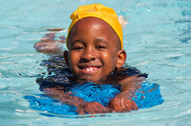
swim without goggles most of the time
“Drowning can happen even when children are not expected to be near water,” according to the Centers of Disease Control and Prevention. A child can fall into unsupervised pools, lakes, reservoirs and other bodies of water before you know it, most likely without their goggles. If that happens, can the swimmer come to the surface and pull themselves out of the water?
Learning to swim without goggles is important. If the swimmer has been in water multiple times without goggles, they have experienced what falling into the water looks and feels like. They know they can’t see clearly, but can open their eyes to find the wall, river’s edge or boat. When a swimmer falls into the water, we hope lessons prepared him or her to remain calm and to come to the surface, float on their back and make their way to the water’s edge to exit. If floating isn’t an option, we also teach bobbing in lessons, so they know how to “bob” to safety.
American Red Cross Learn to Swim program recommends children swim without goggles. They don’t always have to open their eyes underwater, but experiencing the water without goggles prepares them for those times swimming is needed, but goggles are not available. Getting used to opening their eyes underwater is a good thing.
roll call at lessons changes
We are trying a different format for calling swimmers to their class on the first day of lessons. Starting in January all instructors will hold up a card showing the level they are teaching. We will still call out the names of the swimmers in the class, but a list of instructors, the classes they are teaching and the times they are teaching will also be on each table in the pool area at the FunPlex and on the wall at the Rec Center. We hope these changes make it easier for your swimmer to find their teacher.
We're proud to offer you:
Be A Water Smart Family!
During each swimming lesson our instructors review a safety lesson talking about how to be safe around the water. These are lessons cover topics such as always swim with a buddy to thinking before you swim and always wearing a lifejacket when on a boat.
You should also always swim near a lifeguard or another adult who is responsible for watching you while you swim. A supervised swimming area is an area that has been made safe for swimming. It either:
  Has lifeguards on duty who have special training and equipment to help rescue a person from the water.
  Has an adult watching at all times who is responsible if an emergency occurs.
Swimming alone is dangerous. You never know what may happen. We hope you can reiterate to your family members to always swim as a pair—with a “buddy” (another person who can help you in case of an emergency).

