Slide 1
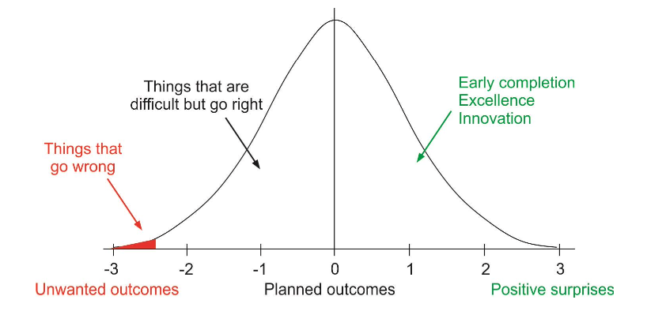
Safety 1 vs Safety 2
Relationship between event probability and safety focus
 | Safety 1 | Safety 2
Definition of Safety | As few things as possible go wrong | As many things as possible go right
Safety Management Principle | Reactive. Respond when something happens, or is categorized as an unacceptable risk | Proactive. Continuously trying to anticipate developments & events
HF View in Safety Management | People are seen as a liability or hazard; they are a problem to be fixed | People are seen as a resource necessary for system flexibility & resilience.
Accident Investigation | Accidents are caused by failures & malfunctions. Investigations look for cause. | Things happen in the same way, regardless of outcome. Learning looks for how things go right, to prevent things going wrong
Risk Assessment | Accidents are caused by failures & malfunctions. Investigations look for cause & contributory factors. | To understand the conditions where performance variability can become difficult or impossible to monitor & control.

