Slide 1
12 Steps for Culture Change – Edgar Schein
Edgar Schein studied the factors that are most important in shaping an organizational culture, and therefore the ones that are also most important for consciously shifting an organizational culture. The organizational culture is “the way we do things around here” – how people behave towards themselves and others. These are the twelve most important ones, in descending order of importance.
Primary Mechanisms – the major “tools” that leaders have available to them to teach their organizations how to perceive, think, feel, and behave based on their own conscious and unconscious convictions.
What a leader attends to, measures, rewards and controls is the main factor affecting culture
How leaders react to critical incidents and organizational crises (do you or they get defensive, go on the attack, support, blame?)
How leaders allocate resources
Deliberate role-modelling, teaching and coaching
How leaders allocate rewards and status
Criteria for recruitment, selection, promotion, performance management and dismissal
Secondary Mechanisms
Organizational design and structure
Organizational systems and procedures
Rites and rituals of the organization
10. Design of physical space and buildings
11. Stories and myths about key people and events
12. Formal mission statements, charters and ethical code
[From Edgar Schein, Organizational Culture and Leadership, 4th edition (2010)]
Edgar Schein (1928–2023) was an American psychologist and business theorist best known for his foundational work on organizational development and culture.

Slide 2
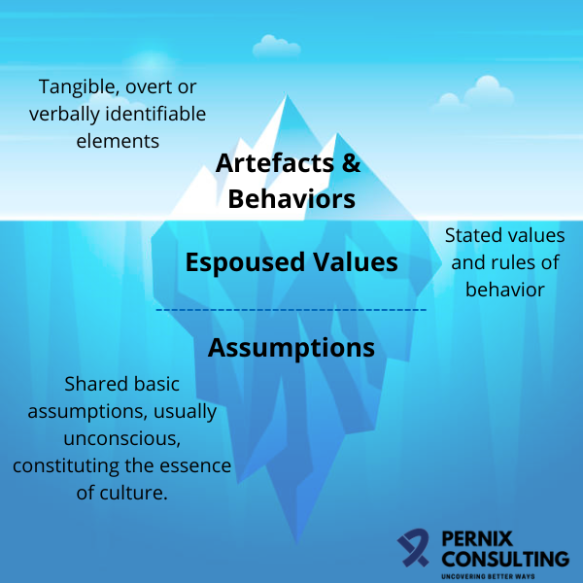
Organisational Culture – Edgar Schein
Artefacts: These are the surface-level manifestations of an organization’s culture, easily perceptible to anyone who steps inside. They are the visible aspects of culture, the things we can observe in an organization. Artifacts encompass tangible elements like the office layout, dress code, logos, and rituals. For instance, a company that encourages a casual dress code signals a relaxed and innovative atmosphere. These artifacts influence not only the physical environment but also the psychological climate within the organization.
Espoused Beliefs and Values: Beneath the surface, organizations have espoused beliefs and values that serve as guiding principles for decision-making. When employees share these beliefs, it creates a sense of alignment, making it easier to make decisions that are in harmony with the company’s mission and values. This level of culture has a significant impact on how leaders shape corporate culture and how employees perceive and interact with one another.
Basic Underlying Assumptions: The deepest and most potent level of culture is comprised of basic underlying assumptions. These are the unconscious beliefs and values that are rarely expressed openly. These assumptions shape how individuals within the organization perceive the world, and they are often resistant to change.

Slide 3
Organisational Culture – Edgar Schein
Artefacts & Behaviours:
Processes & procedures (e.g. HR requirements; Stop Work)
Office design
Dress code
Meeting structures & frequency
Espoused Beliefs & Values:
‘Leader in Seaborne Solutions’
Human Performance Principles
Speak Up Culture
Growth Mindset
Assumptions:
Safety is the top priority
People are valued and supported
Leaders listen and act in the best interests of staff

