Slide 1
Military Funeral Honors Program
Air Force and Space Force

Slide 2
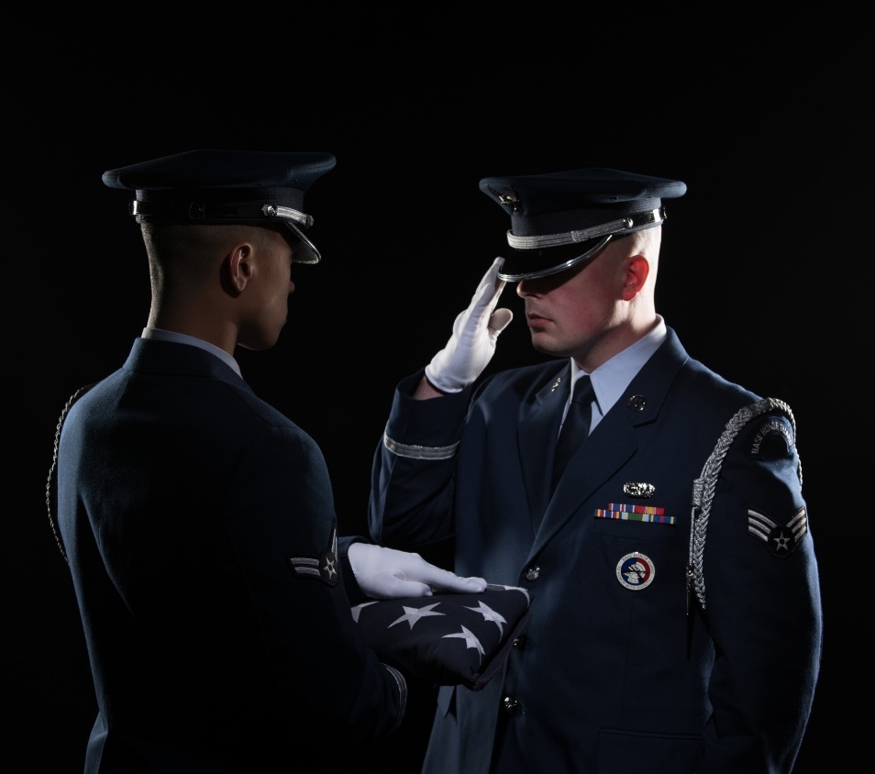
Air Force and Space Force
Military Funeral Honors Program Mission
Fulfilling our nation’s sacred commitment of ensuring dignity, honor and respect to our fallen, and care, service and support to their families

Slide 3
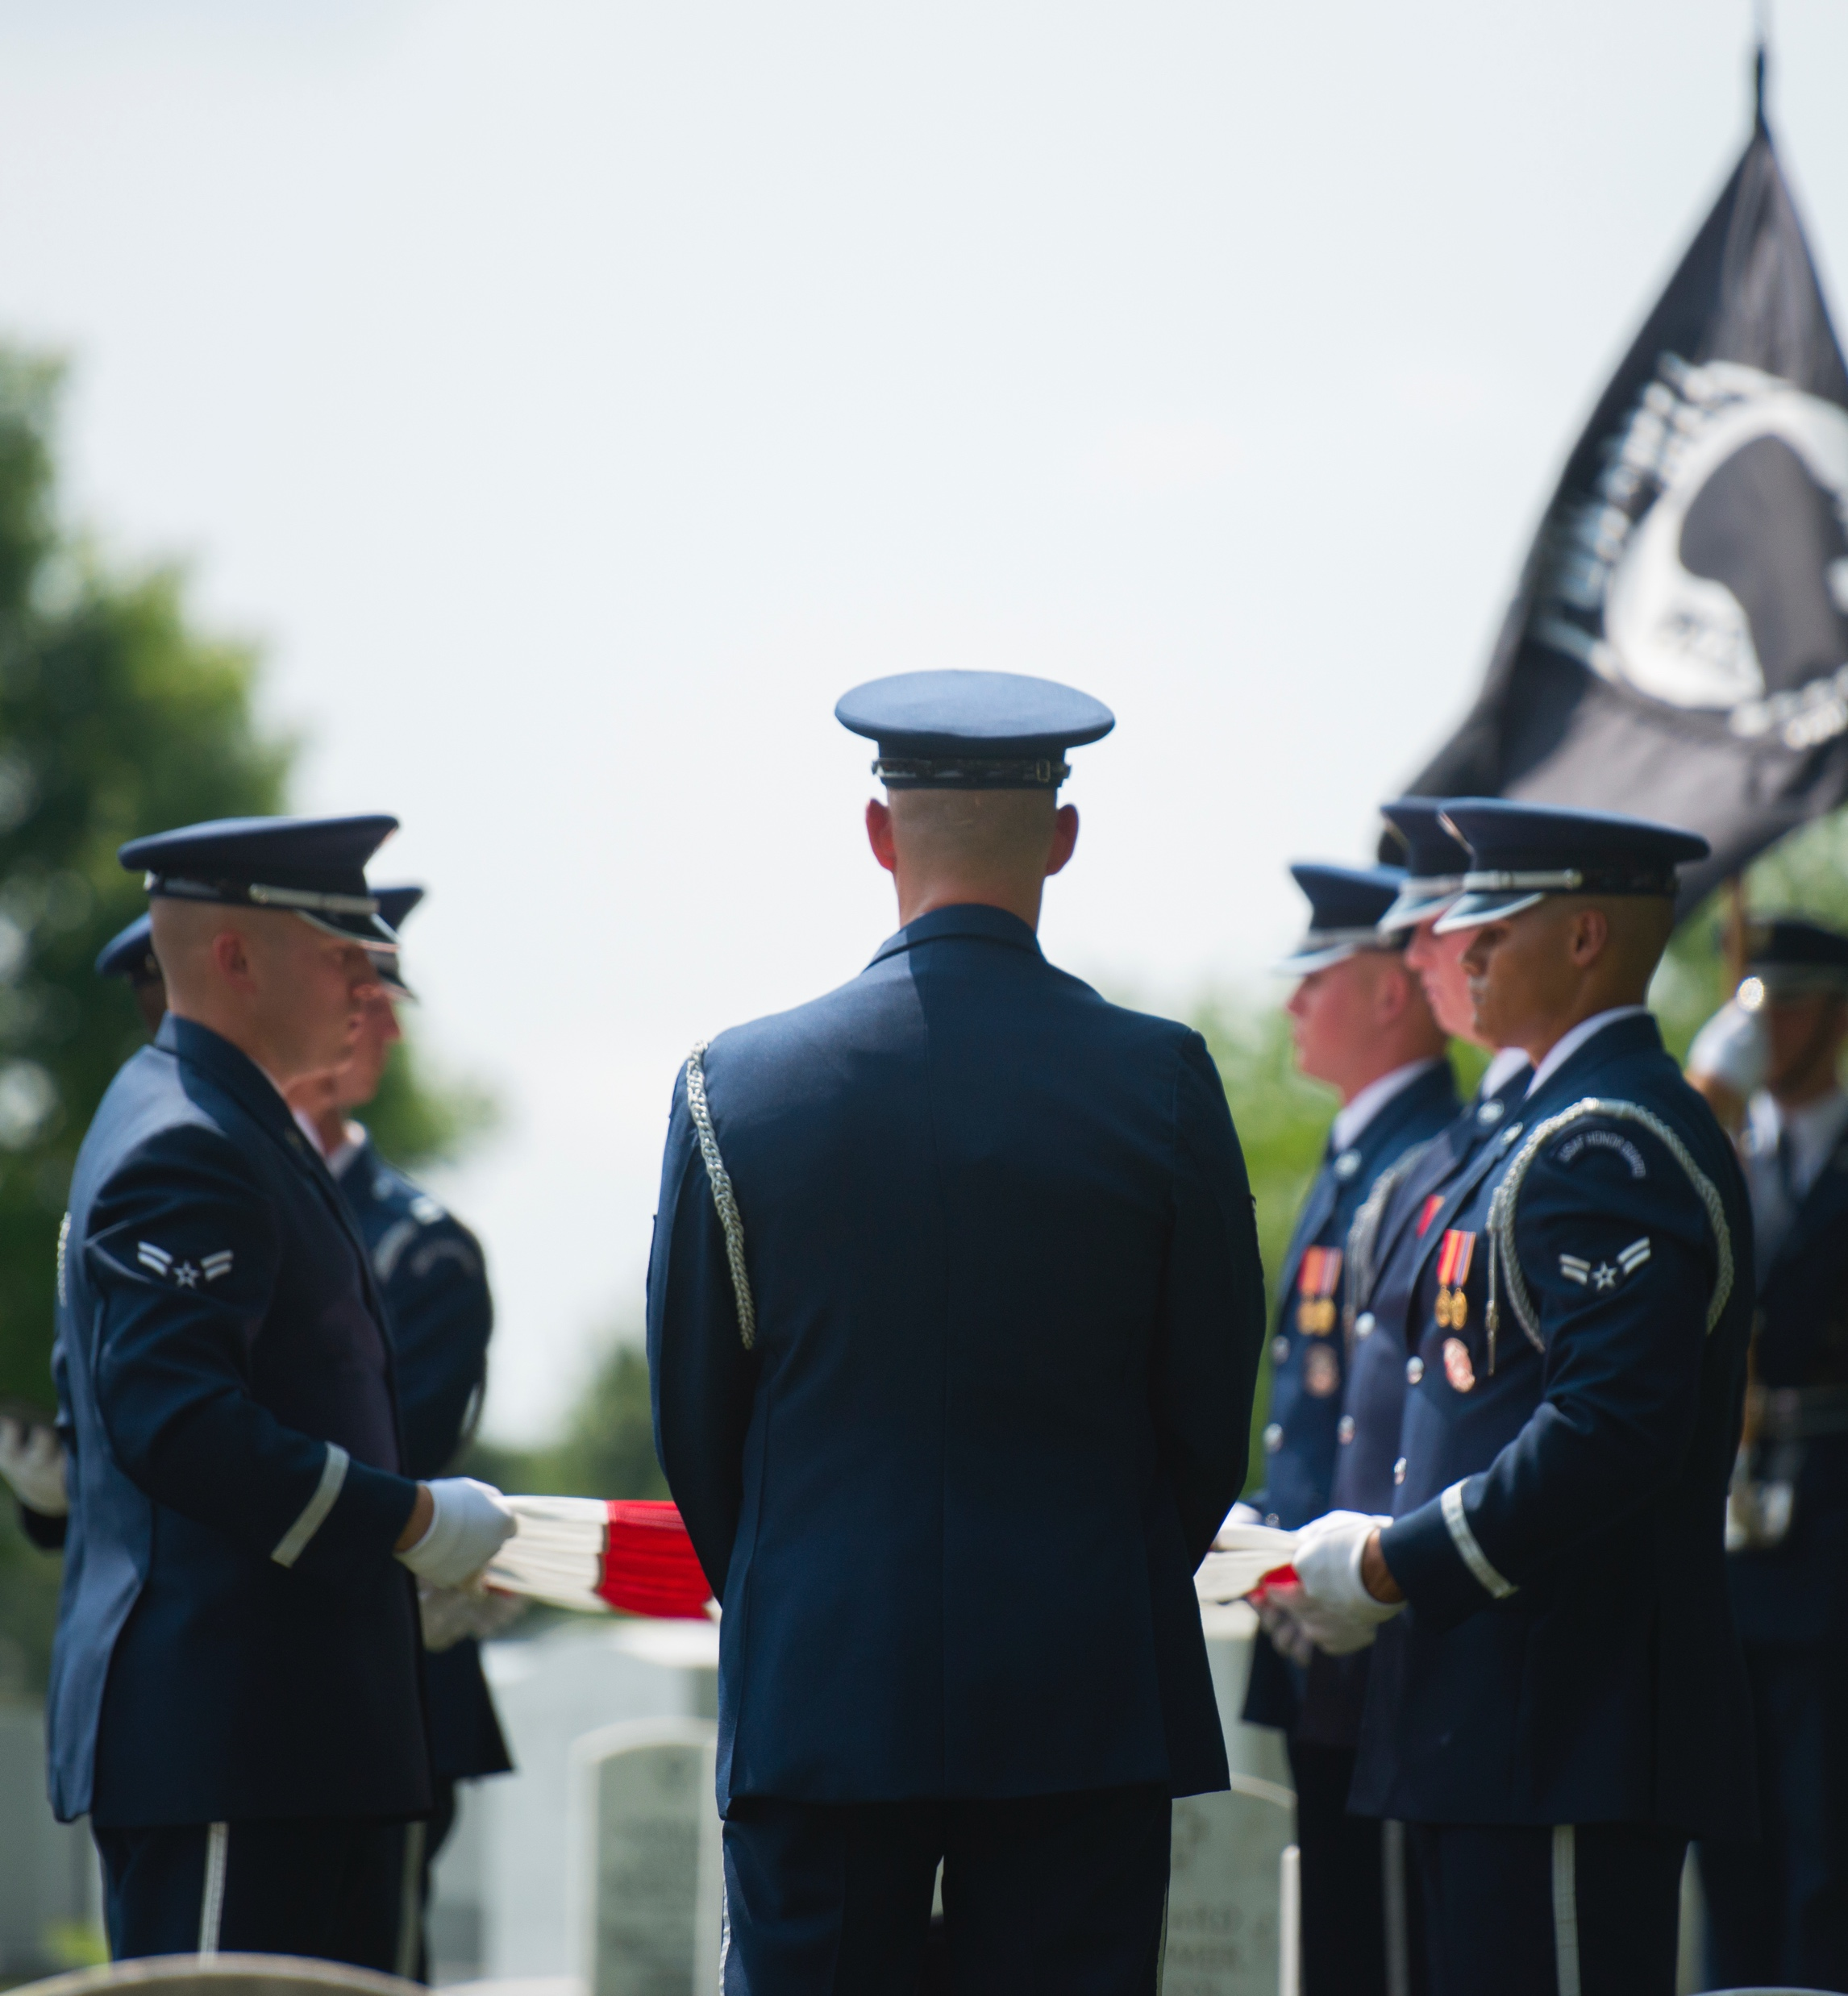
Overview: Military Funeral Honors Program
Military funeral honors support
Flyover request process
Military Funeral Honors Program statistics

Slide 4
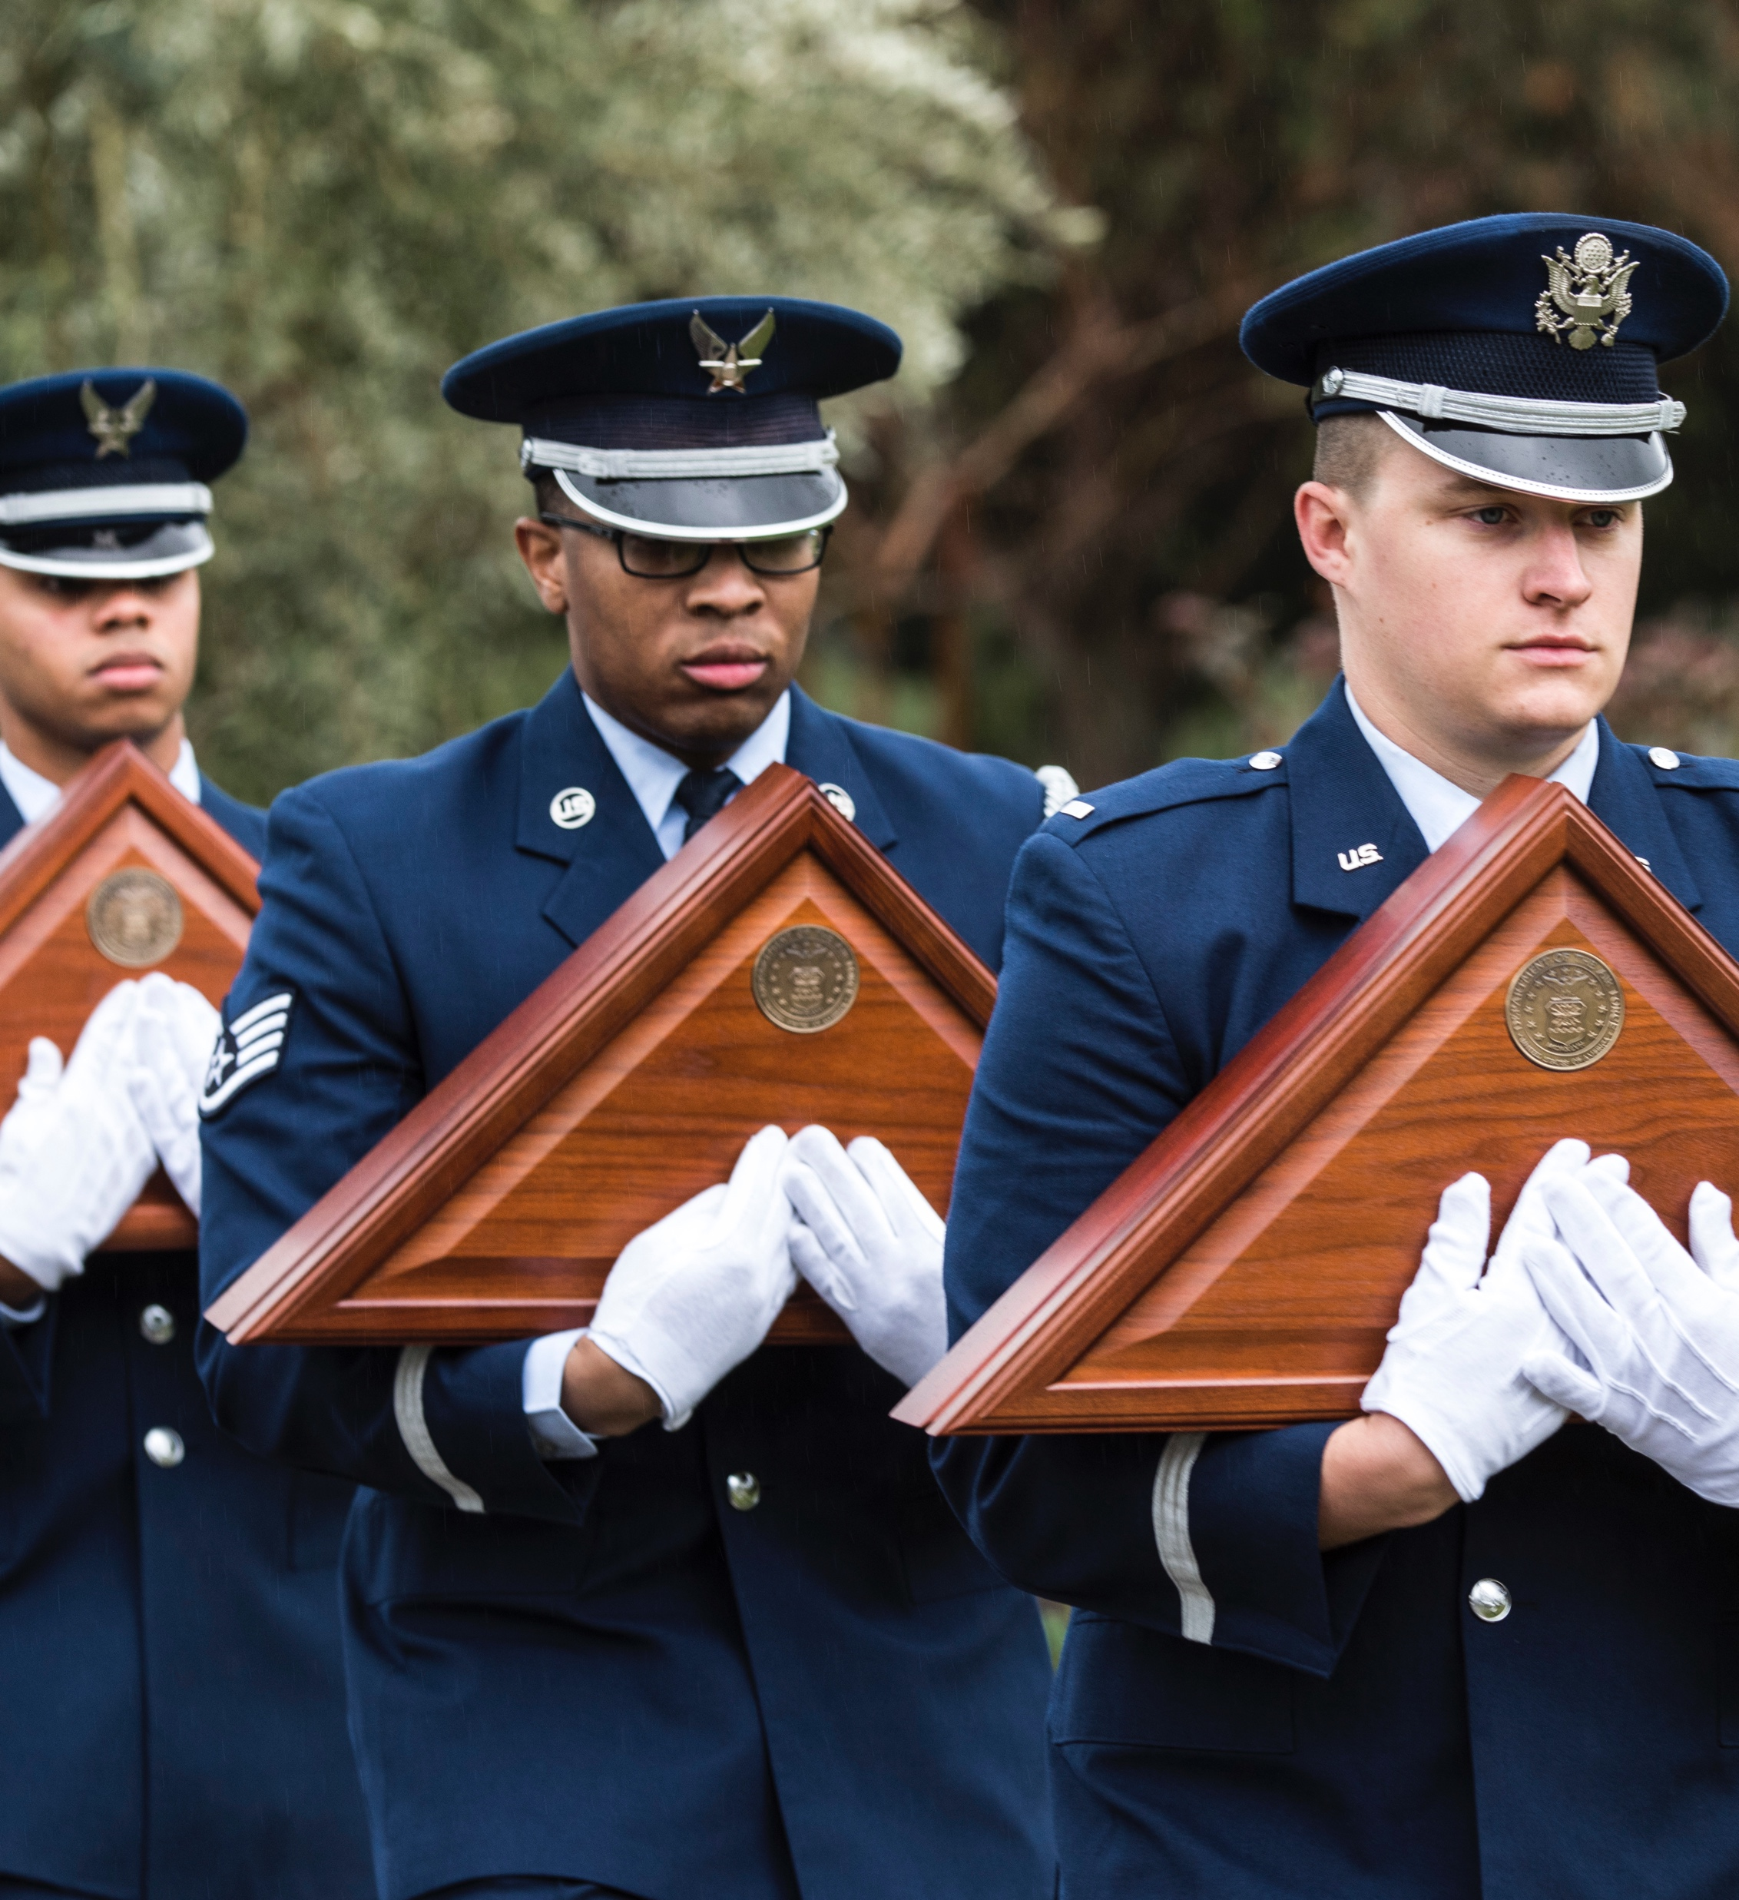
Military Funeral Honors Support
Full military funeral honors:
Consists of a seven- to 20-member honor guard team
      Three- to seven-person firing party
      Pallbearer support
      Color guard team (if available)
      Flag fold and offering of condolences*
      Playing of Taps
      * The Air Force or Space Force base providing honors will provide flags and flag cases to all entitled family members. (Hardwood cases will be presented to all entitled recipients.)
      Dignified arrival: seven-person honor guard team
      Only applies to casketed remains transported via aircraft to the final-destination airport
    Cremated remains will be transported by a military escort

Slide 5
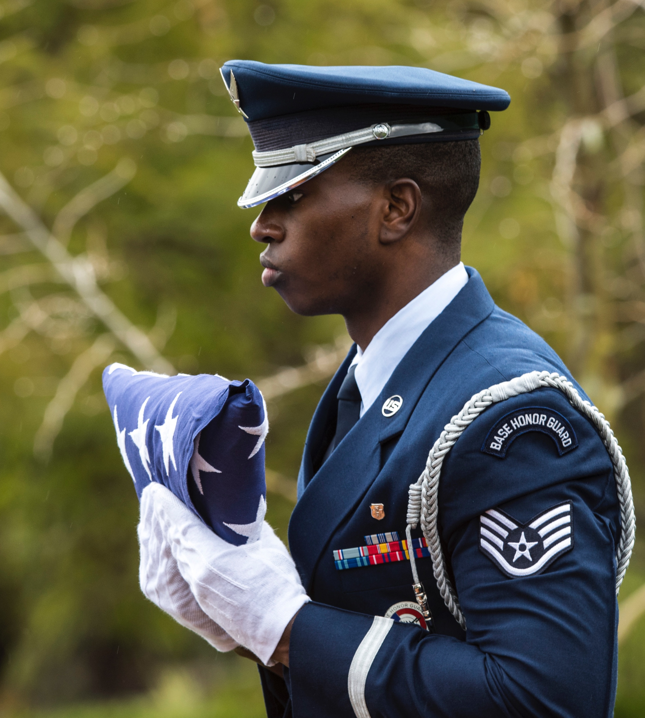
Military Funeral Honors Support continued
Retiree and veteran military funeral honors support:
Retirees: two- to seven-person detail
      Three-person firing party (if available)
      Pallbearer support (if available)
      Flag fold and offering of condolences*
      Playing of Taps
    Veterans: two-person detail
      Flag fold and offering of condolences*
      Playing of Taps
* Air Force and Space Force representatives (officer and/or enlisted) will fold and present the interment flag to the next of kin or designated representative. (The U.S. interment flag is not provided by the servicing honor guard team.)

Slide 6
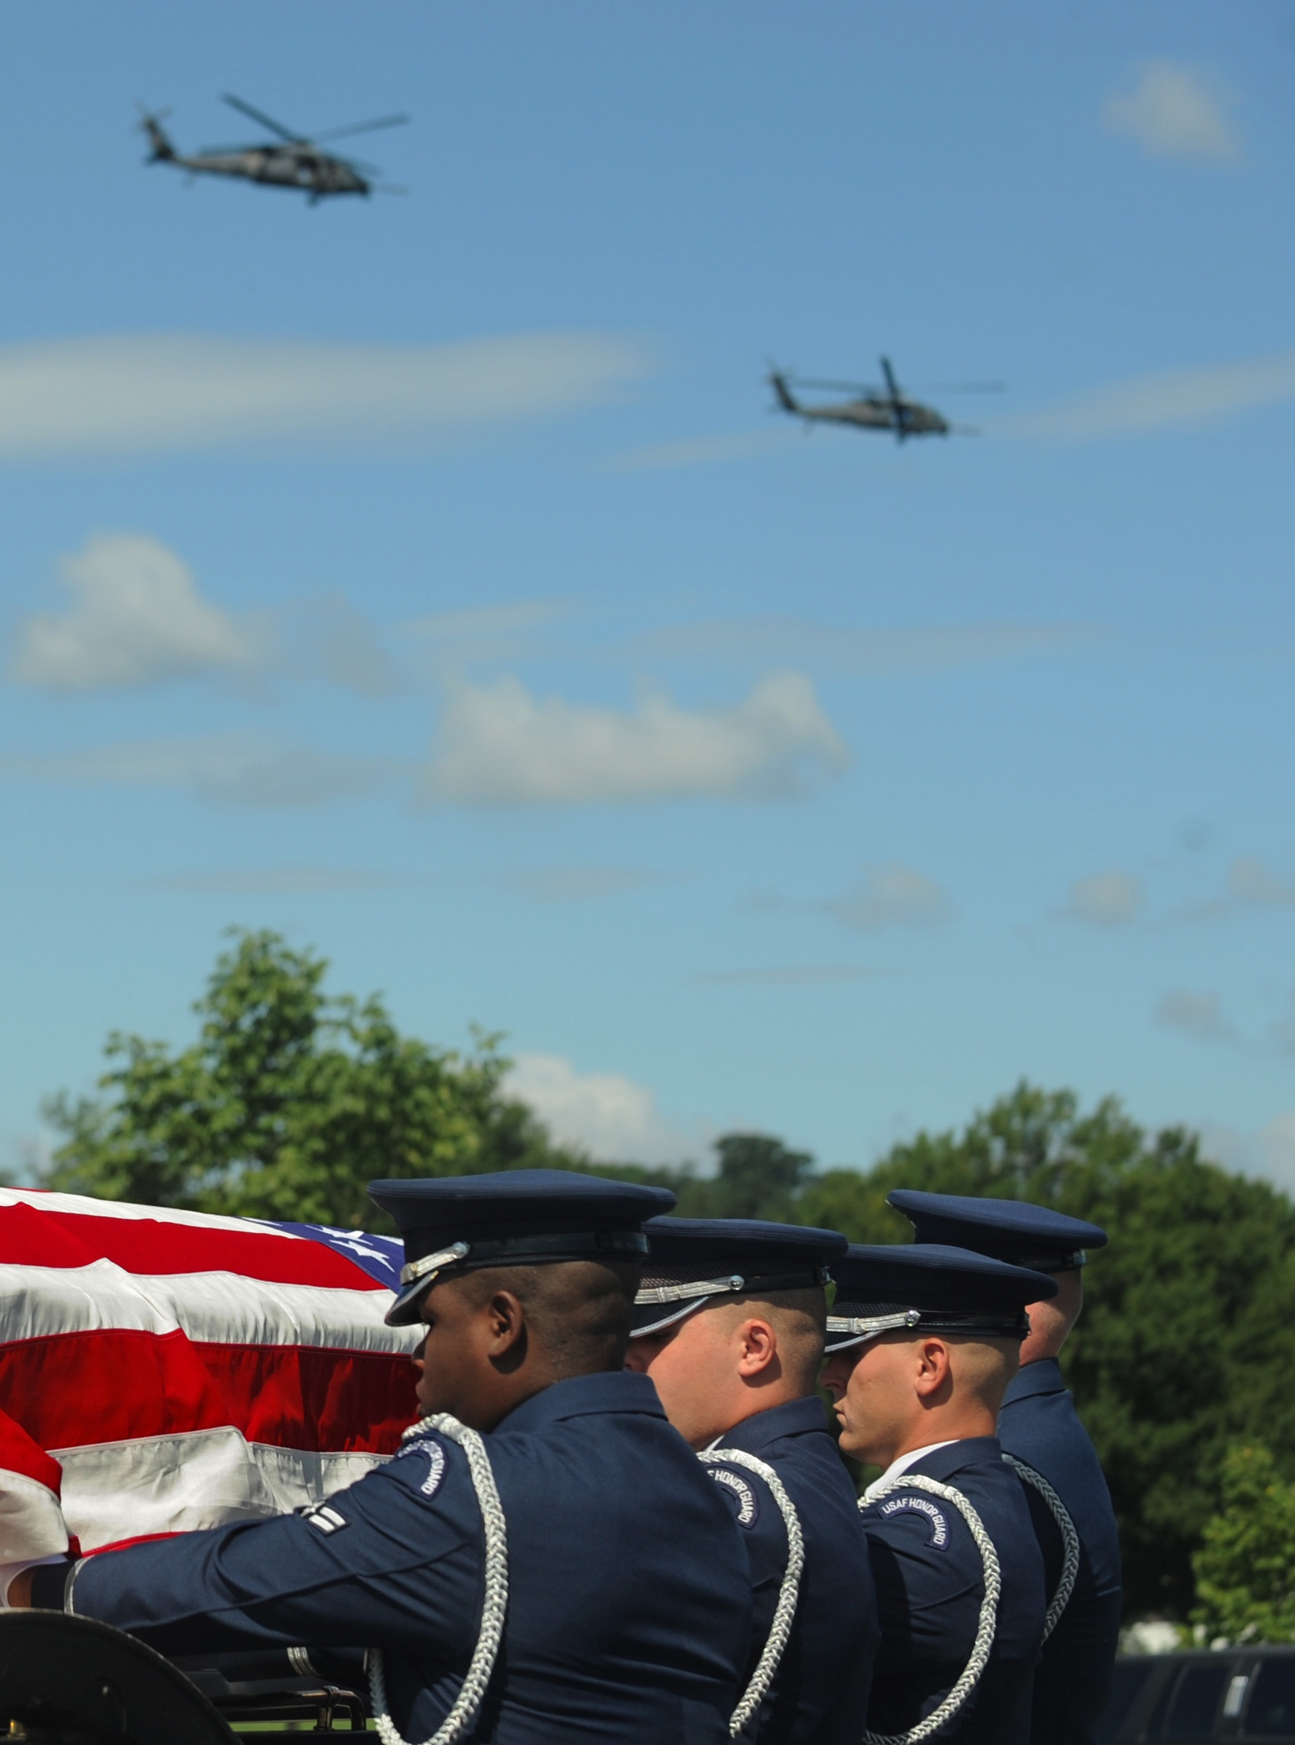
Flyover Request Process - 1 of 3
Person authorized to direct disposition, next of kin or funeral home requests flyover:
Make your request as early as possible, but no later than seven business days before the flyover date
Check eligibility through an Air Force mortuary officer, honor guard team or Air Force Mortuary Affairs Operations representative
Know that flyovers may be limited or not included in the ceremony depending on the availability of aircrew/aircraft, the weather, funeral location and/or operational commitments
Any aircraft can fulfill a flyover request.

Slide 7
Flyover Request Process - 2 of 3
Active duty/retired four- and five-star general officers regardless of aeronautical rating
Medal of Honor, Air Force Cross, Army Distinguished Service Cross or Navy Cross recipients
Air Force aviators who have achieved one or more officially recognized aerial victories
Air Force members (active duty, retired or honorably separated) who were prisoners of war
Active or retired chief master sergeants of the Air Force
Active-duty or currently-serving Reserve Component rated officers
Career enlisted aviators (1AXXX enlisted crewmembers, i.e., flight engineers, loadmasters, boom operators, etc.)

Slide 8
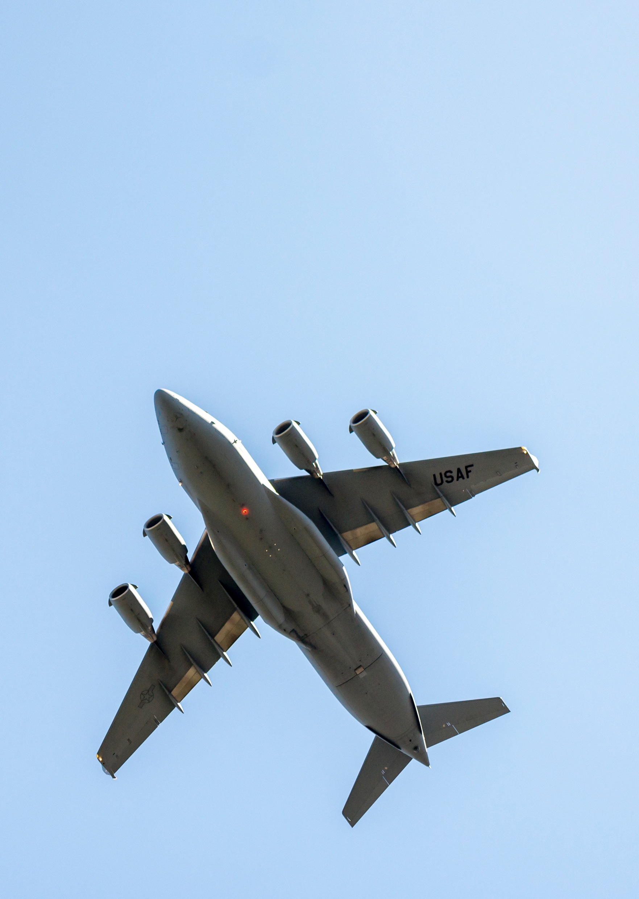
Flyover Request Process - 3 of 3
      Flyover request package must include:
        DD Form 214
        Biography
        Letter signed by the next of kin or requester
      Letter will include:
        Name, address and phone number of the requester
        Location, date and time of service
      Exception to policy requests are:
        Based on appropriate use of limited resources
        Considered only for service marked by valor or heroism
Email package to: AFMAO.HG.honorguard@us.af.mil

Slide 9
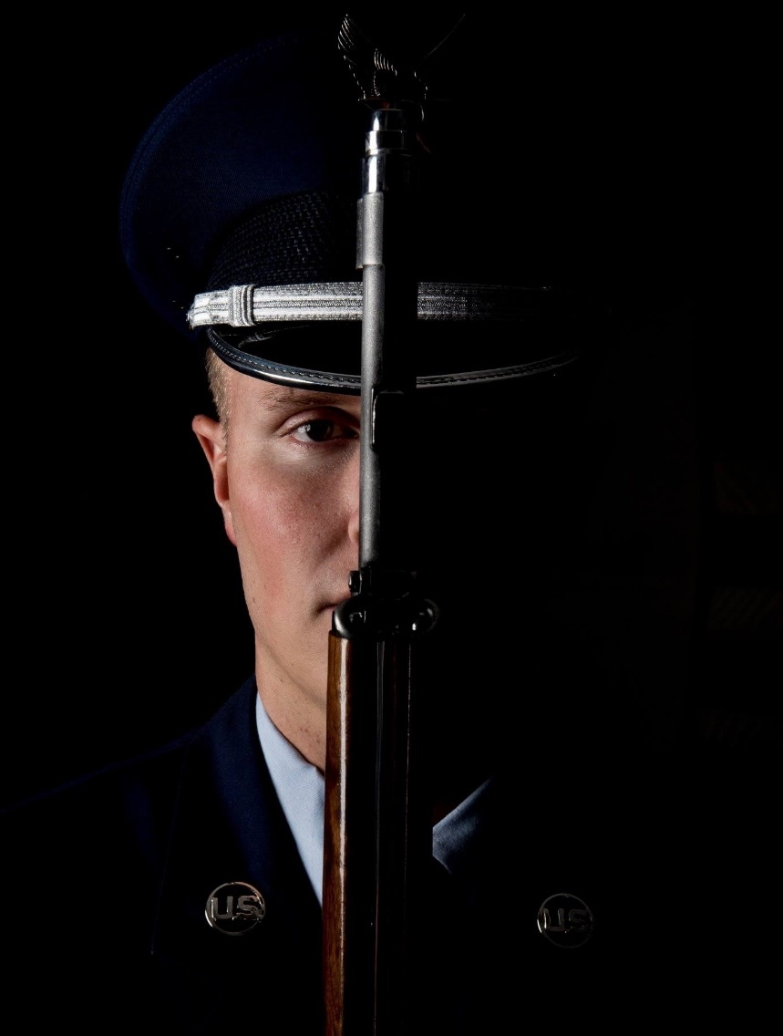
Military Funeral Honors Program Statistics
141 base honor guards
Oversight is by state/county
Visit www.militaryonesource.mil for base honor guard support in your state
Or call 800-531-5803, Option 2
Funeral honors supported (annual average):
      Active duty: 200
      Retirees: 10,000
      Veterans: 30,000
      Air Force flyover requests (annual average):
    Eligible veterans: 70
    Exception to policy veterans: 60

Slide 10

Contact:
For additional information and resources related to the Military Funeral Honors Program, including Air Force and Space Force Military Funeral Honors Program frequently asked questions, visit MilitaryOneSource.mil or call 800-342-9647.

