Slide 1
:
Y1 Art and Design 2019-2020 - Designers
How can I represent myself using art?
:
:
Aspect of Study
Skills needed for self-portrait.
Transferable Knowledge:
Understanding what makes them unique - PSHE.
Music - Instruments and musical language
National Curriculum Overview of Programme of Study
Art, craft and design embody some of the highest forms of human creativity. A high-quality art and design education should engage, inspire and challenge pupils, equipping them with the knowledge and skills to experiment, invent and create their own works of art, craft and design. As pupils progress, they should be able to think critically and develop a more rigorous understanding of art and design. They should also know how art and design both reflect and shape our history, and contribute to the culture, creativity and wealth of our nation.
During Year 1 students should be taught to:
Explore line and pattern.
Begin to use a range of materials creatively.
Represent their personal experiences through drawing, painting and sculpture.

Slide 2
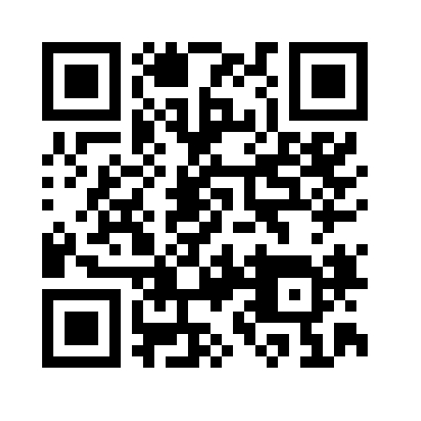
:
Parental Support page
:
:
Places to visit/things to do at home:
Drawing using a mirror
Old school gallery – Alnmouth
Look at family members and draw a picture that reminds them of that person.
Books and websites to support with learning:
What I Like about Me by Allia Zobel Nolan
The Colors of Us by Karen Katz
All the Colors of the Earth by Sheila Haman
Whoever You Are by Mem Fox
Influential Figures
Van Gogh (Portrait artist)
Andy Warhol (Portrait artist)
Frida Kahlo (Portrait Artist)
Pablo Picasso (Portrait work)
Try this QR code for a portrait
lesson you can do at home with
your child.
Knowledge, skills and understanding covered in this unit:
Begins to explore tone using different grades of pencil, pastel and chalk.
Begins to explore and recreate patterns and textures with an extended range of materials.

Slide 3
Key vocabulary | Concepts | Language skills
Self-portrait Line Texture Pencil Artist Shape Space Pop art Cubism Colour wheel Primary colours Secondary colours Colour mixing Symmetry | Reflection Silhouettes | Developing a personal response to others artwork and give an opinion in a sensitive manner.

Slide 4
Sequence of Teaching and Learning
 | National Curriculum LO/EQ?
1 | NC OBJ: Learn about the work of a range of artists. E.Q: Which famous artists have worked with self portraiture?
2 | NC OBJ: Learn about the work of a range of artists. To use drawing, painting and sculpture to develop and share their ideas, experiences and imagination. E.Q: Can I create pieces of art in the style of famous artists I have studied?
3 | NC OBJ: to use drawing, painting and sculpture to develop and share their ideas, experiences and imagination. E.Q: What does my reflection say about me?
4 | NC OBJ: To use drawing, painting and sculpture to develop and share their ideas, experiences and imagination. E.Q: How can you use Primary colours to create a range of other colours, tones and shades.
5 | NC OBJ: to develop a wide range of art and design techniques in using colour, pattern, texture, line, shape, form and space. L.O: To represent myself through a self-portrait using line and tone.
6 | NC OBJ: to use drawing, painting and sculpture to develop and share their ideas, experiences and imagination E.Q: How can you represent yourself using different materials?

Slide 5
 | National Curriculum LO/EQ?
7 | NC OBJ: to use drawing, painting and sculpture to develop and share their ideas, experiences and imagination to develop a wide range of art and design techniques in using colour, pattern, texture, line, shape, form and space E.Q: How can silhouettes be used to create a self-portrait?
8 | NC OBJ: to use drawing, painting and sculpture to develop and share their ideas, experiences and imagination to develop a wide range of art and design techniques in using colour, pattern, texture, line, shape, form and space L.O: To create a final piece that represents yourself.

