Slide 1
PREPARED BY
Clifton Dowers
KI4PHP
ki4php.dmr@fastmail.net
Kentucky DMR Repeaters • Radio Programming
CONTACT
1-270-402-9800 • peavy79@gmail.com
Kentucky DMR • Lebanon, Kentucky, United States
1-270-402-9800 • peavy79@gmail.com • www.Kentuckydmr.com

Slide 2
Slide Index
Slide numbers reflect the current deck order.
CONTACT & REPEATERS
WEATHER & HOTSPOTS
TRUCK HOTSPOT & PHOTOS
01 Prepared by / contact
02 Slide index
03 Maysville DMR programming
04 Maysville talk groups
05 Brooksville DMR programming
06 Brooksville talk groups
07 Prepared by / contact
08 NKARC K4CO quick reference
09 GARC W8STZ quick reference
10 KY4HS MARS quick reference
11 W8MRC Milford quick reference
12 W8MRC Milford WIRES-X 145.450
13 WB4N Mason County quick reference
14 NE4ST SCARES quick reference
15 KY severe storm weather net
16 Kansas City Wide digital links
17 Nearby repeaters within 27.3 miles
18 My hotspots & WIRES-X info
19 WIRES-X room access
20 Office hotspot configuration
21 Office hotspot — TAC zone
22 Office hotspot — Office zone
23 Office hotspot — states zone
24 Office hotspot — world-wide zone
25 Office hotspot — TGI network zone
26 Truck hotspot configuration
27 Truck hotspot — TAC zone
28 Truck hotspot — Truck zone
29 Truck hotspot — states zone
30 Truck hotspot — world-wide zone
31 Truck hotspot — TGI network zone
32 Hotspot / WIRES-X photos
Kentucky DMR • Lebanon, Kentucky, United States • 1-270-402-9800 • peavy79@gmail.com • www.Kentuckydmr.com

Slide 3
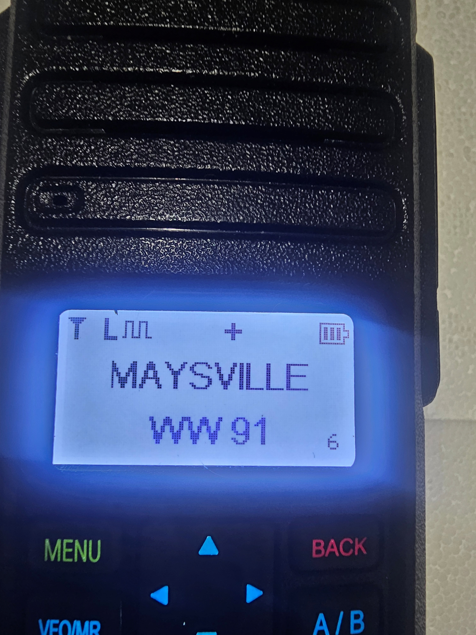
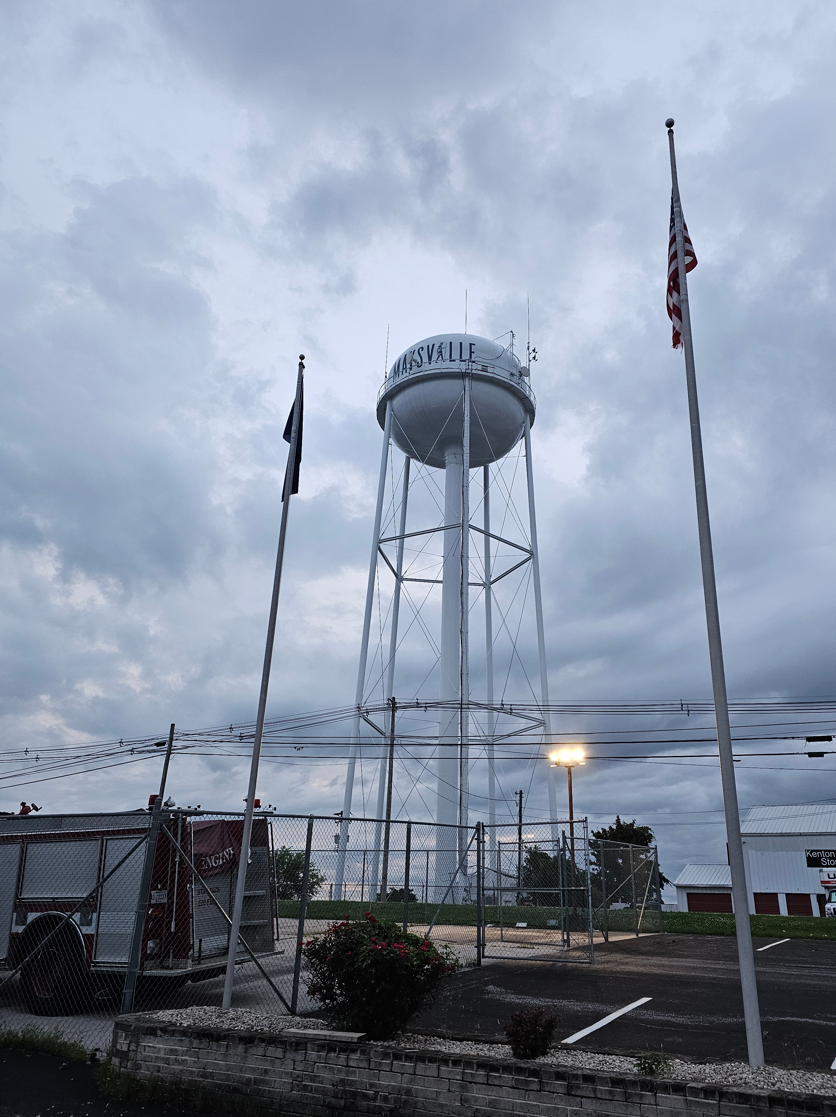
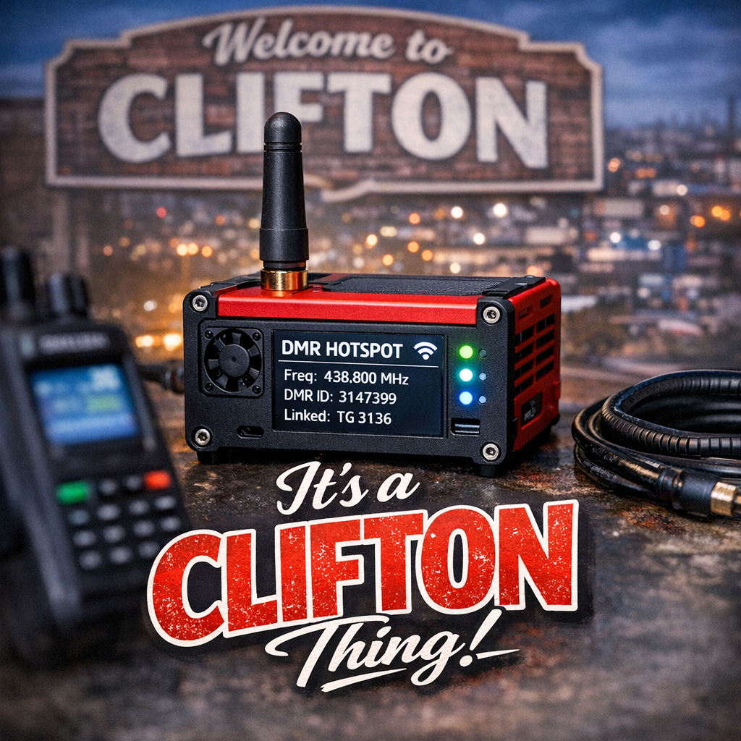
Baofeng DR-1801UV
Maysville Ky DMR
444.550 N1DTA
Operation Steps
Step Power On
Hit Menu Button
Scroll to Zone.
Select MAYSVILLE Hit Menu Button.
Hit back Button.
Use only the up and down arrows to change Talk groups..
Enjoy
More Info www.Kentuckydmr.com
Kentucky DMR • Lebanon, Kentucky, United States
1-270-402-9800 • peavy79@gmail.com • www.Kentuckydmr.com
Notes:
Freq 444.550 + 5

Slide 4
Maysville, KY DMR — Talk Groups
N1DTA Repeater • 444.550 (+5) • Color Code 1
TIME SLOT 1
Talk Group | TG ID
KY | 3121
US | 3100
KY TAC | 31214
MW Regional | 3169
North America 3 | 3
North America 93 | 93
Worldwide 1 | 1
Worldwide 91 | 91
Worldwide Eng | 13
TIME SLOT 2
Talk Group | TG ID | Talk Group | TG ID
IL State | 3117 | XLX Multiprotocol | 3121232
IN State | 3118 | AL State | 3101
KY ARES | 31211 | Baynet | 31075
KY DMR Local | 2 | CA State | 3106
MD State | 3124 | East Kentucky | 31213
MO State | 3129 | OH State | 3139
PA State | 3142 | TX State | 3148
Parrot | 9998 | Local 9 | Somerset link
TAC | 310–319 | FL State | 3112
TN State | 3147 | Net 1 | 31001
VA State | 3151 | Ken-Tenn | 311035
WV State | 3154
QUICK REFERENCE
Frequency: 444.550 (+5 offset)
Color Code: 1
Zone: MAYSVILLE
Parrot 9998 = audio test
Local 9 links to Somerset
Kentucky DMR • Lebanon, Kentucky, United States
1-270-402-9800 • peavy79@gmail.com • www.Kentuckydmr.com

Slide 5
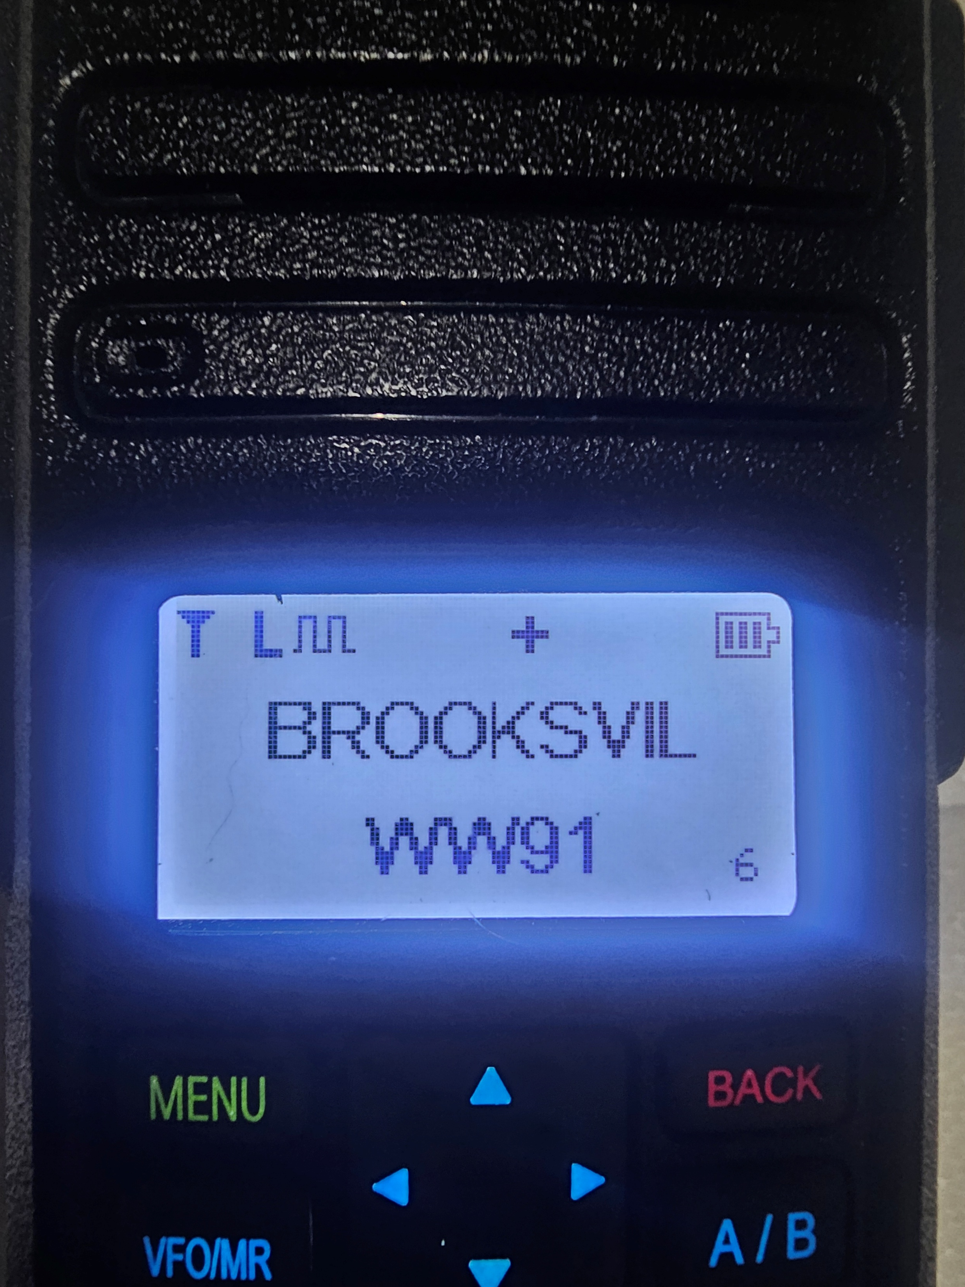

Baofeng DR-1801UV
Brooksville Ky DMR
443.7125 (+5)
Operation Steps
Step Power On
Hit Menu Button
Scroll to Zone.
Select BROOKSVILLE Hit Menu Button.
Hit back Button.
Use only the up and down arrows to change Talk groups..
Enjoy
More Info www.Kentuckydmr.com
REPEATER INFO
Location: Brooksville, KY
Frequency: 443.7125 (+5 offset)
Color Code: 1
Zone: BROOKSVILLE
Talk groups: see next slide
Kentucky DMR • Lebanon, Kentucky, United States
1-270-402-9800 • peavy79@gmail.com • www.Kentuckydmr.com

Slide 6
Brooksville, KY DMR — Talk Groups
Brooksville Repeater • 443.7125 (+5) • Color Code 1
TIME SLOT 1
Talk Group | TG ID
KY | 3121
US | 3100
KY TAC | 31214
MW Regional | 3169
North America 3 | 3
North America 93 | 93
Worldwide 1 | 1
Worldwide 91 | 91
Worldwide Eng | 13
TIME SLOT 2
Talk Group | TG ID | Talk Group | TG ID
IL State | 3117 | XLX Multiprotocol | 3121232
IN State | 3118 | AL State | 3101
KY ARES | 31211
KY DMR Local | 2 | CA State | 3106
MD State | 3124 | East Kentucky | 31213
MO State | 3129 | OH State | 3139
PA State | 3142 | TX State | 3148
Parrot | 9998 | Local 9 | Somerset link
TAC | 310–319 | FL State | 3112
TN State | 3147 | Net 1 | 31001
VA State | 3151 | Ken-Tenn | 311035
WV State | 3154
QUICK REFERENCE
Frequency: 443.7125 (+5 offset)
Color Code: 1
Zone: BROOKSVILLE
Parrot 9998 = audio test
Local 9 links to Somerset
Kentucky DMR • Lebanon, Kentucky, United States
1-270-402-9800 • peavy79@gmail.com • www.Kentuckydmr.com

Slide 7
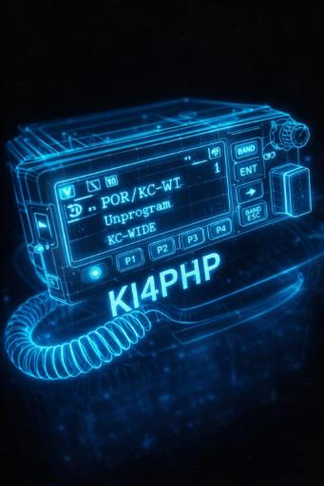
PREPARED BY
Clifton Dowers
KI4PHP
Compiled from resources on the web to help local fellow hams with references about our great hobby.
Special thanks to Thomas Peavy N1DTA, Jack Prindle AB4WS, Ron Brooks AC8MA, Tom King KC5ZC, and Johnny Colon N1YKT
73!
CONTACT
ki4php.dmr@fastmail.com • 606-637-3994
Following Slides
Compiled from resources on the web to help local fellow hams with references about our great hobby.

Slide 8
NKARC K4CO Quick Reference
Northern Kentucky Amateur Radio Club • www.k4co.org • info@nkarc.org • P.O. Box 354, Union, KY 41091
CLUB MEETINGS
3rd Monday • 7:00 PM ET
Bethesda Community Church
989 East Mount Zion Rd,
Independence, KY 41051
Zoom: available — see k4co.org for current link
NETS
REPEATERS (as of Jan 2025)
NET | SCHEDULE | FREQ / NOTES
NKARC Weekly Net | Tue 8:30 PM ET | 146.790 MHz, PL 123.0
Kentucky Emergency Net | Mon 7:30 PM ET | 3972.5 kHz HF (Netlogger)
FREQ | OFFSET | PL | LOCATION / NOTES
147.030 | -600 kHz | 123.0 | St. Elizabeth South, Edgewood KY — K4CO
147.255 | +600 kHz | 123.0 | Edgewood, KY — K4CO
444.350 | +5 MHz | 123.0 | Edgewood, KY — K4CO [OFF AIR]
440.600 | +5 MHz | 123.0 | Edgewood — K4TCD / DMR (NKARC & KY6ARET)
KEY CONTACTS & RESOURCES
General Info: info@nkarc.org
ARRL: k4co@arrl.net
Facebook: facebook.com/NKARC.Official
Groups.io: follow NKARC
AB4WS Radio Show: podcast on iTunes & Spotify
License Exams: offered by club
POTA: members active in Parks on the Air
2026 CLUB OFFICERS
ANNUAL EVENTS
Field Day
Last weekend of June
Lincoln Ridge Park, Independence, KY
Hamvention
Xenia, OH (May)
Club attends annually
ROLE | NAME & CALLSIGN
President | Todd Sayers, KY4TLS
Vice President | Larry Silverman, WB2GYS
Treasurer | Tim Lawrence, W4TWL
Secretary | Rod Milligan, KY4ROD
Director-at-Large | Greg Howard, KQ4RIE
Webmaster | Rod Ford, K4SLF
K4CO — Northern Kentucky Amateur Radio Club • Founded 1959 • www.k4co.org

Slide 9
GARC W8STZ Quick Reference
Grant Amateur Radio Association • Georgetown, OH — Brown County • grantradio4@gmail.com • ARRL Affiliated Dec 10, 1994
CLUB MEETINGS
3rd Thursday • 7:00 PM ET
ABCAP Family Center
ABCAP Family Center
406 West Plum St.,
Georgetown, OH 45121
Founded 1988 • 22 members (17 voting)
NETS
REPEATERS (N1DJS sponsored)
NET | SCHEDULE | FREQ / NOTES
GARC Weekly Net | Sun 9:00 PM ET | 146.730 MHz, CTCSS 162.2 — Fusion/FM, all welcome
FREQ | OFFSET | PL | MODE / NOTES
146.730 | -600 kHz | 162.2 | FM+Fusion, DG-ID 00/61 — Brown Co. ~35 mi; IMRS; closed autopatch
442.200 | +5 MHz | 162.2 | FM+Fusion, DG-ID 00/47 — Brown Co. ~40 mi; IMRS US-wide
KEY CONTACTS & RESOURCES
General: grantradio4@gmail.com
Website: grantamateurradioclub.yolasite.com
Repeater Site: n1djs.us (N1DJS — Jeffrey King)
ARRL Lookup: search “W8STZ”
IMRS: repeaters linked US-wide (Fusion)
Specialties: Public Service, Repeaters, VHF/UHF
CLUB OFFICERS
REPEATER TIPS
• Dual-mode: System Fusion (YSF) + FM; AMS auto-selects
• DG-ID 00 = Open access (both repeaters)
• DG-ID 61 = Brown Co. local (146.730)
• DG-ID 47 = IMRS US-Wide Fusion (442.200)
• 146.730 has closed autopatch — contact club
ROLE | NAME & CALLSIGN
President | Joseph E. Lee, KE8NRY
Vice President | Gregg Johnson, AB8GJ
Treasurer | Daniel L. Pelzel, KE8TTQ
Secretary | Roger A. Suer, WB8HRW
W8STZ — Grant Amateur Radio Association • Founded 1988 • Georgetown, OH (Brown County) • grantamateurradioclub.yolasite.com

Slide 10
KY4HS Quick Reference
Morehead Amateur Radio Society (MARS) • Morehead, KY — Eastern Kentucky • ARRL Affiliated
CLUB MEETINGS
1st Tuesday • 6:00 PM ET
Farmers VFD Station #2
4450 KY-801, Morehead, KY 40351
~50 members • Open to all (no license req.)
Feb 2026 meeting skipped (Winter Field Day) — verify cancellations
NETS
REPEATERS
NET | SCHEDULE | FREQ / NOTES
MARS Weekly Net | Mon 8:00 PM ET | 146.910, CTCSS 123.0 — KY Region 7 ARES
FREQ | OFFSET | PL | MODE / LOCATION
146.910 | -600 kHz | 123.0 | FM — Triangle Mtn (>1,400 ft), KY Region 7 ARES, EchoLink 565257 [OFFLINE]
442.500 | +5 MHz | — | D-Star + FM — Morehead; confirm mode before TX
443.800 | +5 MHz | 123.0 | FM — Morehead (>1,000 ft); installed Apr 17, 2022
KEY CONTACTS & RESOURCES
ARRL Lookup: search “KY4HS”
EchoLink: Node 565257 (KY4HS-R) [OFFLINE]
Specialties: Contest, Digital, DX, Public Service, Repeaters, VHF/UHF
Services: License Classes, Test Sessions, Mentorship, Hamfest
Shack: Farmers VFD Station #2, 4450 KY-801, Morehead, KY
ANNUAL EVENTS & ACTIVITIES
Winter Field Day — January, 24–25 hr operation
Field Day — last weekend of June (ARRL)
Contesting — HF/VHF events year-round
Club HF Station — member use at the fire-station shack
2026 CLUB OFFICERS
ROLE | NAME & CALLSIGN
President | Bob Peterson, AD4Y (elected Jan 2026)
Vice President | Justin Reynolds, KY0KSP
Treasurer | Toby Gardner, KF4LHN
Secretary | Danny Dantzler, W0JMP
In memory: James “Sarge” Sergent, KN4RDT (1962–2025) — SK
KY4HS — Morehead Amateur Radio Society • Serving Eastern Kentucky • ARRL Affiliated • Farmers VFD Station #2, Morehead, KY

Slide 11
W8MRC Quick Reference
Milford Amateur Radio Club • MilfordHamRadio.org • info@MilfordHamRadio.org •
CLUB MEETINGS
3rd Thursday • 7:30 PM ET
Miami Township Civic Center
6101 Meijer Dr, Milford, OH 45150
ARRL Affiliated Sept 27, 1975
501(c)(3) Non-Profit • ~176 members
NETS
REPEATERS
NET | SCHEDULE | FREQ / NOTES
Sunday Analog | Sun 7:30 PM | 147.345, CTCSS 123.0
Wires-X Trivia | Mon 8:00 PM | 145.450, KC-Wide 28054
FREQ | OFFSET | TONE | MODE / NOTES
147.345 | +600 | 123.0 | Analog FM — AllStar 57141, EchoLink 150899
145.450 | -600 | 123.0 | Wires-X / C4FM — Cincinnati-Wide 84898 · AMS mode (Fusion) for Analog + C4FM
443.450 | +5 MHz | CSQ | Analog / Wires-X — K8DV
KEY CONTACTS & RESOURCES
General Info: info@MilfordHamRadio.org
Website: MilfordHamRadio.org
Hamfest: CincinnatiHamfest.org
VE Sessions: contact info@MilfordHamRadio.org
Specialties: Contest, Digital, DX, Public Service, Repeaters, VHF/UHF
CLUB OFFICERS
WIRES-X OPERATING TIPS
CINCINNATI-WIDE Room: 84898
Do NOT use Group Mode on any repeater
Leave 2–3 sec between transmissions
Pause at start; stay keyed ~1 sec at end
C4FM: DN / AMS on 145.450 • Analog: CTCSS 123.0
ROLE | NAME & CALLSIGN
President | Ron Brooks, AC8MA
Vice President | Timothy D. Bastress, KB8DDG
Secretary | Robert C. Overstreet, KE8DIE
Treasurer | Raleigh W. Sizemore, AB8KG
Sunday Net Control — Wk1 AC8MA · Wk2/5 W8UF · Wk3 KB8DDG · Wk4 W8JYQ
W8MRC — Milford Amateur Radio Club • ARRL Affiliated Since 1975 • MilfordHamRadio.org • 73 de W8MRC

Slide 12
W8MRC WIRES-X ACCESS
Milford Wires-X Room
Room 84898 (Cincinnati-Wide) • 145.450 MHz (-600) • CTCSS 123.0 • Milford, OH
ROOM
84898
145.450 (-600)
DN / C4FM • Analog CTCSS 123.0
CONNECT & OPERATE | W8MRC 145.450 WIRES-X
1 Tune the repeater — 145.450 MHz (-600 offset), radio in DN (C4FM); AMS auto-picks Analog/C4FM.
2 Access WIRES-X — press & hold the DX key until the radio links to the W8MRC node.
3 Check the room — repeater rests on Cincinnati-Wide 84898; listen before you transmit.
4 Connect — Search & Direct, key the Room ID — e.g. 84898 Cincinnati-Wide, 28054 KC-Wide.
5 Operate courteously — no Group Mode; leave 2–3 sec between overs, stay keyed ~1 sec at the end.
W8MRC — Milford Amateur Radio Club • ARRL Affiliated Since 1975
MilfordHamRadio.org • Wires-X Trivia Net — Mondays 8:00 PM ET on KC-Wide 28054 • 73 de W8MRC

Slide 13
WB4N Quick Reference
Greater Mason County ARA • kf4bro@qsl.net • P.O. Box 73, Maysville, KY 41056 • Serving Mason, Fleming, Lewis, Robertson & Bracken Counties
CLUB MEETINGS
2nd Tuesday • 7:00 PM ET
Maysville/Mason County EOC Training Room
668 Kenton Station Dr., Maysville, KY 41056
Service Area: Mason, Fleming, Lewis, Robertson & Bracken
Callsign WB4N honors Silent Key Barry Jackson
NETS
REPEATERS
NET | SCHEDULE | FREQ / REPEATER
Club Weekly Net | Sun 8:30 PM ET | 145.470 MHz (Maysville)
Area 7 ARES Net | Mon 8:00 PM ET | 146.955 MHz (Beechburg)
Simplex Net | Wed 7:30 PM ET | 146.580 MHz (Simplex)
FREQ | OFFSET | PL | CALL / NOTES
145.470 | -600 kHz | — | WB4N — Maysville Repeater
146.955 | -600 kHz | — | WB4N — Beechburg [LINK DOWN]
443.500 | +5 MHz | 107.2 | WB4N — NEW 440 Repeater
GMRS | — | — | Club GMRS — Coming Soon
KEY CONTACTS & RESOURCES
Email: kf4bro@qsl.net
Mailing: P.O. Box 73, Maysville, KY 41056
EOC / Meetings: 668 Kenton Station Dr., Maysville
ARES: Area 7 — Monday net on 146.955 MHz
Skywarn: members active in weather spotting
Counties: Mason, Fleming, Lewis, Robertson, Bracken
IMPORTANT NOTICES
No link between Maysville (145.470) & Beechburg (146.955) — use independently
Sunday Club Net on 145.470 ONLY until link restored
New 443.500 active — program PL 107.2 Hz
GMRS repeater — Coming Soon
2026 CLUB OFFICERS
ROLE | NAME & CALLSIGN
President | Paul Earhart, WD4OQH
Vice President | Larry Dodge, KG4PXA
Treasurer | Holton Cartmell, KE4LCZ
Secretary | Holton Cartmell, KE4LCZ
Repeater Trustee | Larry Dodge, KG4PXA
WB4N — Greater Mason County ARA • Serving Mason, Fleming, Lewis, Robertson & Bracken Counties, KY • kf4bro@qsl.net • Revised July 2026

Slide 14
NE4ST Quick Reference
Scott County Amateur Radio Emergency Services (SCARES) • Georgetown, KY • www.ne4st.net • NE4ST@arrl.net • ARRL Affiliated Mar 14, 2013
CLUB MEETINGS
3rd Saturday • 9:00 AM ET
Scott County Extension Office
1130 Cincinnati Rd, Georgetown, KY
Dec: 1st/2nd Sat @ 1:00 PM (Christmas)
27 members • Non-members welcome
Always email to confirm location — may vary
NETS
REPEATERS
NET | SCHEDULE | FREQ / NOTES
Weekly ARES Net (Primary) | Tue 7:00 PM ET | 146.685 MHz, FM — all hams welcome
Rotating 2nd Net | Tue, after primary | Mode/freq announced during primary net
Skywarn Storm Net | NOAA watch/warn | 146.685 → 443.625 backup, FM only
FREQ | OFFSET | PL | MODE / NOTES
146.685 | -600 kHz | 141.3 | FM/C4FM (AMS) — ★ Primary VHF (ARES 1)
443.625 | +5 MHz | 141.3 | FM/C4FM — UHF backup (ARES 2)
147.490 | Simplex | — | FM Wide — countywide simplex (ARES 3)
KEY CONTACTS & RESOURCES
General / ARRL: NE4ST@arrl.net
Web / Groups.io: ne4st.net • NE4ST@groups.io
Facebook: Scott Co KY ARES Club
EMA / OHS: Georgetown-Scott Co Emergency Mgmt
Skywarn: monitor 146.685 on watch/warning
VE Testing: Georgetown PD — 4×/yr; Tech/Gen/Extra
IMPORTANT NOTICES & TIPS
All repeaters FM/C4FM dual-mode — AMS (DG-ID 00); verify mode before TX
After Tue 146.685 FM net, a 2nd net rotates mode/freq — listen for announcement
Skywarn nets ALWAYS FM only — UHF 443.625 if VHF fails, 147.490 simplex last resort
Net check-in: give callsign to net control (ARES records)
CLUB OFFICERS
ROLE | NAME & CALLSIGN
President | David L. Perkins, N4UCP
Vice President | Greg O. Shaw, WC4B
Treasurer | Michael H. Hennigan, KI4OQL
Secretary | Carol A. Dziubakowski, KC8TIE
NE4ST — Scott County Amateur Radio Emergency Services • Georgetown, KY • ARRL Affiliated Since March 14, 2013 • www.ne4st.net • NE4ST@arrl.net

Slide 15
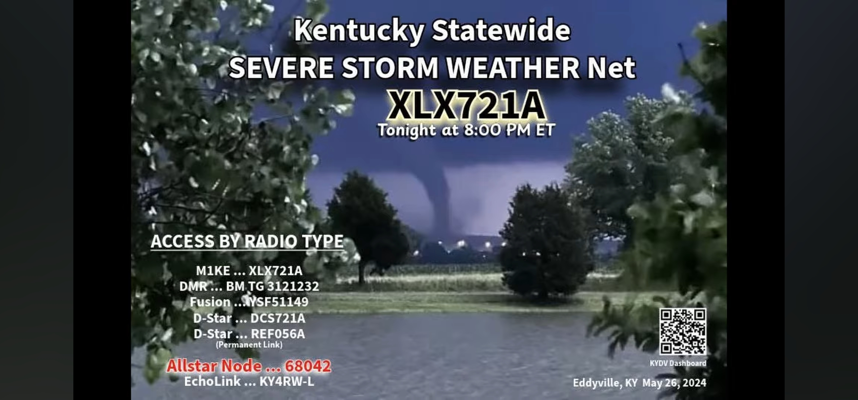
Kentucky Severe Storm Weather Net XLX721A
Weekly Net Schedule
Monday • 8:00 PM ET
Kentucky Severe Weather Net on XLX721A
Wednesday • 8:00 PM ET
“The Little Event” on the 224.400 Repeater
Allstar 61054 • Echolink WW4KY-R • XLX721A
Thursday • 7:00 PM ET (occasional)
Kentucky DSTAR Net
XLX721A linked to REF056B
Clifton W Dowers, KI4PHP

Slide 16
Kansas City Wide – Digital Connections
Multi-mode linked system • Connect via any supported digital mode
Mode | Connection Details
Yaesu Wires-X | Room 28054 (AMERICA-KC-WIDE) Milford Trivia Net on Wires-X: Monday, July 27 • 8:00–9:00 PM ET • Weekly Mondays
Icom D-STAR | XLX458 / XRF458 — Module A · Dashboard: https://xxlx.w0fh.net/
Brandmeister DMR | Talkgroup 313136
P25 Reflector | 31313 · 172.238.171.106 : 41000
YSF (Fusion) | YSF32453 (US-KCWIDE) · Dashboard: http://ysf.kansascitywide.com
YSF (Fusion) | YSF28054 (US-XLX458) · Dashboard: https://xxlx.w0fh.net/
NXDN | Talkgroup 31313
M17 | M17-KCW Module A · 172.234.217.28 : 17000 · Dashboard: http://m17.kansascitywide.com
Echolink | Node WØFH-L — No connections from -L or -R calls, repeater links, or conferences, please
Hams Over IP | Extension 15135
Broadcastify (listen only) | https://www.broadcastify.com/webPlayer/30282

Slide 17
Repeaters Within 27.3 Miles of 41004
CALL SIGN | FREQ | OFFSET | TONE | MODE | LOCATION | COUNTY
N1DTA | 443.7125 | +5 | CC 1 | DMR | Brooksville | Bracken
N1DTA | 444.9875 | +5 | CC 1 | DMR | Brooksville | Bracken
N8SIM | 145.3100 | -0.6 | 123 | FM | Cincinnati | Hamilton
K8GE | 147.000 | +6 | 98.4 | FM | Cherry Fork | Adams
N1DJS | 146.7300 | -0.6 | 162.2 | FM Fusion | Georgetown | Brown
K4KJQ | 147.165 | +6 | 67 | FM | Cynthiana | Harrison
N1DJS | 442.2000 | +5 | 162.2 | FM Fusion | Mount Orab | Brown
Clifton W Dowers, KI4PHP

Slide 18
My Hotspots & WIRES-X Info
DETAILED SETUP
DMR hotspot channels, zones, and WIRES-X operating reminders
OFFICE HOTSPOT
439.450 MHz +5 offset
Color Code 1 • TS 1 & 2 linked • Zones: TAC, Office, States, World-Wide, TS1 For TGI NETWORK
WIRES-X / DIGITAL LINKS
KI4PHP
146.460 Simplex Room 20371 Brooksville, Kentucky 41004
OTHER ROOMS TO CONNECT TO:
Room 28054 (AMERICA-KC-WIDE MULTIMODE)
Room 84898 (Cincinnati-Wide)
Room 83134 (Mid South Multimode)
WIRES-X
TRUCK HOTSPOT
433.450 MHz simplex
Color Code 1 • TS 1 & 2 linked • Mobile use with the same talk-group zone structure
OPERATING CHECKLIST
1. Pick zone
Office or Truck hotspot; match the zone to the talk group list.
2. Confirm slot
TS2 for TAC/Office/States/World-Wide; TS1 for TGI Network.
3. Test audio
Use Parrot 310997 before important calls or after programming changes.
4. Watch limits
State talk groups note a 10-minute limit; keep transmissions brief.
Clifton W Dowers KI4PHP • Brooksville, KY 41004 • Ph 606-637-3994 • email ki4php.dmr@fastmail.com

Slide 19
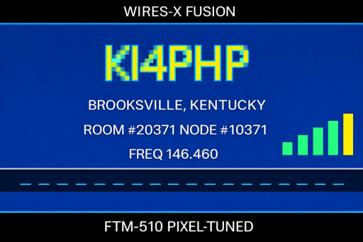
WIRES-X ROOM ACCESS
My WIRES-X Room
Room 20371 • 146.460 MHz Simplex • Brooksville, KY 41004
ROOM
20371
146.460 Simplex
DN MODE • Rooms are steerable
CONNECT & CHANGE ROOMS | FROM DN MODE ON 146.460
1 Tune the node — 146.460 MHz simplex, radio in DN (C4FM) mode.
2 Access WIRES-X — press & hold the DX key until the radio links to the local node.
3 Find the room — Search & Direct > ALL, or key in the Room ID directly.
4 Connect — select the room and press PTT — e.g. 28054, 84898, 83134.
5 Change rooms — disconnect first (hold BAND, or enter Room #99999), then search the next ID.
Clifton W Dowers KI4PHP • Brooksville, KY 41004
Ph 606-637-3994 • email ki4php.dmr@fastmail.com

Slide 20
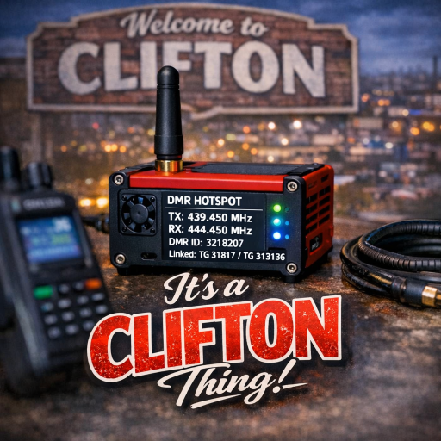
DMR HOTSPOT CONFIGURATION
Office Hotspot
439.450 (+5) • Color Code 1 • Time Slots 1 and 2 linked
FREQUENCY
439.450 MHz
+5 offset
RX 439.450 • TX 444.450 MHz
TIME SLOT 2 | FRQ 439.450 MHz
COLOR CODE
CC1
Color Code 1
TIME SLOTS
TS 1 & 2
Both time slots active
LINK STATUS
Linked
TS 1 and TS 2 linked
Quick reference for programming the office hotspot channel.
To Clifton W Dowers KI4PHP • Brooksville, Ky 41004
Ph 606-637-3994 • email ki4php.dmr@fastmail.com

Slide 21
Office Hotspot-TAC Zone
BrandMeister Network
439.450 (+5) • Time Slot 2 • Tactical (TAC) talk groups
INDIANA TAC
31180
TG ID
KY TAC
31214
TG ID
OHIO TAC
31390
TG ID
Full TAC channel lookup
Freq 439.450 (+5) • all entries use Time Slot 2
Talk Group | TG ID | Talk Group | TG ID | Talk Group | TG ID
Indiana TAC | 31180 | KY TAC | 31214 | Ohio TAC | 31390
TAC 310 | 310 | TAC 311 | 311 | TAC 313 | 313
TAC 314 | 314 | TAC 315 | 315 | TAC 316 | 316
TAC 317 | 317 | TAC 318 | 318 | TAC 319 | 319
TAC ZONE | FRQ 439.450 (+5) | TIME SLOT 2
To Clifton W Dowers KI4PHP • Brooksville, Ky 41004
Ph 606-637-3994 • email ki4php.dmr@fastmail.com

Slide 22
Office Hotspot-Office Zone
BrandMeister Network
439.450 (+5) • Time Slot 2 • Office hotspot zone
ALL CALL
16776415
TG ID
WEST PALM BEACH
3149803
TG ID
KENTUCKY XLX
3121232
TG ID
Full office zone lookup
Freq 439.450 (+5) • all entries use Time Slot 2
Talk Group | TG ID | Talk Group | TG ID | Talk Group | TG ID
Parrot | 310997 | All Call | 16776415 | AllStar | 3167
Civil Air Patrol | 3160 | East Kentucky | 31213 | Disconnect | 4000
Indiana WX Op | 31183 | KRMOP2-RPT | 31365 | K4MOP-RPT | 314295
KD4LN-RPT | 31274 | Ken-Tenn | 311035 | KY ARES | 31211
Kentucky XLX | 3121232 | Ohio/Link | 31399 | Pi-Star | 31672
POTA | 3181 | RF020A | 31675 | SW Ohio | 31394
Treasure Coast | 31123 | US 3100 | 3100 | West Palm Beach | 3149803
W5LLS-BM | 31817
OFFICE ZONE | FRQ 439.450 (+5) | TIME SLOT 2
To Clifton W Dowers KI4PHP • Brooksville, Ky 41004
Ph 606-637-3994 • email ki4php.dmr@fastmail.com

Slide 23
Office Hotspot – States Zone
BrandMeister Network
Per-state Talk Groups • Time Slot 2 • 10-Minute Limit on all
State | TG ID | State | TG ID | State | TG ID
Alabama | 3101 | Kentucky | 3121 | North Dakota | 3138
Alaska | 3102 | Louisiana | 3122 | Ohio | 3139
Arizona | 3104 | Maine | 3123 | Oklahoma | 3140
Arkansas | 3105 | Maryland | 3124 | Oregon | 3141
California | 3106 | Massachusetts | 3125 | Pennsylvania | 3142
Colorado | 3108 | Michigan | 3126 | Rhode Island | 3144
Connecticut | 3109 | Minnesota | 3127 | South Carolina | 3145
Delaware | 3110 | Mississippi | 3128 | South Dakota | 3146
D.C. | 3111 | Missouri | 3129 | Tennessee | 3147
Florida | 3112 | Montana | 3130 | Texas | 3148
Georgia | 3113 | Nebraska | 3131 | Utah | 3149
Hawaii | 3115 | Nevada | 3132 | Vermont | 3150
Idaho | 3116 | New Hampshire | 3133 | Virginia | 3151
Illinois | 3117 | New Jersey | 3134 | Washington | 3153
Indiana | 3118 | New Mexico | 3135 | West Virginia | 3154
Iowa | 3119 | New York | 3136 | Wisconsin | 3155
Kansas | 3120 | North Carolina | 3137 | Wyoming | 3156
To Clifton W Dowers KI4PHP • Brooksville, Ky 41004
Ph 606-637-3994 • email ki4php.dmr@fastmail.com

Slide 24
Office Hotspot- World-Wide Zone
BrandMeister Network
Talk Groups • All Time Slot 2
BAYNET
31075
TG ID
NW
3169
TG ID
KC-WIDE
313136
TG ID
Full world-wide lookup
Top three largest TG IDs shown.
WORLD-WIDE TALKGROUPS
Talk Group | TG ID | Talk Group | TG ID | Talk Group | TG ID
Asia E | 94 | Baynet | 31075 | Europe | 92
 |  | N America | 93 | NW | 3169
Philippines | 515 | WW Eng | 13 | WW | 91
KC-Wide | 313136
ALL ENTRIES USE TIME SLOT 2
To Clifton W Dowers KI4PHP • Brooksville, Ky 41004
Ph 606-637-3994 • email ki4php.dmr@fastmail.com

Slide 25
Office Hotspot-TGI Network Zone
TGI Network
439.450 (+5) • Time Slot 1 • TGI network talk groups
W.O.T.A.R
4031817
TG ID
MIDSOUTH MULTI NETWORK
4042450
TG ID
Full network talk group lookup
Freq 439.450 (+5) • all entries use Time Slot 1
Talk Group | TG ID
W.O.T.A.R | 4031817
Midsouth Multi Network | 4042450
NOTE: All talk groups must be 7 digits starting with 4. Examples: 31817 becomes 4031817; TG 91 becomes 4000091.
TGI NETWORK ZONE | FRQ 439.450 (+5) | TIME SLOT 1
To Clifton W Dowers KI4PHP • Brooksville, Ky 41004
Ph 606-637-3994 • email ki4php.dmr@fastmail.com

Slide 26
DMR HOTSPOT CONFIGURATION
Truck Hotspot
433.450 Simplex • Color Code 1 • Time Slots 1 and 2 linked
FREQUENCY
433.450 MHz
Simplex
RX 433.450 • TX 433.450 MHz
TIME SLOT 2 | FRQ 433.450 MHz
COLOR CODE
CC1
Color Code 1
TIME SLOTS
TS 1 & 2
Both time slots active
LINK STATUS
Linked
TS 1 and TS 2 linked
Quick reference for programming the truck hotspot channel.
To Clifton W Dowers KI4PHP • Brooksville, Ky 41004
Ph 606-637-3994 • email ki4php.dmr@fastmail.com

Slide 27
Truck Hotspot-TAC Zone
BrandMeister Network
433.450 Simplex • Time Slot 2 • Tactical (TAC) talk groups
INDIANA TAC
31180
TG ID
KY TAC
31214
TG ID
OHIO TAC
31390
TG ID
Full TAC channel lookup
Freq 433.450 Simplex • all entries use Time Slot 2
Talk Group | TG ID | Talk Group | TG ID | Talk Group | TG ID
Indiana TAC | 31180 | KY TAC | 31214 | Ohio TAC | 31390
TAC 310 | 310 | TAC 311 | 311 | TAC 313 | 313
TAC 314 | 314 | TAC 315 | 315 | TAC 316 | 316
TAC 317 | 317 | TAC 318 | 318 | TAC 319 | 319
TAC ZONE | FRQ 433.450 Simplex | TIME SLOT 2
To Clifton W Dowers KI4PHP • Brooksville, Ky 41004
Ph 606-637-3994 • email ki4php.dmr@fastmail.com

Slide 28
Truck Hotspot-Truck Zone
BrandMeister Network
433.450 Simplex • Time Slot 2 • Truck hotspot zone
ALL CALL
16776415
TG ID
WEST PALM BEACH
3149803
TG ID
KENTUCKY XLX
3121232
TG ID
Full office zone lookup
Freq 433.450 Simplex • all entries use Time Slot 2
Talk Group | TG ID | Talk Group | TG ID | Talk Group | TG ID
Parrot | 310997 | All Call | 16776415 | AllStar | 3167
Civil Air Patrol | 3160 | East Kentucky | 31213 | Disconnect | 4000
Indiana WX Op | 31183 | KRMOP2-RPT | 31365 | K4MOP-RPT | 314295
KD4LN-RPT | 31274 | Ken-Tenn | 311035 | KY ARES | 31211
Kentucky XLX | 3121232 | Ohio/Link | 31399 | Pi-Star | 31672
POTA | 3181 | RF020A | 31675 | SW Ohio | 31394
Treasure Coast | 31123 | US 3100 | 3100 | West Palm Beach | 3149803
W5LLS-BM | 31817
OFFICE ZONE | FRQ 433.450 Simplex | TIME SLOT 2
To Clifton W Dowers KI4PHP • Brooksville, Ky 41004
Ph 606-637-3994 • email ki4php.dmr@fastmail.com

Slide 29
Truck Hotspot – States Zone
BrandMeister Network
Per-state Talk Groups • Time Slot 2 • 10-Minute Limit on all
State | TG ID | State | TG ID | State | TG ID
Alabama | 3101 | Kentucky | 3121 | North Dakota | 3138
Alaska | 3102 | Louisiana | 3122 | Ohio | 3139
Arizona | 3104 | Maine | 3123 | Oklahoma | 3140
Arkansas | 3105 | Maryland | 3124 | Oregon | 3141
California | 3106 | Massachusetts | 3125 | Pennsylvania | 3142
Colorado | 3108 | Michigan | 3126 | Rhode Island | 3144
Connecticut | 3109 | Minnesota | 3127 | South Carolina | 3145
Delaware | 3110 | Mississippi | 3128 | South Dakota | 3146
D.C. | 3111 | Missouri | 3129 | Tennessee | 3147
Florida | 3112 | Montana | 3130 | Texas | 3148
Georgia | 3113 | Nebraska | 3131 | Utah | 3149
Hawaii | 3115 | Nevada | 3132 | Vermont | 3150
Idaho | 3116 | New Hampshire | 3133 | Virginia | 3151
Illinois | 3117 | New Jersey | 3134 | Washington | 3153
Indiana | 3118 | New Mexico | 3135 | West Virginia | 3154
Iowa | 3119 | New York | 3136 | Wisconsin | 3155
Kansas | 3120 | North Carolina | 3137 | Wyoming | 3156
To Clifton W Dowers KI4PHP • Brooksville, Ky 41004
Ph 606-637-3994 • email ki4php.dmr@fastmail.com

Slide 30
Truck Hotspot- World-Wide Zone
BrandMeister Network
Talk Groups • All Time Slot 2
BAYNET
31075
TG ID
NW
3169
TG ID
KC-WIDE
313136
TG ID
Full world-wide lookup
Top three largest TG IDs shown.
WORLD-WIDE TALKGROUPS
Talk Group | TG ID | Talk Group | TG ID | Talk Group | TG ID
Asia E | 94 | Baynet | 31075 | Europe | 92
 |  | N America | 93 | NW | 3169
Philippines | 515 | WW Eng | 13 | WW | 91
KC-Wide | 313136
ALL ENTRIES USE TIME SLOT 2
To Clifton W Dowers KI4PHP • Brooksville, Ky 41004
Ph 606-637-3994 • email ki4php.dmr@fastmail.com

Slide 31
Truck Hotspot-TGI Network Zone
TGI Network
433.450 Simplex • Time Slot 1 • TGI network talk groups
W.O.T.A.R
4031817
TG ID
MIDSOUTH MULTI NETWORK
4042450
TG ID
Full network talk group lookup
Freq 433.450 Simplex • all entries use Time Slot 1
Talk Group | TG ID
W.O.T.A.R | 4031817
Midsouth Multi Network | 4042450
NOTE: All talk groups must be 7 digits starting with 4. Examples: 31817 becomes 4031817; TG 91 becomes 4000091.
TGI NETWORK ZONE | FRQ 433.450 Simplex | TIME SLOT 1
To Clifton W Dowers KI4PHP • Brooksville, Ky 41004
Ph 606-637-3994 • email ki4php.dmr@fastmail.com

Slide 32

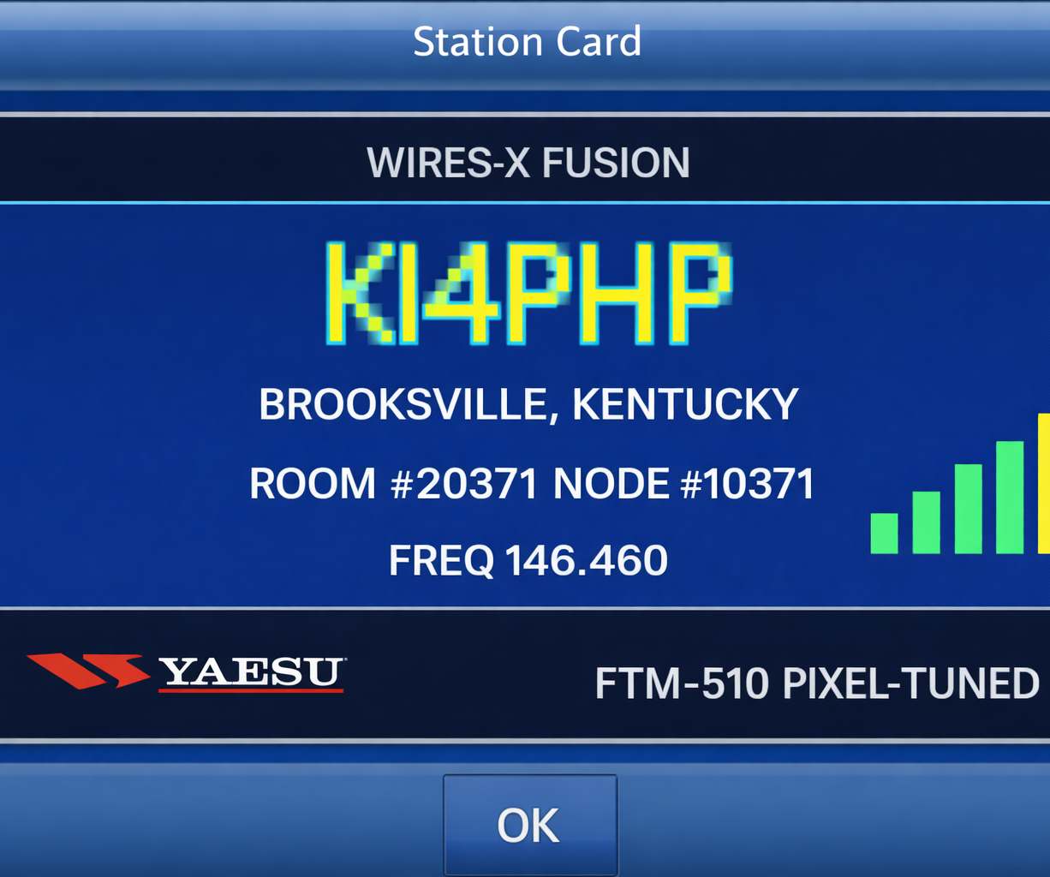
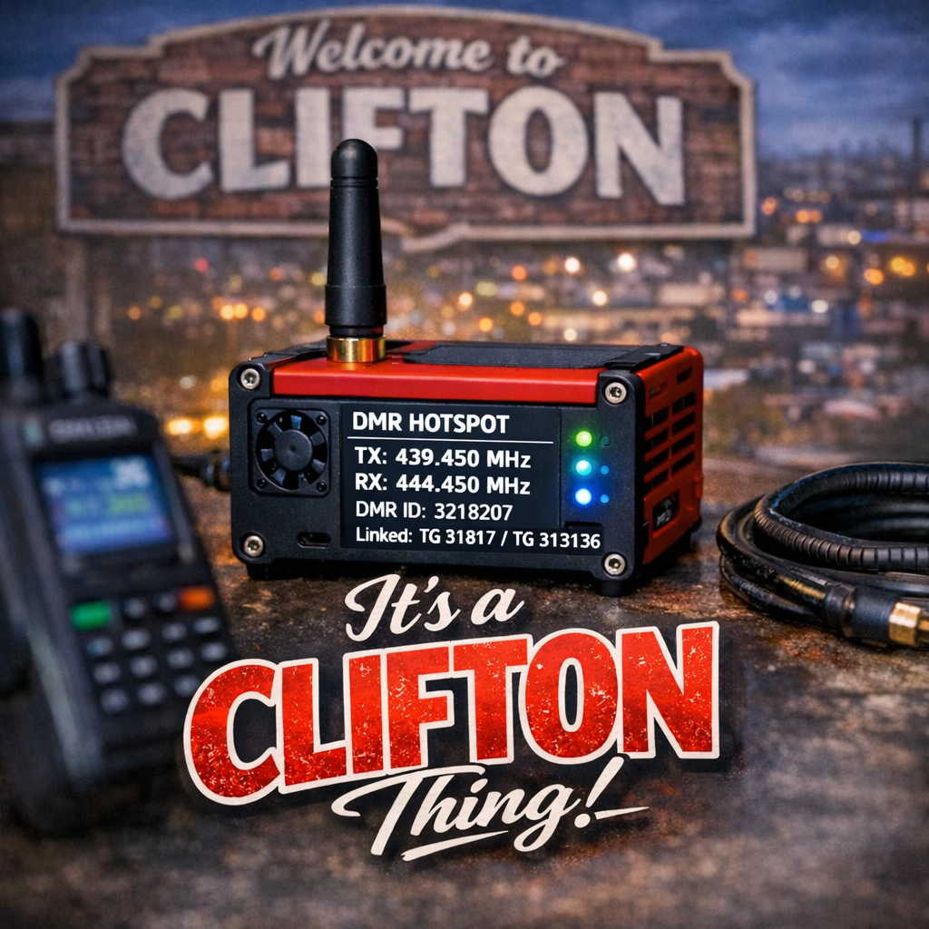
Pictures about my hotspots and wires-x station
Use bright, close-up pictures with the radio or hotspot filling most of the frame.
Clifton W Dowers, KI4PHP

