Slide 1



1/28
SOFT skills
Soft Skills for Youth Employment
SELF-AWARENESS
Project number: 2022-1-TR01-KA220-YOU-000087078

Slide 2



2/28
SELF-AWARENESS
Individulay or in a group
of 20-24 participants
2.0 hours
Colorful markers,
Crayons,
A4 Papers,
Cricle of life - Worksheets

Slide 3
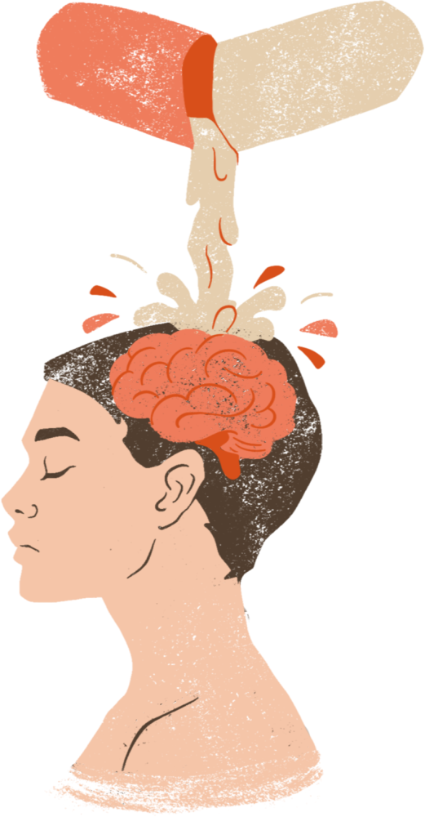
3/28
AIM OF THE TRAINING
Improve self-awareness in the area of life moments, making decisions, choices.

Slide 4


STEP 1 - WARM UP ACTIVITY - (10 -15 MINUTES)
4/28
Guiding Maxims
Step 1.
Choose a maxim or maxims that are close to you, that you follow in your everyday life. Write it on a paper.
Step 2.
Now think about it for at least 2-3 minutes.
Step 3.
What maxims have you chosen? Why?
What do you gain and what do you lose by following those maxims in life?

Slide 5
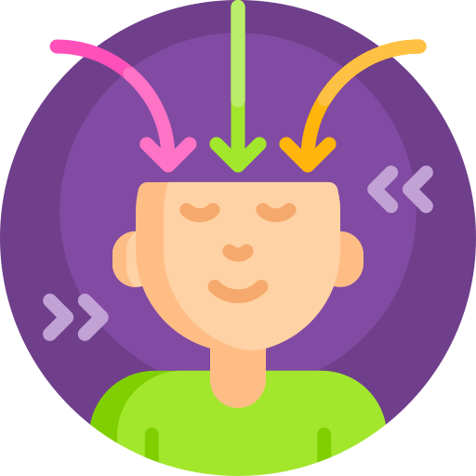
STEP 2 - UNDERSTANDING SELF AWARENESS (15 MINUTES)
5/28
Self-awareness is the capacity of an individual to identify and comprehend their own feelings, motives, values, and strengths and shortcomings. It entails being acutely aware of the effects that one's ideas and deeds have on oneself and other people. Self-aware people are aware of their own feelings, are able to evaluate themselves objectively, and are cognizant of their own ideals and aspirations.
When it comes to soft skills, self-awareness is essential for both professional and personal growth. It improves communication with others, judgment, and general efficacy in a range of contexts.

Slide 6

UNDERSTANDING
SELF AWARENESS
6/28
Self-awareness is a fundamental soft ability that supports emotional intelligence, flexibility, effective communication, and ongoing development, all of which are beneficial for both personal and professional success. It serves as the cornerstone for establishing solid and fulfilling connections in both personal and professional spheres.
Being self-aware is a process that takes time and dedication. Be gentle to yourself, keep open to growth, and be willing to make modifications as you discover more about who you are and what you want in life.

Slide 7

KEY COMPONENTS
OF SELF AWARENESS
7/28
Self-awareness is a fundamental component of emotional intelligence. Emotionally intelligent people are able to recognize and control their own feelings, which makes social interactions easier for them to handle.
Being adaptable - a self-aware individual can adjust to change more easily. They are more adaptable and receptive to new information because they recognize that their attitudes and behaviors may need to change depending on the circumstances.

Slide 8
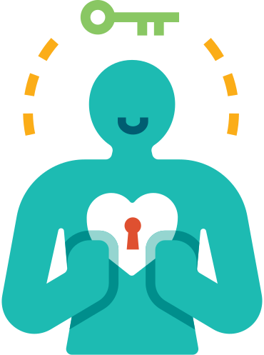
8/28
Key components
of self awareness
Effective Communication - people who are self-aware communicate more effectively. They are able to communicate effectively and are aware of how others could be affected by the way they communicate. In interpersonal as well as professional interactions, this ability is essential.
Managing Conflicts - a crucial component of self-awareness is realizing one's own place in disputes. Self-aware people are better able to accept responsibility for their actions and handle problems in a constructive manner.

Slide 9

9/28
Key components
of self awareness
Leadership highly self-aware individuals are excellent leaders. Being aware of one's advantages and disadvantages helps leaders develop effective teams, assign work in a smart way, and reach wise decisions.
Continuous Development - people who are self-aware are more inclined to reflect on their lives and look for chances to advance both personally and professionally. They recognize the value of ongoing education and growth.
Empathy - Having a better understanding of one's own feelings helps increase empathy for other people. Positive interpersonal connections are largely dependent on one's capacity to relate to and comprehend the sentiments of others..

Slide 10

DEVELOPMENT
OF SELF AWARENESS SKILLS
10/28
Cultivating self-awareness is an ongoing process that calls for self-examination contemplation, and a dedication to improving one's understanding of oneself. The following methods and techniques will assist you in developing your self-awareness:
Explore Your Values and Beliefs
Be open to receiving feedback, even criticism:
Constructive criticism can be a valuable tool for self-improvement, helping you identify blind spots and areas where you can grow.
Engage in Continuous Learning, take on new challenges, acquire new skills, and expose yourself to diverse experiences.
Practice Active Listening
Connect with Your Emotion, identify and label your feelings.
Consider Professional Help - seeking guidance from a therapist, counselor, or coach can provide an external perspective and offer tools and strategies to deepen your self-awareness.
· Celebrate Successes and Learn from Failures, both success and failure can contribute to your self-awareness journey.
Practice Mindfulness
Regularly write in a journal about your thoughts, emotions, and experiences.
Ask for constructive feedback from trusted friends, family members, or colleagues.
Use Personality Assessments (Myers-Briggs Type Indicator (MBTI) or the DISC assessment.
Set Aside Time for Self-Reflection: daily or weekly, review your thoughts, actions, and goals.

Slide 11

SELF AWARNESS BARRIERS
11/28
It can be difficult to develop self-awareness, and there are a number of obstacles that might prevent people from using this talent to its greatest potential. These are a few typical obstacles to developing self-awareness.
Lack of self-reflection - discomfort or fear of confronting emotions, weaknesses, or past experiences.
Defensive mechanisms, such as rationalization or denial, can prevent people from developing true self-awareness by erecting mental walls that keep them from confronting difficult realities about who they are.
Fear of judgment might result in self-censorship and a refusal to admit certain attitudes or actions.
How people view themselves can be influenced by societal or cultural expectations. It could lead to a lack of self-awareness and genuineness.

Slide 12

SELF AWARNESS BARRIERS
12/28
It can be difficult to develop self-awareness, and there are a number of obstacles that might prevent people from using this talent to its greatest potential. These are a few typical obstacles to developing self-awareness.
Chaotic and Busy Lifestyle - those who have busy lives and are continuously preoccupied with work, obligations, and distractions may not set aside enough time for introspection and personal growth.
Insufficient or nonexistent positive feedback may hinder self-awareness. External viewpoints are helpful in offering insights that people might not notice on their own.
Hidden Biases - gaining a more accurate and complex view of oneself requires acknowledging and confronting unconscious biases.
Fixed Mindset - the development of self-awareness depends on a growth mindset.

Slide 13

SELF AWARNESS BARRIERS
13/28
It can be difficult to develop self-awareness, and there are a number of obstacles that might prevent people from using this talent to its greatest potential. These are a few typical obstacles to developing self-awareness.
Fear of Changes - people who are afraid of change or of upending the status quo may find it difficult to go on a journey of self-discovery.
External Evaluation - trying to win other people's favor can result in a skewed perception of oneself.
Difficulty Handling Emotions - people who lack emotional intelligence or coping skills may find it difficult to explore their feelings.
Negative experiences or trauma can erect emotional barriers that make it difficult to examine particular facets of oneself. In order to overcome such obstacles, professional assistance can be required.

Slide 14

TOOLS FOR STRENGHTENING SELF AWARNESS
14/28
Multiple techniques and tools can support the growth of creativity by offering organized frameworks, stimulating original thought, and assisting in brainstorming.
To keep track of your feelings, experiences, and thoughts, keep a daily notebook. When you think back on your responses to different circumstances, patterns may start to show themselves and provide important insights into your behavior.
Personality tests include the Enneagram, DISC, and Myers-Briggs Type Indicator (MBTI).
Practicing mindfulness and meditation can aid in developing awareness of the present moment.
The 360-Degree Feedback approach offers a comprehensive assessment of your areas of strength and growth.

Slide 15
15/28
TOOLS FOR STRENGHTENING
SELF AWARNESS
A tool called StrengthsFinder can assist you in determining and comprehending your primary strengths.
A qualified professional's therapy or counseling can offer direction and encourage self-discovery.
Critical Friends' Feedback - only frank and helpful criticism can provide insightful information.
Emotional Intelligence Assessments techniques include the Emotional Intelligence Appraisal by Travis Bradberry and Jean Greaves. You can better comprehend and develop your emotional self-awareness by doing this.
Exercises for Self-Reflection - raise challenging questions to yourself regarding your beliefs, objectives, and feelings. Returning to these inquiries on a regular basis helps enhance self-awareness.

Slide 16
16/28
TOOLS FOR STRENGHTENING
SELF AWARNESS
Using artistic expression to express oneself through writing, drawing, or music can help you better understand yourself and your feelings.
Establishing measurable objectives might help you better understand your priorities and values.
Acknowledging and evaluating errors and failures. Finding the underlying reasons of failures can be a very useful tool for developing one's self-awareness and self-improvement.
You can have a better awareness of how you relate to other people through mindful communication.
Peer coaching - talking about objectives, difficulties, and introspection

Slide 17



15/23
ACTIVITIES
(AS MUCH TIME AS YOU NEED)
Life path
activity 1
Circle of Life
(Life Vaules)
activity 2
Maxims
activity 3

Slide 18

ACTIVITY 1 - LIFE PATH
18/28
Task 1 - Life path
Draw a path from the beginning of your life until today (which you follow to your destination)
Mark your key, critical moments on this road,
Mark the needs and values that guide you on this path
Define these values
Presentation in threes - presentation of works and discussion
Make self reflection or debriefing with a group
Which part of the exercise was more difficult for you, why?
What are the difficulties?
What is value-based (self/other) motivating?

Slide 19

ACTIVITY 1 - LIFE PATH
19/28
Task 2 - PLANS
Draw your further path and mark in it key moments that you know will happen and that you would like to experience.
Presentation in threes - presentation of works and discussion
Make a comparison of these two ways - how does it change in relation to the current one?

Slide 20

ACTIVITY 2 -
CIRCLE OF LIFE - LIFE VALUES
20/28
Circle of Life (Life Vaules)
Introduction: Many religions and philosophies believe that a happy life is one that is consistent with the values that are in balance. That is why it is so important to look at your values and find the most important one. The first step on this path may be to create your own value wheel.

Slide 21

ACTIVITY 2 - CIRCLE OF LIFE
LIFE VALUES
21/28
Task 1
Make a brainstorming about the values in your live. Write them on the paper, and list the values that are important in your live.
EXAMPLES OF VALUES ARE:
LOVE,
FAITH,
HEALTH,
PEACE,
GRATITUDE,
HARMONY,
INDEPENDENCE
SUCCESS,
PERSONAL DEVELOPMENT,
SECURITY,
PEACE,
FAMILY,
RISK

Slide 22


ACTIVITY 2 - CIRCLE OF LIFE
LIFE VALUES
22/28
Task 2
From the values, choose 8 that are the most important to you.
Assign a score to them, from 1-10, according to how you feel these values are being realized in your life.
1 10
1 10

Slide 23
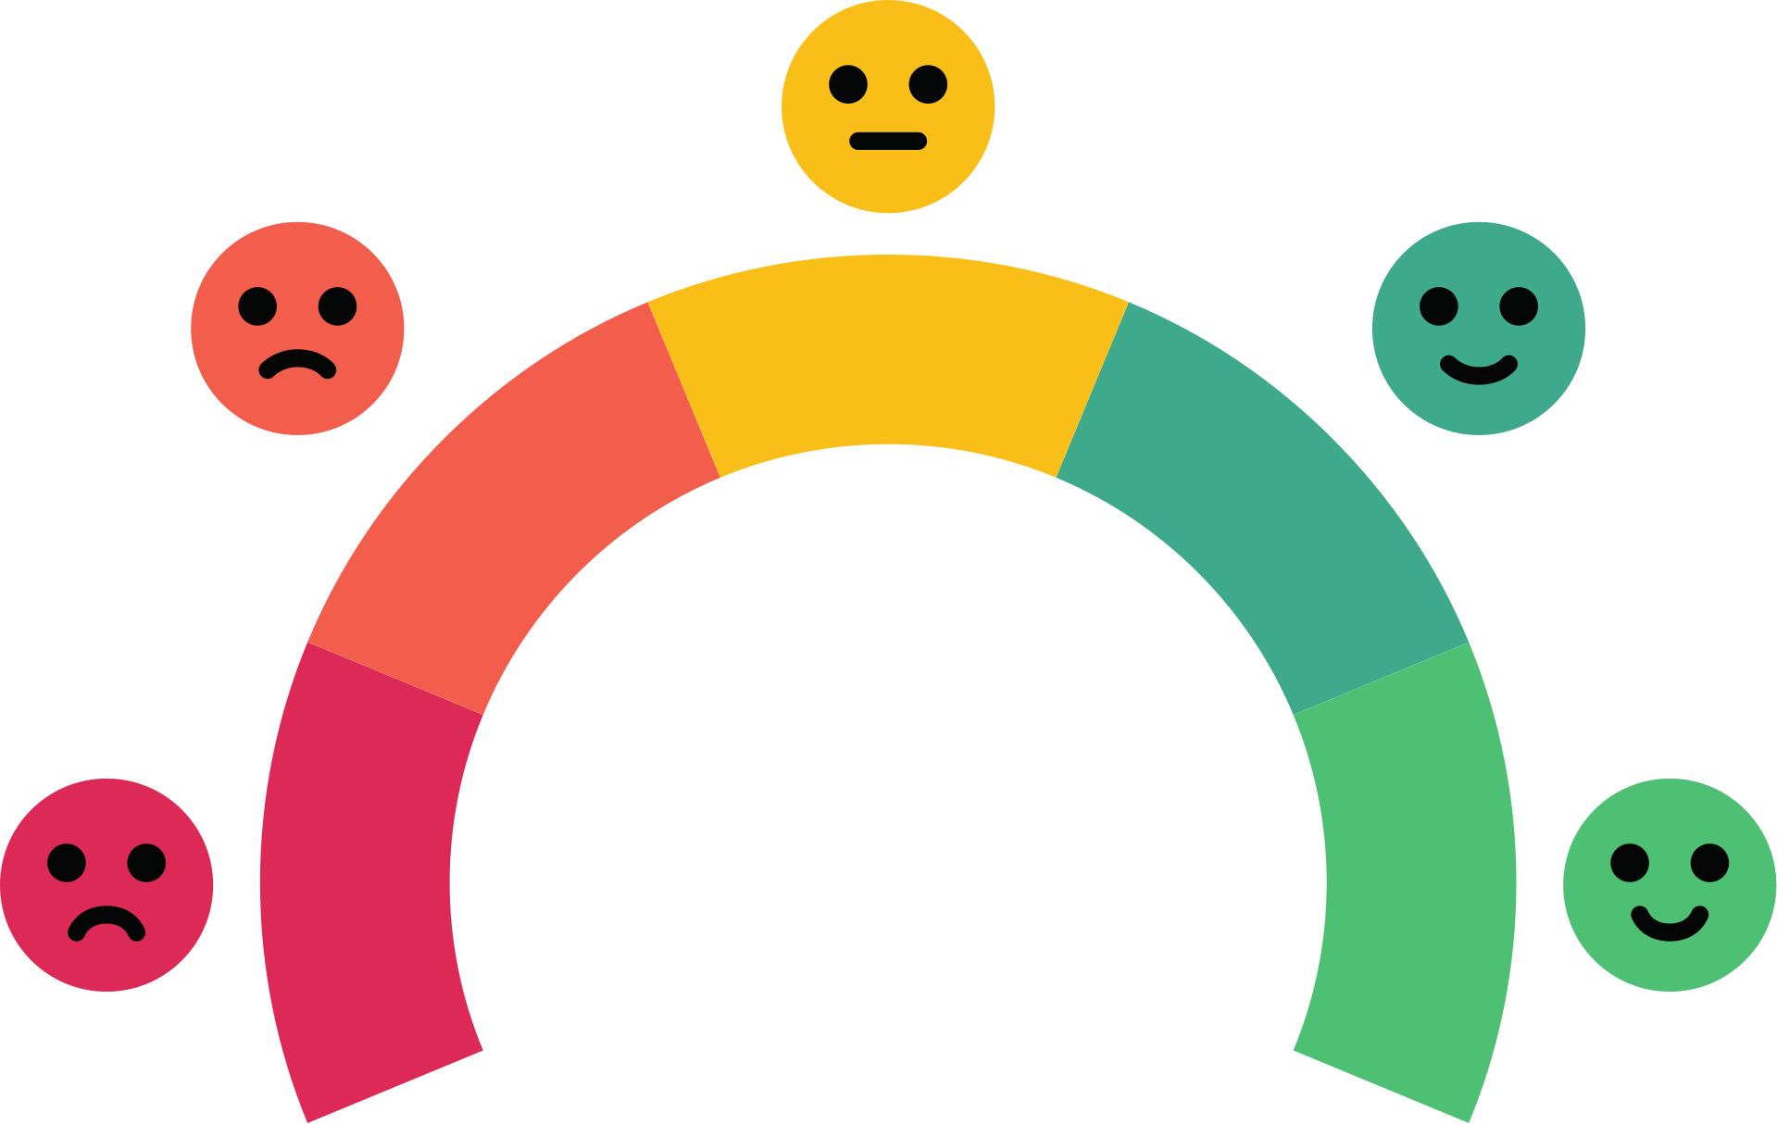
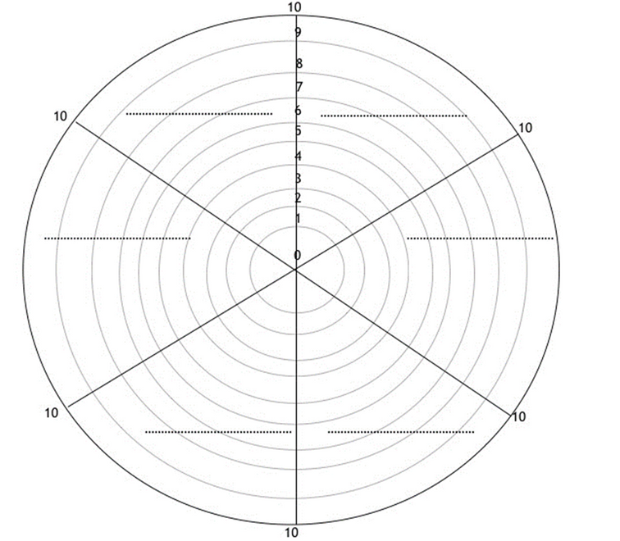
ACTIVITY 2 - CIRCLE OF LIFE
LIFE VALUES
23/28
Task 3
Draw a circle, divide it into 8 parts, and write a value of your choice in each part. You mark graphically how many percent you implement it in your life.
For example, love is the most important thing for you, but you feel that in your life you realize this value in 50%, so you mark half of the given part of the circle.
You do that with every part. This is how your wheel of life will be created. If your life is perfect, every value in the circle will reach 100%. Ideals, however, are extremely rare. It may happen that the wheel will be equal, but the percentages assigned to individual values will be at a low level, e.g. 30%.

Slide 24

ACTIVITY 2 - CIRCLE OF LIFE
LIFE VALUES
24/28
Task 4
Looking at your wheel, reflections come to your mind that are worth writing down. Often this first thought is the most valuable for the change process.
Look at your wheel, see if it's in balance? By realizing which areas are failing you are taking a giant step towards change.
try to answer following the questions:
Which area needs the most change. Why do you think?
What will you gain by making changes in this particular area?
What will happen if you don't change anything?

Slide 25

25/28
ACTIVITY 3
LIFE MAXIMES
Task1 - Read the maximes and think if it could be your life maxime and why. Take a paper and write it down.
"Seize the Day, Trust Tomorrow to No One." - Horace
"Make Today Your Masterpiece." - John Wooden
"Live Now, Procrastinate Never." - Lucius Annaeus Seneca
"Carpe Diem, Carpe Noctem, Carpe Viam." - Unknown
"Harvest Time is Today, Not Tomorrow." - Martin Luther King Jr.
"Today is a Gift, That's Why It's Called Present." - Bil Keane (commonly attributed to Eleanor Roosevelt)
"Seize the Moment, Seize the Day, Seize the Future." - Helen Keller
"The Best Way to Predict the Future is to Create It Today." - Peter Drucker

Slide 26
26/28
CONCLUSION AND WRAP UP
(10 MINUTES)
How you felt during this activity?
What have you learnt about yourselves?
What could be improved or changed?

Slide 27
27/28
WHERE TO FIND THEORY? USEFUL LINKS
https://positivepsychology.com/self-awareness-matters-how-you-can-be-more-self-aware/
https://positivepsychology.com/building-self-awareness-activities/
https://www.verywellmind.com/what-is-self-awareness-2795023
https://www.indeed.com/career-advice/career-development/what-is-self-awareness

Slide 28
REFERENCES
28/28
Smith, J. A. (2008). "Innovation in the Digital Age: A Comprehensive Study." Journal of Creative Technologies, 15(2), 101-120.
Patel, S. M. (2014). "Transformative Leadership: A Catalyst for Creative Organizational Cultures." International Journal of Leadership and Innovation, 7(3), 45-62.
Johnson, E. L. (2011). "The Power of Design Thinking: A Case Study in Product Development." Journal of Innovation and Design, 28(4), 221-240.
Chen, L. Y. (2016). "Cross-Cultural Collaboration in Creative Teams: Strategies and Challenges." International Journal of Cross-Cultural Management, 12(1), 78-96.
Garcia, M. R. (2019). "Unlocking Creativity: A Comparative Analysis of Creative Processes in Art and Business." Journal of Creative Studies, 36(3), 189-208.
Thompson, R. B. (2013). "The Role of Mindfulness in Fostering Creativity: A Longitudinal Study." Mind and Cognition, 22(4), 511-530.
Wang, Q. H. (2015). "Enhancing Workplace Creativity: The Impact of Organizational Support." Journal of Applied Psychology, 42(2), 187-204.
Robinson, A. G. (2017). "Beyond the Box: Exploring Innovative Solutions in Global Enterprises." International Journal of Business Innovation, 10(1), 34-51.
Park, Y. S. (2020). "Digital Technologies and Creative Education: A Review of Current Trends." Educational Technology Research and Development, 29(3), 145-162.
Brown, C. D. (2012). "The Intersection of Art and Science: A Study on Creativity in Interdisciplinary Research." Journal of Interdisciplinary Studies, 18(4), 301-320

Slide 29
Funded by the European Union. Views and opinions expressed are however those of the author(s) only and do not necessarily reflect those of the European Union or the European Education and Culture Executive Agency (EACEA). Neither the European Union nor EACEA can be held responsible for them.

