Slide 1



SOFT skills
1/18
SOFT SKILLS FOR YOUTH EMPLOYMENT
ADAPTATION
Project number: 2022-1-TR01-KA220-YOU-000087078

Slide 2



2/18
Adaptation
1.5 HOUR
25-30 PARTICIPANTS
  FLIPCHART PAPER AND MARKERS.
  STICKY NOTES.
  COLOURED PENS OR MARKERS.
  INDEX CARDS.
  PRINTOUTS OF DIFFERENT SCENARIOS (RELATED TO ADAPTATION)
FOR A GROUP ACTIVITY OR INDIVIDUAL WORK.
  SMALL PRIZES OR REWARDS FOR THE WINNING TEAM.

Slide 3

3/18
AIM of the training
  UNDERSTAND THE CONCEPT OF ADAPTATION AND ITS IMPORTANCE.
  Explore different examples of adaptation in various fields.
  Foster creative thinking and problem-solving skills.
  Encourage participants to reflect on personal experiences of adaptation.
  Promote teamwork and collaboration.

Slide 4

DEFINITION (20 MINUTES)
4/18
Adaptation
Adaptability is a soft skill that describes a person's capacity to change with their surroundings and still succeed in novel scenarios. It entails learning from experiences, staying open to new concepts, and handling ambiguity skillfully. A highly adaptive individual is resilient and resourceful in a variety of professional and personal contexts because they can quickly adjust their approach, techniques, or perspectives to meet the demands of changing circumstances.

Slide 5

5/18
Personal Growth:
ADAPTABILITY AND COPING MECHANISMS
  Aspect of Adaptability - coping strategies and resilience are necessary while dealing with personal obstacles like relationship or life scenario changes.
  Importance - being adaptable enables people to deal with the ups and downs of life, overcome obstacles, and come out stronger.
ACQUIRING KNOWLEDGE AND DEVELOPING SKILLS
  Flexibility Aspect - taking up new interests, learning new skills, and embracing hobbies all require adjusting to novel situations.
  The acquisition of varied skills and knowledge through adaptation fosters a continual learning mentality and personal growth. Therefore, adaptability is deemed important.

Slide 6

6/18
Personal Growth:
ADAPTABILITY IN INTERPERSONAL RELATIONSHIPS
  ADAPTABILITY IS NECESSARY TO RECOGNIZE AND TAKE INTO ACCOUNT DIVERSE POINTS OF VIEW IN INTERPERSONAL RELATIONSHIPS.
  IMPORTANCE - HAVING THE ABILITY TO ADAPT IMPROVES EMPATHY, COMMUNICATION, AND CONFLICT RESOLUTION, ALL OF WHICH LEAD TO HAPPIER AND MORE SATISFYING RELATIONSHIPS.
ACCEPTING SHIFTS IN BELIEFS AND VALUES
  FLEXIBILITY ASPECT - PEOPLE MAY NEED TO MODIFY THEIR VALUES AND IDEAS AS THEY MATURE AND CHANGE IN ORDER TO ACCOMMODATE NEW VIEWPOINTS.
  IMPORTANCE - BY MAKING IT EASIER TO ACCEPT AND INCORPORATE CHANGING VALUES AND IDEAS, A FLEXIBLE MENTALITY PROMOTES HUMAN DEVELOPMENT.

Slide 7

7/18
Professional Growth:
PROMOTION IN CAREERS
  Adaptability - since the workplace is always changing, people who can keep up with the latest technological advancements and business trends tend to succeed in their jobs.
  Importance - taking on new tasks, advancing in your profession, and being relevant all depend on your capacity to adapt.
INNOVATION AND PROBLEM-SOLVING
  The capacity to adjust tactics and approaches is a necessary skill for overcoming obstacles in the business.
  Relevance: Flexible workers are excellent at coming up with new ideas and addressing problems, which helps their companies develop and succeed.

Slide 8

Professional Growth:
8/18
DEVELOPMENT OF LEADERSHIP
  ADAPTABILITY ASPECT: ADAPTABLE LEADERS MUST LEAD THEIR TEAMS THROUGH TIMES OF CHANGE.
  IMPORTANCE: ADAPTABLE LEADERS ENCOURAGE SELF-ASSURANCE, CULTIVATE A POSITIVE WORK ENVIRONMENT, AND AID IN THE TEAM MEMBERS' PROFESSIONAL DEVELOPMENT.
ADAPTABILITY IN DUTIES AND POSITIONS
  ASPECT OF ADAPTABILITY: CHANGING POSITIONS AND RESPONSIBILITIES ARE A COMMON PART OF CAREER PATHWAYS.
  RELEVANCE: PROFESSIONALS THAT ARE ADAPTABLE ARE MORE WILLING TO TAKE ON NEW CHALLENGES, DEVELOP NEW SKILL SETS, AND PUT THEMSELVES UP FOR CAREER ADVANCEMENT.
SUCCESSFUL COOPERATION
  ADAPTABILITY: THE ABILITY TO ADJUST TO VARIOUS WORKING STYLES AND METHODS IS NECESSARY WHEN WORKING IN DIVERSE TEAMS.
  RELEVANCE: FLEXIBLE WORKERS ARE EXCELLENT AT COLLABORATING WITH OTHERS, BUILDING A LIVELY AND CREATIVE WORK ATMOSPHERE, AND WORKING IN TEAMS.

Slide 9

9/18
Scenarios
  each station, requires brainstorming and coming up with at least three unique adaptations that would help you to survive and thrive in described environment.
  brainstorm for 5-7 minutes and write down your adaptations on a sheet of paper or sticky notes.
  choose another/next station, and repeat the brainstorming process for that new environment.
  continue until you have visited all the stations.

Slide 10

Scenarios (40 minutes)
10/18
ARCTIC TUNDRA SURVIVAL STATION
THE DEEP SEA RESEARCH STATION
Following a snowfall, you wind up stuck in the Arctic Tundra. You have to learn how to adapt to the harsh surroundings, which include well below freezing temperatures, little daylight, and few supplies. Think about finding food, shelter, and a way to remain warm in this freezing environment.
As a member of an underwater exploration team, you go to extremely deep places where light is not visible. The extreme pressure, total darkness, and poor vision present formidable obstacles. Coming up with ideas for exploring, navigating, and doing research in the deep water is your duty.

Slide 11
Scenarios (40 minutes)
11/18
EXPERIENCE AS A DESERT NOMAD
SURVIVING IN THE JUNGLE
Imagine yourself stranded in a wide desert with intense heat, few water sources, and vast sand dunes. You'll need to come up with plans to survive and thrive in this harsh environment. Think of how to find or make shelter, secure water, and shield from the sun's rays.
You are deep in the heart of a dense jungle, where you must contend with a variety of wildlife, heavy flora, and erratic weather. Your objective is to come up with and put into action plans for safe and efficient navigation, defense against dangers unique to the jungle, and creating a reliable food supply.

Slide 12
Scenarios (40 minutes)
12/18
URBAN CITY RESILIENCE CENTER
LIFE ON SPACE STATION
There are particular difficulties in adjusting to a fast-paced, crowded, and polluted metropolitan existence. Think about strategies for adjusting to the rigors of city living, tackling problems like waste management, environmentally friendly transportation, and preserving mental health in a metropolitan environment.
You experience solitude, scarce supplies, and microgravity as a member of a space station crew. Your task is to come up with ideas for adjusting to living in space, taking into account things like producing artificial gravity, building closed-loop life support systems, and dealing with the psychological effects of prolonged space flight.

Slide 13
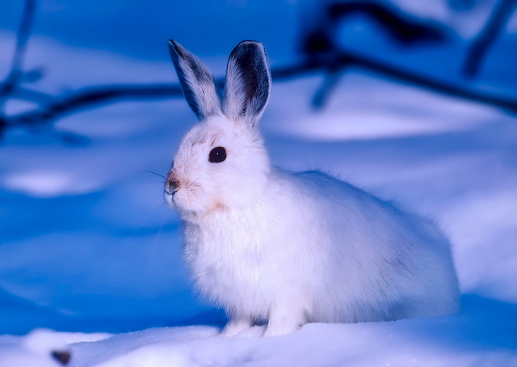
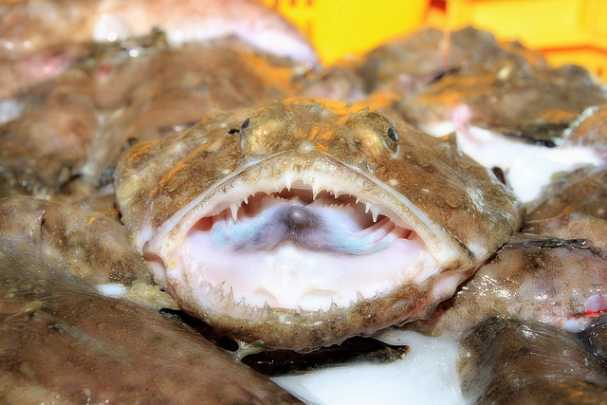
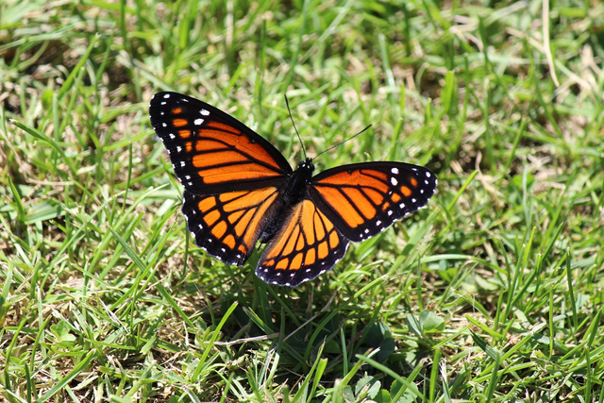

Adaptation in Nature and Science
13/18
ADAPTATION IN NATURE
Take a look on the pictures and try to answer the questions:
  What specific adaptations have you noticed in these examples?
  How do these adaptations help organisms or systems thrive?
  Can you think of any other examples of adaptation in nature or science?
Viceroy ( Limenitis archippus )
Peppered
moth
Arctic hare
Anglerfish

Slide 14




Scientific Breakthroughs
14/18
SCIENTIFIC BREAKTHROUGHS
Take a look on the pictures and try to answer the questions:
  What specific adaptations have you noticed in these examples?
  How do these adaptations help organisms or systems thrive?
  Can you think of any other examples of adaptation in nature or science?
Mars Rover Perseverance
Liposomal drug deliver
CRISPR-Cas9
Quantum technology

Slide 15

15/18
Personal Adaptation
Stories
  hand out sticky notes and colored pens/markers
  reflect on personal experiences of adaptation and write down a brief story or example on the sticky notes.
  collect the sticky notes
  think if you would choose different solutions to adapt better
.

Slide 16
16/18
CONCLUSION AND WRAP UP
(10 MINUTES)
Summarize the key takeaways from the training.
Emphasizing the value of adaptation

Slide 17
ADAPTATION - USEFULL LINKS
17/18
How to Demonstrate Adaptability in the Workplace - https://peopledynamics.co/how-to-demonstrate-your-adaptability-at-work/
Coping with Ambiguity: The Key to Success in Today’s Workplace - https://www.indeed.com/career-advice/career-development/dealing-with-ambiguity
The Importance of Adaptability in the Workplace - https://www.linkedin.com/pulse/importance-adaptability-workplace-ejamjobs
How to Demonstrate Adaptability on the Job - https://your.yale.edu/learn-and-grow-what-adaptability-workplace
How to Develop Adaptability Skills in Uncertain Times
https://asana.com/pl/resources/workplace-adaptability-skills
How to Adapt to Remote Work: The Ultimate Guide - https://zapier.com/resources/guides/remote-work

Slide 18
REFERENCES
18/18
  Etemad-Sajadi, R., & Etemad, H. (2018). Soft Skills as Key Drivers of Economic Development. Journal of the Knowledge Economy, 9(1), 54-71.
  Graves, L. M., & Cawthon, T. W. (2019). Adaptability: An Important Skill for the 21st Century Workforce. Delta Kappa Gamma Bulletin, 85(1), 13-19.
  Feldman, S. P., Tarba, S., et al. (2019). The Role of Adaptability in Expatriate Performance: A Cross-Cultural Study. Journal of World Business, 54(1), 1-12.
  Stimpson, C., & Câmara, G. (2019). Employability Skills in the 21st Century. Geospatial World, 32(4), 38-41.
  Motyl, M., & Kashdan, T. (2019). Developing the Adaptive Workforce: Training and Education for the Future Workplace. Current Opinion in Behavioral Sciences, 34, 80-85.
  Adams, S. (2015). Embrace change and thrive: Strategies for developing adaptability. Forbes.
  Cappelli, P. (2015). Why we love to hate HR... and what HR can do about it. Harvard Business Review, 93(7-8), 54-61.
  Pulakos, E. D., Arad, S., Donovan, M. A., & Plamondon, K. E. (2000). Adaptability in the workplace: Development of a taxonomy of adaptive performance. Journal of Applied Psychology, 85(4), 612-624.
  HBR Ascend. (2019). The 5 skills you need to adapt to change at work. Harvard Business Review.
  Tannenbaum, S. I., Mathieu, J. E., Salas, E., & Cannon-Bowers, J. A. (1991). Meeting trainees' expectations: The influence of training fulfillment on the development of commitment, self-efficacy, and motivation. Journal of Applied Psychology, 76(6), 759-769.

Slide 19
Funded by the European Union. Views and opinions expressed are however those of the author(s) only and do not necessarily reflect those of the European Union or the European Education and Culture Executive Agency (EACEA). Neither the European Union nor EACEA can be held responsible for them.

