Slide 1



Home
Advantages
Guidelines
Contact us
Buy Before You Sell
The modern bridge solution for your clients
15k +
28k +
760M +
Top loan officers
Top real estate agents
Total equity unlocked

Slide 2
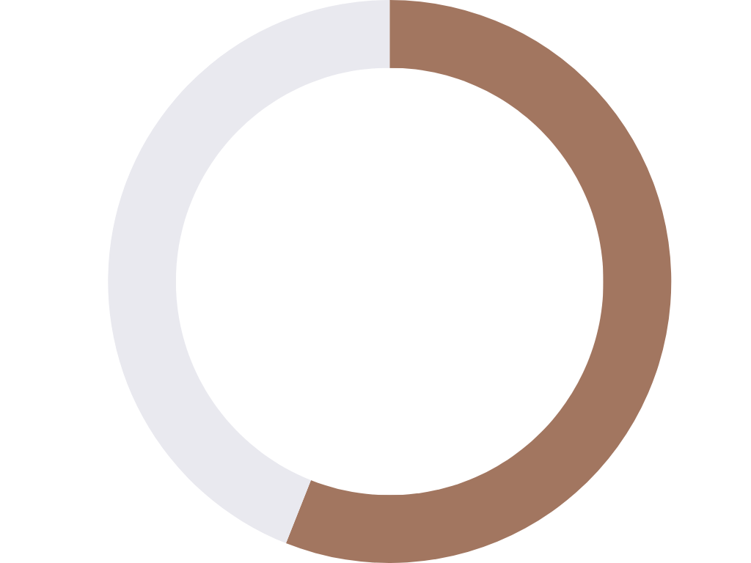

BUY BEFORE YOU SELL
Home
Advantages
Guidelines
Contact us
A modern solution
We’re solving a problem that more than half of your clients face when buying a new home.
56%
of repeat buyers use funds from their departing residence for their down payment*
*Based on the 2021 NAR Profile of Home Buyers and Sellers

Slide 3

BUY BEFORE YOU SELL
Home
Advantages
Guidelines
Contact us
From registration to closing — we do the heavy lifting
You now have access to the modern bridge solution needed to move forward on your client’s new purchase!

Slide 4

BUY BEFORE YOU SELL
Home
Advantages
Guidelines
Contact us
Goodbye Pending Home Sale
Save your clients money by removing their pending sale contingency before they submit their next offer
Boost Your Client’s Financial Leverage
The Equity Unlock gives clients access to up to 70% CLTV of their departing residence
Help your clients purchase first
Remove clients departing residence mortgage liability from their debt-to-income ratio

Slide 5
BUY BEFORE YOU SELL
Home
Advantages
Guidelines
Contact us
Sample Transaction
1
Step 1: Departing Residence Approval
Expected Sales Price: $500k
Mortgage Balance: $250k
Equity Unlock: $100k
2
Step 2: Shop Contingency Free!
Client shops for new home with a contingency-free offer and a 0% interest bridge loan in their back pocket.
3
Step 3: Close on new home/mortgage!
New Purchase: $600k
Down Payment: $100k
EQUITY UNLOCK
4
Step 4: Sell at Full Market Value!
*Fees subject to change; additional fees may apply
*Minimums apply if the final sale price of the current home is less than $375,000
List the home and sell at Full Market Value within 120 days after the new home is purchased!
2.4%* transaction fee to be paid at home sale.

Slide 6
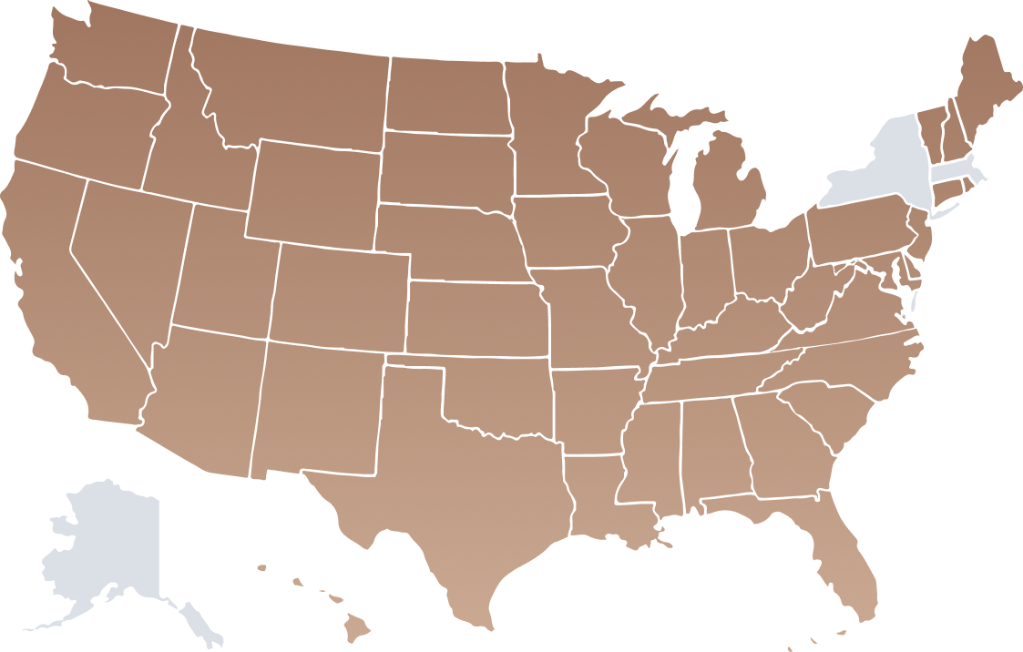

BUY BEFORE YOU SELL
Home
Advantages
Guidelines
Contact us
Discover where Buy Before You Sell is currently available
Alabama
Arizona
Arkansas
California
Colorado
Connecticut
Delaware
Florida*
Georgia
Hawaii
Idaho
Illinois*
Indiana
Iowa
Kansas
Kentucky
Louisiana
Maine
Maryland
Michigan
Minnesota
Mississippi
Missouri
Montana
Nebraska
Nevada
New Hampshire
New Jersey
New Mexico
North Carolina
North Dakota
Ohio
Oklahoma
Oregon
Pennsylvania
Rhode Island
South Carolina
South Dakota
Tennessee
Texas*
Utah
Vermont
Virginia
Washington
Washington D.C.
West Virginia
Wisconsin
Wyoming
Chicago, IL
Galveston, TX
Key West, FL
Available now
*Exclusions

Slide 7
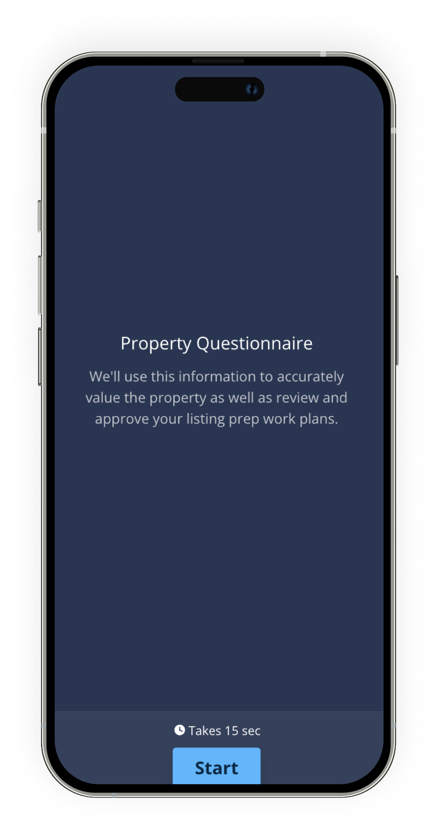
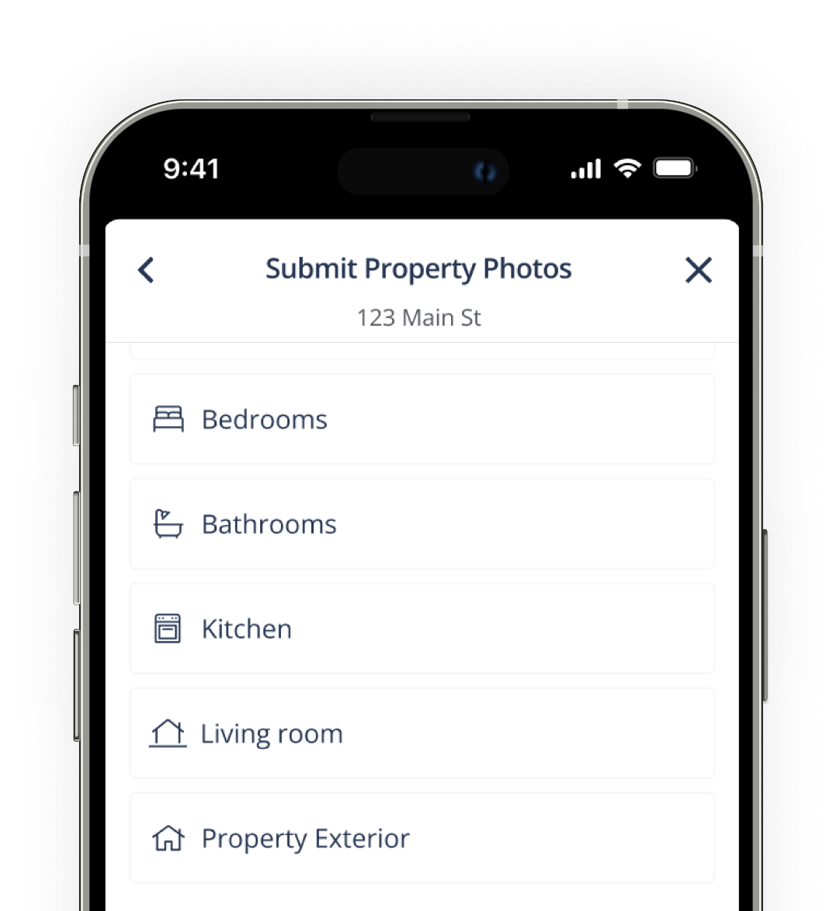
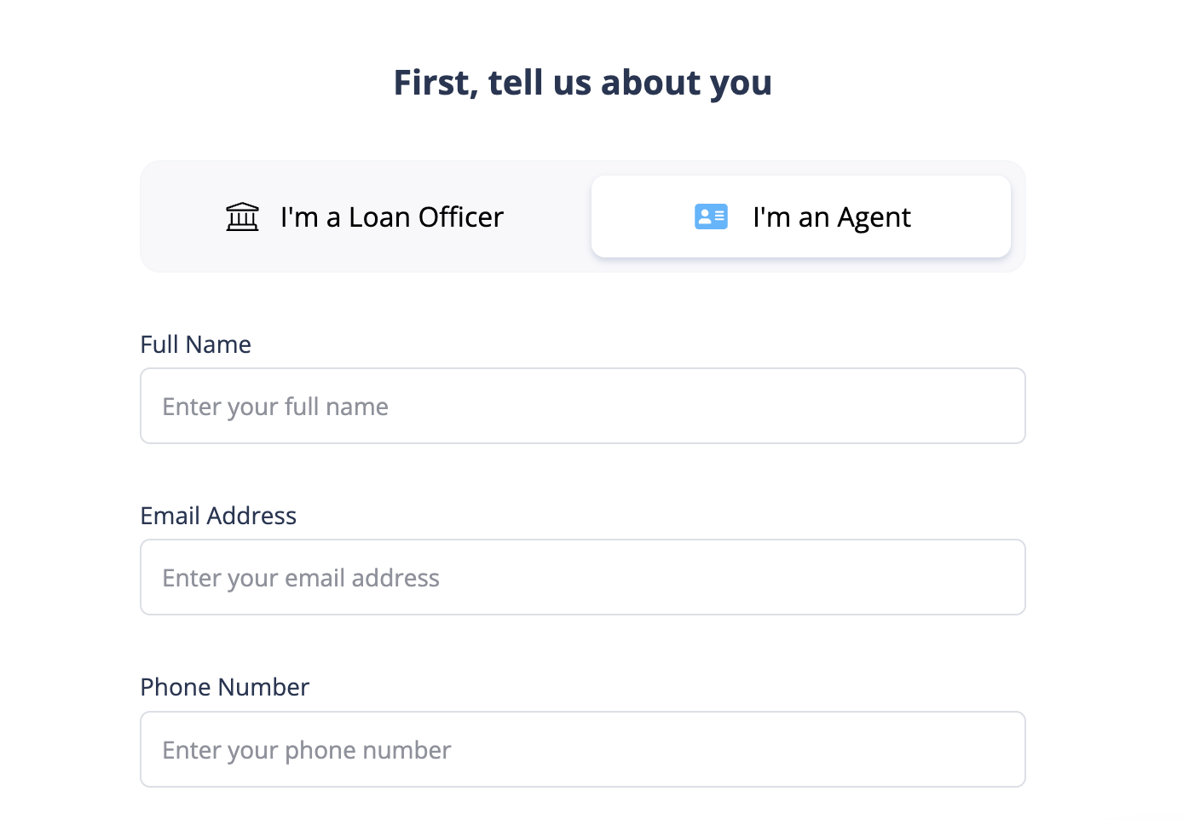
BUY BEFORE YOU SELL
Home
Advantages
Guidelines
Contact us
24-hour Full Approval
1
2
Submit your client’s departing residence & preferred loan officer’s information to the Buy Before You Sell application.
After submission, your loan officer will receive a link to submit 10+ photos of your client’s property. They may also forward this link to you and/or Client to complete.

Slide 8
BUY BEFORE YOU SELL
Home
Advantages
Guidelines
Contact us
Property
Requirements
Eligible properties: single-family home, townhome, or condo*
Cannot be greater than 5 acres
Must have access to public roads and utilities (water, electricity)
Must be zoned as residential
Not in an age-restricted community
Not a short-sale or pre-foreclosure
Not subject to any leases, including tenancy, oil/gas/mineral rights
Departing residence cannot be part of an active new construction community
Incoming Residence must have a Certificate of Occupancy if it is a new construction
No Active Foreclosures or Bankruptcies
Not a Log Home
Not a Non-warrantable Condo
*Condos & HOAs require additional approval

Slide 9

BUY BEFORE YOU SELL
Home
Advantages
Guidelines
Contact us
The Home Requirements
We can provide Equity Unlock amount up to $2M
Square feet: 750-5,550**
Home value
  Less than $100,00 are ineligible
  Less than $150,000 will be subject to further review
At least 1 bedroom and 1 bathroom
Any lien on the home from solar financing or leasing must be fully paid
Solar lease does not need to be fully paid off but we need to account for the payoff in the econ model
Not occupied by tenants during or after the purchase
No leasehold, no outstanding life estates, trusts will need trust agreement to review before approval
No VA, FHA, or reverse mortgages on incoming residence
If the Departing Residence or Incoming Residence is a second home or investment property, the transaction is NOT eligible
**Exceptions can be made if the size of the property is conforming for the area

Slide 10
BUY BEFORE YOU SELL
Home
Advantages
Guidelines
Contact us
Repairs & Renovations
No ongoing renovations affecting bathroom, kitchen, drywall, or landscaping
No major defects in or ongoing repairs or upgrades to foundation, framing, roof, plumbing, electrical, HVAC, fireplace, and chimney
Listing & DOM
Expected days on market is less than 90 days list-to-pending
Properties listed for more than 150 days in total are ineligible.

Slide 11

BUY BEFORE YOU SELL
Home
Advantages
Guidelines
Contact us
Frequently Asked Questions
What does the program cost?
2.4%* of the sale of the home. Minimums
apply if departing residence is valued less
than $375,000.
How does the Equity Unlock work?
0% bridge loan to use as down
payment on new purchase
How do you determine the Backup Offer?
Loan Payoff Value = Mortgage Balance + Equity Unlock Amount
What if HomeLight purchases the home and sells it for more?
With our Home Sale Guarantee, the client receives 100% net proceeds if HomeLight needs to purchase the home
*Fees subject to change; Minimums apply.

Slide 12

Home
Advantages
Guidelines
Contact us
Let us know if you have any questions
E-mail
Journey Mortgage Group | NMLS #460804
Powered by HomeLight Home Loans | NMLS ID #1529229 | 1375 N. Scottsdale Rd. Suite 480, AZ 85257
Lenders@HomeLight.com

