Slide 1
Taking Charge of
Your Financial Wellness
A financial education workshop
F³E
The Foundation for Financial Education
A 501(c)(3) Nonprofit Organization
F3Eonline.org | (240) 499-0390 | info@F3Eonline.org

Slide 2
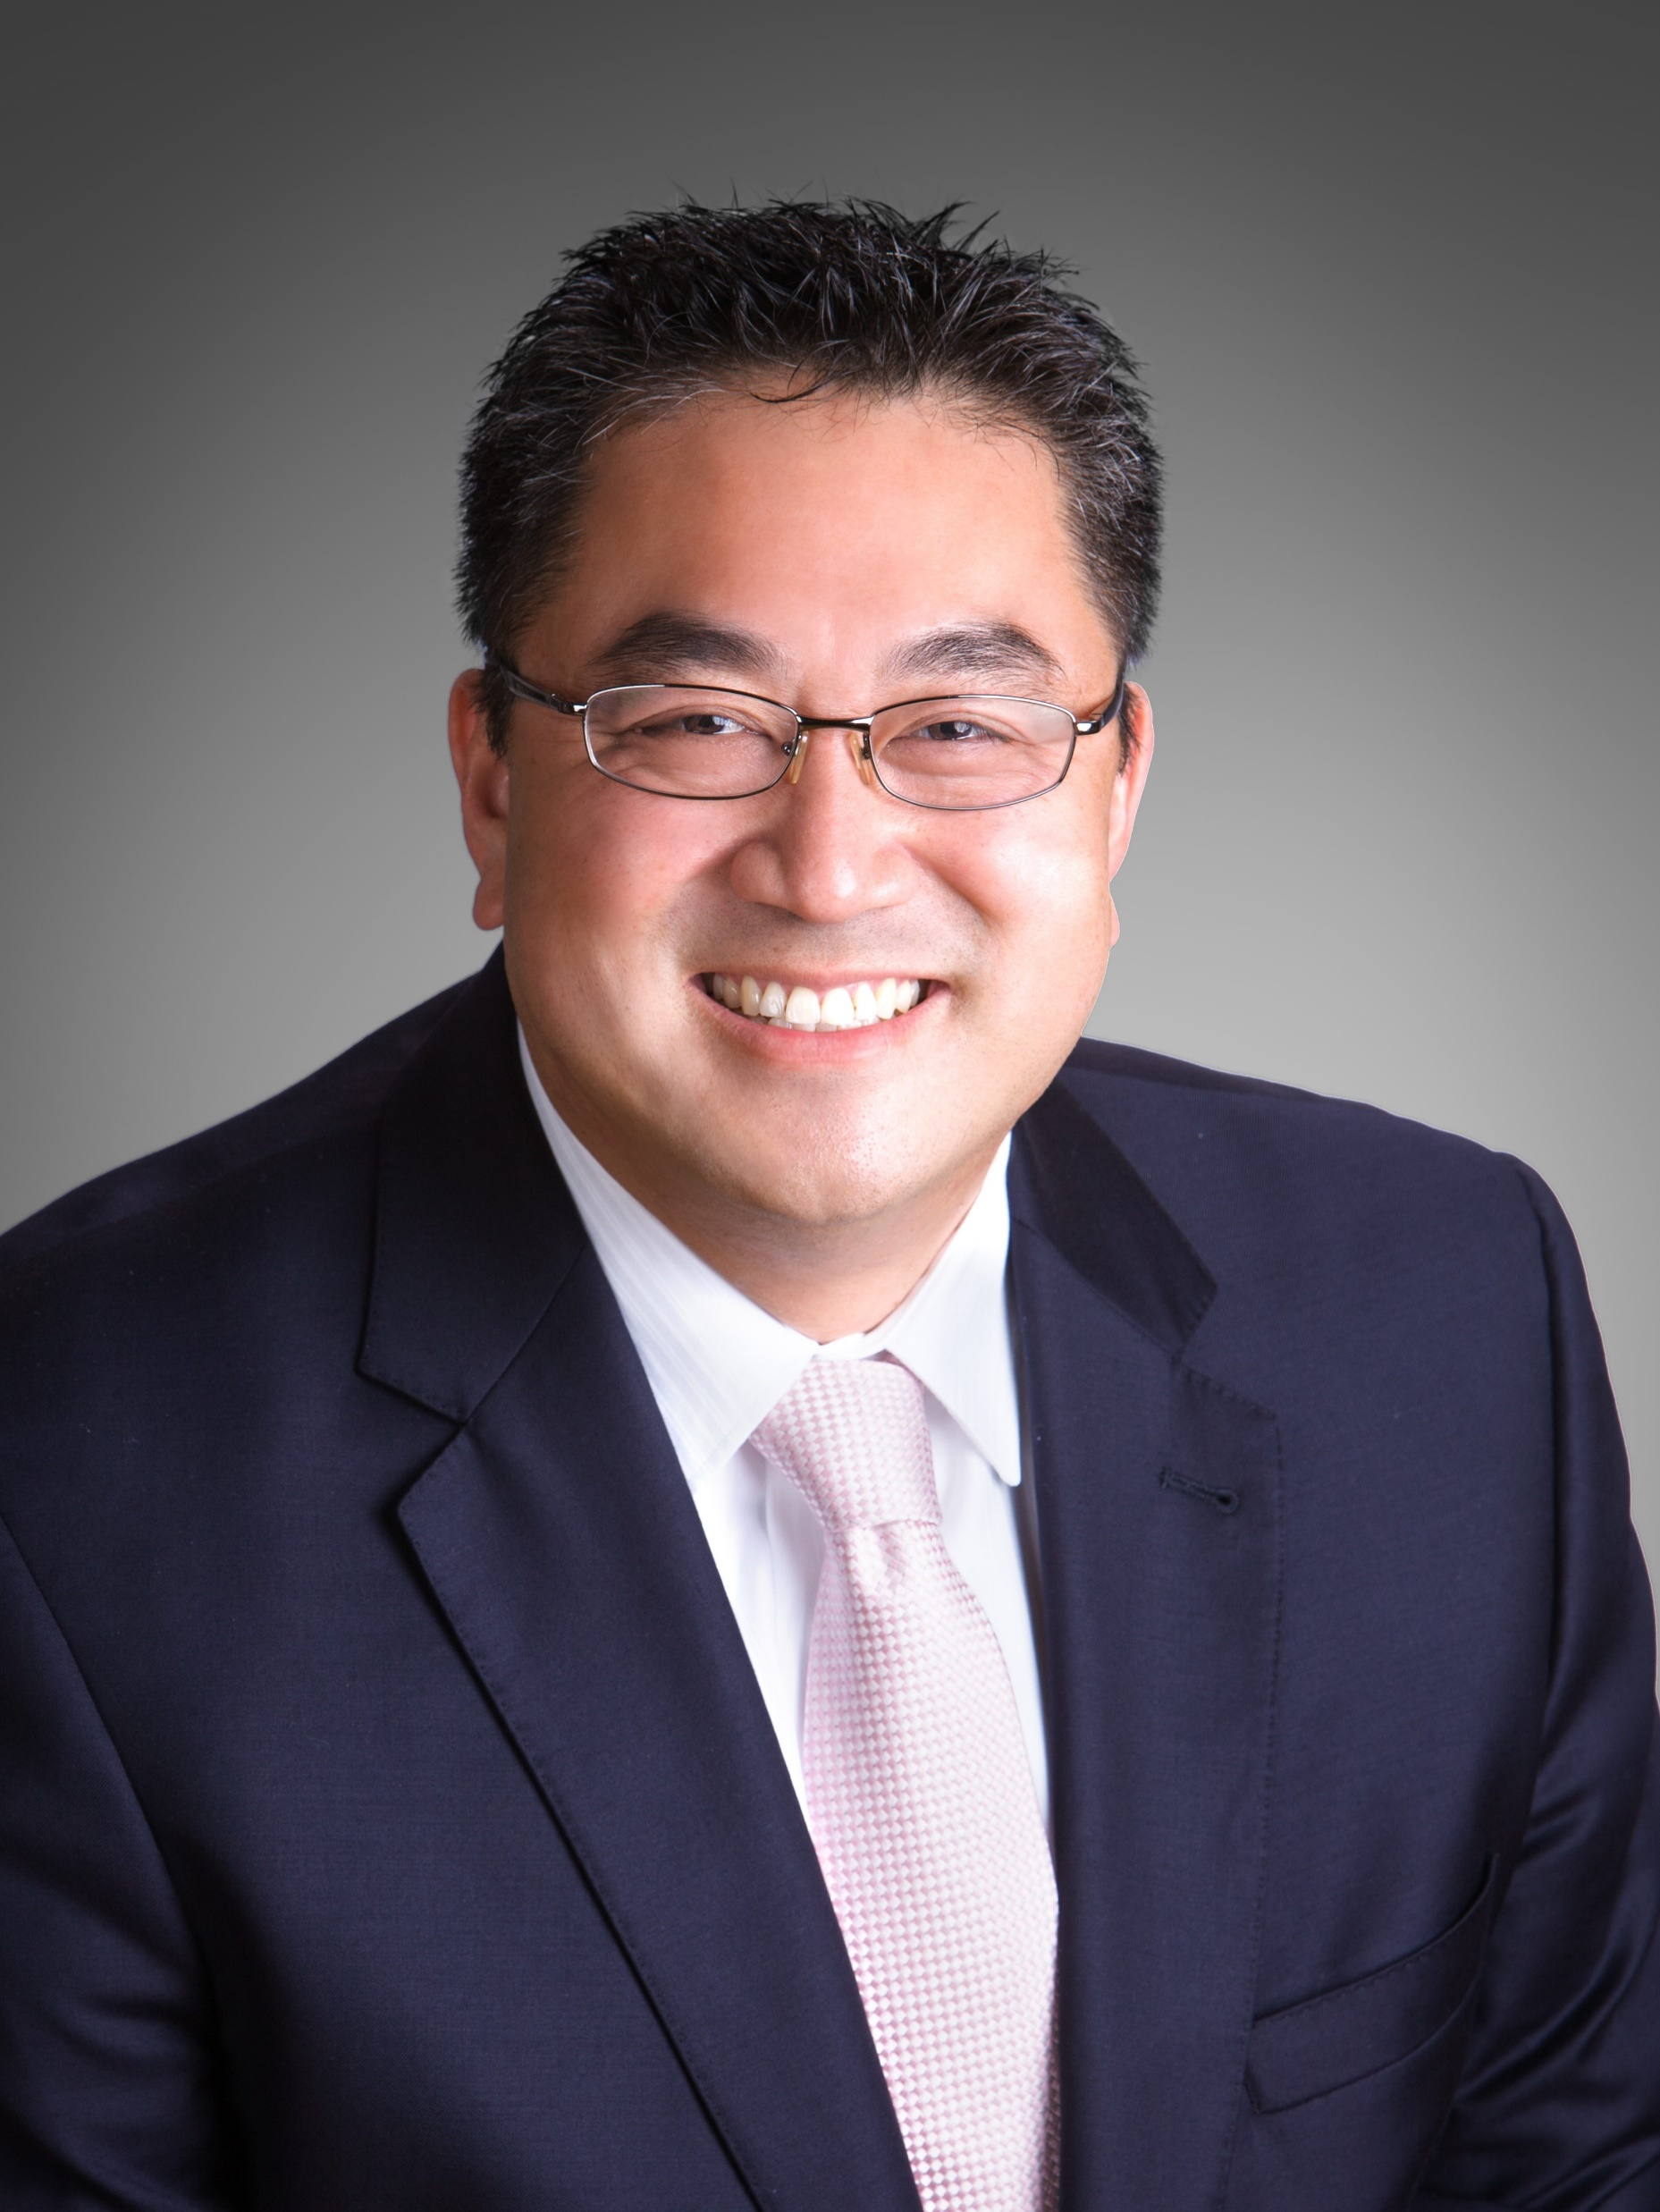
Today’s Featured Speakers:
Jonathan Lee
Founder and National Director
The Foundation for Financial Education
Susan Fauber
Community Outreach Coordinator
The Foundation for Financial Education

Slide 3
Disclaimer:
This educational workshop is presented by Foundation for
Financial Education (F³E) volunteers. The following presentation does not in any way advocate for any advice or recommendations about the stock market or any related investments. No products, services or advice are endorsed by the Foundation (F³E), and any action taken by the consumer is solely at their discretion. Please consult with a licensed advisor who is specifically licensed in the jurisdiction where you reside prior to taking any action relating to investments, insurance, tax, legal, real estate or any other financial instruments. The Foundation (F³E) is not directly affiliated with any of its Certified Educational Consultant Volunteers and is not owned in part or in whole by any private corporation, organization or association. The material contained herein should not be construed by any audience as anything other than general and generic educational information available to the public. Individuals are encouraged to seek professional advice so they may receive actionable recommendations from a licensed professional.

Slide 4
When will your financial journey begin?
3 Phases of Wealth:
Accumulation
Distribution
Conservation

Slide 5
Generation Challenges
Each generation faces a different set of challenges
in reaching its financial objectives
Accumulation
Eroding Factors
Distribution
Income Planning Issues
Conservation
Legacy Planning Issues

Slide 6
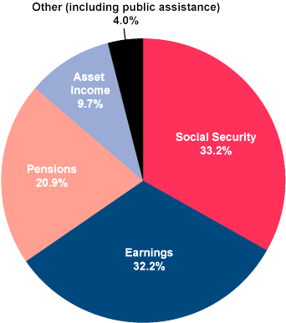
How Much Am I Responsible For?
33.2%
Social Security
32.2%
Earnings
20.9%
Pensions
9.7%
Asset Income
4%
Other
(including public assistance)

Slide 7
Deferral vs. Roth: Tax Strategy
Dependent deduction
Mortgage interest deduction
Taxes are at an all time low
All retirement benefits are taxable (except Roth)
401(k) or TSP is largest taxable base by time of retirement
Social Security is added income on top of savings & retirement
Worst time to pay taxes: no salary

Slide 8
The vision we need to have:
Product vs. Strategy
Financial Products
Mutual Funds
Stock
Trusts
Mortgage
401(k) / 403(b)
IRA / Roth IRA
Real Estate
Bonds
CDs
Will
Living Trusts

Slide 9
Retirement Planning
Social Security
Spousal benefits
Survivors benefits
Primary benefits
Dependent benefits
Disability benefits
Stocks, bonds, and mutual funds
401(k)s, 403(b)s, and TSPs
Pension
Roth IRAs
All taxed upon withdrawal except Roth
Exit plan: long-term impact → Consider taxes, performance, inflation, market volatility
Social Security:
Spousal benefits
Survivors benefits
Primary benefits
Dependent benefits
Disability benefits

Slide 10
Wills
1
Last Will & Testament: Transfer of assets
Beneficiary:
Doesn’t avoid probate, but expedites the process
A named beneficiary > Will
Any asset can have a named beneficiary
2
Power of Attorney:
General and durable
Competency/capacity
POD: Checking & Savings
TOD: Securities or Brokerage Account
Beneficiary deed: Real Estate
3
Medical Directive /
Living Will
Heroic effort or DNR

Slide 11
Error: No Estate Plan
Avoiding probate and taxes
Three parts to a Will
Revocable Living Trusts
Beneficiary designation
Long-term care and protecting your assets

Slide 12
Error: Following “One-Size-Fits-All” Advice
Most schools of thought:
15-year mortgages vs. 30-year mortgages
Stocks vs. mutual funds vs. ETFs
Term vs. Permanent life insurance
Pay down debt first before saving vs. start saving now!

Slide 13
What To Do Now?
Act!
Start Accumulation Phase
Consult knowledgeable advisors to help guide you

Slide 14
Thank you for your participation!
Following the webinar, please be sure to submit the Feedback Survey that will pop up after closing the software or inside of the thank-you email.
Contact 301-718-0030 | info@f3eonline.org
to connect with a volunteer right away.
Your input is appreciated!

