Slide 1


IRA, TSP, & 401(k)
Rollovers
PRESENTED BY
The Foundation for Financial Education
A 501(C)(3) NONPROFIT ORGANIZATION

Slide 2



Today’s Featured Presenters:
Jonathan Lee
Founder and National Director
The Foundation for Financial Education
Kyna Erickson
Outreach Coordinator
The Foundation for Financial Education

Slide 3
Disclaimer:
This educational workshop is presented by Foundation for Financial Education (F³E) volunteers. The following presentation does not in any way advocate for any advice or recommendations about the stock market or any related investments. No products, services, or advice are endorsed by the Foundation (F³E), and any action taken by the consumer is solely at their discretion. Please consult with a licensed advisor who is specifically licensed in the jurisdiction where you reside prior to taking any action relating to investments, insurance, tax, legal, real estate or any other financial instruments. The Foundation (F³E) is not directly affiliated with any of its Certified Educational Consultant Volunteers and is not owned in part or in whole by any private corporation, organization, or association. The material contained herein should not be construed by any audience as anything other than general and generic educational information available to the public. Individuals are encouraged to seek professional advice so they may receive actionable recommendations from a licensed professional.

Slide 4

ERISA TAX ACT 1974
Studebaker Corporation
Pension Benefit Guarantee Corporation
Vesting, Matches, Joint and Survivor
Cobra & HIPPA

Slide 5




Retirement Accounts
IRA Traditional/ROTH/non-deductible
Employer Sponsored Plans, 401k, TSP, 403b, etc.
Self-Employed Plans, SEP, SIMPLE, DB’s
Other (non-qualified deferred Comp, NUA, Options, Grants)

Slide 6


TSP
-1987 G, F & C
-2001 I & S
Lifecycle Funds
Mutual Fund Window 2022
TSP Roth 2025

Slide 7


Taxation of Accounts
Traditional
Roth
Non-Deductible
RMDs
Inheritance and Trusts

Slide 8
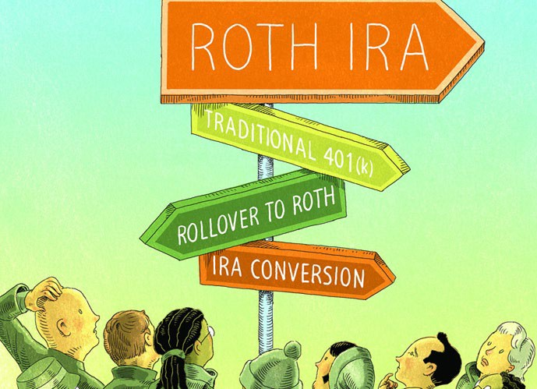
Rollovers and Conversions
New money vs. Old money
Direct vs. Indirect
Conversions, the 5-year rule

Slide 9

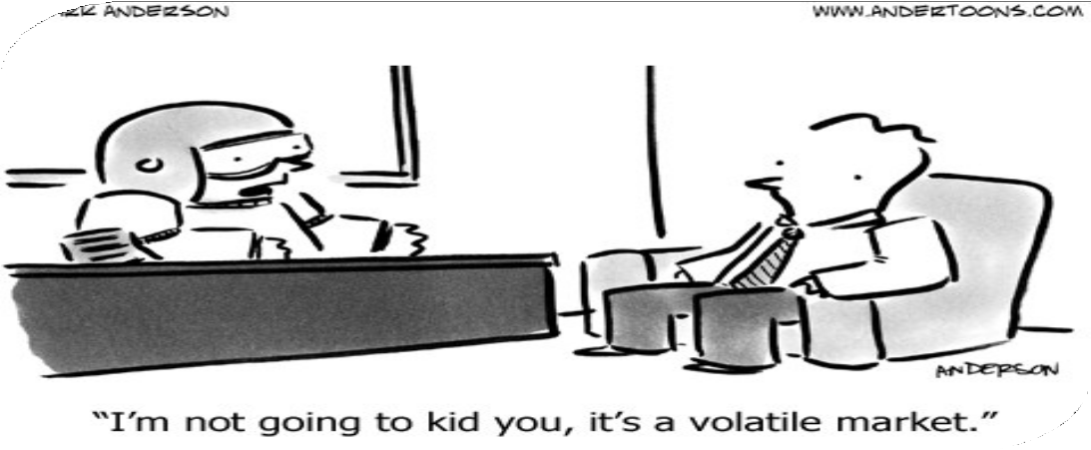
TSP Mid-Air Conversion
3-Step process
Future considerations
Market volatility
Niche products

Slide 10

To Be Mentioned….
60-day Rollovers
Non-deductible conversion for higher income earners can be repeated every year.
Fill up your tax bucket to maximize your bracket.
Pro-Rata Conversion Rule

Slide 11

Withdrawals, 72T and 72Q
Age 59.5
1
Age 70.5
2
Age 73
3

Slide 12
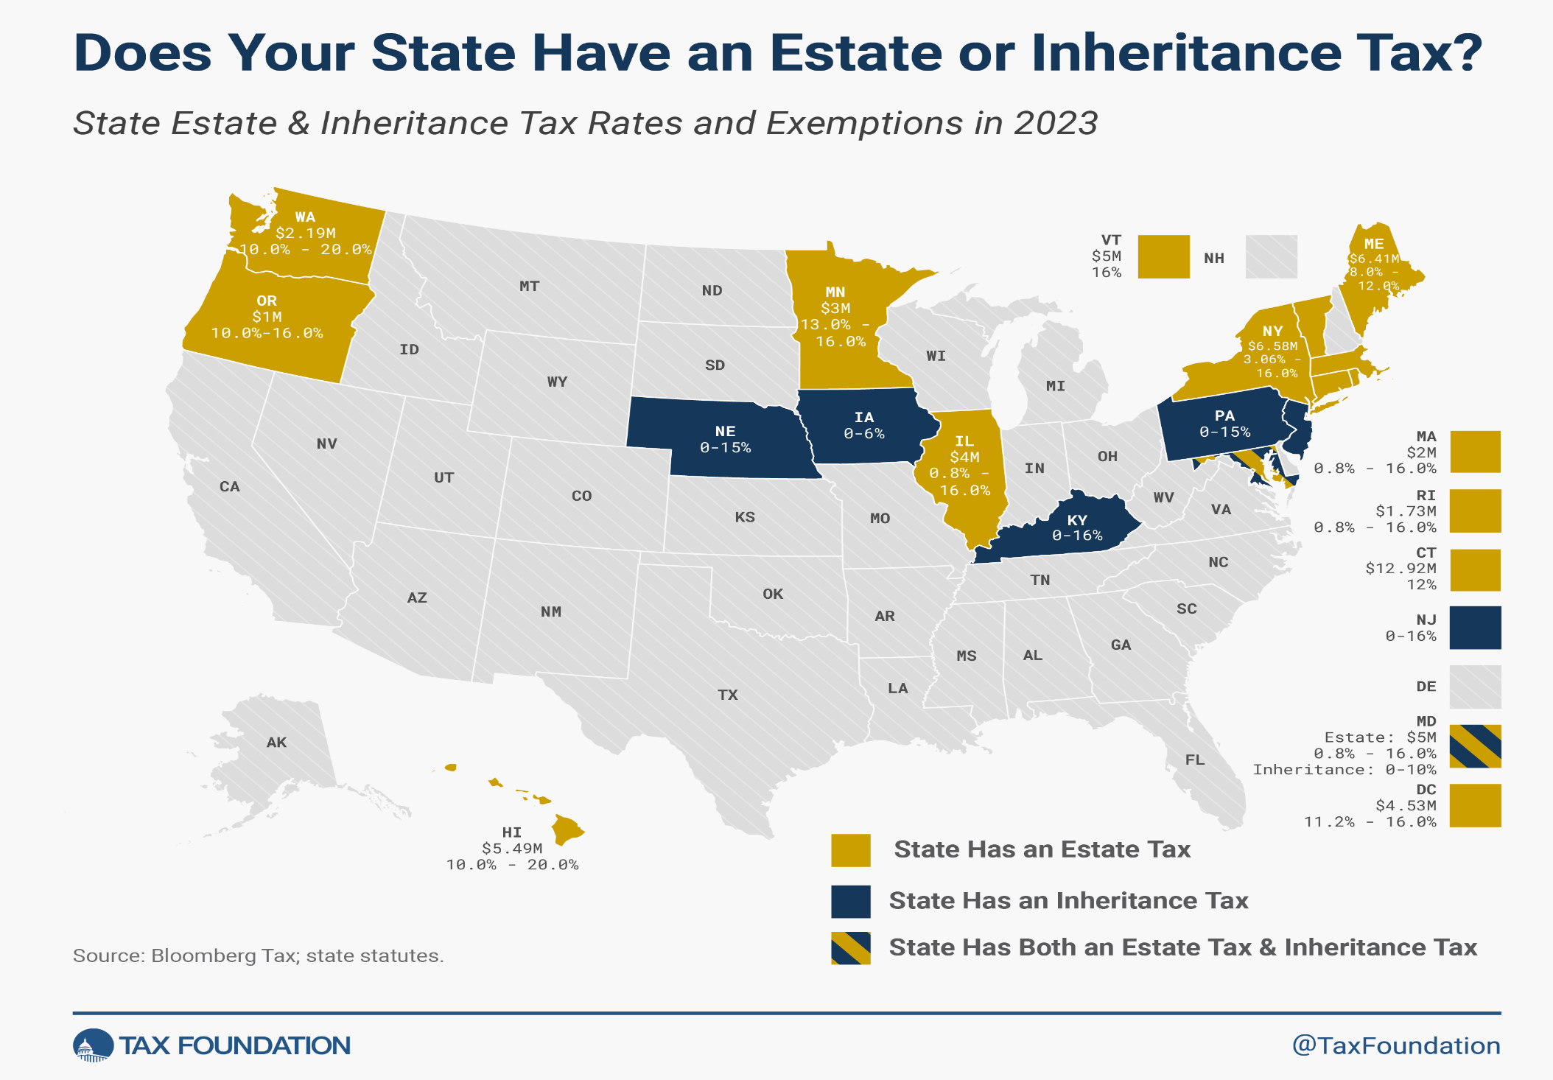

Slide 13

Exit Strategy
3 steps for withdrawal
Passing on to heirs
Gifting/Life Insurance

Slide 14
Thank you for your participation!
Following the webinar, please be sure to submit
the feedback survey that will pop up after closing the software or inside of the thank-you email.
Contact 301-718-0030 | info@f3eonline.org
to connect with a volunteer right away.
Your input is appreciated!

