Slide 1
Financial planning
In uncertain times
Presented by
The foundation for financial education
A 501(c)(3) Non-profit organization
www.f3eonline.org | (240) 499-0390 | info@f3eonline.org
F³E

Slide 2
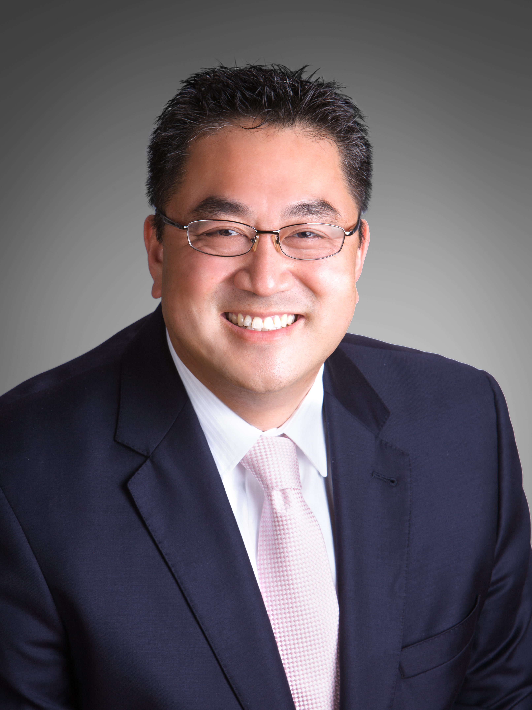
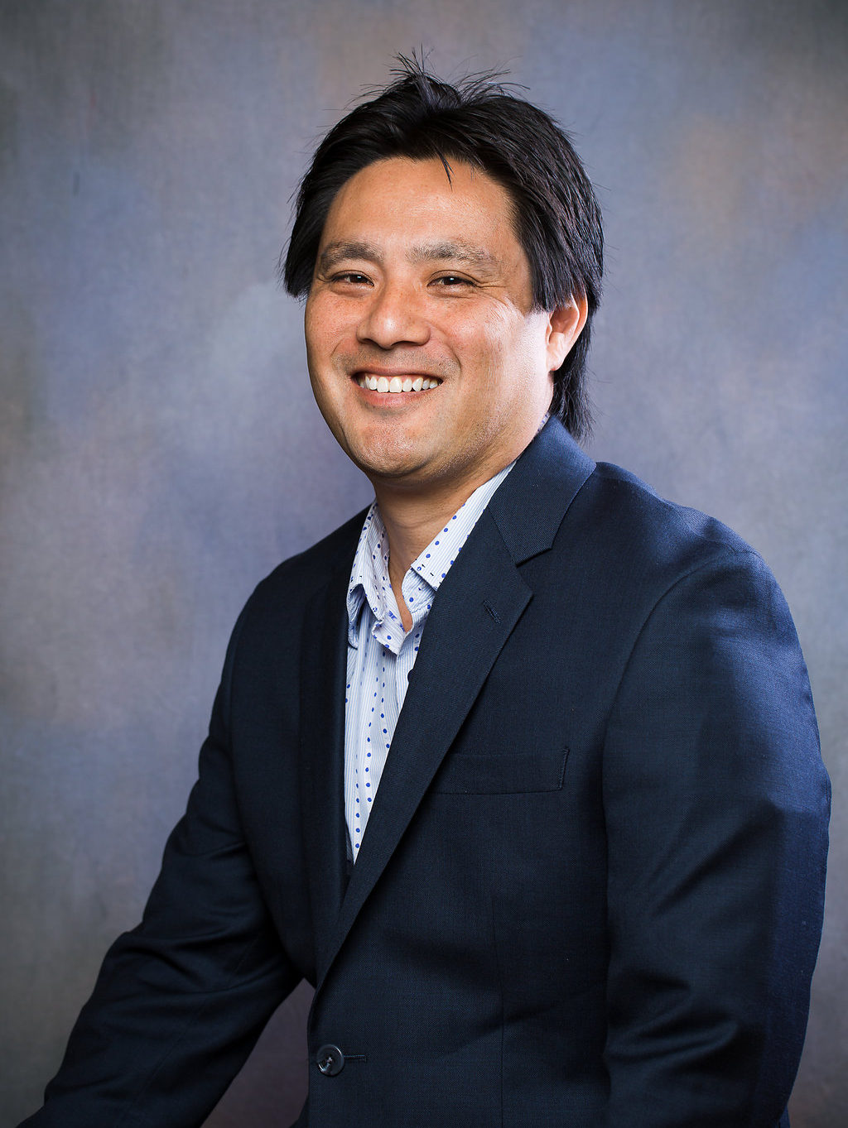
Today’s Featured speakers
Jonathan Lee
Caine Nakata
Founder and National Director
The Foundation for Financial Education
Director of Hawaii Operations
The Foundation for Financial Education

Slide 3

Disclaimer:
This educational workshop is presented by Foundation for Financial Education (F³E) volunteers. The following presentation does not in any way advocate for any advice or recommendations about the stock market or any related investments. No products, services or advice are endorsed by the Foundation (F³E), and any action taken by the consumer is solely at their discretion. Please consult with a licensed advisor who is specifically licensed in the jurisdiction where you reside prior to taking any action relating to investments, insurance, tax, legal, real estate or any other financial instruments. The Foundation (F³E) is not directly affiliated with any of its Certified Educational Consultant Volunteers and is not owned in part or in whole by any private corporation, organization or association. The material contained herein should not be construed by any audience as anything other than general and generic educational information available to the public. Individuals are encouraged to seek professional advice so they may receive actionable recommendations from a licensed professional.

Slide 4
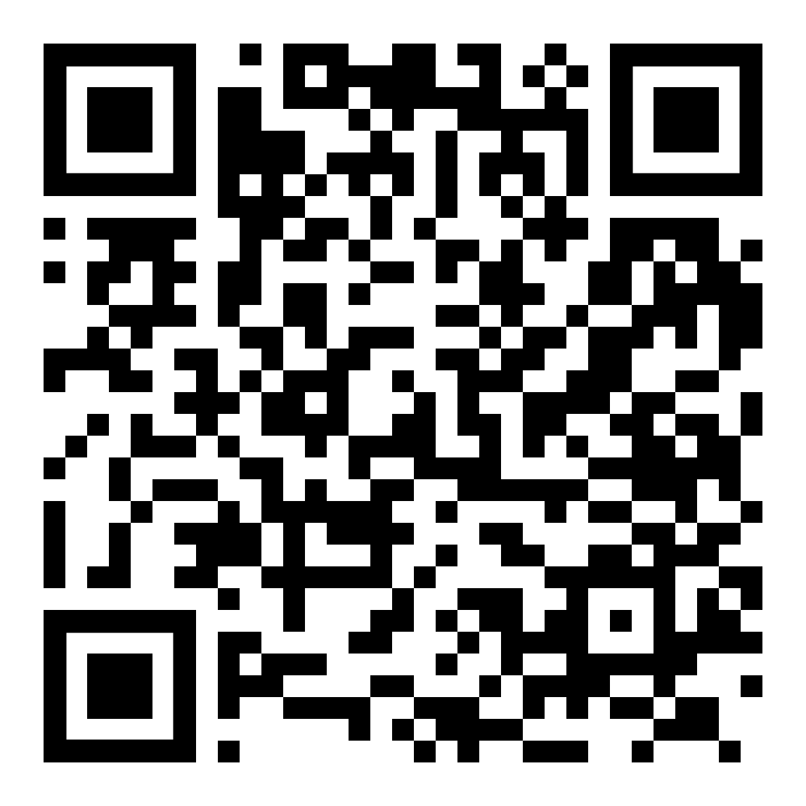
As a reminder, there will be a brief 2-minute Feedback Survey after the webinar where you can schedule a time to meet with one of our volunteer financial wellness coordinators. If you would like to schedule a teleconference now, please scan the QR code below to connect to our calendar:

Slide 5
“The New Normal”
Volatility in Market
Tax Changes
Career Uncertainty

Slide 6



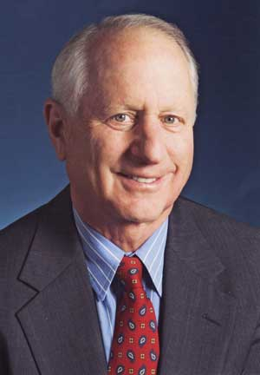
What to do during market volatility
A market downturn doesn’t bother us. It is an opportunity to increase our ownership of great companies with great management at good prices.
Your success in investing will depend in part on your character and guts and in part on your ability to realize, at the height of ebullience and the depth of despair alike, that this, too, shall pass.
History provides a crucial insight regarding market crises: They are inevitable, painful and ultimately surmountable.
Warren Buffett
Jack Bogle
Shelby M.C. Davis
Chairman and CEO of
Berkshire Hathaway
Founder and Former chief executive of The Vanguard Group
Founder and Former mutual fund manager at Davis Selected Advisers

Slide 7

Consult with a professional
One reason people avoid consulting with a professional financial educator to develop a plan is that they don’t think they have enough assets to warrant a formal plan. They may believe they have a good grasp of their finances and/or they think it will be expensive or way too complicated.
This Photo by Unknown Author is licensed under CC BY-NC-ND
However, setting aside these concerns, if you could achieve greater confidence in your financial planning strategy during a down market, that alone may be worth it to have a one-on-one consultation.
If you don’t have a financial strategy, or even if you do but you’re feeling distressed over the current market environment, consult with a financial educator. These professionals have day-to-day experience and can share insights that may help you get through periods of uncertainty.

Slide 8
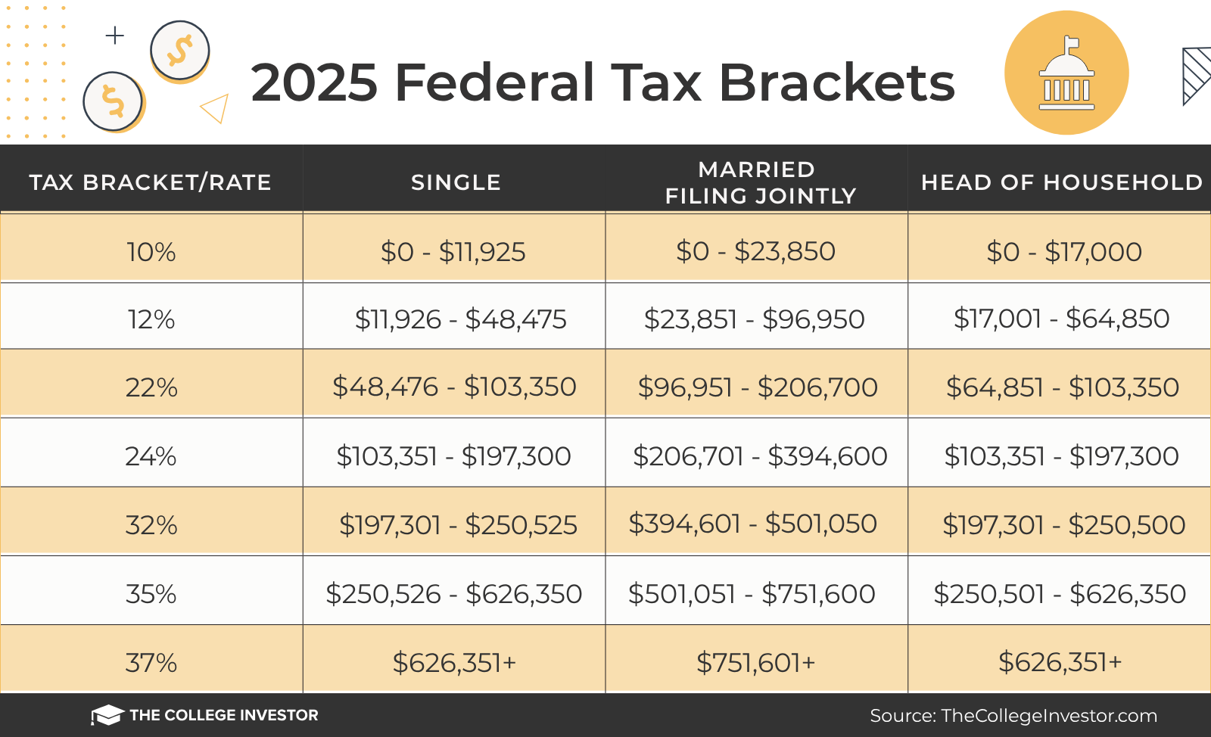

Slide 9
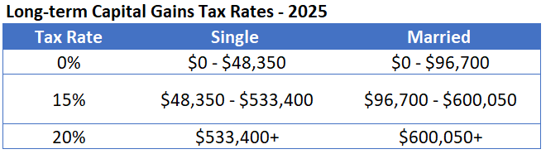

Slide 10
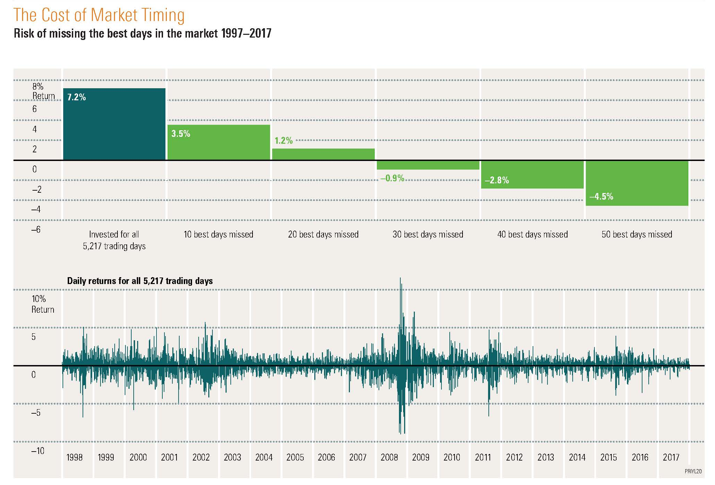

Slide 11
7
 | 1998 | 1999 | 2000 | 2001 | 2002 | 2003 | 2004 | 2005 | 2006 |  | 2007 | 2008 | 2009 | 2010 | 2011 | 2012 | 2013 | 2014 | 2015 | 2016 | 2017
Highest return | 28.6 | 29.8 | 21.5 | 22.8 | 17.8 | 60.7 | 20.7 | 14.0 | 26.9 |  | 11.6 | 25.9 | 32.5 | 31.3 | 27.1 | 18.2 | 45.1 | 24.7 | 1.4 | 25.6 | 25.6
 | 20.3 | 27.3 | 5.9 | 3.8 | 1.6 | 39.2 | 18.4 | 7.8 | 16.2 |  | 9.9 | 1.6 | 28.1 | 15.1 | 2.9 | 17.9 | 32.4 | 13.7 | 0.0 | 12.0 | 21.8
 | 13.1 | 21.0 | 0.1 | 3.7 | –6.3 | 28.7 | 11.9 | 7.1 | 15.8 |  | 5.5 | –17.9 | 26.5 | 13.0 | 2.1 | 16.0 | 23.3 | 7.4 | –0.4 | 8.2 | 13.1
 | 11.9 | 14.8 | –3.6 | –0.6 | –13.3 | 26.2 | 10.9 | 5.7 | 13.0 |  | 5.3 | –36.7 | 14.4 | 10.1 | 0.0 | 11.1 | 17.6 | 2.9 | –0.6 | 1.8 | 11.2
 | 4.9 | 4.7 | –9.1 | –11.9 | –15.7 | 1.4 | 8.5 | 4.9 | 4.8 |  | 4.7 | –37.0 | 0.1 | 8.2 | –3.3 | 3.4 | 0.0 | 0.0 | –0.7 | 1.5 | 6.2
Lowest return | –7.3 | –9.0 | –14.0 | –21.2 | –22.1 | 1.0 | 1.2 | 3.0 | 1.2 |  | –5.2 | –43.1 | –14.9 | 0.1 | –11.7 | 0.1 | –12.8 | –4.5 | –3.6 | 0.2 | 0.8
 | Small stocks |  | Large stocks |  |  | International stocks |  |  |  | Long-term government bonds |  |  |  |  | Treasury bills |  |  | Diversified portfolio |  |  |  | PRIYL09

Slide 12

Roth contributions and roth Conversions
Tax Free (x3)
No RMD
Out of Government Control!

Slide 13

Estate Planning Changes
The Secure Act:
Required Minimum Distributions
Inherited IRAs

Slide 14

Required minimum distributions Changes
Before now, RMDs generally must have
been taken in the year you turn 70 ½. (If
you work past age 70 ½, RMDs from your
current employer’s 401(k) aren’t required
until after you leave your job, unless you
own at least 5% of the company.)
The Secure Act pushes the age that triggers RMDs from 70 ½ to 73.

Slide 15

Inherited IRA Changes
All funds from an inherited IRA generally
must now be distributed to non-spouse
beneficiaries within 10 years of the IRA
owner’s death.
The new retirement law also makes it
easier for 401(k) plan sponsors to offer
annuities and other “lifetime income” options to plan participants.

Slide 16

Preparing for changes
Pay changes
Business shutdowns
Furloughs
Stock Market declines
Tax Increases

Slide 17

SURVIVAL GUIDE
Budget(Now and
retirement)
Debt consolidation
Real estate strategies
Social Security maximization
Tax shelters
Emergency fund
Fees/investments
Lower risk

Slide 18

TSP / ira /401(k) PLANNING
Loans
Allocations and contributions
Distribution options
Estate transfer

Slide 19

retirement
Can I afford to retire?
Survivor benefit options and
health insurance
Tax law changes and inflation
Long-term care

Slide 20

Where do we go from here?
Don’t go at it alone.
Focus on what you can control:
  Taxes
  Fees
  Risk
Review your strategy with a financial education consultant. Many of our financial wellness volunteers have decades of experience in financial education, tax, and estate planning.
Take a few seconds to fill out the survey and schedule your complimentary consultation.

Slide 21
Thank you for your participation!!
Following the webinar, please be sure to submit the feedback survey that will pop up after closing the software or inside of the thank you email.
Contact 301-718-0030 | info@f3eonline.org to connect with a volunteer right away.
Your input is appreciated!

