Slide 1

Julie Acosta
Mapping My Studio Series:
Reclaiming Regalia

Slide 2
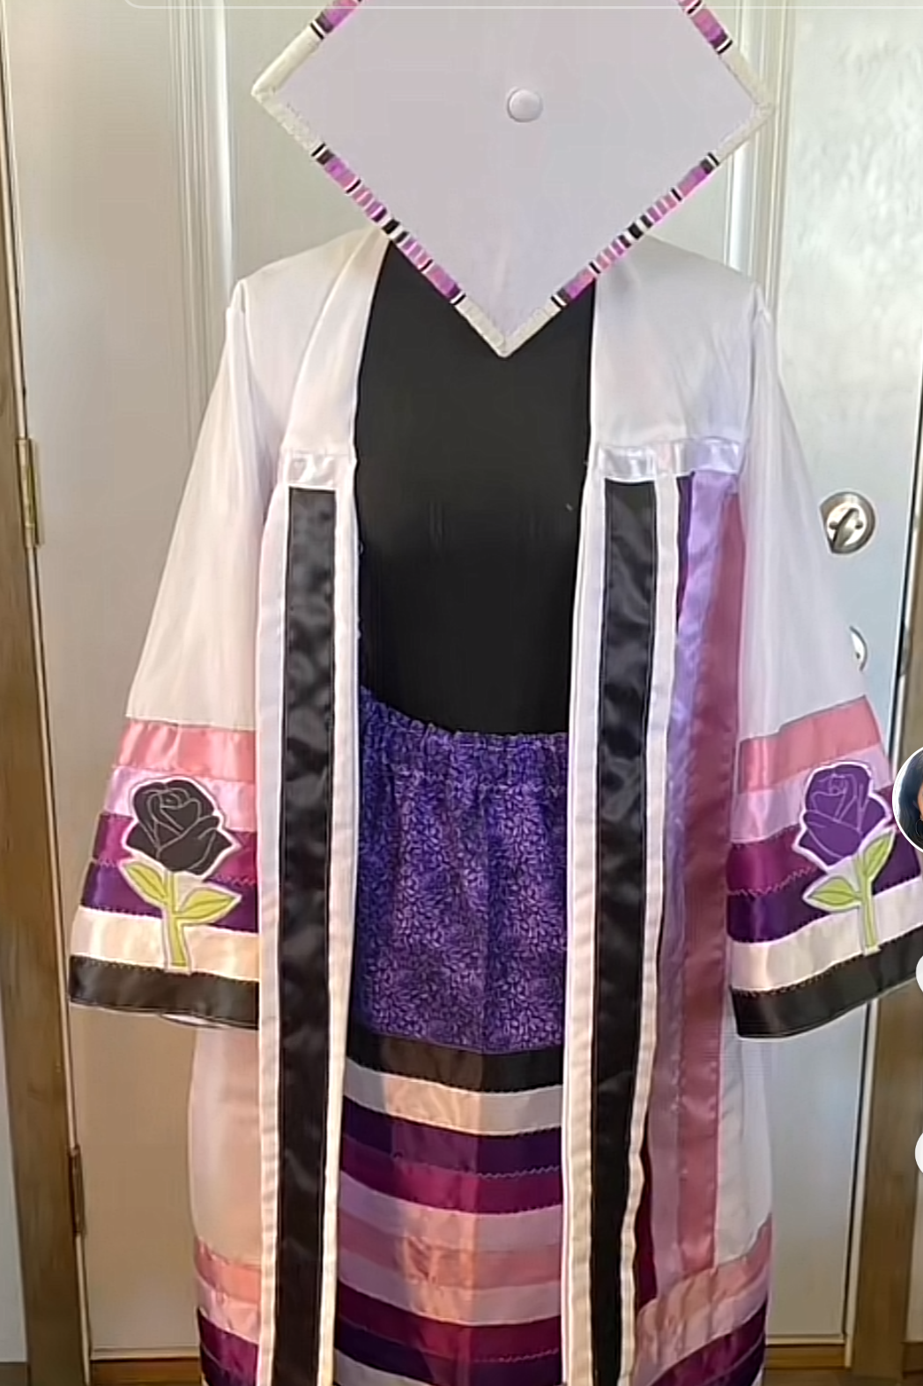
Project Concept
For my Senior Studio Series, I will transform my UCSC
graduation regalia into a full tribal regalia set. This includes:
• A beaded graduation cap
• A Native American ribbon gown (made from my graduation gown)
• A matching ribbon skirt
This work celebrates my heritage and brings visibility to
Indigenous identity within academic spaces.

Slide 3
Creative Goals and themes
• To reclaim colonial garments and transform them into expressions of Indigenous pride
• To honor underrepresented peoples through cultural storytelling
• To use fabric, beadwork, and ribbon as forms of resistance, remembrance, and resilience
• To explore themes of visibility, survival, and beauty

Slide 4
Materials and process
• Beads, fabric, ribbon, thread
• Graduation cap and gown (provided)
• Sewing machine + hand-stitching tools
• Time spent in beadwork sessions, garment deconstruction and reconstruction
• Studio time will include experimentation with texture, stitching, and symbolic color palettes

Slide 5
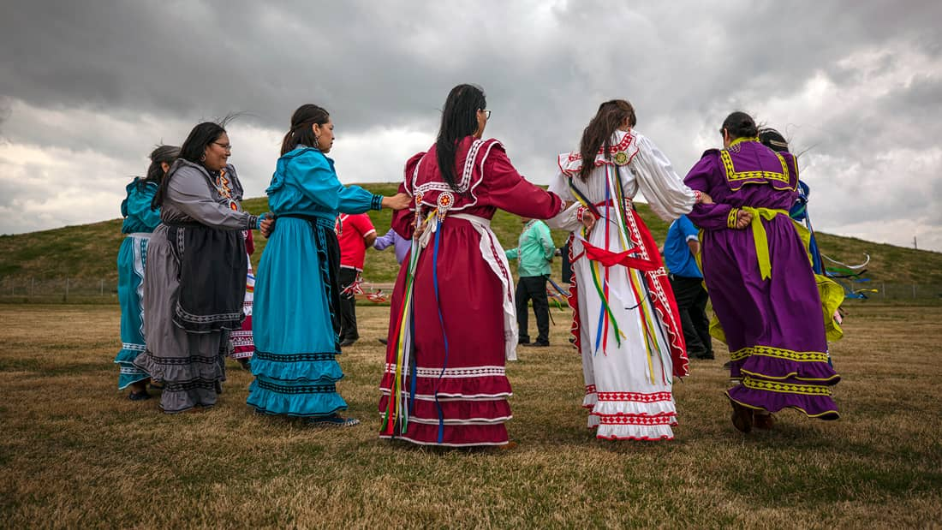
Planned Studio Pieces
1. Beaded Graduation Cap — Cultural designs with traditional patterns
2. Transformed Gown into Ribbon Dress — Incorporating stripes, symbolism, and a flowing silhouette
3. Matching Ribbon Skirt — Completed set with cohesive color palette and narrative unity

Slide 6
TIMELINE/STUDIO PLAN
Week-by-week or module style:
• Week 1–2: Begin beading cap, researching, gathering materials
• Week 3–4: Finish beading cap, test ribbon layouts, begin construction of Ribbon Skirt
• Week 5–6: Finish Ribbon Skirt, Begin transformation of Graduation Gown
• Week 7–8: Finish Graduation Gown, Final Stitching + detail work
• Week 9: Photoshoot, digital portfolio updates, and artist talk prep
• Week 10: Open Studios, Wrap Up, prepare for graduation.

Slide 7
DIGITAL PORTFOLIO
I will photograph the completed regalia set on a dress form, accompanied by detail shots of stitching and beadwork. These images will be used in my online portfolio with artist statements, process documentation, and captions that contextualize each piece.

Slide 8
ARTIST TALK/OPEN STUDIOS
Community Engagement
During my Artist Talk, I will discuss:
• Why I chose to work with graduation regalia
• The symbolism of each piece
• The intersection of visibility, culture, and reclamation in creative spaces
At Open Studios, I plan to display the full set on a dress form, possibly with a QR code linking to my portfolio.

Slide 9
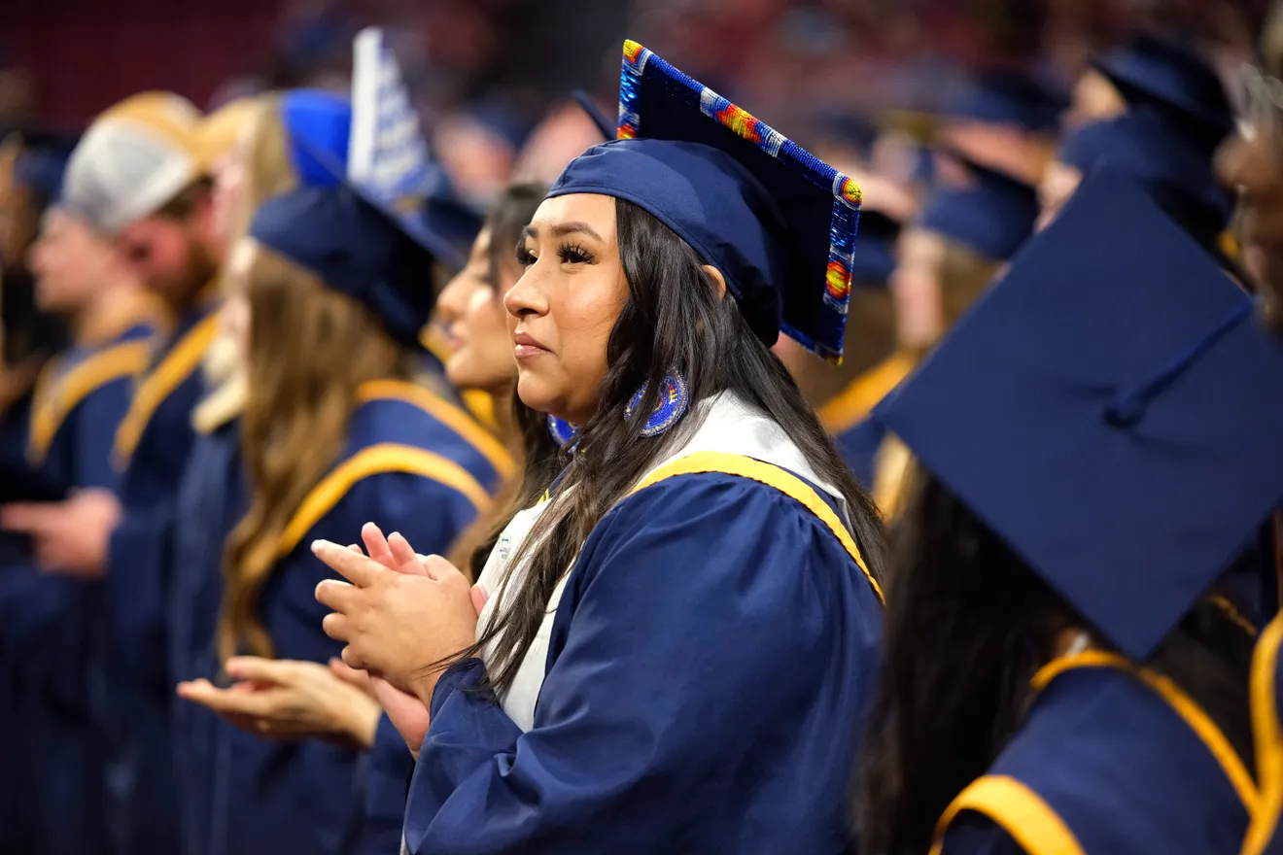
WHY THIS MATTERS
This work allows me to walk across the stage not just as a graduate, but as an Indigenous woman reclaiming space. Through this transformation, I want others to feel seen, honored, and inspired to bring their whole selves into academic and artistic spaces.

