Slide 1
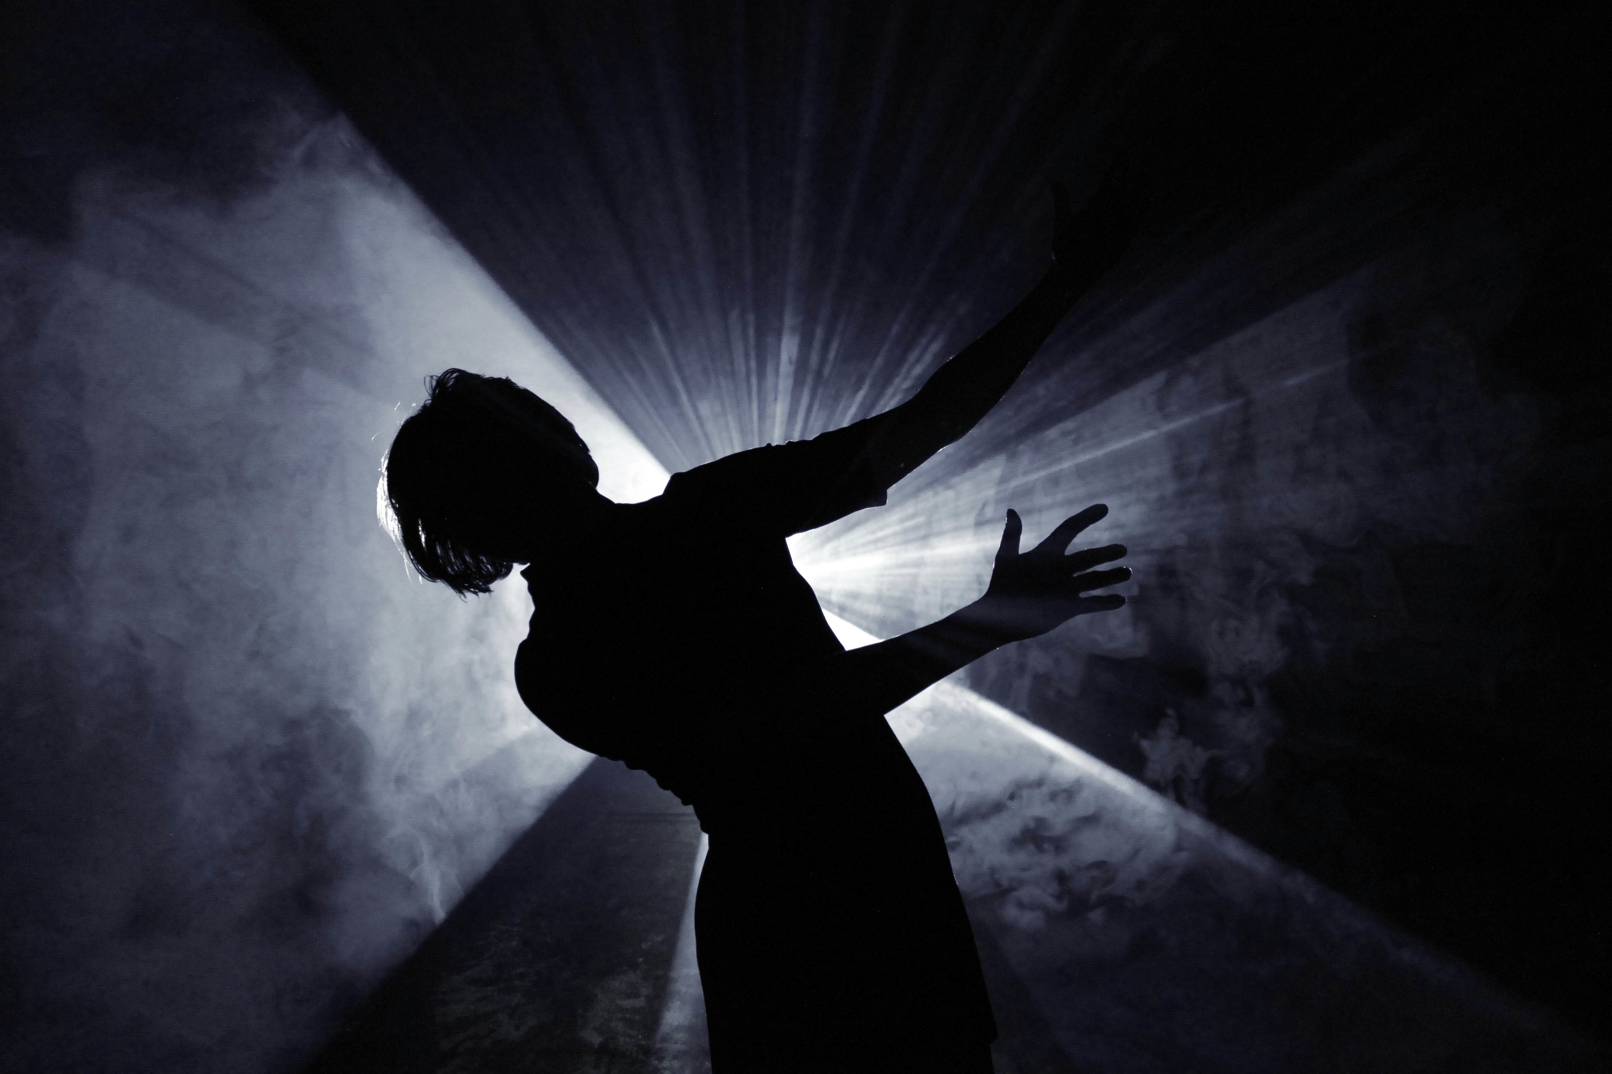
Why We Dance
Senior Project Presentation
by Julie Acosta

Slide 2
Introduction & Inspiration
The Beauty of Dance: Dance is a universal language that transcends words. It communicates emotions, stories, and experiences that are often difficult to express verbally.
• An Underappreciated Art Form: Despite its expressive power, dance is sometimes overlooked compared to other art forms like music or film. I want to shine a light on its emotional depth and artistic value.
• Capturing the Intangible: I am fascinated by the fleeting, ephemeral nature of dance—how it exists in a moment and then is gone. Using Super 8 film, with its nostalgic and timeless quality, I hope to preserve these moments in a way that feels both intimate and eternal.
• Why Super 8 Film: I chose black and white Super 8 film to emphasize the raw emotion and movement, stripping away distractions to focus on the dancer’s expression and form.

Slide 3
Concept & Vision
• Exploring Personal Stories: At its core, “Why We Dance” is about uncovering the deeply personal motivations behind why people dance. Each dancer has a unique story—whether it’s a form of self-expression, cultural connection, healing, or pure joy. I want to capture these stories in their own words.
• Intimate Moments and Performances: My vision is to go beyond the stage and showcase the quiet, vulnerable moments—like the anticipation before a performance, the concentration during practice, or the emotional release afterward. I believe these moments reveal the human side of dance that is rarely seen.
• Visual and Emotional Storytelling: By filming in black and white on Super 8 film, I aim to create a timeless, nostalgic feel that emphasizes movement and emotion rather than color or spectacle. This artistic choice will help the audience focus on the dancer’s form and expression.
• Diversity in Dance Genres: I plan to feature a variety of dance styles—from ballet and contemporary to hip hop, traditional, and even experimental forms. This diversity not only showcases the universal nature of dance but also highlights its cultural and personal significance.
• Connecting Audiences to the Art Form: I want to bridge the gap between dancers and viewers, helping the audience understand that dance isn’t just about performance—it’s about storytelling, emotion, and connection.

Slide 4
Technical Approach
• Why Super 8 Film?
• I chose Super 8 film because of its nostalgic, timeless quality, which complements the emotional and intimate nature of the stories I want to tell.
• The grainy texture and black-and-white aesthetic add a raw, emotional layer, emphasizing movement and expression rather than color or flashy visuals.
• Super 8 film also creates a sense of nostalgia, connecting viewers to the past while exploring contemporary stories of dance.
• Challenges and Advantages of Analog Film:
• Unlike digital filming, Super 8 requires careful planning and precision, as every shot counts—there are no do-overs. This limitation forces me to be more intentional with my storytelling.
• The challenges include managing limited film stock, precise lighting requirements, and the lack of immediate playback, which requires trust in my vision and technical skills.
• On the flip side, these constraints encourage creativity and authenticity, leading to more genuine, in-the-moment captures.

Slide 5
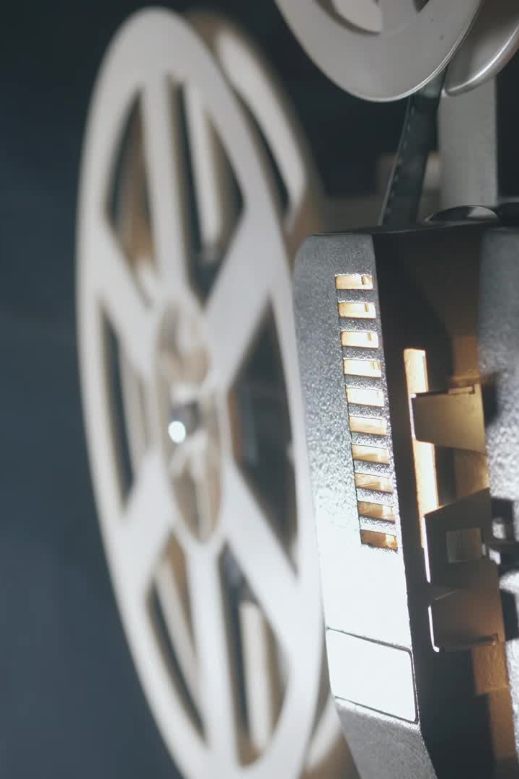
• Equipment and Workflow:
• I have secured a fully functioning Super 8 camera and a film digitizer, allowing me to shoot in analog but edit digitally for a modern, polished finish. I have a sound recorder, a ring light, and I may also use my phone with a super 8 film app to supplement some footage.
• My workflow will involve filming on Super 8, developing the film, digitizing it, and then editing the footage to create a cohesive narrative.
• This hybrid approach retains the nostalgic aesthetic of Super 8 while enabling precise editing techniques.
• Creative Techniques and Aesthetics:
• I plan to experiment with different filming techniques, such as close-up shots of dancers’ feet, hands, and facial expressions, to capture the emotional nuances of their movements.
• Slow-motion sequences will be used to emphasize fluidity and grace, creating a dreamlike, poetic visual experience.
• I will also play with light and shadow to enhance the emotional depth of each scene.

Slide 6
Storytelling & Interviews
• Capturing Authentic Narratives:
• The heart of “Why We Dance” lies in the personal stories of the dancers. I want to create a safe, comfortable space for them to share their motivations, struggles, and triumphs.
• By letting the dancers speak in their own words, the film will provide an intimate look into their lives, revealing the emotional and cultural significance of dance.
• Interview Approach and Techniques:
• My interview style will be conversational rather than structured, encouraging dancers to open up naturally and authentically.
• Questions will focus on their first memories of dance, pivotal moments in their journey, and the emotions they experience while dancing.
• I will also explore the challenges they face, such as stereotypes, body image issues, or balancing dance with other life responsibilities, adding depth and relatability to their stories.

Slide 7
• Weaving Stories into the Narrative:
• The film will not just be a series of interviews; it will be a woven tapestry of voices and movements, creating a poetic narrative that flows seamlessly between spoken word and dance.
• I plan to intercut the interviews with footage of the dancers practicing, performing, or simply lost in thought, visually representing the emotional connection between their words and movements.
• Narrative Structure and Flow:
• The film will follow a thematic narrative structure, grouping stories by common emotions or experiences rather than a linear timeline. For example, segments on joy, pain, freedom, and identity.
• This approach allows the audience to feel the emotional journey rather than just watching a documentary.
• Emotional and Visual Storytelling:
• To capture the emotional weight of each story, I will use close-up shots to focus on facial expressions and body language.
• Slow-motion and black-and-white aesthetics will emphasize the dancers’ movements, making the audience feel the grace, tension, and emotion behind each gesture.
• Ambient soundscapes and minimalist music will enhance the mood without overpowering the dancers’ voices or movements.

Slide 8
Challenges & Anticipated Outcomes
• Technical Challenges:
• Working with Super 8 Film: Shooting on Super 8 presents unique challenges, including limited film stock and the absence of playback, which requires precise planning and execution.
• Lighting and Exposure: Super 8 film is highly sensitive to light, making it challenging to shoot in low-light environments, such as rehearsal studios or backstage areas. I will need to strategically use natural light or minimal lighting equipment to maintain the raw, authentic feel of the footage.
• Digitization and Editing: The process of digitizing Super 8 film while preserving its vintage quality requires specialized equipment and meticulous attention to detail during editing. Achieving a cohesive narrative flow with analog footage is also more complex compared to digital formats.
• Logistical Challenges:
• Coordinating Schedules: Dance rehearsals, performances, and personal schedules are often unpredictable. Coordinating interviews and filming sessions with multiple dancers across different dance genres will require flexibility and strategic planning.
• Access and Permissions: Gaining access to rehearsal spaces, performance venues, and intimate backstage moments involves navigating permission requirements and building trust with dancers and venue owners.
• Emotional Vulnerability and Comfort: Since the film explores personal motivations and emotional connections to dance, building a safe, comfortable environment is crucial. Establishing trust with each dancer will be essential to capture genuine, heartfelt stories.

Slide 9
• Creative Challenges:
• Balancing Narrative and Performance: One of the artistic challenges will be seamlessly blending spoken narratives with dance performances without disrupting the emotional flow.
• Maintaining Authenticity: Filming in black and white on Super 8 film is a stylistic choice that enhances nostalgia and emotional depth. However, it’s crucial to maintain authenticity and avoid over-stylization, ensuring that the storytelling remains raw and real.
• Anticipated Outcomes and Impact:
• Emotional Connection and Empathy: I hope the audience will connect emotionally with the dancers’ stories, understanding the deep, personal reasons behind why they dance.
• New Perspective on Dance as Art: By showcasing a variety of dance genres and personal narratives, the film aims to challenge stereotypes and broaden the audience’s perception of dance as an art form.
• Cultural and Emotional Resonance: The film will not only celebrate the physical beauty of dance but also highlight its cultural and emotional significance, inspiring conversations about identity, expression, and resilience.
• Timeless Cinematic Experience: Using Super 8 film will create a nostalgic, poetic viewing experience that resonates emotionally, evoking a sense of timelessness.
• Hopes and Aspirations:
• Festival Submissions and Audience Reach: I aim to submit “Why We Dance” to independent film festivals, hoping to reach diverse audiences and foster a greater appreciation for dance and storytelling.
• Long-term Vision: Beyond this project, I hope to continue exploring documentary storytelling through analog film, preserving intimate human experiences in a timeless, cinematic form.

Slide 10
