Slide 1
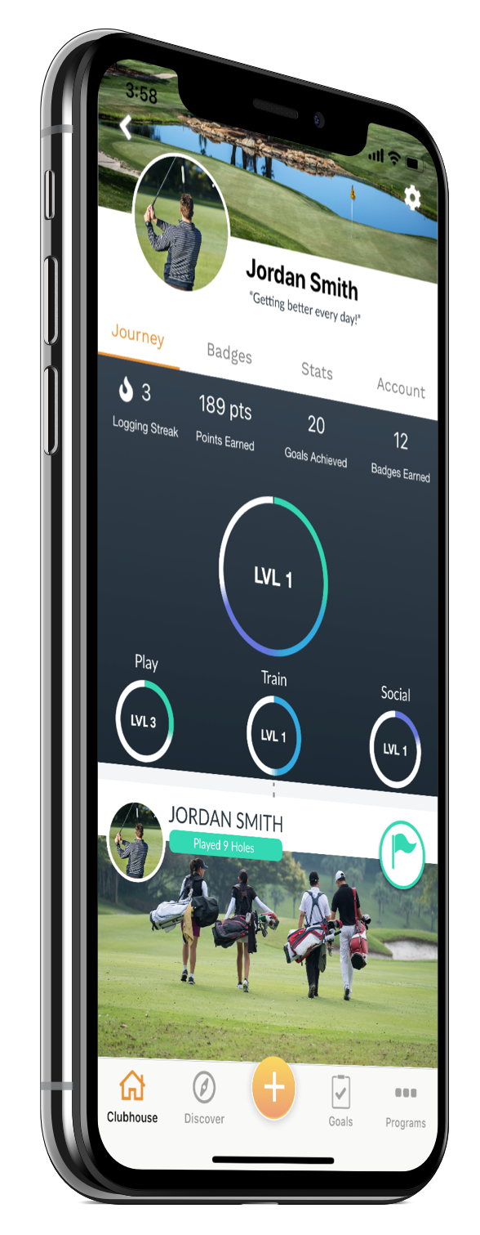
ADULT
+
PRACTICE
Join our Practice + Program to see measurable improvement!
YOUR GUARANTEED PLAN TO SHOOT LOWER SCORES & IMPROVE SKILLS!
+
WE WILL PLAY TOGETHER
This program includes structured weekly practice programs + on course playing sessions leveraging the Op 36 Challenge. We will get our baseline 9 hole score and assemble our practice to help you improve.
WHAT IS IT?
+
WE WILL PRACTICE
Are you tired of skulled or chunked shots and shooting the same scores? The Practice+ Program is perfect for anyone who is sick of hitting the same poor shots and wants a guide. Our team will work with you to assess your skills and make a clear plan to help you improve.
Learning to practice the right way is hard. We not only show you how to structure it, but everyone will walk away with personal education on how to improve.
HOW DOES IT WORK?
+
YOU WILL MEET OTHERS
This program includes 9 hole Operation 36 Challenges + Weekly Practice Sessions. First we will go on the course to see what you shoot for 9 holes leveraging the Operation 36 Format. Then you will attend a weekly group practice session to help you improve your skills! We will track progress throughout the semester. You will walk away knowing how to practice and which area of your game to focus on to get better.
Meet other golfers of all skill levels working to improve their game. Group training will enhance your practice and make learning the game a fun experience.
+
WE WILL TRACK PROGRESS
We use the Operation 36 Mobile App to help you track progress and see improvement. This tool will be available to all participants to help guide you.
THE OPERATION 36 MOBILE APP
You will be invited to our community in the the Op 36 Mobile App. The app is designed to make it fun to play and practice and guide you on your journey. All your stats go back to your coach so they can help you break down areas of your game to focus on. Finally... a simple app that will help guide you on your improvement journey!
HOW DO I SIGN UP?
RESERVE YOUR SPOT TODAY BY CONTACTING
Tony Allen PGA
tagolfswing@gmail.com
281-979-6522
THE OP 36 9 HOLE CHALLENGE | WHICH DIVISION CAN YOU SHOOT 36 FROM?

Slide 2
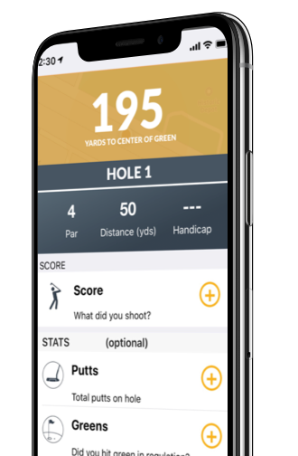
STEP 1 - CHOOSE YOUR PACKAGE
ADULT
+
PRACTICE
$120 /mo
PRACTICE
+
(12) 1 HOUR PRACTICE SESSIONS
JOIN OUR PRACTICE + PROGRAM ACCELERATE YOUR SKILLS IN 2019
Pay in Full - $360 per semester
PRACTICE PLUS +
RECOMMENDED TO SEE MOST IMPROVEMENT
+
(12 1 HOUR PRACTICE SESSIONS
$153 /mo
+
(4) 9 HOLE - ON COURSE TRAINING
Pay in Full - $460 per semester
+
PRIVATE LESSON
Do you want to have a personal session to set some private goals? Contact Coach Tony to add a private lesson.
$60 1/2hr
ENROLL YOUR FAMILY TODAY!
STEP 2 - CHOOSE YOUR PRACTICE GROUP
Are you a beginner? Advanced golfer? Your improvement starts here! Our coaches are here to help you find the areas you need to focus on and we will measure improvement over time.
We split our Practice + Program into 2 semesters. Participants will attend a group practice session once a week and have the option to participate in group on-course sessions as well.
1st Semester will begin this summer starting Saturday June 1st thur Aug 17th, 2019
You will attend a group session each week and work through a series of drills & education under a watchful eye from Caoch Tony.
Only 10 spots available in each group. Reserve your spot today!
Wednesday
6:00 – 7:00
Sunday
1:30 – 2:30
PRACTICE SCHEDULE
ON-COURSE SESSION DATES
We rotate the skills we focus on each week. Each session we will have drills and activities that are proven to accelerate your skills, and also cover education to make you a skilled golfer!
Below are the dates for our on-course sessions. For each session, we will do light instruction on course, and help you learn how to keep stats and evaluate which areas of your game we need to improve.
Session 1 - PUTTING
Saturday June 15th – 6:00pm
Session 2 - CHIPPING/PITCHING
Saturday July 13th – 6:00pm
Session 3 - FULL SWING IRONS
Saturday July 27th- 6:00pm
Session 4 - FULL SWING WOODS
Saturday Aug 10th – 6:00pm
STEP 3 - JOIN OUR OP 36 COMMUNITY
MOBILE APP PROGRESS TRACKING
“I tried the Practice Plus program last year and I was able to improve by four strokes a round!”
Each participant will be invited to our community in the Op 36 Mobile App. This app allows us to communicate with you, and track your progress. The tools in the app make it fun to play and practice, and will help guide you on your improvement journey!
-John T.
+
PLAY GOLF & LOG SCORES - LIVE GPS
HOW DO I SIGN UP?
+
ACCESS PRACTICE PLANS & TRACK SKILLS
+
VIEW & REVIEW GOALS WITH COACH
RESERVE YOUR SPOT TODAY BY CONTACTING
+
EARN POINTS FOR OUR COMMUNITY
Coach Tony Allen
+
MOBILE PROGRAM ANNOUNCEMENTS
tagolfswing@gmail.com
281-979-6522

