Slide 1
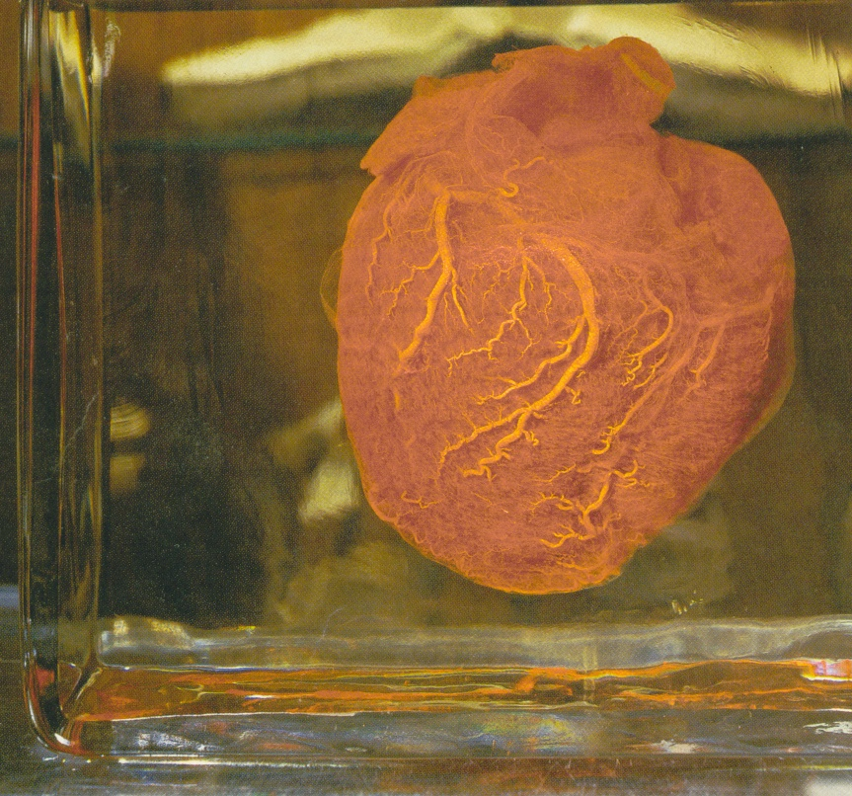

ACLS OVERVIEW
PUTTING IT ALL TOGETHER
Adam S. Blumenthal
NOT AN AHA PRESENTATION

Slide 2
Today’s Course
Parking
Bathrooms
Phones
Expired Providers
Cards/Proof
All Cards Come via EMAIL
www.heart.org/cpr/mycards
Plan for Today

Slide 3
CURRENT INFORMATION
  EVIDENCE BASED
  Class I definitely recommended STANDARD OF CARE
  Class IIa acceptable and useful
  Class IIb acceptable and useful optional or alternative
  Class III May be harmful, No benefit documented

Slide 4
Science Updates
2020
BLS Rate 110
CPR Prompts
Vents via advanced airway 10 min
Lidocaine 1-1.5mg/kg for VF/pVT
Atropine 1mg
Epinephrine 1mg every 4 minutes
ACS First medical contact to balloon inflation 90 minutes
Oxygen
  Add if <90% with ACS
  Add if <94% with Stroke
  Maintain 92 – 98% following ROSC

Slide 5
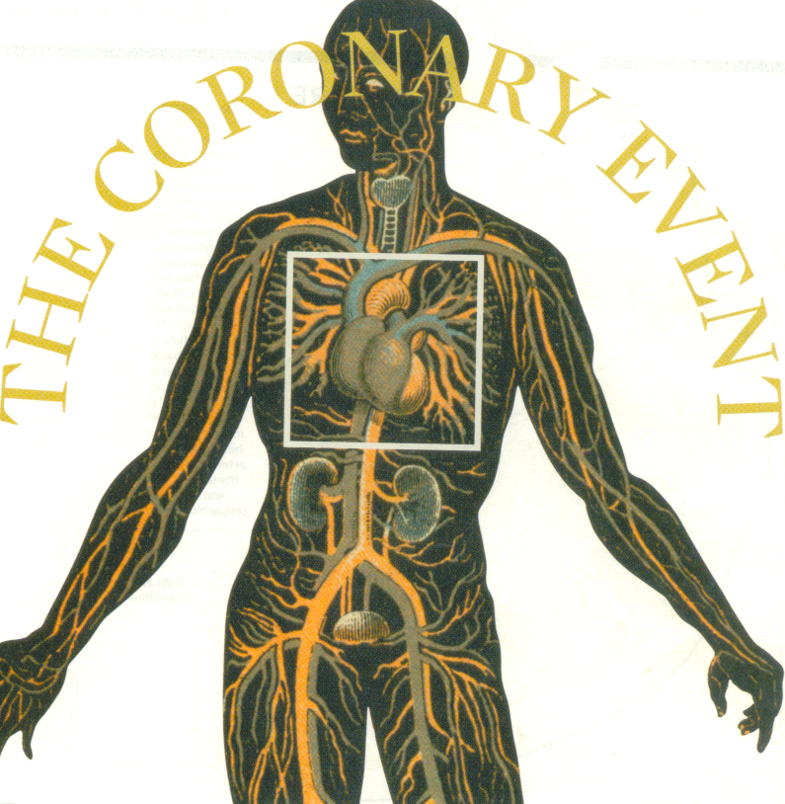
Working with the Algorithms

Slide 6
ACLS OVERVIEW
Patient Assessment
Is the scene safe?
Level of Consciousness
Activate – Rapid Response or Code team or 911
Bring Equipment – BVM and Defibrillator
Circulation – Assess the need for CPR: agonal respirations/no pulse, start compressions 2” to 2.4” depth, 110 compressions/minute (no more than120 minute)
Airway – open, clear as needed

Slide 7
PRIMARY PATIENT ASSESSMENT
Breathing – assess, provide 2 vents, 1 sec per vent, watch for chest rise
Defibrillate once –
  Immediate defibrillation for VF/pulselessVT
Apply pads, if VF/pVT - defibrillate:
  120j – 200j biphasic
Or AED (turn on and follow prompts) 1 shock only
Return to CPR for 2 minutes without pulse or rhythm check – if the patient is perfusing, they’ll let you know!

Slide 8
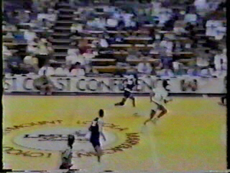
Hank Gathers March 1990

Slide 9
SECONDARY ASSESSMENT
Airway – consider advanced airway: ETT, LMA; ensure placement primarily and with secondary method (PETCO2) document regularly; secure ett
  Intubate at 2 min CPR pause
Breathing – size and place OPA, provide ventilations with Bag Valve, 100% O2
  10 vents/min with advanced airway (1 q 6 seconds)
  10 – 12 with BVM (about 5 vents/min during CPR)
Smoothly over 1 second

Slide 10
Continuous Waveform Capnography/PETCO2
Best indicator of tube placement
Assists in assessment of CPR quality
PETCO2 should be >10 mmHg during CPR if lower, reassess CPR quality
Will notify of ROSC rapidly
Low PETCO2 after 20 min associated with low likelihood of ROSC

Slide 11
SECONDARY ASSESSMENT
Circulation – resume excellent, high quality CPR for pulseless patients; gain IV access or IO, consider adding volume; attach ECG electrodes, lead II for monitor input
Drugs and Differential diagnosis – provide appropriate medications; search for treatable causes – THINK!

Slide 12
Medications
Oxygen
Epinephrine
Lidocaine
Amiodarone (megacode, mix for tachy)
Atropine (take the foot off the brake)
Adenosine (disrupts the AV)
Aspirin (saves the myocardium)

Slide 13
TREATABLE CAUSES
Tablets
Tension Pneumothorax
Tamponade
Thrombosis (ACS & PE)
Hypoxia
Hypovolemia
Hypothermia
Hypo/Hyperkalemia
Hydrogen Ion
Hypomagnesemia

Slide 14
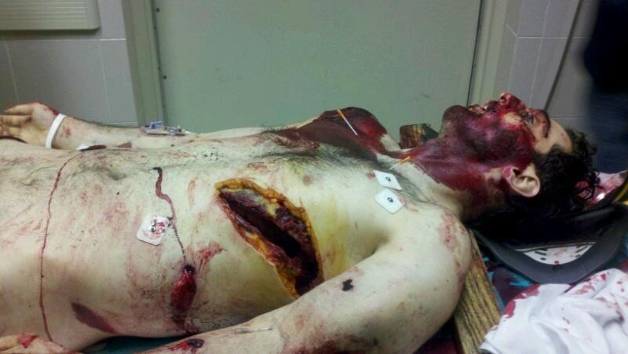

Slide 15
ACLS MANTRA for a non-arrest Patient
Call a Rapid Response/Medical Emergency Team, then :
Assess vitals, obtain history
O2, IV, MONITORS (ECG, BP, SPO2):
Gain peripheral IV access, deliver volume as needed
Attach monitor leads, and assess rhythm, BP, O2 saturation

Slide 16
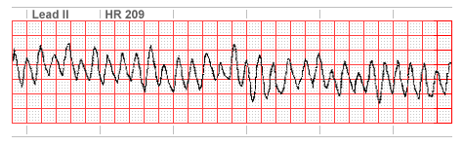
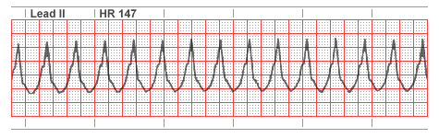
VF/pVT
EDISON BEFORE MEDICINE –SEE FIB, DEFIB!
Scene Safe?
Call for help, start CPR
AED: Power up machine, attach pads and follow voice prompts, allow to analyze
If “Shock advised”, clear personnel and deliver defibrillation
2 minutes of compression-first CPR

Slide 17
VF/pVT
Manual defibrillator: apply hands-free pads without interrupting CPR
  120j – 200j biphasic and clear personnel, compressor last
Deliver defibrillation
Immediate return to compression-first CPR

Slide 18
VF/pVT
Bag Valve with O2, consider advanced airway with PETCO2; Start peripheral IV access, consider fluid; Attach lead wires, monitor to lead II
Administer Epinephrine 1mg (prefilled syringe) (consider preparing antiarrhythmic agent)

Slide 19
VF/pVT
CPR for 2 minutes, check pulse and rhythm and defibrillate
Resume compression first CPR immediately following defib
Consider Amiodarone 300mg IV or Lidocaine 1-1.5mg/kg
Circulate for 2 minutes, check pulse and rhythm and defibrillate

Slide 20
VF/pVT
Resume CPR
Consider repeat dose of Epi (1mg) every 4 minutes
CPR for 2 minutes, check pulse and rhythm and defibrillate
Resume CPR
Consider Amiodarone 150mg or Lidocaine 0.5-0.75 mg/kg
Defibrillate and resume CPR

Slide 21
VF/pVT
If patient fails to convert, consider treatable causes (H’s & T’s)
If patient does convert: assess rhythm and pulse after 2 minutes of CPR
Follow ROSC Guidelines

Slide 22
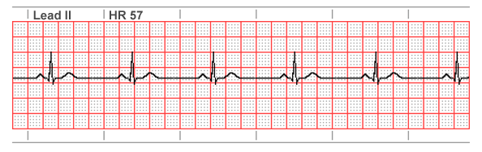
PULSELESS ELECTRICAL ACTIVITY
PEA
Assess C, A, B, Start CPR, O2, Intubate, IV, Monitor (if not attached)
Pour fluids - consider hypovolemia (check lung sounds, JVD, peripheral edema first)
Epi 1mg every 4 minutes
Assess for treatable cause (H’s & T’s)

Slide 23
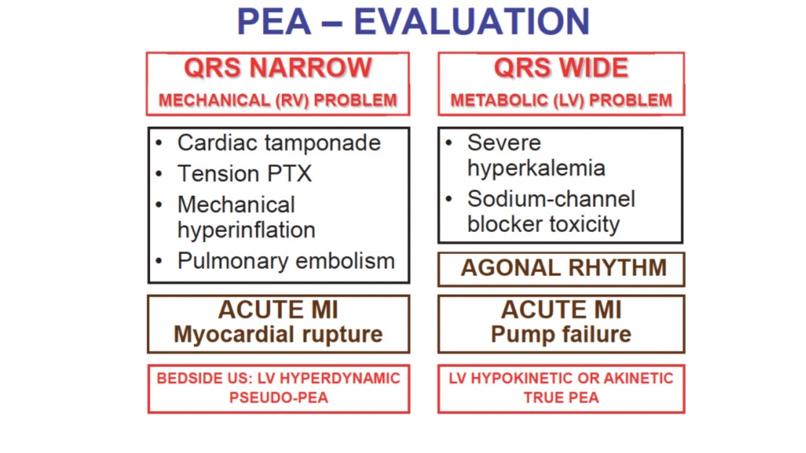

Slide 24
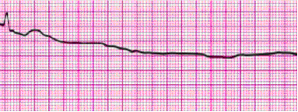
ASYSTOLE
The Most Stable of all Rhythms
Assess responsiveness & pulse, begin CPR, No Defib
O2, Consider advanced airway, IV, check 2 monitor leads and gain knob
Administer Epi 1mg every 4min
Ask why: treatable causes (H’s & T’s)

Slide 25
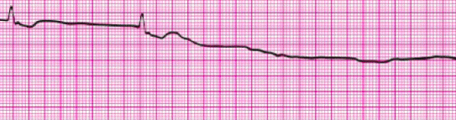
ASYSTOLE
Asystole caused by Hypothermia, Drug Overdose, and Lightning may be responsive to therapy
Consider Termination of code after 15 minutes with family present at resuscitation (Consider setting)
Be SURE to rule out all treatable causes!

Slide 26
ROSC Guidelines
Assure Airway and ventilation
O2 saturation maintained between 92 – 98%
Assess vital signs, 12 lead ECG, labs
  1 to 2 liters of fluid if hypotensive (<90)
Consider Targeted Temp Mgt(32-36c) if patient unresponsive after ROSC
Coronary reperfusion if STEMI (90 minutes to balloon inflation)
Advanced Critical Care

Slide 27
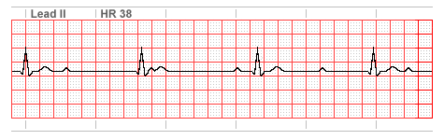
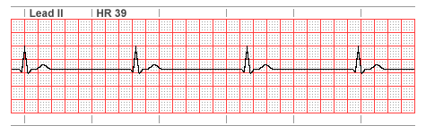
SYMPTOMATIC BRADYCARDIA
Ensure bradycardia is symptomatic
Includes sinus, junctional, first degree, second degree types I & II, and third degree heart blocks, IVR
O2 (sat <94%), IV, Monitors

Slide 28
SYMPTOMATIC BRADYCARDIA
If the patient is severely compromised, consider starting CPR
Consider Atropine
  works best for: sinus, junctional, first degree block and second degree type I
1.0mg Atropine repeated every 3 to 5 minutes

Slide 29
SYMPTOMATIC BRADYCARDIA
Repeat 1.0mg Atropine every 3 to 5 minutes as needed to a maximum of 3mg
Trans Cutaneous Pacemaker
  Best for: Second degree type II, Third degree, IVR or atropine refractory
TC Pacing does not fix the underlying cause!
Select Pacemaker function, Apply pads to patient (A/P or anterior/anterior lateral)

Slide 30
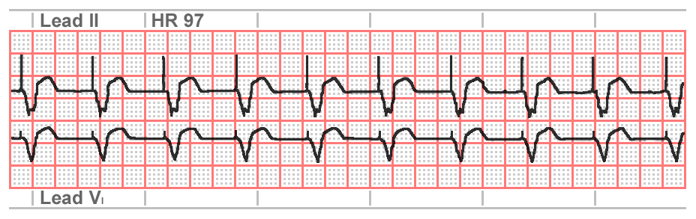
SYMPTOMATIC BRADYCARDIA
Set pacing rate (60 to 80 ppm)
Consider sedation
Push ‘Start’, increase electrical output
Look for electrical capture –wide QRS complex and a T wave
Assess patient – palpable pulse? Adequate BP?

Slide 31
SYMPTOMATIC BRADYCARDIA
Capture and poor BP? Consider: adding volume, using an inotrope or vasopressor
No capture? Increase electrical output and look for treatable causes (H’s & T’s)
No pacer? No capture? Consider:
  Dopamine drip 2 to 20micrograms/kg/min or
  Epinephrine drip 2 to 10micrograms/min
Pass off to definitive care (Cardiology)

Slide 32
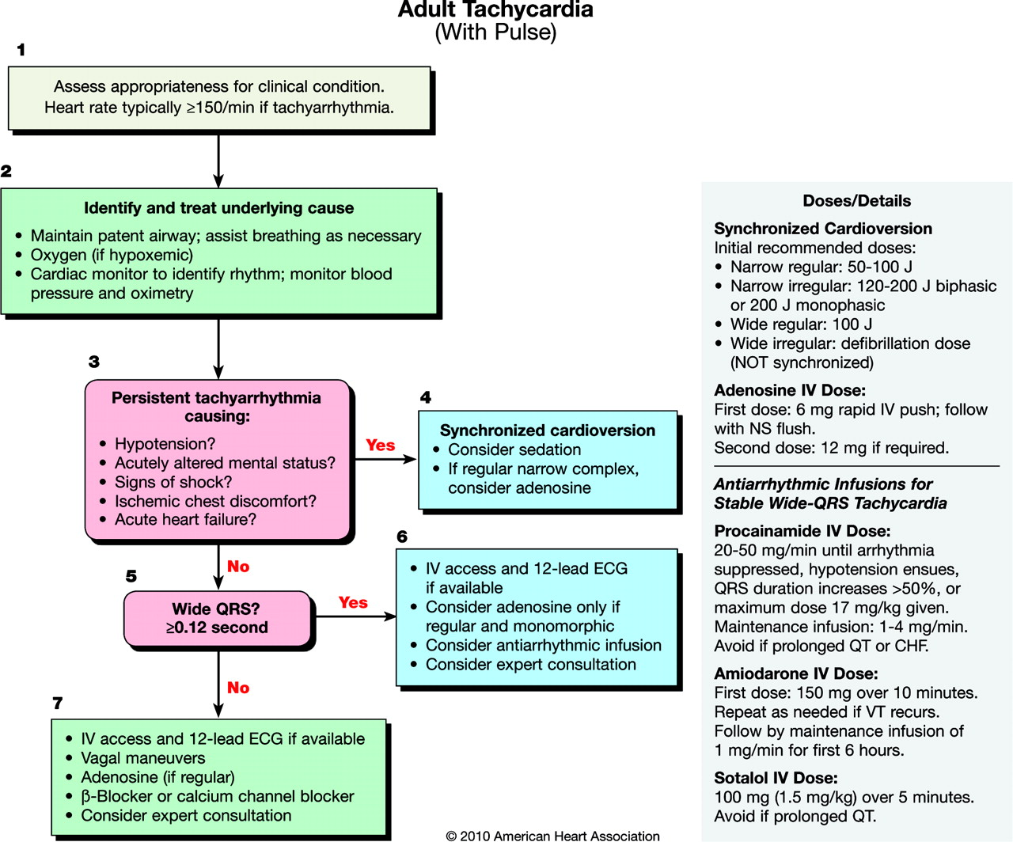

Slide 33
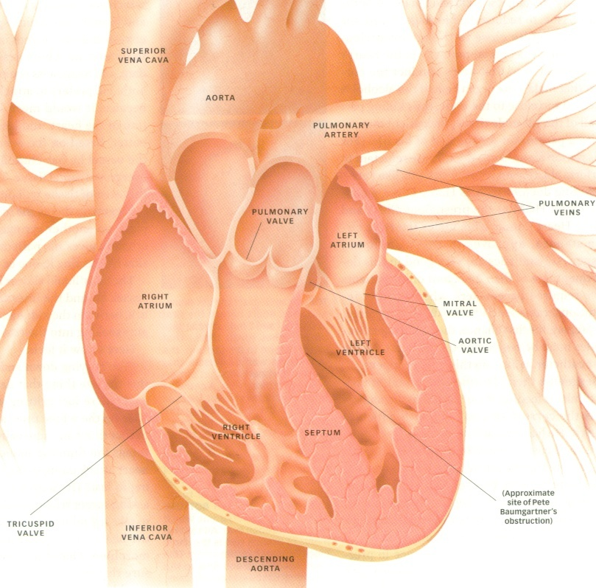
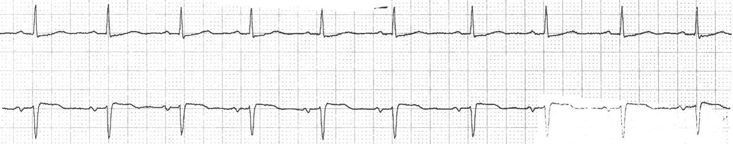
Acute Coronary Syndrome
Includes Angina and MI

Slide 34
ACUTE CORONARY SYNDROME
Assess vitals, Use pain scale
Female, elderly and diabetic patients have atypical signs & symptoms
Start IV, draw labs, ECG and 12 lead, Cardiology consult
Morphine – 2 to 5mg (titrate)
Oxygen add only if <90% saturation
Nitroglycerin – sublingual and IV
Aspirin – 162 to 325mg chewed and swallowed

Slide 35

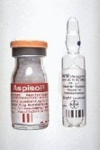
ACUTE CORONARY SYNDROME
Assess vitals, Use pain scale
Female, elderly and diabetic patients have atypical signs & symptoms
Start IV, draw labs, ECG and 12 lead, Cardiology consult
Morphine – 2 to 8mg (titrate)
Oxygen (if sat <90%)
Nitroglycerin – sublingual and IV (Staxin, Adcirca, Revatio)
Aspirin – 162 to 324mg chewed and swallowed
Beta blockers, consider cath lab (PCI)< 90 min or Fibrinolytics and heparin

Slide 36
STROKE
O2 (sat <94%), IV, Monitor, Assess blood glucose
Assess Resp, pulse, BP, temp
  Assessment tool: FAST-ED (new)
Transport to Stroke Center
  Diversion acceptable if no CT Scan
Notify multidisciplinary Stroke Team
Non-contrast head CT scan <20 min, Radiologist to read <45min from arrival, focused exam and history
TPA or Interventional Neurology

Slide 37
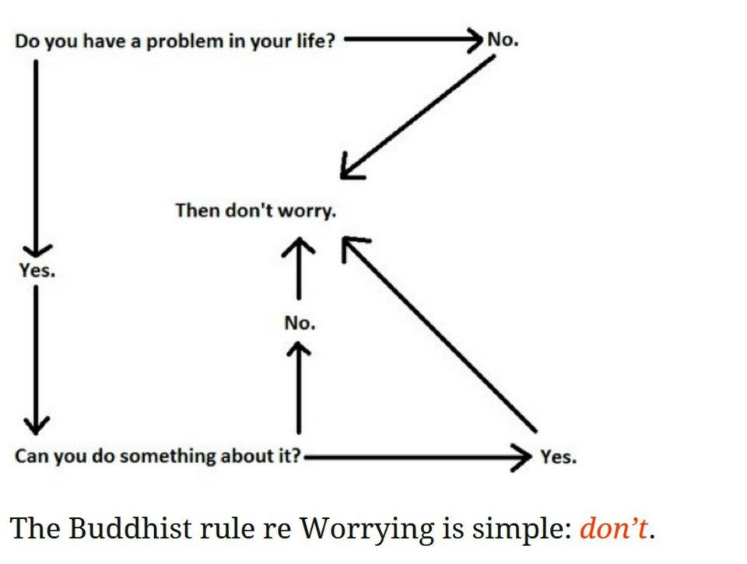

Slide 38
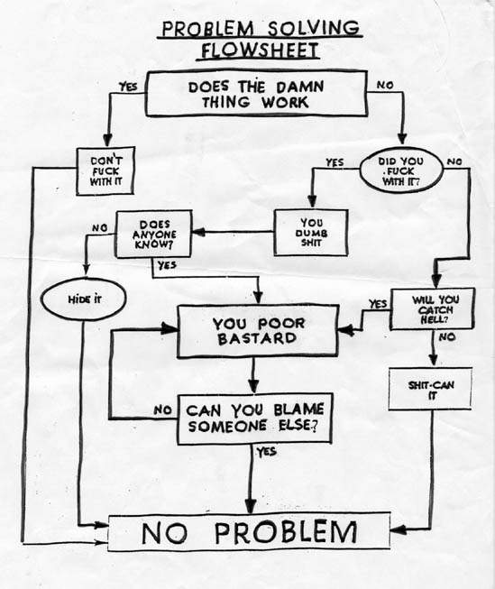
Questions?

