Slide 1
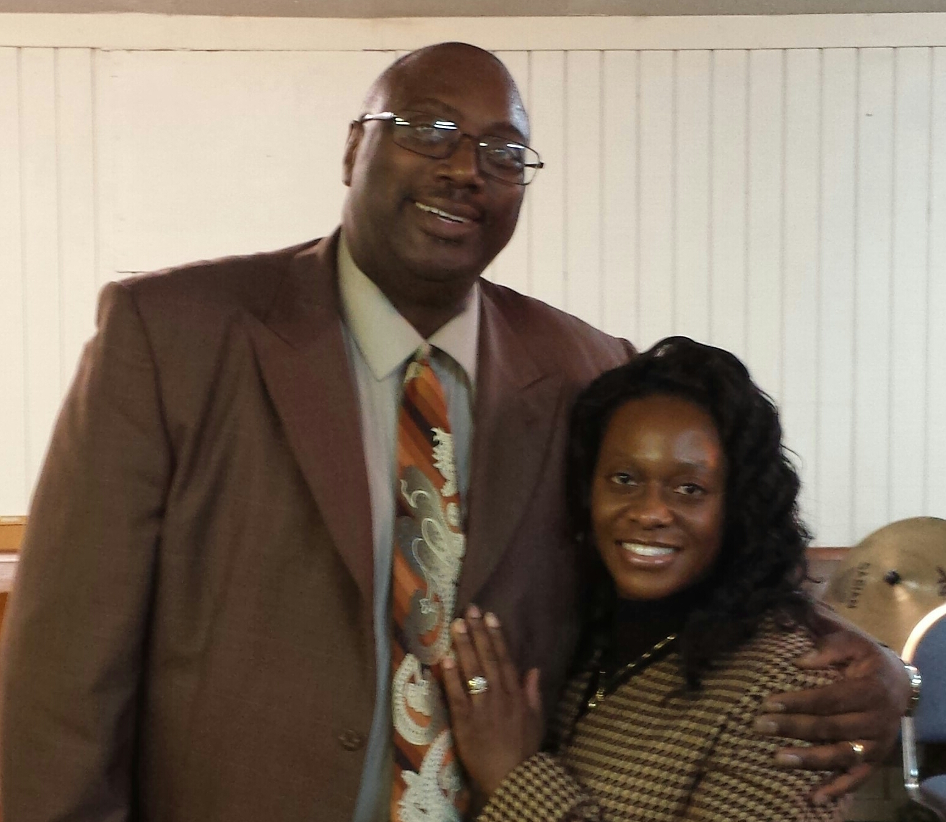
Pastor Timothy D. Roberson
By The Grace Of God Home Bible Study And Phone Ministry
3515 Arista Blvd # 811 Texarkana, TX 75503
Monday Night Phone Ministry (667)770-1530 access Code 585817# 6:30pm Central/7:30pm Eastern
Playback Number (667)770-1529 Access Code 585817# *Available Until Following Monday
It’s Free (Please Tune In)
www.gracehomebiblestudy.org

Slide 2
Salvation
If You Were To Die Today,Where Would You Spend Eternity?

Slide 3
Salvation
Are You A Hope So Going To Heaven Or Are You A Know For Sure I’m Going To Heaven?

Slide 4
Salvation
There are numerous ways in which Satan attempts to blind the minds of the unsaved. Perhaps his most effective means is through organized religion. Sadly, countless souls have gone to a Christless eternity because they were led to believe that, if their good works outweighed their folly, they would go to heaven.

Slide 5
Salvation
But let’s be clear from the outset: The good news of salvation is vested in a person, and that person is the Lord Jesus Christ. The only way to receive the forgiveness of your sins is by believing Christ died for your sins and rose again (I Cor. 15:3,4, I Thes. 4:14).

Slide 6
Salvation
In my case, Satan used my own pride and self-confidence against me for years to keep me in darkness. I didn’t have a true understanding of salvation.

Slide 7
(Was Me For Years) Trying Pleasing Men Instead Of God
Galatians 1:10 - For do I now persuade men, or God? or do I seek to please men? for if I yet pleased men, I should not be the servant of Christ. Notice the time elements in that verse - “now” and “yet.” What is that about?
Galatians 1:13-14 - For ye have heard of my conversation in time past in the Jews' religion, how that beyond measure I persecuted the church of God, and wasted it: And profited in the Jews' religion above many my equals in mine own nation, being more exceedingly zealous of the traditions of my fathers.

Slide 8
Pleasing Men Instead Of God
Paul is saying he was serving men when he was a Jew persecuting the church, making a profit pleasing people. But not NOW. (Vs. 10) God did not save us just so we could live the way we want to live.

Slide 9
My Personal Testimony
I sought the praise of men for years. I tried to please men for years. I remember my days of whooping and hollering so I could get the praise of men. Satan had me blinded, Christ was not the issue. Seeking the praise of men is what motivated me. I just wanted to hear people say “boy you know you preached”.

Slide 10
My Personal Testimony
I put men on pedestals and praised the creature instead of the Creator. I was exalting myself. I was locked into a performance based system. Sad but true, I was relying on man for my spiritual growth and development and many today are still relying on men for their spiritual development and growth.

Slide 11
My Personal Testimony
I thank God He brought me out by pointing me to His word rightly divided. I begin to rely on God and not man. I begin to study for myself, not relying on the man behind the pulpit. If someone would have asked me how to be saved, they probably would have left confused. Sad but true, all those years, I was sitting under those who were not apt to teach. I sat under snatch and grab preachers, who took verses out of context and didn’t understand how to rightly divide the Word of Truth as 2nd Timothy 2:15 tells us to do.

Slide 12
Paul had the marks of a slave
Galatians 6:17 - From henceforth let no man trouble me: for I bear in my body the marks of the Lord Jesus.
He could prove who he was from the scars he carried on his body from having been beaten with a rod 195 times 2nd Corinthians 11:24. (39 stripes on five occasions)
2nd Corinthians 4:5 - For we preach not ourselves, but Christ Jesus the Lord; and ourselves your servants for Jesus' sake. I can’t emphasize enough the fact that a servant of Jesus Christ does not exalt himself.

Slide 13
Christ Is The Issue
If we are going to serve the Lord in preaching, teaching or witnessing so that we can call attention to ourselves, let us do ourselves and God a favor -stay at home. We must make Christ the issue. If we can’t get in the pulpit or stand in front of others and preach God’s Word rightly divided instead of our word, go fishing. My point to us is to get our motivation as a servant from the example God gave us in our apostle, Paul.

Slide 14
Christ Is The Issue
The ministry is not designed to give us a “front row on cheerleader alley.” If our heart is not right in that regard, we will “sell out” because when the persecution comes, we will quit. We may start out with the right attitude, but we will need to watch ourselves all the time. Remember what Paul said about his service: “I magnify my office(Romans 11:13).”

Slide 15
Servant To Please Christ
There is the key to our whole ministry. Romans 1:1- Paul, a servant of Jesus Christ, called to be an apostle, separated unto the gospel of God,
The apostle Paul goes out with the authority of the person that sent him. (Jesus Christ). 2nd Corinthians 5:20 Now then we are ambassadors for Christ, as though God did beseech you by us: we pray you in Christ's stead, be ye reconciled to God.

Slide 16
Salvation
Many people think they will go to heaven because they have lived a good life. Perhaps, they treat all of their neighbors fairly. Maybe they volunteer for charity work and have never broken the law. Maybe they were even baptized or go to church regularly. But the Bible, God's Word, says that no one can live up to God's standard of righteousness.

Slide 17
Salvation
Romans 3:10 "As it is written, There is none righteous, no, not one ...."
Romans 3:23 "For all have sinned, and come short of the glory of God ...."

Slide 18
Salvation
Romans 6:23 "For the wages of sin is death; but the gift of God is eternal life through Jesus Christ our Lord."
Salvation cannot be earned. Everyone is a sinner and deserves death, but God gives eternal life. So how can we receive God's gift of eternal life?

Slide 19
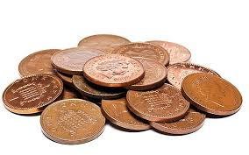
Wages
wages are something we work for, we own them, they are ours. What does the bible say we get for our sin, death?

Slide 20
The Wages For Sin Is Death
The wages the unbeliever earns for his sin is physical, spiritual, and eternal death, and accepting eternal life as the gift of God is his only hope.

Slide 21
Notice Romans 6:23 Says Sin And Not Sins
We need to be careful to notice the difference between sin and sins. If we fail to notice the subject changes in Romans Ch. 5:12 from sins(Romans 3:25) to sin, we have not properly studied the Book of Romans. Sins are the fruit -the things we do. SIN is your nature - the root cause of the problem.

Slide 22
A Fallen Nature
Paul does not just deal with our sins in showing us we have a right standing before God, but he also deals with our sin nature, the real problem. We sin because we are sinners. We are not sinners because we sin. The reason we sin is that we have a fallen nature.

Slide 23
Where Did We Get Our Sin Nature?
Wherefore, as by one man sin entered into the world, and death by sin; and so death passed upon all men, for that all have sinned: (Romans 5:12)
If you are kin to Adam and carry about in you the Adamic nature, then you carry the curse of Adam – sin. That is where we get our sin nature. I tell people all the time, the problem with our kids is that they are kin to their Daddy( Adam). The only way to keep our children from being kin to their Daddy (Adam) is to not have any children.

Slide 24
Our Sin Nature
It should be observed that while sin entered into the world "by one man," Adam, death "passed upon all men for that [because all have sinned," i.e., in Adam. We cannot say, "It was no fault of mine," for we were in Adam. We cannot dissociate ourselves from Adam any more than the branch can separate itself from the tree, or the tree from its root.

Slide 25
God Tells Us Why We Die, IN His Word
God says in 1st Corinthians 15:22, For as in Adam all die, even so in Christ shall all be made alive.
We just read this in Romans 5:12. God explains by letting us know that sin entered the world because of the sin of Adam. Adam and Eve disobeyed God. That is what sin is, disobeying God. The consequence of sin is death, spiritually and physically.

Slide 26
God Tells Us Why We Die, In His Word
In Genesis 2:16-17 , God tells Adam and Eve, “And the Lord God commanded the man, saying, Of every tree of the garden thou mayest freely eat:¹⁷ But of the tree of the knowledge of good and evil, thou shalt not eat of it: for in the day that thou eatest thereof thou shalt surely die.
In Genesis 3:4 we read how Satan changed the word of God to Eve and contradicted God with the words “ And the serpent said unto the woman, Ye shall not surely die.”

Slide 27
God Tells Us Why We Die, IN His Word
God who cannot lie, kept His word to Adam and Eve. They did die. God had two deaths in view here. One was spiritual and one was physical. Their sin immediately broke their previously unbroken fellowship between them and God. They died spiritually.

Slide 28
God Tells Us Why We Die, IN His Word
They were now dead to God. (baby and the mother’s umbilical cord) when Adam sinned, he severed the umbilical cord to God. They were no longer in a right relationship to their creator God. They would also suffer a physical death sometime in the future. They both did die a physical death. ( Genesis 5:5) And all the days that Adam lived were nine hundred and thirty years: and he died.
Many today are confused about the purpose of healing in the bible. Many asked God for healing thinking they can avoid death. If man only understood death, they would see and understand what Paul meant when he said For me to live is Christ, and to die is gain in Philippians 1:21.

Slide 29
Our Sin Nature
The Lord Jesus Christ was born without a human father so as not to have an old sin nature imputed to him. The old sin nature is genetically resident in your flesh and imputed in physical birth from the father to the child.

Slide 30
Salvation
Romans 1:16 "For I am not ashamed of the gospel of Christ: for it is the power of God unto salvation to every one that believeth ...."
To be saved, we must believe the gospel. The word "gospel" means "good news". But before we can believe the good news, we have to know what it is.

Slide 31
Gospel By Which We Are Saved
1st Corinthians 15:1-4 Moreover, brethren, I declare unto you the gospel which I preached unto you, which also ye have received, and wherein ye stand;
² By which also ye are saved, if ye keep in memory what I preached unto you, unless ye have believed in vain.
³ For I delivered unto you first of all that which I also received, how that Christ died for our sins according to the scriptures;
⁴ And that he was buried, and that he rose again the third day according to the scriptures:

Slide 32
Salvation
1st Corinthians 15:1-4 "Moreover, brethren, I declare unto you the gospel ... that Christ died for our sins(past, present and future) according to the scriptures; And that he was buried, and that he rose again the third day according to the scriptures ...."
This is the gospel which we must believe in order to be saved.

Slide 33
Salvation
Romans 5:8-9 "But God commendeth his love toward us, in that, while we were yet sinners, Christ died for us. Much more then, being now justified by his blood, we shall be saved from wrath through him."

Slide 34
Salvation
Romans 3:22-26 "Even the righteousness of God which is by faith of Jesus Christ unto all and upon all them that believe: for there is no difference: For all have sinned, and come short of the glory of God; Being justified freely by his grace through the redemption that is in Christ Jesus:

Slide 35
Salvation
Whom God hath set forth to be a propitiation (appeasing sacrifice) through faith in his blood, to declare his righteousness for the remission of sins that are past, through the forbearance of God; To declare, I say, at this time his righteousness: that he might be just, and the justifier of him which believeth in Jesus."

Slide 36
Salvation
We can be saved from the wrath of God, because Jesus Christ, the Son of God, died on the cross as a sacrifice for our sins and rose from the dead. He paid the price for us, and we are justified in God's eyes through our faith in the blood of Jesus Christ.

Slide 37
Salvation
Ephesians 2:8-9 "For by grace are ye saved through faith; and that not of yourselves: it is the gift of God: Not of works lest any man should boast."
There will be no boasting in heaven. We cannot be saved by our own righteousness, but only by God's grace, through faith.

Slide 38
Salvation: The Qualifications
“What must I do to be saved?” (Acts 16:30). First of all, God saves the following kind of people: “sinners” (Rom. 3:23), “ungodly” (Rom. 4:5), those “without strength” (Rom. 5:6), His “enemies” (Rom. 5:10).
If you do not think that you are any of the above, you cannot be saved. If you still think you’re good enough, you cannot be saved. God does not save good people, or people trying to earn their way to heaven. You must come to God God’s way.

Slide 39
Salvation
“For all have sinned, and come short of the glory of God; being justified freely by His grace through the redemption that is in Christ Jesus” (Rom. 3:23-24). God saves sinners on this basis:

Slide 40
Salvation
Salvation: The Basis
Freely. It does not cost the sinner anything. It is free. You can’t earn salvation by being good, and you cannot lose salvation by being bad. God does not require any works from a sinner. Good works do not make it easier, and bad works do not make it harder to get saved. It is FREE, FREE, FREE! God justifies the sinner freely. Justification is the act whereby God declares a person righteous, even though that person in himself is not righteous.

Slide 41
Salvation
“For all have sinned, and come short of the glory of God; being justified freely by His grace through the redemption that is in Christ Jesus” (Rom. 3:23-24). God saves sinners on this basis:
By His Grace. That means that it comes from the heart of God without finding anything in the recipient that would draw out His grace. Grace is all that God is free to do for the undeserving sinner because Christ paid for our sins on the Cross. If we have to work for our salvation, then salvation is not “by His grace.” If we can earn it, why did He die?

Slide 42
Salvation
“For all have sinned, and come short of the glory of God; being justified freely by His grace through the redemption that is in Christ Jesus” (Rom. 3:23-24). God saves sinners on this basis:
Through the Redemption that is in Christ Jesus. Salvation is free to the sinner, but it cost God everything! Free is not cheap. As a matter of fact, salvation is the most expensive thing that has ever been paid. The cost of salvation was that Almighty God had to become a man and die in the sinner’s place. The cost was infinite!

Slide 43
Salvation
Redemption (Freedom By Payment Of A Price) when we were enslaved under the debt of our sin. Romans 6:23 says the payment of sin is death. The Lord Jesus Christ loved us enough to come (by virgin birth) to the earth (the slave market). As a kin to mankind and being the sinless Son of God, He was able to pay the price for all mankind’s sin and He willingly died upon the cross, shedding His Blood for the payment of our debt sin.

Slide 44
Salvation
Sin against an infinite God requires an infinite payment. No man or church or works of any kind can pay this debt. The debt has been fully paid for by the Lord Jesus Christ. It would be the highest insult to offer to God your good works or religion in view of the fact that His Own Son suffered on the Cross to pay for your sins.
So to answer the question, “What must I do to be saved?” Stop making excuses, and place yourself in the “Qualifications” category, and receive the gift of salvation God has provided.

Slide 45
Salvation
So to answer the question, “What must I do to be saved?” Stop making excuses, and place yourself in the “Qualifications” category, and receive the gift of salvation God has provided.

Slide 46
Qualifications Category
Freely: Romans 3:23-24
By His Grace: Romans 3:23-24, Ephesians 2:8-9
Through the Redemption that is in Christ Jesus: Romans 3:23-24

Slide 47
Salvation
Ephesians 1:13-14 "In whom ye also trusted, after that ye heard the word of truth, the gospel of your salvation: in whom also after that ye believed, ye were sealed with that holy Spirit of promise, which is the earnest of our inheritance until the redemption of the purchased possession, unto the praise of his glory."

Slide 48
Salvation
Once we believe the gospel, we are sealed with God's Holy Spirit. This is God's deposit, that guarantees he will redeem us, whom our Lord Jesus Christ "purchased with his own blood."

Slide 49
Salvation
(Acts 20:28 Take heed therefore unto yourselves, and to all the flock, over the which the Holy Ghost hath made you overseers, to feed the church of God, which he hath purchased with his own blood.).

Slide 50
What About Water? I Don’t See Water
Some Might Be Saying, “I Didn’t Hear Having To Be Water Baptized As Part Of Being Saved.”
Where Did Water Baptism Begin?
What Was The Purpose Of Water Baptism?
Why Was John The Baptist Baptizing?
Who Was He Baptizing?
Why Did Jesus Get Baptized?

Slide 51
Salvation
I have Articles On Water Baptism That Will Clear Up A Lot Of The Confusion In The Body Of Christ (The Church). Please take them and study them.

Slide 52
True Meaning Of Joy
J-Jesus: 1st Corinthians 2:2 For I determined not to know any thing among you, save Jesus Christ, and him crucified. 2 Corinthians 4:5 - For we preach not ourselves, but Christ Jesus the Lord; and ourselves your servants for Jesus' sake.
O-Others: Philippians 2:3 Let nothing be done through strife or vainglory; but in lowliness of mind let each esteem other better than themselves.
Y-You: Galatians 2:20 I am crucified with Christ: nevertheless I live; yet not I, but Christ liveth in me: and the life which I now live in the flesh I live by the faith of the Son of God, who loved me, and gave himself for me.

Slide 53
Understanding Grace
It is not Grace that makes you want to live the old way. It is your old sin nature that does that. God sets us free from sin so we can please God and not men.

Slide 54
Understanding Grace
Romans 6:14 For sin shall not have dominion over you: for ye are not under the law, but under grace.
Why does the verse say that sin shall not have dominion over you? “For ye are not under the law, but under grace.” You will never have victory over the dominion of sin until you are properly oriented to the assets you have under grace. Those two principles of law and grace are opposites.

Slide 55
The Law Principle
The law principle is what we call, the “If then,” principle. IF you do this, then I will do that. IF this happens then that will happen. The law says if you perform this, you will get a blessing. If you don’t do that you get a curse. It is a performance system.

Slide 56
Grace
Grace says – here, and hands you the blessing. Grace is all that God is free to do for you through the cross. Grace gives you a blessing freely. Turn to Galatians 5:16 where we will see why this is important to understand.
[This] I say then, Walk in the Spirit, and ye shall not fulfill the lust of the flesh. (Galatians 5:16) But if ye be led of the Spirit, ye are not under the law. (Galatians 5:18) If you walk in the Spirit, if you are led of the Spirit, you are not under the law.

Slide 57
Old Nature And The Law
The old sin nature works on the basis of the law. Your old sin nature works on the basis of reactionary legalism. It works on the basis of developing a lifestyle that seeks to resist God’s efforts to show us that we are sinners and to manifest his love and his grace to us through Christ and Christ alone.

Slide 58
Old Sin Nature
The old sin nature works on the basis of performing, working, doing. If you walk in the flesh, you are going to work under the law principle. If you walk in the Spirit you walk under the grace principle.

Slide 59
Being Led By The Spirit
Walking and being led by the Spirit does not have anything to do with the Spirit of God taking control of you and leading you by the hand. Being led by the Spirit and walking by the Spirit means that you walk in line with what he says he is doing today.

Slide 60
Grace/By The Spirit-Law/By The Flesh
When you are filled with and walk under the principles of grace, then you are walking by the Spirit. If you walk under the principles of the law – the “if, then” principle, - then you are walking in the flesh.

Slide 61
Grace/By The Spirit-Law/By The Flesh
The law is a performance/fear syndrome. If you perform you get the blessing; if you don’t perform, I’m going to curse you. That system uses fear as motivation and the result of that is a guilt complex when you fail.

Slide 62
If Principle/Nation Of Israel
Now therefore, if ye will obey my voice indeed, and keep my covenant, then ye shall be a peculiar treasure unto me above all people: for all the earth [is] mine: (Exodus 19:5)
Notice the IF and THEN principle. The issue in this passage is keeping the law. The law says, perform and I’ll bless you.

Slide 63
We Are Under Grace
Romans 11:6 “And if by grace, then is it no more of works: otherwise grace is no more grace. But if it be of works, then it is no more grace: otherwise work is no more work.”
We are not saved by works!!!!

Slide 64
We Are Saved Unto Good Works
Ephesians 2:10 “For we are his workmanship, created in Christ Jesus unto good works, which God hath before ordained that we should walk in them.”

Slide 65
Right Division In The Dispensation Of Grace
Godliness
Ungodliness
To think like God does; 2. To do things God’s way; and 3. To labor with God in what He is doing. These are the three fundamental components to godliness, with the inner man issue of thinking like God does being the crux of the matter.
Ungodliness, by definition therefore, is the opposite of godliness. It is the issue of not thinking like God does; not doing things God’s way; and not laboring with God in what He is doing.

Slide 66
Let Us Pray

