Slide 1
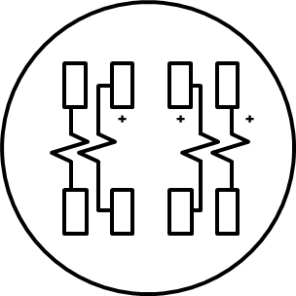
1Ø 3 Wire 120/208 V Network
H1
X1
H1
X1

Slide 2
1Ø 3 Wire 120/208 V Network
A
H1
X1
B
H1
X1
N

Slide 3
3 Wire 1 Phase 120/240 Volt
H1
X1
H1
X1

Slide 4
3 Wire 1 Phase 120/240 Volt
A
H1
X1
B
H1
X1
N

Slide 5
3 Wire 3 Phase 480
H1
X1
H1
X1

Slide 6
3 Wire 3 Phase 480
A
H1
X1
B
N
H1
X1

Slide 7
3 Wire 3 Phase 480 with PT’s
H1
X1
4:1
4:1
H₁
H₂
H₁
H₂
H1
X1
X₁
X₂
X₁
X₂

Slide 8
3 Wire 3 Phase 480 with PT’s
A
H1
X1
B
C
4:1
4:1
H₁
H₂
H₁
H₂
H1
X1
X₁
X₂
X₁
X₂

Slide 9
4 Wire 3 Phase 277/480 with PT’s
H1
X1
H1
X1
H1
X1
2.5:1
2.5:1
2.5:1
H₁
H₂
H₁
H₂
H₁
H₂
X₁
X₂
X₁
X₂
X₁
X₂

Slide 10
4 Wire 3 Phase 277/480 with PT’s
A
H1
X1
B
H1
X1
C
H1
X1
N
2.5:1
2.5:1
2.5:1
H₁
H₂
H₁
H₂
H₁
H₂
X₁
X₂
X₁
X₂
X₁
X₂

Slide 11
4 Wire 3 Phase 277/480 with PT’s
H1
X1
H1
X1
H1
X1
2.5:1
2.5:1
2.5:1
H₁
H₂
H₁
H₂
H₁
H₂
X₁
X₂
X₁
X₂
X₁
X₂

Slide 12
4 Wire 3 Phase 277/480 with PT’s
A
H1
X1
B
H1
X1
C
H1
X1
N
2.5:1
2.5:1
2.5:1
H₁
H₂
H₁
H₂
H₁
H₂
X₁
X₂
X₁
X₂
X₁
X₂

Slide 13
4 Wire 3 Phase 120/240
H1
X1
H1
X1
H1
X1

Slide 14
4 Wire 3 Phase 120/240
A
VLL-240 VOLTS
120 VOLTS
H1
X1
B
120 VOLTS
H1
X1
C
208 VOLTS
H1
X1
N

