Slide 1
DENVER FORECAST
Weather.com 8/7/222
Notes:
Here’s the same remake for Sunday’s forecast but with data from weather.com for Sunday, 8/7/2022.
Subscribe to Spotlight Impact Data Design on YouTube for data visualization, PowerPoint, and Excel tutorials for all skill levels: www.youtube.com/spotlightimpactdatadesign

Slide 2
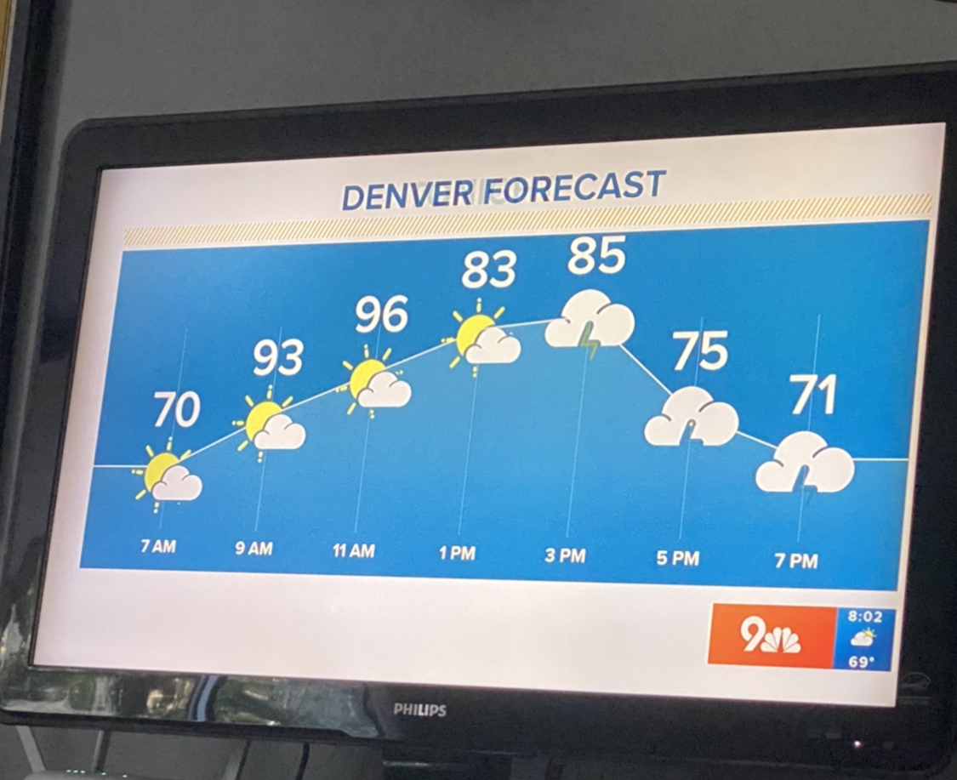
DENVER FORECAST
Broadcast 8/7/222
Notes:
Re-make from forecast graphic broadcast on Sunday, 8/7/2022. Used the same numbers and times broadcast but they’re likely off – don’t make sense.
Subscribe to Spotlight Impact Data Design on YouTube for data visualization, PowerPoint, and Excel tutorials for all skill levels: www.youtube.com/spotlightimpactdatadesign

Slide 3
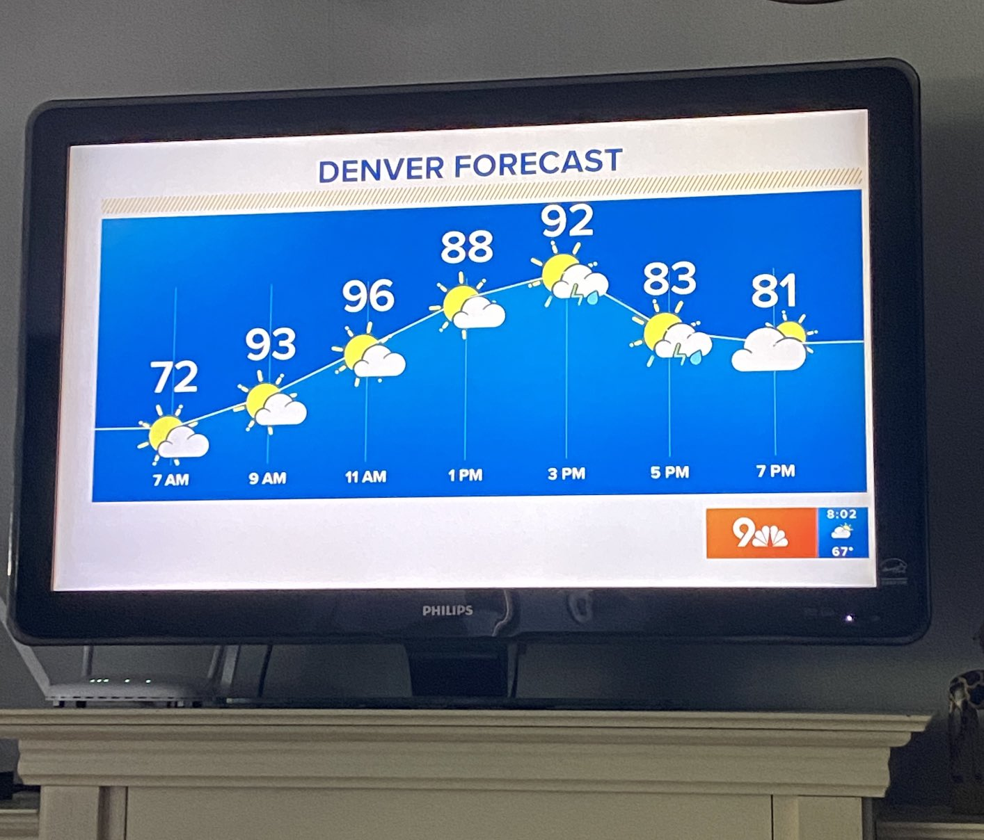
DENVER FORECAST
Broadcast 8/6/222
Notes:
This is a version re-make from Saturday, 8/6/22. Photo of what was broadcast can be seen to the right. Temp labels are definitely off because temp distribution likely wouldn’t take this shape over the course of the day.
Subscribe to Spotlight Impact Data Design on YouTube for data visualization, PowerPoint, and Excel tutorials for all skill levels: www.youtube.com/spotlightimpactdatadesign

