Slide 1
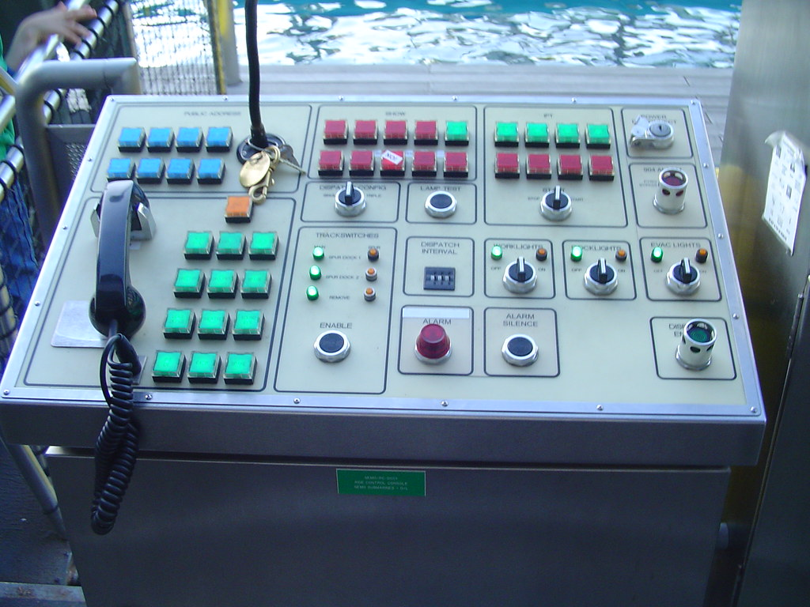
Recalibrating Student Success:
Setting the Tone for Student [Re-]Engagement
Notes:
Shortly after having a conversation with my oldest daughter about how I don’t understand Generation Z, I came to the part in the book I was reading at the time, Lightmaker’s Manifesto, that mentioned a TED Talk by Shawn Achor. The details in that book and in the TED Talk started me down the proverbial rabbit hole of learning all that I could – not about Generation Z, specifically, but about the role a sense of well-being plays in learning, resilience, and satisfaction with ones life. I want to share some of what I learned with you, but first . . . .

Slide 2
Something good that happened to you within the past 24 hours.
One way you used math within the past 24 hours.
Notes:
After first bullet, have them close their eyes and think about that positive event. [Wait 15 seconds, then] “Just notice how you feel having reflected on that good thing. Flip the card over.”
After second bullet, have them close their eyes and think about that success. [Wait 15 seconds, then] “Just notice how you feel having reflected on that good thing.”
We’re going to circle back to this shortly.

Slide 3
The Science of Well-Being
Approximately 90% of long-term happiness comes from the way we view the world, not from circumstances.
50% of our sense of happiness is determined by our genetic set point (our “factory settings”); 10% is determined by our circumstances; and 40% by our intentional actions and thoughts.
When our brains are at rest, doing what they’re designed to do, they consume 20-25% of our calorie intake. When we are stressed, however, our stress hormones rob our brains of that nutrition.
Notes:
First bullet – In other words, success doesn’t result in happiness so much as happiness results in success. How might this, as a Student Success paradigm shift, look? Let’s talk about that.
Second bullet – I got the Eeyore gene. One of my SIL got the Tigger gene. The 40% is where we can help guide our students; also where I personally must be intentionally intentional.
Third bullet – in a 2020 survey, almost 3 out of 4 18-24 y.o. report poor mental health tied to the pandemic. Those seem to be lingering statistics, esp. considering the adult brain isn’t fully developed until well into the 20’s.

Slide 4
Maybe, just maybe . . .
That last fact might help explain some of what we’ve been seeing . . .
She came to every class, but ______.
He logged in at least once a week, but ______.
I walked around, offering help, and then _______.
I emailed, I called, I offered to meet on Teams, but _____.
I allowed them to earn additional points for redoing assignments, and yet _____.
Stress comes in all sorts of disguises, and depletes our bandwidth!
Notes:
Help me fill in the blanks from your experiences the past few years and even now.
Did you know that 58% of adolescents suffering from major depression in 2020 did not receive treatment? And those are adolescents who’ve been identified as having depression . . . . I think some students don’t realize how stressed, depressed, or anxious they are until they encounter the rigors of college.

Slide 5
Happiness Doesn’t Just Happen
What we mean by “happiness”
What the science tells us boosts happiness:
Gratitude – trains our brains to look for what’s right with the world
Meditation – stops “monkey-brain” multi-tasking, keeps us present
Exercise – teaches our brains that behavior matters
Journaling – helps us relive and reinforce the positive; helps short-circuit obsessive ruminating
Random Acts of Kindness – builds connection, contributes to what’s right with the world
Notes:
Researcher Sonja Lyubomirsky says she uses the term happiness “to refer to the experience of joy, contentment, or positive well-being, combined with a sense that one’s life is good, meaningful, and worthwhile.” (versus a mood). This definition does not discount the injustices and sorrows in the world, but a recognition that there is the possibility of joy, of contentment, and essentially becomes a reservoir of sorts to cope with said injustices and sorrows. Lyubomirsky’s Subjective Happiness Scale available online, and I’ve included a link in the resources slide.
A example – if I were to ask you to look for a particular book on a shelf of books, randomly lined up, you’d be attending to every title on the spines, but if I said “it’s got a dark green binding with gold lettering,” you would be attending to that detail.
B need not be complicated. Maybe try parasympathetic breathing using the fingers on one hand, the version used in many elementary schools.
As well, B and C can be combined.
D – this is one way of savoring events; the science of well-being has something to say about savoring, which I’ll touch on in the next slide; Happiness handout has some particular recommendations for journaling
E – perhaps, as a class, one day, between classes, you all can do something as simple as handing out a piece of bubblegum, a smile, and an encouraging word. RAOK not only boost the happiness scores of recipients, but also the one doing the kind act.

Slide 6
Incorporating Happiness Into Academia
How did the index card exercises make you feel?
What are some ways we can help our students access positive feelings, setting the tone for that day’s learning objectives? How can we facilitate those intentional actions and thoughts? How can we help them feel seen and safe?
Heather Howington – math
Carla Chwat - English
Notes:
First bullet: well-being research tells us that savoring positive experiences increases and enhances our happiness quotient. Additionally, developing the habit of savoring positive events helps us make the most of our personal and interpersonal resources and helps reinforce a glass-half-full outlook.
Second bullet: After the disruptions of the past few years, I believe one of the things our students want is structure. They need to know what the expectations are. They may chafe against said structure, but there is a greater sense of safety when we, as human beings, know where the guardrails are, and that they are in place. Our students seem to be struggling with connecting, not only with the content and with their professors, but also with each other. Their educational, social, and emotional development has been disrupted. There’s often a degree of ambivalence when one is struggling with imposter syndrome (struggling with life in general) - that of wanting to be seen and be invisible at the same time. Perhaps if we can help our students, with structured, intentional activities, access an enhanced sense of well being, they’ll be more inclined to connect (and learn); conversely, perhaps if we can facilitate their connection with each other, they’ll experience a heightened sense of well-being and, therefore, be more primed to learn. Think again of how a group RAOK might work on both those elements simultaneously.

Slide 7
Resources
The Lightmaker’s Manifesto: How To Work For Change Without Losing Your Joy, Karen Walrond; Broadleaf Books, 2021
Pursuing Happiness (A Bedford Spotlight Reader), Matthew Parfitt, Dawn Skorczewski; Bedford/St. Martin’s; 2020 (Thank you, Carla, for this!)
The How of Happiness: A New Approach to Getting the Life You Want, Sonja Lyubomirsky; Penguin Press, 2008.
Subjective Happiness Scale: https://hthgse.online/wp-content/uploads/2020/03/SubjectiveHappinessScale.pdf
Shawn Achor TED Talk: https://www.youtube.com/watch?v=GXy__kBVq1M (This one is delightful and informing!)
Keeping Up With . . . Trauma-Informed Pedagogy: https://www.ala.org/acrl/publications/keeping_up_with/trauma-informed-pedagogy
Whole Body Mental Health podcast: https://onbeing.org/programs/kimberley-wilson-whole-body-mental-health/

Slide 8
Our Contact Information
Carla Chwat, Professor of English, UNG; Carla.Chwat@ung.edu; 678-717-3842
Heather Howington, Professor of Math, UNG; Heather.Howington@ung.edu; 678-717-3887
Dede deLaughter; Director of Learning Support, UNG; Dede.deLaughter@ung.edu; 706-310-6207

