Slide 1


BitStone Energy
Powered by HEGATECH
Product Series and Datasheet

Slide 2
CONTENTS
Part One
Part Two
Part Three
Part Four
Product Series
solar module Datasheet
Inverter Datasheet (HV)
Battery Datasheet (HV)

Slide 3
Product Series
 |  |  |  |  |  |  | System Upgrade | Basic | Essential | Plus | Luxery | Premium
Product Series | Total kwp | Number of Panels | Panel Brand | Panel Type | Inverter | Max. kwp | Max Panels | Battery | Battery | Battery | Battery | Battery
BSLV486 | 4.86 | 12 | HEGATECH | HGT-S108|M10H-XXX-BG | SUN-5K-SG04LP3-EU | 7.5 | 19 | N/A | 10kwh | 15kwh | 20kwh | 30kwh
BSLV648 | 6.48 | 16 | HEGATECH | HGT-S108|M10H-XXX-BG | SUN-5K-SG04LP3-EU | 7.5 | 19 | N/A | 10kwh | 15kwh | 20kwh | 30kwh
BSLV729 | 7.29 | 18 | HEGATECH | HGT-S108|M10H-XXX-BG | SUN-6K-SG04LP3-EU | 9.0 | 22 | N/A | 10kwh | 15kwh | 10kwh | 30kwh
BSHV729 | 7.29 | 18 | HEGATECH | HGT-S108|M10H-XXX-BG | SUN-6K-SG01HP3-EU-AM2 | 9.0 | 22 | N/A | 8kwh | 12kwh | 20kwh | 24kwh
BSHV1053 | 10.53 | 26 | HEGATECH | HGT-S108|M10H-XXX-BG | SUN-8k-SG01HP3-EU-AM2 | 12.0 | 30 | N/A | 8kwh | 12kwh | 20kwh | 24kwh
BSHV1296 | 12.96 | 32 | HEGATECH | HGT-S108|M10H-XXX-BG | SUN-10K-SG01HP3-EU-AM2 | 15.0 | 37 | N/A | 8kwh | 12kwh | 20kwh | 24kwh
BSHV1620 | 15.39 | 38 | HEGATECH | HGT-S108|M10H-XXX-BG | SUN-12k-SG01HP3-EU-AM2 | 18.0 | 44 | N/A | 8kwh | 12kwh | 20kwh | 24kwh
BSHV1944 | 19.44 | 48 | HEGATECH | HGT-S108|M10H-XXX-BG | SUN-15K-SG01HP3-EU-AM2 | 22.5 | 56 | N/A | 8kwh | 12kwh | 20kwh | 24kwh
BSHV2430 | 25.92 | 64 | HEGATECH | HGT-S108|M10H-XXX-BG | SUN-20K-SG01HP3-EU-AM2 | 30.0 | 74 | N/A | 8kwh | 12kwh | 20kwh | 24kwh

Slide 4
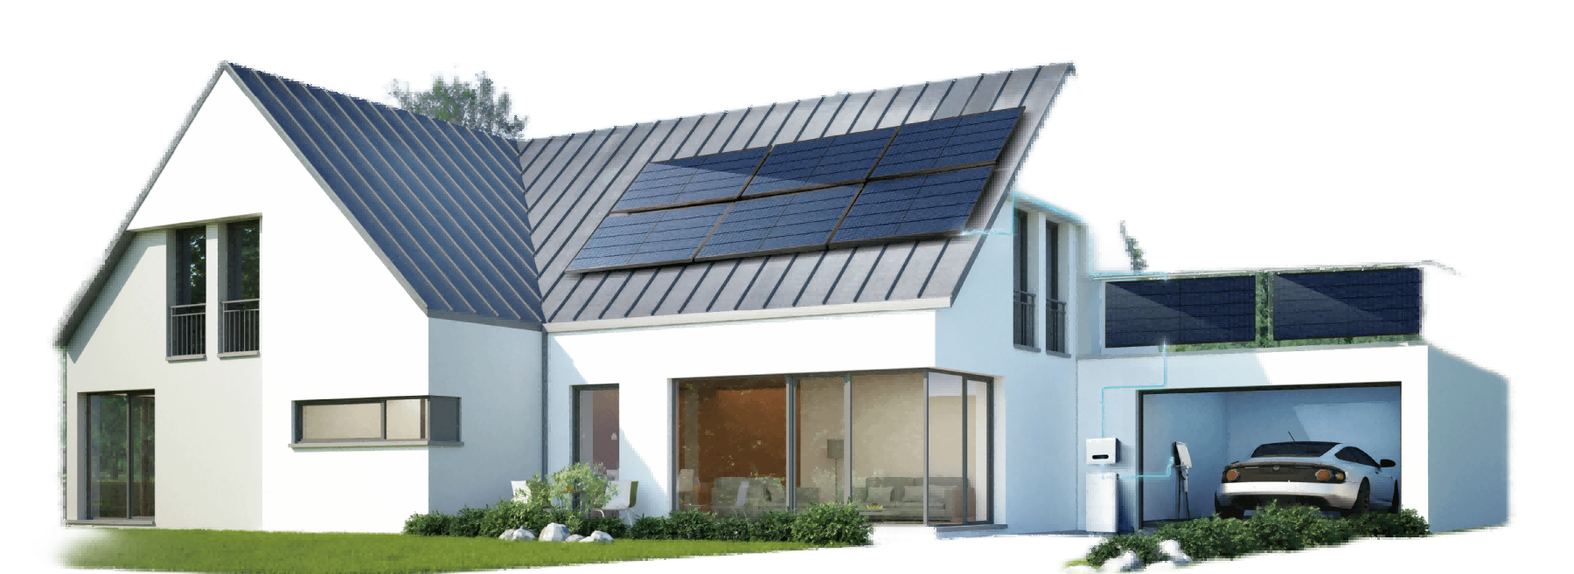




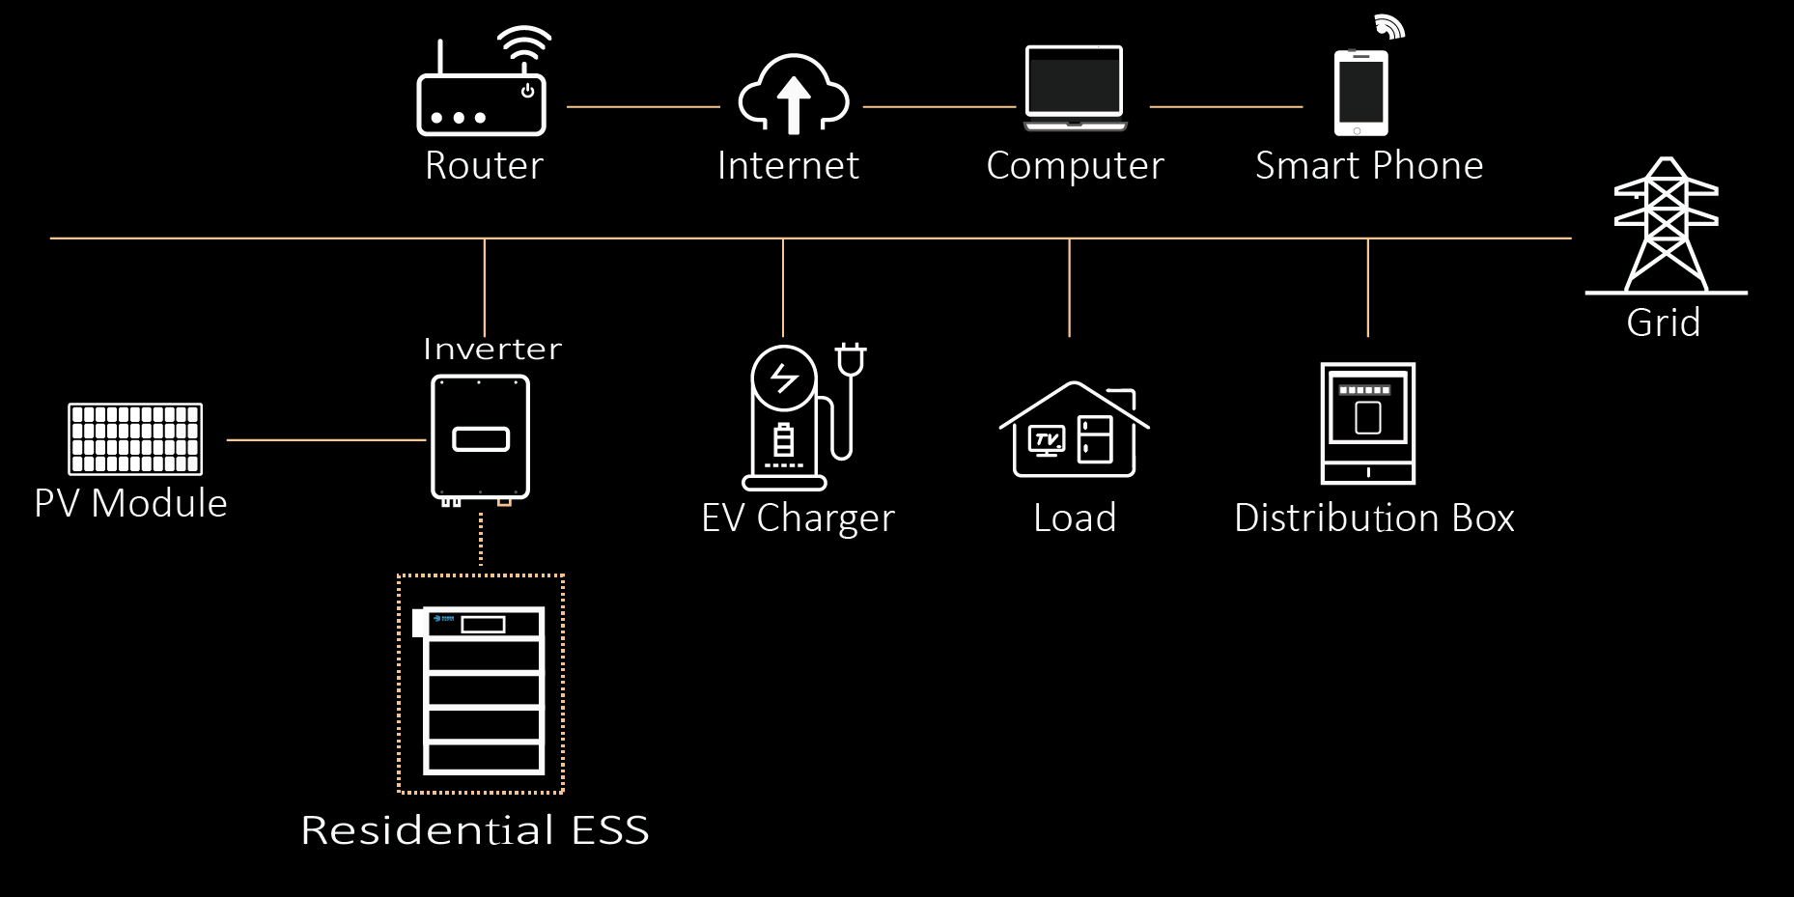
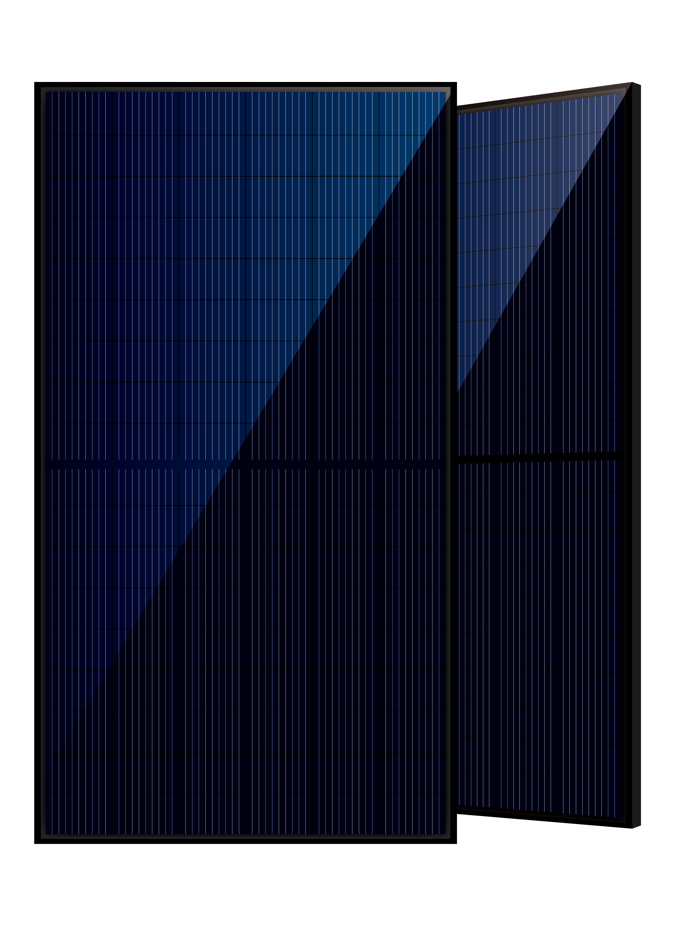
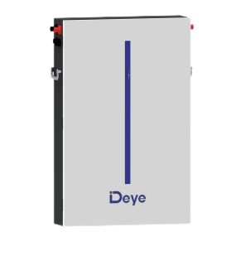
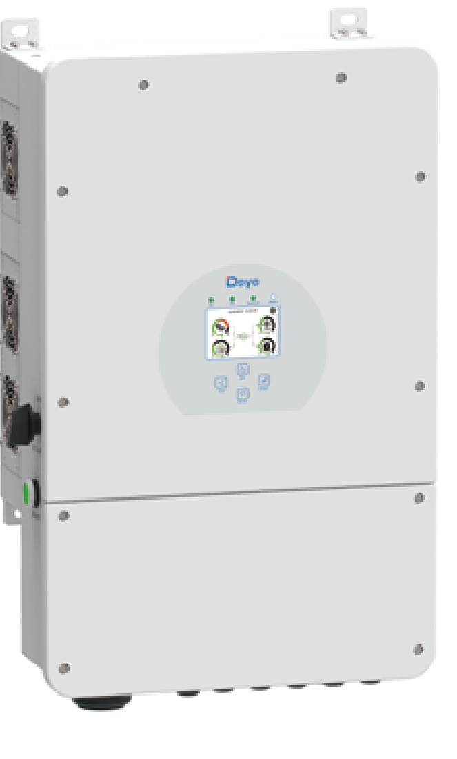
BS Redsdential PV power system
FULL PV POWER SYSTEM VALUE CHAIN
QUALIFIED ORIGINAL COMPONENTS
PROFESSIONAL FULL SYSTEM DESIGN
RELIABLE DELIVERY
LONG TERM AFTER-SALE SERVICE
HEGA MODULE
Deye Inverter
DEYE Energy
Storage System

Slide 5

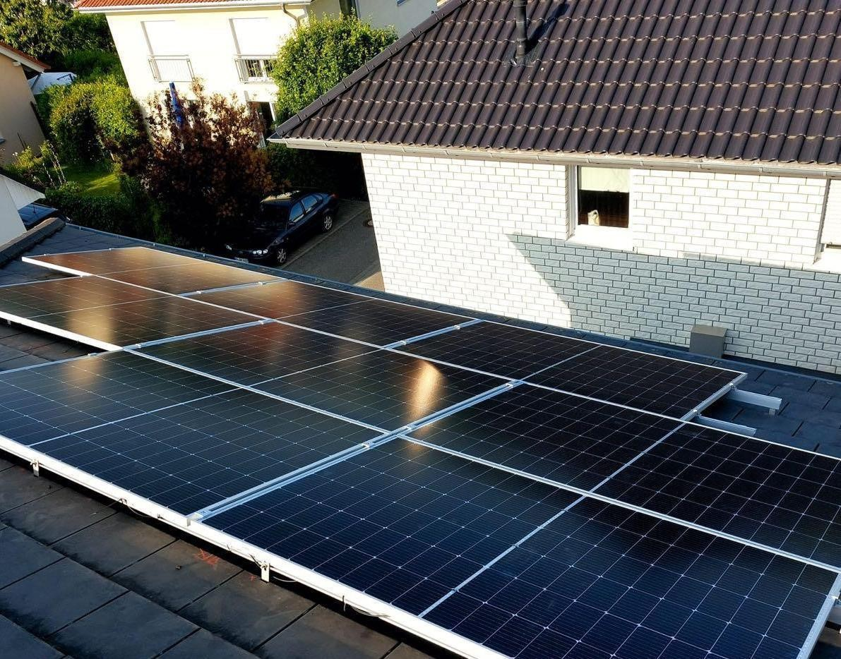




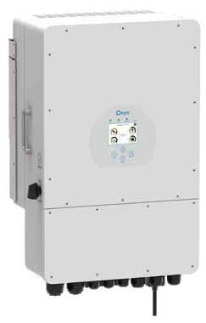
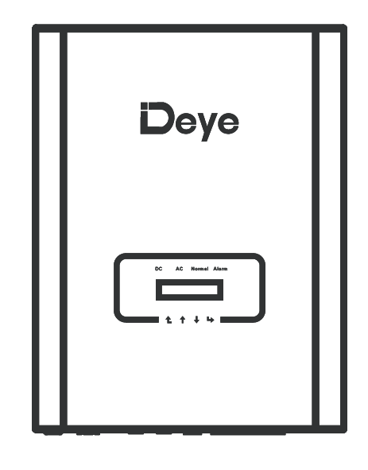
BS Home PV System 4.86W
4.86W
Redsdential PV Power System-BSLV486
Higher Bifacial Dual Glass Module
Original Quality Assurance
Takes 182 mm silicon wafer with the power to 410W
More suitable for inslalled capacity.
Stringent quality control system;Professional design qualification,safe and reliable
Innovative high tech & half cut
After-sales service
Mature MBB technology, enabing lower curent loss;
Lower temperature coefficient, to bring with higher power generation.
PV smart cloud platform monitoring; Big data analysis,speedy service
HGT Bifacial Dual Glass Module
Deye Three Phase Hybrid Inverter - 5kW
108 Cells
410W
12 pics
1722 x 1134 x 30 mm
100
100% unbalanced output, each phase; Max. output up to 50% rated power
Mono MBB cell solar module
AC couple to retrofit existing solar system
Output power
10
Max.10 pcs parallel for on and off-grid operation; Support multiple batteries parallel
240
Max. charging/discharging current of 240A
Numbers of modules
48
48V low voltage battery, transformer isolation design
HGT-S108|M10H-410-BG
Dimensions (L x W x T)
SUN-5K-SG04LP3-EU
6
6 time periods for battery charging/discharging

Slide 6
BS Home PV System 6.48W
6.48W
Redsdential PV Power System-BSLV648
Higher Bifacial Dual Glass Module
Original Quality Assurance
Takes 182 mm silicon wafer with the power to 410W
More suitable for inslalled capacity.
Stringent quality control system;Professional design qualification,safe and reliable
Innovative high tech & half cut
After-sales service
Mature MBB technology, enabing lower curent loss;
Lower temperature coefficient, to bring with higher power generation.
PV smart cloud platform monitoring; Big data analysis,speedy service
HGT Bifacial Dual Glass Module
Deye Three Phase Hybrid Inverter - 5kW
108 Cells
410W / 21.0%
16 pics
1722 x 1134 x 30 mm
100
100% unbalanced output, each phase; Max. output up to 50% rated power
Mono MBB cell solar module
AC couple to retrofit existing solar system
Output power / Enfficiency
10
Max.10 pcs parallel for on and off-grid operation; Support multiple batteries parallel
240
Max. charging/discharging current of 240A
Numbers of modules
48
48V low voltage battery, transformer isolation design
HGT-S108|M10H-410-BG
Dimensions (L x W x T)
SUN-5K-SG04LP3-EU
6
6 time periods for battery charging/discharging

Slide 7
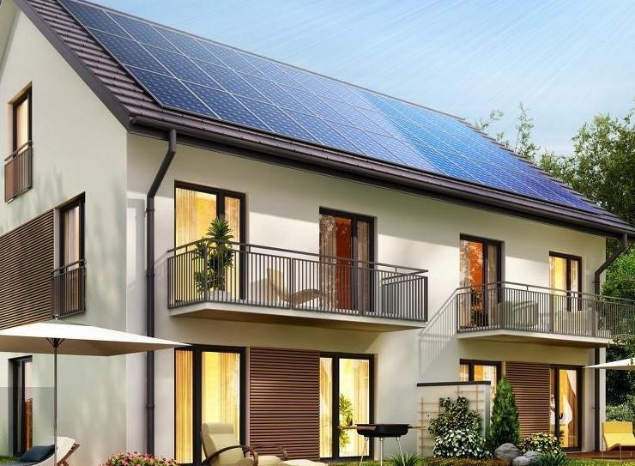
BS Home PV System 7.29W
7.29W
Redsdential PV Power System-BSLV729
Higher Bifacial Dual Glass Module
Original Quality Assurance
Takes 182 mm silicon wafer with the power to 410W
More suitable for inslalled capacity.
Stringent quality control system;Professional design qualification,safe and reliable
Innovative high tech & half cut
After-sales service
Mature MBB technology, enabing lower curent loss;
Lower temperature coefficient, to bring with higher power generation.
PV smart cloud platform monitoring; Big data analysis,speedy service
HGT Bifacial Dual Glass Module
Deye Three Phase Hybrid Inverter - 6kW
108 Cells
410W / 21.0%
18 pics
1722 x 1134 x 30 mm
100
100% unbalanced output, each phase; Max. output up to 50% rated power
Mono MBB cell solar module
AC couple to retrofit existing solar system
Output power / Enfficiency
10
Max.10 pcs parallel for on and off-grid operation; Support multiple batteries parallel
240
Max. charging/discharging current of 240A
Numbers of modules
48
48V low voltage battery, transformer isolation design
HGT-S108|M10H-410-BG
Dimensions (L x W x T)
SUN-6K-SG04LP3-EU
6
6 time periods for battery charging/discharging

Slide 8
BS Home PV System 10.53W
10.53W
Redsdential PV Power System-BSHV1053
Higher Bifacial Dual Glass Module
Original Quality Assurance
Takes 182 mm silicon wafer with the power to 410W
More suitable for inslalled capacity.
Stringent quality control system;Professional design qualification,safe and reliable
Innovative high tech & half cut
After-sales service
Mature MBB technology, enabing lower curent loss;
Lower temperature coefficient, to bring with higher power generation.
PV smart cloud platform monitoring; Big data analysis,speedy service
HGT Bifacial Dual Glass Module
Deye Three Phase Hybrid Inverter - 8kW
108 Cells
410W / 21.0%
26 pics
1722 x 1134 x 30 mm
100
100% unbalanced output, each phase; Max. output up to 50% rated power
Mono MBB cell solar module
AC couple to retrofit existing solar system
Output power / Enfficiency
10
Max.10 pcs parallel for on and off-grid operation; Support multiple batteries parallel
240
Max. charging/discharging current of 240A
Numbers of modules
48
48V low voltage battery, transformer isolation design
HGT-S108|M10H-410-BG
Dimensions (L x W x T)
UN-8k-SG01HP3-EU-AM2
6
6 time periods for battery charging/discharging

Slide 9
BS Home PV System 12.96W
12.96W
Redsdential PV Power System-BSHV1296
Higher Bifacial Dual Glass Module
Original Quality Assurance
Takes 182 mm silicon wafer with the power to 410W
More suitable for inslalled capacity.
Stringent quality control system;Professional design qualification,safe and reliable
Innovative high tech & half cut
After-sales service
Mature MBB technology, enabing lower curent loss;
Lower temperature coefficient, to bring with higher power generation.
PV smart cloud platform monitoring; Big data analysis,speedy service
HGT Bifacial Dual Glass Module
Deye Three Phase Hybrid Inverter - 10kW
108 Cells
410W / 21.0%
32 pics
1722 x 1134 x 30 mm
100
100% unbalanced output, each phase; Max. output up to 50% rated power
Mono MBB cell solar module
AC couple to retrofit existing solar system
Output power / Enfficiency
10
Max.10 pcs parallel for on and off-grid operation; Support multiple batteries parallel
240
Max. charging/discharging current of 240A
Numbers of modules
48
48V low voltage battery, transformer isolation design
HGT-S108|M10H-410-BG
Dimensions (L x W x T)
SUN-10K-SG01HP3-EU-AM2
6
6 time periods for battery charging/discharging

Slide 10


BS Home PV System 15.39W
15.39W
Redsdential PV Power System-BSHV1539
Higher Bifacial Dual Glass Module
Original Quality Assurance
Takes 182 mm silicon wafer with the power to 410W
More suitable for inslalled capacity.
Stringent quality control system;Professional design qualification,safe and reliable
Innovative high tech & half cut
After-sales service
Mature MBB technology, enabing lower curent loss;
Lower temperature coefficient, to bring with higher power generation.
PV smart cloud platform monitoring; Big data analysis,speedy service
HGT Bifacial Dual Glass Module
Deye Three Phase Hybrid Inverter - 12kW
108 Cells
410W / 21.0%
38 pics
1722 x 1134 x 30 mm
100
100% unbalanced output, each phase; Max. output up to 50% rated power
Mono MBB cell solar module
AC couple to retrofit existing solar system
Output power / Enfficiency
10
Max.10 pcs parallel for on and off-grid operation; Support multiple batteries parallel
240
Max. charging/discharging current of 240A
Numbers of modules
48
48V low voltage battery, transformer isolation design
HGT-S108|M10H-410-BG
Dimensions (L x W x T)
SUN-12K-SG04LP3-EU
6
6 time periods for battery charging/discharging

Slide 11
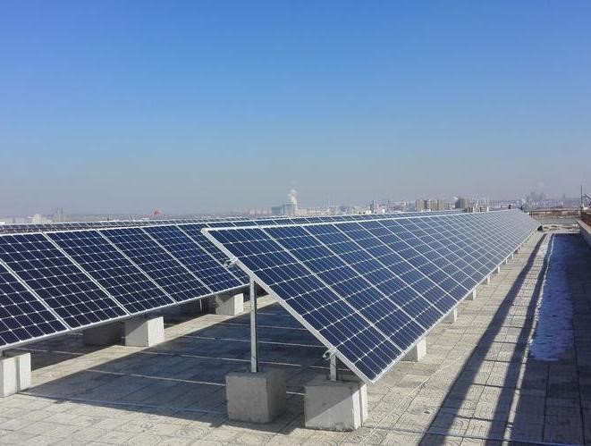
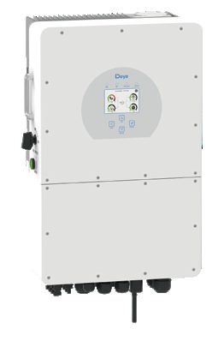
BS Home PV System 19.44W
19.44W
Redsdential PV Power System-BSHV1944
Higher Bifacial Dual Glass Module
Original Quality Assurance
Takes 182 mm silicon wafer with the power to 410W
More suitable for inslalled capacity.
Stringent quality control system;Professional design qualification,safe and reliable
Innovative high tech & half cut
After-sales service
Mature MBB technology, enabing lower curent loss;
Lower temperature coefficient, to bring with higher power generation.
PV smart cloud platform monitoring; Big data analysis,speedy service
HGT Bifacial Dual Glass Module
Deye Three Phase Hybrid Inverter - 15kW
108 Cells
410W / 21.0%
48 pics
1722 x 1134 x 30 mm
100
100% unbalanced output, each phase
Mono MBB cell solar module
AC couple to retrofit existing solar system
Output power / Enfficiency
10
Max.10 pcs parallel for on and off-grid operation; Support multiple batteries parallel
50
Max. charging/discharging current of 50A
Numbers of modules
H
High voltage battery, higher efﬁciency
HGT-S108|M10H-410-BG
Dimensions (L x W x T)
SUN-15K-SG01HP3
-EU-AM2
6
6 time periods for battery charging/discharging

Slide 12
BS Home PV System 24.30W
24.30W
Redsdential PV Power System-BSHV2430
Higher Bifacial Dual Glass Module
Original Quality Assurance
Takes 182 mm silicon wafer with the power to 410W
More suitable for inslalled capacity.
Stringent quality control system;Professional design qualification,safe and reliable
Innovative high tech & half cut
After-sales service
Mature MBB technology, enabing lower curent loss;
Lower temperature coefficient, to bring with higher power generation.
PV smart cloud platform monitoring; Big data analysis,speedy service
HGT Bifacial Dual Glass Module
Deye Three Phase Hybrid Inverter - 20kW
108 Cells
410W / 21.0%
64 pics
1722 x 1134 x 30 mm
100
100% unbalanced output, each phase
Mono MBB cell solar module
AC couple to retrofit existing solar system
Output power / Enfficiency
10
Max.10 pcs parallel for on and off-grid operation; Support multiple batteries parallel
50
Max. charging/discharging current of 50A
Numbers of modules
H
High voltage battery, higher efﬁciency
HGT-S108|M10H-410-BG
Dimensions (L x W x T)
SUN-20K-SG01HP3-EU-AM2
6
6 time periods for battery charging/discharging

Slide 13
SOLAR MODULE
ELECTRICAL DATA (STC)
Maximum Power (Pmax) | 410W
Maximum Power Voltage (Vmp) | 31.6V
Maximum Power Current (Imp) | 12.98A
Open Circuit Voltage (Voc) | 37.5V
Short Circuit Curren | 13.88A
Efficiency m(%) | 21.0%
ELECTRICAL DATA (NMOT)
Maximum Power (Pmax) | 302W
Maximum Power Voltage (Vmp) | 29.18V
Maximum Power Current (Imp) | 10.35A
Open Circuit Voltage (Voc) | 37.5V
Short Circuit Curren | 13.88A
HGT Bifacial Dual Glass Module-182mm
MECHANICAL DATA
No.of cells | 108 cells (6x18)
Module Dimensions | 1722 × 1134 × 30 mm
Weight | 21 kg
Glass | 2.0+2.0 mm , High Transmission, AR Coated Heat Strengthened Glass
Encapsulant Material | EVA
Frame | Anodized Aluminium Alloy (silver/balck)
J-Box | IP 68 rated（3 bypass diodes）
Cables | 4.0mm , cable length +350mm/-350mm or customized length
Connector | MC4 Compatible
410W
WARRANTY
12 year Product Workmanship Warranty
30 year Power Warranty
2% first year degradation
0.45% Annual Power Attenuation
PACKAGING CONFIGURATION
Pieces per pallet | 36
Pallets per container | 26
Pieces per container 40’HC | 936
Packaging box dimensions | 1770x1120x1270mm
Packaging box weight | 795kg
bifacial dual glass half cut cell technology
21.0%
0~+5W
Module Efficiency
Power Tolerance

Slide 14

Three Phase Hybrid Inverter
SUN-5K-SG04LP3-EU
Technical Data
Model | SUN-5K-SG04LP3-EU
Battery Input Data
Battery Type | Lead-acid or Lithium-ion
Battery Voltage Range (V) | 40-60
Max. Charging Current (A) | 120
Max. Discharging Current (A) | 120
External Temperature Sensor | yes
Charging Curve | 3 Stages / Equalization
Charging Strategy for Li-Ion Battery | Self-adaption to BMS
PV String Input Data
Max. DC Input Power (W) | 6500
Rated PV Input Voltage (V) | 550 (160-800)
Start-up Voltage (V) | 160
MPPT Voltage Range (V) | 200-650
Full Load DC Voltage Range (V) | 350-650
PV Input Current (A) | 13+13
Max. PV ISC (A) | 17+17
No.of MPP Trackers | 2
No.of Strings per MPP Tracker | 1+1
Model | SUN-5K-SG04LP3-EU
AC Output Data
Rated AC Output Active Power (W) | 5000
Max AC Output Active Power (W) | 5500
AC Output Rated Current (A) | 7.6/7.2
Max AC Output Current (A) | 8.4/8
Max. Three-phase Unbalanced Output Current (A) | 11.4/10.9
Max Output short circuit current (A) | 75
Max. Continuous AC Passthrough (A) | 45
Peak Power (off grid) | 2 time of rated power, 10 S
Power Factor Adjustment Range | 0.8 leading to 0.8 lagging
Rated Input/Output Voltage/Range(V) | 220/380, 230/400 0.85Un-1.1Un
Rated Input/Output Grid Frequency/Range | 50Hz/45Hz-55Hz 60Hz/55Hz-65Hz
Grid Connection Form | 3L+N+PE
Total Harmonics Current Distortion (THDi) | <3% (of nominal power)
DC Current Injection | <0.5% In
100
100% unbalanced output, each phase; Max. output up to 50% rated power
Model | SUN-5K-SG04LP3-EU
Battery Input Data
Battery Voltage Range (V) | 40-60
Max. Charging Current (A) | 120
Max. Discharging Current (A) | 120
External Temperature Sensor | yes
Charging Curve | 3 Stages / Equalization
Charging Strategy for Li-Ion Battery | Self-aadaption to BMS
PV String Input Data
Max. DC Input Power (W) | 6500
Rated PV Input Voltage (V) | 550 (160-800)
Start-up Voltage (V) | 160
MPPT Voltage Range (V) | 200-650
Full Load DC Voltage Range (V) | 350-650
PV Input Current (A) | 13+13
Max. PV ISC (A) | 17+17
No.of MPP Trackers | 2
No.of Strings per MPP Tracker | 1+1
AC couple to retrofit existing solar system
10
Max.10 pcs parallel for on and off-grid operation; Support multi-batteries parallel
240
Max. charging/discharging current of 240A
48
48V low voltage battery, transformer isolation design
6
6 time periods for battery charging/discharging

Slide 15
Three Phase Hybrid Inverter
SUN-6K-SG04LP3-EU
Technical Data
Model | SUN-6K-SG04LP3-EU
Battery Input Data
Battery Type | Lead-acid or Lithium-ion
Battery Voltage Range (V) | 40-60
Max. Charging Current (A) | 150
Max. Discharging Current (A) | 150
External Temperature Sensor | yes
Charging Curve | 3 Stages / Equalization
Charging Strategy for Li-Ion Battery | Self-adaption to BMS
PV String Input Data
Max. DC Input Power (W) | 7800
Rated PV Input Voltage (V) | 550 (160-800)
Start-up Voltage (V) | 160
MPPT Voltage Range (V) | 200-650
Full Load DC Voltage Range (V) | 350-650
PV Input Current (A) | 13+13
Max. PV ISC (A) | 17+17
No.of MPP Trackers | 2
No.of Strings per MPP Tracker | 1+1
Model | SUN-6K-SG04LP3-EU
AC Output Data
Rated AC Output Active Power (W) | 6000
Max AC Output Active Power (W) | 6600
AC Output Rated Current (A) | 9.1/8.7
Max AC Output Current (A) | 10/9.6
Max. Three-phase Unbalanced Output Current (A) | 13.6/13
Max Output short circuit current (A) | 75
Max. Continuous AC Passthrough (A) | 45
Peak Power (off grid) | 2 time of rated power, 10 S
Power Factor Adjustment Range | 0.8 leading to 0.8 lagging
Rated Input/Output Voltage/Range(V) | 220/380, 230/400 0.85Un-1.1Un
Rated Input/Output Grid Frequency/Range | 50Hz/45Hz-55Hz 60Hz/55Hz-65Hz
Grid Connection Form | 3L+N+PE
Total Harmonics Current Distortion (THDi) | <3% (of nominal power)
DC Current Injection | <0.5% In
100
100% unbalanced output, each phase; Max. output up to 50% rated power
Model | SUN-5K-SG04LP3-EU
Battery Input Data
Battery Voltage Range (V) | 40-60
Max. Charging Current (A) | 120
Max. Discharging Current (A) | 120
External Temperature Sensor | yes
Charging Curve | 3 Stages / Equalization
Charging Strategy for Li-Ion Battery | Self-aadaption to BMS
PV String Input Data
Max. DC Input Power (W) | 6500
Rated PV Input Voltage (V) | 550 (160-800)
Start-up Voltage (V) | 160
MPPT Voltage Range (V) | 200-650
Full Load DC Voltage Range (V) | 350-650
PV Input Current (A) | 13+13
Max. PV ISC (A) | 17+17
No.of MPP Trackers | 2
No.of Strings per MPP Tracker | 1+1
AC couple to retrofit existing solar system
10
Max.10 pcs parallel for on and off-grid operation; Support multi-batteries parallel
240
Max. charging/discharging current of 240A
48
48V low voltage battery, transformer isolation design
6
6 time periods for battery charging/discharging

Slide 16
Three Phase Hybrid Inverter
SUN-6K-SG01HP3-EU-AM2
Technical Data
Model | SUN-6K-SG01HP3-EU-AM2
Battery Input Data
Battery Type | Lithium-ion
Battery Voltage Range (V) | 40-60
Max. Charging Current (A) | 150
Max. Discharging Current (A) | 150
External Temperature Sensor | yes
Charging Curve | 3 Stages / Equalization
Charging Strategy for Li-Ion Battery | Self-adaption to BMS
PV String Input Data
Max. DC Input Power (W) | 7800
Rated PV Input Voltage (V) | 550 (160-800)
Start-up Voltage (V) | 160
MPPT Voltage Range (V) | 200-650
Full Load DC Voltage Range (V) | 350-650
PV Input Current (A) | 13+13
Max. PV ISC (A) | 17+17
No.of MPP Trackers | 2
No.of Strings per MPP Tracker | 1+1
Model | SUN-6K-SG01HP3- EU-AM2
AC Output Data
Rated AC Output Active Power (W) | 6000
Max AC Output Active Power (W) | 6600
AC Output Rated Current (A) | 9.1/8.7
Max AC Output Current (A) | 10/9.6
Max. Three-phase Unbalanced Output Current (A) | 13.6/13
Max Output short circuit current (A) | 75
Max. Continuous AC Passthrough (A) | 45
Peak Power (off grid) | 2 time of rated power, 10 S
Power Factor Adjustment Range | 0.8 leading to 0.8 lagging
Rated Input/Output Voltage/Range(V) | 220/380, 230/400 0.85Un-1.1Un
Rated Input/Output Grid Frequency/Range | 50Hz/45Hz-55Hz 60Hz/55Hz-65Hz
Grid Connection Form | 3L+N+PE
Total Harmonics Current Distortion (THDi) | <3% (of nominal power)
DC Current Injection | <0.5% In
100
100% unbalanced output, each phase; Max. output up to 50% rated power
Model | SUN-5K-SG04LP3-EU
Battery Input Data
Battery Voltage Range (V) | 40-60
Max. Charging Current (A) | 120
Max. Discharging Current (A) | 120
External Temperature Sensor | yes
Charging Curve | 3 Stages / Equalization
Charging Strategy for Li-Ion Battery | Self-aadaption to BMS
PV String Input Data
Max. DC Input Power (W) | 6500
Rated PV Input Voltage (V) | 550 (160-800)
Start-up Voltage (V) | 160
MPPT Voltage Range (V) | 200-650
Full Load DC Voltage Range (V) | 350-650
PV Input Current (A) | 13+13
Max. PV ISC (A) | 17+17
No.of MPP Trackers | 2
No.of Strings per MPP Tracker | 1+1
AC couple to retrofit existing solar system
10
Max.10 pcs parallel for on and off-grid operation; Support multi-batteries parallel
50
Max. charging/discharging current of 50A
H
High voltage battery, higher efﬁciency
6
6 time periods for battery charging/discharging

Slide 17
Three Phase Hybrid Inverter
SUN-8K-SG01HP3-EU-AM2
Technical Data
Model | SUN-8K-SG04LP3-EU
Battery Input Data
Battery Type | Lithium-ion
Battery Voltage Range (V) | 160-700
Max. Charging Current (A) | 37
Max. Discharging Current (A) | 37
Number of Battery Input | 1
Charging Strategy for Li-Ion Battery | Self-adaption to BMS
PV String Input Data
Max. DC Input Power (W) | 10400
Max. DC Input Voltage (V) | 1000
Start-up Voltage (V) | 180
MPPT Range (V) | 150-850
Full Load DC Voltage Range (V) | 260-850
Rated DC Input Voltage (V) | 600
PV Input Current (A) | 20+20
Max. PV ISC (A) | 30+30
No.of MPP Trackers | 2
No.of Strings per MPP Tracker | 1+1
Model | SUN-8K-SG04LP3-EU
AC Output Data
Rated AC Output Active Power (W) | 8000
Max AC Output Active Power (W) | 8800
AC Output Rated Current (A) | 12.2/11.6
Max AC Output Current (A) | 13.4/12.8
Max. Three-phase Unbalanced Output Current (A) | 18
Max. Continuous AC Passthrough (A) | 40
Peak Power (off grid) | 1.5 time of rated power, 10 S
Power Factor Adjustment Range | 0.8 leading to 0.8 lagging
Rated Input/Output Voltage/Range(V) | 220/380, 230/400 0.85Un-1.1Un
Rated Input/Output Grid Frequency/Range | 50Hz/45Hz-55Hz 60Hz/55Hz-65Hz
Grid Connection Form | 3L+N+PE
Total Harmonics Current Distortion (THDi) | <3% (of nominal power)
DC Current Injection | <0.5% In
100
100% unbalanced output, each phase; Max. output up to 50% rated power
Model | SUN-5K-SG04LP3-EU
Battery Input Data
Battery Voltage Range (V) | 40-60
Max. Charging Current (A) | 120
Max. Discharging Current (A) | 120
External Temperature Sensor | yes
Charging Curve | 3 Stages / Equalization
Charging Strategy for Li-Ion Battery | Self-aadaption to BMS
PV String Input Data
Max. DC Input Power (W) | 6500
Rated PV Input Voltage (V) | 550 (160-800)
Start-up Voltage (V) | 160
MPPT Voltage Range (V) | 200-650
Full Load DC Voltage Range (V) | 350-650
PV Input Current (A) | 13+13
Max. PV ISC (A) | 17+17
No.of MPP Trackers | 2
No.of Strings per MPP Tracker | 1+1
AC couple to retrofit existing solar system
10
Max.10 pcs parallel for on and off-grid operation; Support multi-batteries parallel
50
Max. charging/discharging current of 50A
H
High voltage battery, higher efﬁciency
6
6 time periods for battery charging/discharging

Slide 18

Three Phase Hybrid Inverter
SUN-10K-SG01HP3-EU-AM2
Technical Data
Model | SUN-10K-SG01HP3-EU-AM2
Battery Input Data
Battery Type | Lithium-ion
Battery Voltage Range (V) | 160-700
Max. Charging Current (A) | 37
Max. Discharging Current (A) | 37
Number of Battery Input | 1
Charging Strategy for Li-Ion Battery | Self-adaption to BMS
PV String Input Data
Max. DC Input Power (W) | 13000
Max. DC Input Voltage (V) | 1000
Start-up Voltage (V) | 180
MPPT Voltage Range (V) | 150-850
Full Load DC Voltage Range (V) | 325-850
Rated DC Input Voltage (V) | 600
PV Input Current (A) | 20+20
Max. PV ISC (A) | 30+30
No.of MPP Trackers | 2
No.of Strings per MPP Tracker | 1+1
Model | SUN-10K-SG01HP3- EU-AM2
AC Output Data
Rated AC Output Active Power (W) | 10000
Max AC Output Active Power (W) | 11000
AC Output Rated Current (A) | 15.2/14.5
Max AC Output Current (A) | 16.7/16
Max. Three-phase Unbalanced Output Current (A) | 22
Max. Continuous AC Passthrough (A) | 40
Peak Power (off grid) | 1.5 time of rated power, 10 S
Power Factor Adjustment Range | 0.8 leading to 0.8 lagging
Rated Input/Output Voltage/Range(V) | 220/380, 230/400 0.85Un-1.1Un
Rated Input/Output Grid Frequency/Range | 50Hz/45Hz-55Hz 60Hz/55Hz-65Hz
Grid Connection Form | 3L+N+PE
Total Harmonics Current Distortion (THDi) | <3% (of nominal power)
DC Current Injection | <0.5% In
100
100% unbalanced output, each phase; Max. output up to 50% rated power
Model | SUN-5K-SG04LP3-EU
Battery Input Data
Battery Voltage Range (V) | 40-60
Max. Charging Current (A) | 120
Max. Discharging Current (A) | 120
External Temperature Sensor | yes
Charging Curve | 3 Stages / Equalization
Charging Strategy for Li-Ion Battery | Self-aadaption to BMS
PV String Input Data
Max. DC Input Power (W) | 6500
Rated PV Input Voltage (V) | 550 (160-800)
Start-up Voltage (V) | 160
MPPT Voltage Range (V) | 200-650
Full Load DC Voltage Range (V) | 350-650
PV Input Current (A) | 13+13
Max. PV ISC (A) | 17+17
No.of MPP Trackers | 2
No.of Strings per MPP Tracker | 1+1
AC couple to retrofit existing solar system
10
Max.10 pcs parallel for on and off-grid operation; Support multi-batteries parallel
50
Max. charging/discharging current of 50A
H
High voltage battery, higher efﬁciency
6
6 time periods for battery charging/discharging

Slide 19
Three Phase Hybrid Inverter
SUN-12K-SG01HP3-EU-AM2
Technical Data
Model | SUN-12K-SG01HP3-EU-AM2
Battery Input Data
Battery Type | Lithium-ion
Battery Voltage Range (V) | 160-700
Max. Charging Current (A) | 37
Max. Discharging Current (A) | 37
Number of Battery Input | 1
Charging Strategy for Li-Ion Battery | Self-adaption to BMS
PV String Input Data
Max. DC Input Power (W) | 15600
Max. DC Input Voltage (V) | 1000
Start-up Voltage (V) | 180
MPPT Voltage Range (V) | 150-850
Full Load DC Voltage Range (V) | 340-850
Rated DC Input Voltage (V) | 600
PV Input Current (A) | 26+20
Max. PV ISC (A) | 39+30
No.of MPP Trackers | 2+1
No.of Strings per MPP Tracker | 2+1
Model | SUN-12K-SG01HP3- EU-AM2
AC Output Data
Rated AC Output Active Power (W) | 12000
Max AC Output Active Power (W) | 13200
AC Output Rated Current (A) | 18.2/17.4
Max AC Output Current (A) | 20/19.2
Max. Three-phase Unbalanced Output Current (A) | 25
Max. Continuous AC Passthrough (A) | 80
Peak Power (off grid) | 1.5 time of rated power, 10 S
Power Factor Adjustment Range | 0.8 leading to 0.8 lagging
Rated Input/Output Voltage/Range(V) | 220/380, 230/400 0.85Un-1.1Un
Rated Input/Output Grid Frequency/Range | 50Hz/45Hz-55Hz 60Hz/55Hz-65Hz
Grid Connection Form | 3L+N+PE
Total Harmonics Current Distortion (THDi) | <3% (of nominal power)
DC Current Injection | <0.5% In
100
100% unbalanced output, each phase; Max. output up to 50% rated power
Model | SUN-5K-SG04LP3-EU
Battery Input Data
Battery Voltage Range (V) | 40-60
Max. Charging Current (A) | 120
Max. Discharging Current (A) | 120
External Temperature Sensor | yes
Charging Curve | 3 Stages / Equalization
Charging Strategy for Li-Ion Battery | Self-aadaption to BMS
PV String Input Data
Max. DC Input Power (W) | 6500
Rated PV Input Voltage (V) | 550 (160-800)
Start-up Voltage (V) | 160
MPPT Voltage Range (V) | 200-650
Full Load DC Voltage Range (V) | 350-650
PV Input Current (A) | 13+13
Max. PV ISC (A) | 17+17
No.of MPP Trackers | 2
No.of Strings per MPP Tracker | 1+1
AC couple to retrofit existing solar system
10
Max.10 pcs parallel for on and off-grid operation; Support multi-batteries parallel
50
Max. charging/discharging current of 50A
H
High voltage battery, higher efﬁciency
6
6 time periods for battery charging/discharging

Slide 20
Three Phase Hybrid Inverter
SUN-15K-SG01HP3-EU-AM2
Technical Data
Model | SUN-15K-SG01HP3-EU-AM2
Battery Input Data
Battery Type | Lithium-ion
Battery Voltage Range (V) | 160-700
Max. Charging Current (A) | 37
Max. Discharging Current (A) | 37
Number of Battery Input | 1
Charging Strategy for Li-Ion Battery | Self-adaption to BMS
PV String Input Data
Max. DC Input Power (W) | 19500
Max. DC Input Voltage (V) | 1000
Start-up Voltage (V) | 180
MPPT Range (V) | 150-850
Full Load DC Voltage Range (V) | 420-850
Rated DC Input Voltage (V) | 600
PV Input Current (A) | 26+20
Max. PV ISC (A) | 39+30
No.of MPP Trackers | 2
No.of Strings per MPP Tracker | 2+1
Model | SUN-15K-SG01HP3-EU-AM2
AC Output Data
Rated AC Output Active Power (W) | 15000
Max AC Output Active Power (W) | 16500
AC Output Rated Current (A) | 22.8/21.8
Max AC Output Current (A) | 25/24
Max. Three-phase Unbalanced Output Current (A) | 30
Max. Continuous AC Passthrough (A) | 80
Peak Power (off grid) | 1.5 time of rated power, 10 S
Power Factor Adjustment Range | 0.8 leading to 0.8 lagging
Rated Input/Output Voltage/Range(V) | 220/380, 230/400 0.85Un-1.1Un
Rated Input/Output Grid Frequency/Range | 50Hz/45Hz-55Hz 60Hz/55Hz-65Hz
Grid Connection Form | 3L+N+PE
Total Harmonics Current Distortion (THDi) | <3% (of nominal power)
DC Current Injection | <0.5% In
100
100% unbalanced output, each phase; Max. output up to 50% rated power
Model | SUN-5K-SG04LP3-EU
Battery Input Data
Battery Voltage Range (V) | 40-60
Max. Charging Current (A) | 120
Max. Discharging Current (A) | 120
External Temperature Sensor | yes
Charging Curve | 3 Stages / Equalization
Charging Strategy for Li-Ion Battery | Self-aadaption to BMS
PV String Input Data
Max. DC Input Power (W) | 6500
Rated PV Input Voltage (V) | 550 (160-800)
Start-up Voltage (V) | 160
MPPT Voltage Range (V) | 200-650
Full Load DC Voltage Range (V) | 350-650
PV Input Current (A) | 13+13
Max. PV ISC (A) | 17+17
No.of MPP Trackers | 2
No.of Strings per MPP Tracker | 1+1
AC couple to retrofit existing solar system
10
Max.10 pcs parallel for on and off-grid operation; Support multi-batteries parallel
50
Max. charging/discharging current of 50A
H
High voltage battery, higher efﬁciency
6
6 time periods for battery charging/discharging

Slide 21
Three Phase Hybrid Inverter
SUN-20K-SG01HP3-EU-AM2
Technical Data
Model | SUN-20K-SG01HP3-EU-AM2
Battery Input Data
Battery Type | Lithium-ion
Battery Voltage Range (V) | 160-700
Max. Charging Current (A) | 37
Max. Discharging Current (A) | 37
Number of Battery Input | 1
Charging Strategy for Li-Ion Battery | Self-adaption to BMS
PV String Input Data
Max. DC Input Power (W) | 26000
Max. DC Input Voltage (V) | 1000
Start-up Voltage (V) | 180
MPPT Range (V) | 150-850
Full Load DC Voltage Range (V) | 500-850
Rated DC Input Voltage (V) | 600
PV Input Current (A) | 26+26
Max. PV ISC (A) | 39+39
No.of MPP Trackers | 2
No.of Strings per MPP Tracker | 2+2
Model | SUN-20K-SG01HP3-EU-AM2
AC Output Data
Rated AC Output Active Power (W) | 20000
Max AC Output Active Power (W) | 22000
AC Output Rated Current (A) | 30.4/29
Max AC Output Current (A) | 33.4/31.9
Max. Three-phase Unbalanced Output Current (A) | 35
Max. Continuous AC Passthrough (A) | 80
Peak Power (off grid) | 1.5 time of rated power, 10 S
Power Factor Adjustment Range | 0.8 leading to 0.8 lagging
Rated Input/Output Voltage/Range(V) | 220/380, 230/400 0.85Un-1.1Un
Rated Input/Output Grid Frequency/Range | 50Hz/45Hz-55Hz 60Hz/55Hz-65Hz
Grid Connection Form | 3L+N+PE
Total Harmonics Current Distortion (THDi) | <3% (of nominal power)
DC Current Injection | <0.5% In
100
100% unbalanced output, each phase; Max. output up to 50% rated power
Model | SUN-5K-SG04LP3-EU
Battery Input Data
Battery Voltage Range (V) | 40-60
Max. Charging Current (A) | 120
Max. Discharging Current (A) | 120
External Temperature Sensor | yes
Charging Curve | 3 Stages / Equalization
Charging Strategy for Li-Ion Battery | Self-aadaption to BMS
PV String Input Data
Max. DC Input Power (W) | 6500
Rated PV Input Voltage (V) | 550 (160-800)
Start-up Voltage (V) | 160
MPPT Voltage Range (V) | 200-650
Full Load DC Voltage Range (V) | 350-650
PV Input Current (A) | 13+13
Max. PV ISC (A) | 17+17
No.of MPP Trackers | 2
No.of Strings per MPP Tracker | 1+1
AC couple to retrofit existing solar system
10
Max.10 pcs parallel for on and off-grid operation; Support multi-batteries parallel
50
Max. charging/discharging current of 50A
H
High voltage battery, higher efﬁciency
6
6 time periods for battery charging/discharging

Slide 22
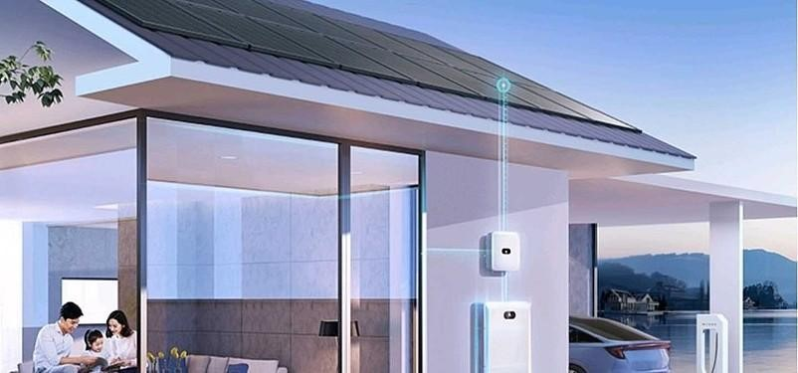
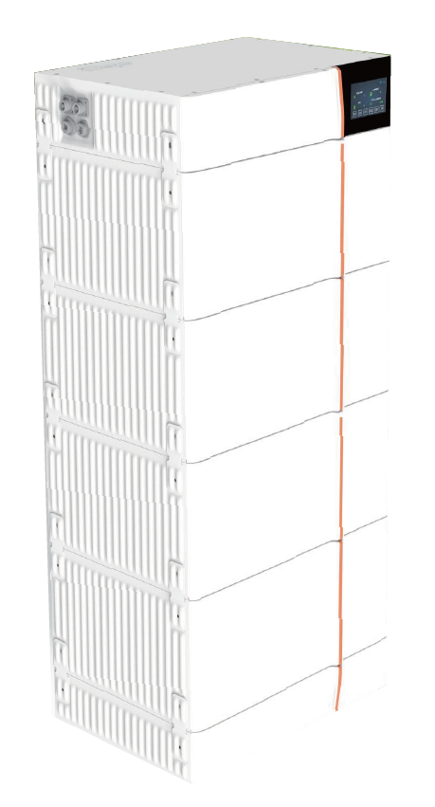
DEYE Energy Storage System
Technical Data
Main Parameter
Cell Chemistry |  | LiFePO4
Module Energy (kWh) |  | 4.09
Module Nominal Voltage (V) |  | 102.4
Module Capacity (Ah)) |  | 40
Battery Module Qty In Series (Optional) |  | 2 | 3 | 4 | 5 | 6
System Nominal Voltage (V) |  | 204.8 | 307.2 | 409.6 | 512 | 614.4
System Operating voltage(V) |  | 179.2~691.2
System Energy (kWh) |  | 8.18 | 12.27 | 16.36 | 20.45 | 24.56
System Usable Energy (kWh) |  | 7.36 | 11.04 | 14.72 | 18.40 | 22.10
Charge/Discharge Current (A) | Recommend | 20
 | Max | 40
 | Peak Discharge (2mins,25°C) | 50
Working Temperature (°C) |  | Charge:0~55/Discharge:-20~55
LCD Display |  | SOC%,Power,Total Voltage
Communication Port |  | CAN2.0, RS485
Humidity |  | 5%~90%
Altitude |  | ≤2000m
IP Rating of Enclosure |  | IP65
Storage Temperature (°C) |  | 0~35
Dimension (W/D/H,mm) |  | 540*385* 650 | 540*385* 870 | 540*385*1090 | 540*385*1310 | 540*385* 1530
Weight(kg) |  | 76 | 108 | 140 | 172 | 204
Installation Location |  | Floor Mount
Recommend Depth of Discharge |  | 90%
Cycle Life |  | 25±2,0.5C/0.5C, EOL70%≥6000
Warranty |  | 10 years
Certiﬁcation |  | CE, IEC62619, VDE2510-50, UKCA, UN38.3
Type: GB-L
Structural safety
Meet high seismic grade zone 4.
High-voltage stack
Modules are connected in series without cable connection,
and high-voltage platform improves system eﬃciency.
Thermal management
Temperature detection of key parts, cell, power plug-in, etc.
Wide temperature operation
The heating function is optional to meet the application
scenarios with low temperature and no sense.
Environmental friendliness
IP protection grade 65, anti-corrosion grade ≥C2,
environmental protection battery.
Intelligent and visual
Support remote upgrade, real-time battery warning
information push,LCD data display.

