Slide 1
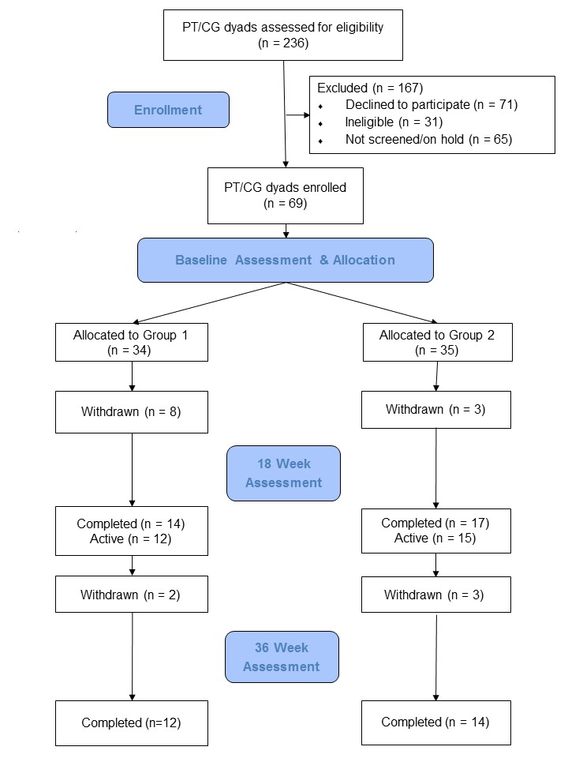
Preventing Loss of Independence through Exercise in Persons with Dementia in the VA (PLIÉ-VA)
Deborah E. Barnes, PhD, MPH; Jennifer Lee, GCFP; Margaret A. Chesney, PhD; Kristine Yaffe, MD; Gary Abrams; MD; and Wolf Mehling, MD.
University of California, San Francisco, San Francisco, CA, USA, and San Francisco Veterans Affairs Medical Center, San Francisco, CA, USA.
Background
Preventing Loss of Independence through Exercise (PLIÉ) is a novel, integrative group movement program for people with dementia.
PLIÉ is grounded in neuroscience and focuses on abilities that are relatively well-maintained:
Procedural memory for daily movements
Mindful body awareness
Social connection
Flow Chart
Results
Enrollment to Date
2 sites completed (39 enrolled: 26 completed, 13 withdrawn)
2 sites ongoing (30 enrolled: 27 active, 3 withdrawn)
Withdrawal reasons: health (n=7), personal (n=6), time/other (n=3)
Satisfaction Survey (n=21)
75% highly satisfied
67% highly likely to recommend to others
Anonymous Feedback
What changes did you notice in your loved one?
“More engaged. She felt appreciated and cared for. Better walking and standing methods used. Better posture in general.”
“She was more agile. She became more confident and I believe her memory grew somewhat.”
“More (increased) general awareness and engagement, increased stability while walking, moving from sitting- standing or laying.
What changes did you notice in yourself?
“I felt "closer" to her.
“I was happy he was participating in a positive way.”
“It gave me a one hour break 2x week.”
Objective
To perform a process evaluation of an ongoing randomized, controlled trial of PLIÉ vs. waitlist control.
Methods
Study sites: Adult day centers that contract with the San Francisco VA Health Care System
Inclusion criteria: Mild-to-moderate dementia, English fluency, ability to participate in intervention activities.
Randomization: Participants randomized in blocks to PLIÉ intervention (1 hour, 2-3 days/week, 18 weeks + monthly home visit) or waitlist control (Flow Chart).
Outcomes: Standard measures of physical function, cognitive function, quality of life and caregiver burden administered by blinded assessors at 0, 18 and 36 weeks
Process evaluation: Satisfaction surveys sent anonymously after completion or withdrawal.
Conclusion
PLIÉ is feasible to deliver to individuals with mild-to-moderate dementia
PLIÉ is associated with high satisfaction and qualitative improvements in physical function, cognitive function and well-being in affected individuals and caregivers.
Funded by the Department of Veterans Affairs (Barnes: 1I01RX001507). Clinical Trial Registration: NCT02350127. Website: www.plie4dementia.com. Facebook: https://www.facebook.com/plie4dementia/. Twitter: @DeborahEBarnes

