Slide 1




Real Smart Agent
856.363.3000
Cell: 609-868-6888
www. HomeSmart.com
Smart Agent
555.555.5555
SmartAgent.com
Notes:
Customization Edits:
Update the yard sign with agent’s information

Slide 2



Professional Development Programs
& Training
We’ll Guide You
on a Pathway
to Success.
Professional Development and Mentor Program
Business Development Meetings (Masterminds)
Daily Classes and Webinars (RSA webinar & onsite training)
Continuing Education
Investors Club & Tuesday Trainings
Notes:
NOTES: Customize to your company
SmartStart: Learn the building blocks of real estate
Professional Development and Mentor Program: Gain first-hand experience
Business Development Meetings (i.e Sales Meetings) Collaborate with peers and learn from experts how to build your business
Join daily classes and webinars on marketing, industry and ‘how-to’ topics

Slide 3


Full Scale
Support
Every Step
of the Way
Need Help?
We’ve Always Got Your Back.
Services available to all HomeSmart agents:
Agent Services
Responsive Broker Support
Access to Branch Office(s) & Amenities
Unparalleled Industry Software
Marketing Design Services
Lunch & Learn Training Series
Notes:
Notes: Customize bullet points to your company
Agent services for onboarding and attentive support whenever you need it - if applicable
Responsive broker support ensures compliance and keeps transactions moving
Access to branch office(s) and amenities
Courier services for convenient deliveries
Easily create marketing materials via the Marketing Design Center
Unparalleled industry software for easy and efficient workflow

Slide 4

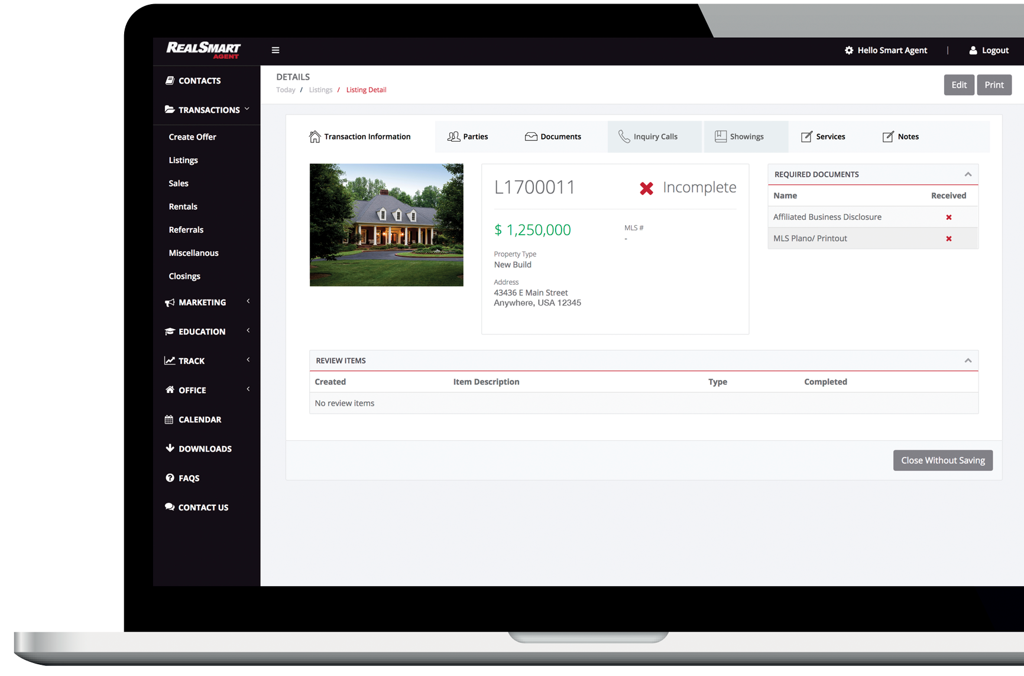

Technology to Simplify
Your Business
RealSmart Agent
SmartSites
Marketing Design Center
Notes:
RealSmart Agent
Manage your business growth and transaction tasks in a centralized, paperless location
Continuously monitor productivity through custom reporting
Stay compliant with organized documents, status checks and broker visibility
Single point of access for marketing and educational resources for agent and business growth
Our CRM will keep your clients organized
Create your own website with our customizable SmartSites
Easily create branded marketing materials with our templates in the Marketing Design Center

Slide 5








Enterprise Resources
to Build Your Foundation
Jumpstart Your Career With Our Developed Infrastructure:
Systems & Technology
Programs & Training
Service to Support
Local Presence
More than 18,000 Agents
Nationwide Prestige
Notes:
Notes:
Systems and technology for productivity and visibility
Programs and training to develop your career
Service to support your growth and transactions
Nearly 16,000 agents to enhance collaboration
Nationwide prestige to grow your brand

Slide 6


Find
Financial Success
Solo Agent Plan A:
$75/ Monthly fee
$599/Transaction Side
Solo Agent Plan B:
$125/month
$499/ Transaction Side
Solo Agent Top Producer: (30 T min)
$150/month
$399/ Transaction Side
$170 (30+ Transactions, Cap @ .38th Transaction*)
Team Plan:
$150/ month (Team Lead)
$100/month (Team Member)
$399/ Transaction Side
Solo Agent Plan D:
***(NEWLY LICENSED AGENTS)***
70/30 (20% goes to coach, 10% to HomeSmart)
$59/ Monthly Fee
Notes:
Notes: Customize to your company information

Slide 7
What you will get when you move to HomeSmart!
5 REAL ESTATE SIGNS PER AGENT
1000 BUSINESS CARDS
PLANS BASED ON YOUR 12 MONTHS OF TRANSACTION
ACCESS TO ALL HOMESMART OFFICES ANY GIVEN TIME
BROKER SUPPORT AND ADMIN SUPPORT
AGENT WEBSITES WITH FREE IDX
AGENT TRANSACTION AND MARKETING PORTAL

Slide 8

$250,000 SALE PRICE, GROSS COMMISSION $7,500
50/50 | 60/40 | 64/36 | 70/30 | 80/20 | HS PLAN A | HS PLAN B | HS PLAN C
$3,750 | $4,500 | $4,800 | $5,250 | $6,000 | $6,901 | $7,001 | $7,101
$499,000 SALE PRICE, GROSS COMMISSION $14,970
50/50 | 60/40 | 64/36 | 70/30 | 80/20 | HS PLAN A | HS PLAN B | HS PLAN C
$7,485 | $8,982 | $9,581 | $10,479 | $11,976 | $14,471 | $14,571 | $14,671
Notes:
Notes: Customize to your company information

Slide 9




Additional Support Where You Need It Most
Agent Benefits
Marketing Creative Services
Transaction Coordination

Slide 10
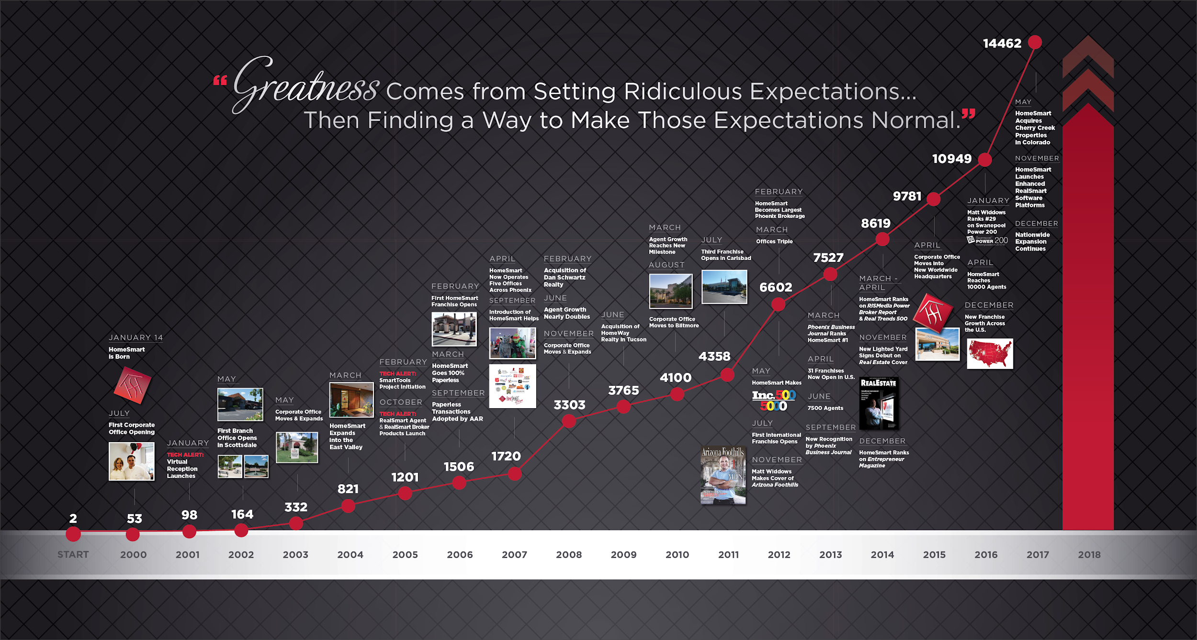
17,686

Slide 11


Traditional
Brokerage
HomeSmart
vs.
Proprietary, end-to-end technology —
every tool you need at your fingertips
Full-service support — service to
grow your brand and business
Education and training courses — continuously learn from industry leaders
100% commission — reinvest where
and how you want
3rd party technology
Limited brokerage support & training
Outdated commission splits

Slide 12



What Else
Do You Need From Us?
At HomeSmart we aim to make the brokerage decision process easy for you.
What do you need from us
to make the move?

Slide 13

Thank You.

