Slide 1
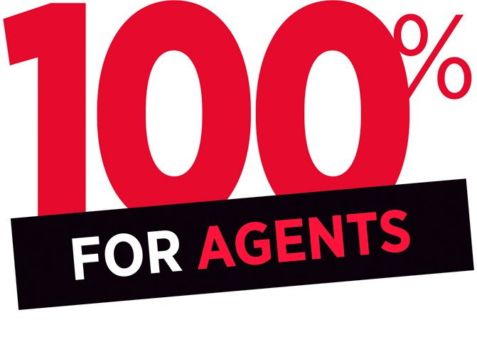



FOR SALE
Real Smart Agent
888.777.7777
Cell: 888-888-8888
www. HomeSmart.com
Smart Agent
555.555.5555
SmartAgent.com
Notes:
Customization Edits:
Update the yard sign with agent’s information

Slide 2





Your Future Career
v
Real Estate as a Career
Your First Year Goals
Brokerage Needs
Initial Concerns
Notes:
NOTES
Why did you get into the real estate business?
What did you enjoy most during your time at real estate school?
What are your goals for your first year?
What are you most anxious about?
What are you looking for in a brokerage?
What are your long term goals?
Have you built a business plan?
How would you define your personal brand?

Slide 3


Professional Development Programs
& Training
We’ll Guide You
on a Pathway
to Success.
Professional Development and Mentor Program
Business Development Meetings (Masterminds)
Daily Classes and Webinars (RSA webinar & onsite training)
Continuing Education
Investors Club & Tuesday Trainings
Notes:
NOTES: Customize to your company
SmartStart: Learn the building blocks of real estate
Professional Development and Mentor Program: Gain first-hand experience
Business Development Meetings (i.e Sales Meetings) Collaborate with peers and learn from experts how to build your business
Join daily classes and webinars on marketing, industry and ‘how-to’ topics

Slide 4


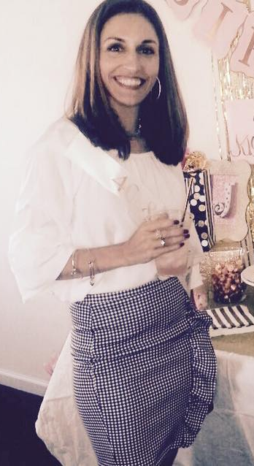
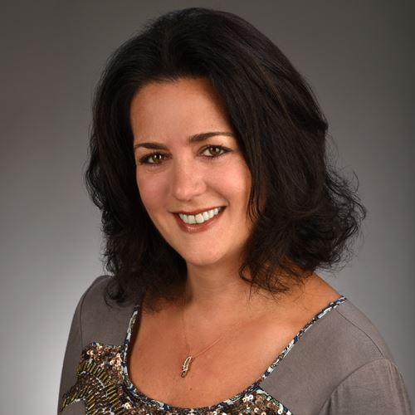

Available Mentors:
Morshad “Saami” Hossain
Justin O’Hara
JoLyn Hartman Gilligan
Karen Snider Ravoni
Michelle Ianella
You get to Choose!

Slide 5


Full Scale
Support
Every Step
of the Way
Need Help?
We’ve Always Got Your Back.
Services available to all HomeSmart agents:
Agent Services
Responsive Broker Support
Access to Branch Office(s) & Amenities
Unparalleled Industry Software
Marketing Design Services
Lunch & Learn Training Series
Notes:
Notes: Customize bullet points to your company
Agent services for onboarding and attentive support whenever you need it - if applicable
Responsive broker support ensures compliance and keeps transactions moving
Access to branch office(s) and amenities
Courier services for convenient deliveries
Easily create marketing materials via the Marketing Design Center
Unparalleled industry software for easy and efficient workflow

Slide 6

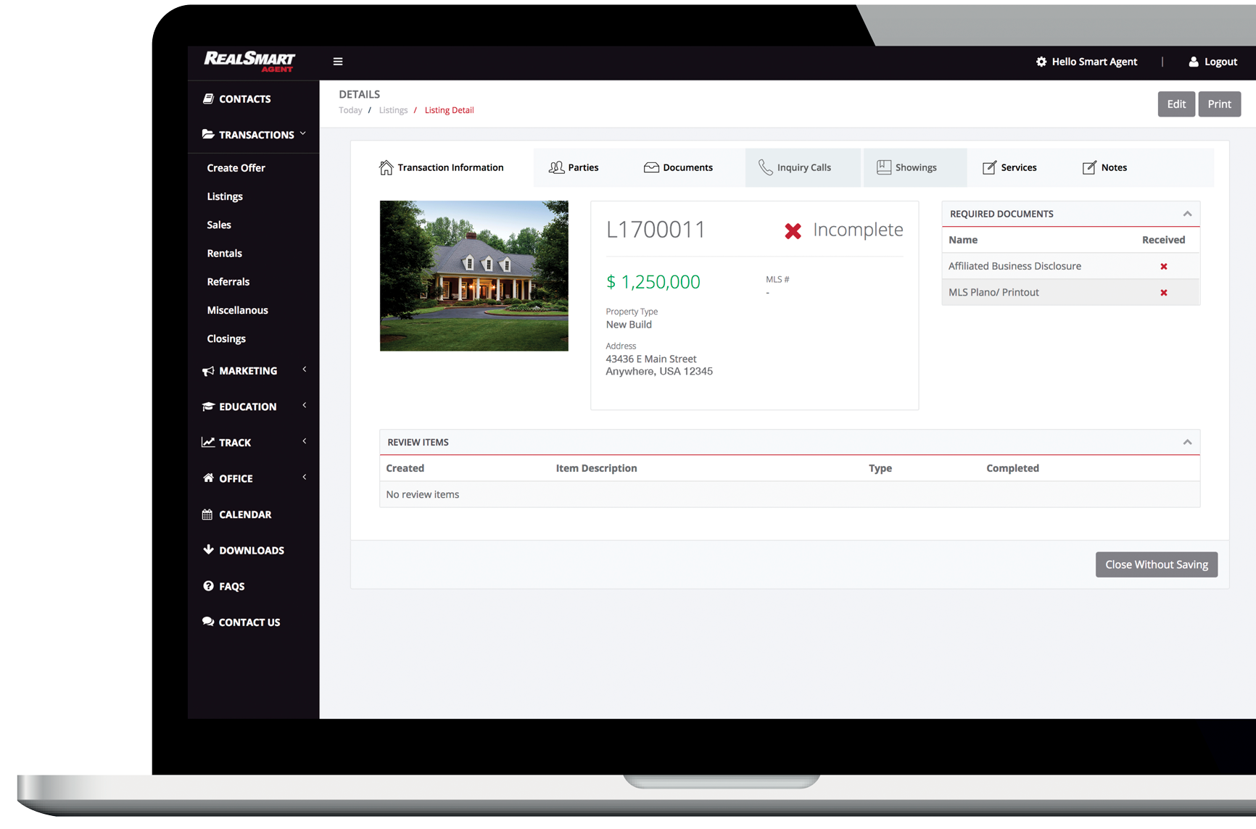

Technology to Simplify
Your Business
RealSmart Agent
SmartSites
Marketing Design Center
Notes:
RealSmart Agent
Manage your business growth and transaction tasks in a centralized, paperless location
Continuously monitor productivity through custom reporting
Stay compliant with organized documents, status checks and broker visibility
Single point of access for marketing and educational resources for agent and business growth
Our CRM will keep your clients organized
Create your own website with our customizable SmartSites
Easily create branded marketing materials with our templates in the Marketing Design Center

Slide 7






Enterprise Resources
to Build Your Foundation
Jumpstart Your Career With Our Developed Infrastructure:
Systems & Technology
Programs & Training
Service to Support
Local Presence
More than 17,000 Agents
Nationwide Prestige
Notes:
Notes:
Systems and technology for productivity and visibility
Programs and training to develop your career
Service to support your growth and transactions
Nearly 16,000 agents to enhance collaboration
Nationwide prestige to grow your brand

Slide 8



Find
Financial Success
Solo Agent Plan A:
$75/ Monthly fee
$649/Transaction Side
Solo Agent Plan B:
$100/month
$549/ Transaction Side
Solo Agent Top Producer: (30 T min)
$125/month
$449/ Transaction Side
$170 (30+ Transactions, Cap @ .38th Transaction*)
Team Plan:
$150/ month (Team Lead)
$100/month (Team Member)
$449/ Transaction Side
Solo Agent Plan D:
***(NEWLY LICENSED AGENTS)***
70/30 (20% goes to coach, 10% to HomeSmart)
$75/ Monthly Fee
Notes:
Notes: Customize to your company information

Slide 9


$250,000 SALE PRICE, GROSS COMMISSION $7,500
SPLIT | 50/50 | 60/40 | 64/36 | 70/30 | 80/20 | HS PLAN A | HS PLAN B | HS PLAN C
COMM. | $3,750 | $4,500 | $4,800 | $5,250 | $6,000 | $6,851 | $6,951 | $7,051
SAVINGS | $3,301 | $2,551 | $2,251 | $1,801 | $1,051
$499,000 SALE PRICE, GROSS COMMISSION $14,970
SPLIT | 50/50 | 60/40 | 64/36 | 70/30 | 80/20 | HS PLAN A | HS PLAN B | HS PLAN C
COMM. | $7,485 | $8,982 | $9,581 | $10,479 | $11,976 | $14,421 | $14,521 | $14,621
SAVINGS | $7,136 | $5,639 | $5,040 | $4,142 | $2,645
$750,000 SALE PRICE, GROSS COMMISSION $22,500
SPLIT | 50/50 | 60/40 | 64/36 KW | 70/30 | 80/20 | HS PLAN A | HS PLAN B | HS PLAN C
COMM. | $11,250 | $13,500 | $14,400 | $15,750 | $18,000 | $21,651 | $21,651 | $21,651
SAVINGS | $10,401 | $8,051 | $7,251 | $5,901 | $3,651
Notes:
Notes: Customize to your company information

Slide 10





Additional Support Where You Need It Most
Agent Benefits
Marketing Creative Services
Transaction Coordination

Slide 11
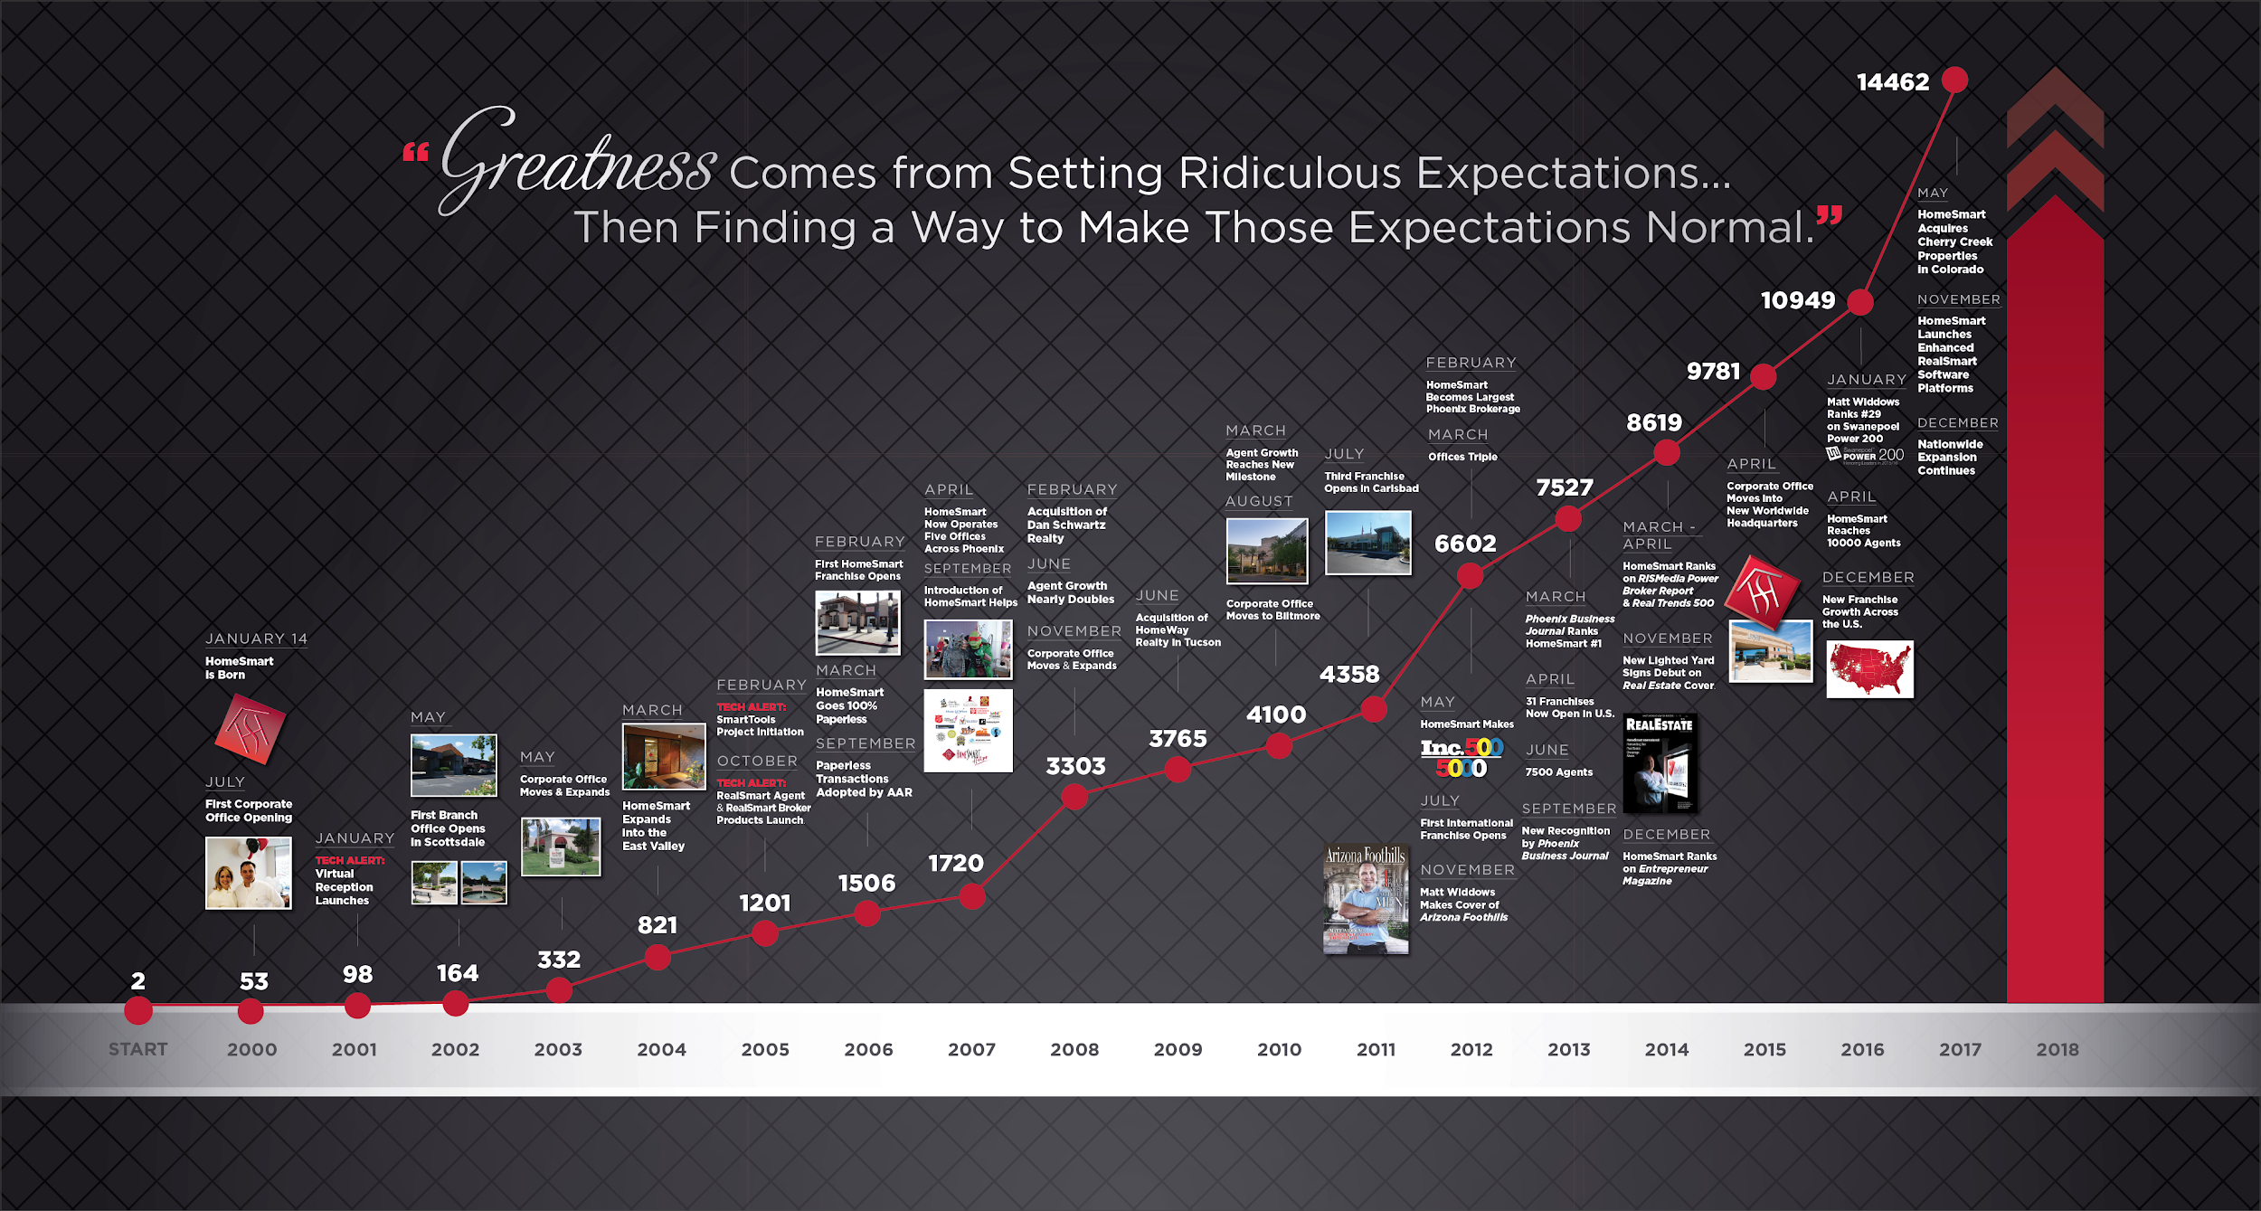
17,686
2021 - 22853

Slide 12


Traditional
Brokerage
vs.
HomeSmart
3rd party technology
Limited brokerage support & training
Outdated commission splits
Proprietary, end-to-end technology —
every tool you need at your fingertips
Full-service support — service to
grow your brand and business
Education and training courses — continuously learn from industry leaders
100% commission — reinvest where
and how you want

Slide 13


What Else
Do You Need From Us?
At HomeSmart we aim to make the brokerage decision process easy for you.
What do you need from us
to make the move?

Slide 14


Thank You.

