Slide 1
Bees - Wax
Carbon
Hydrogen
Oxygen
Waxes are not soluble in water because they have mostly nonpolar
C-H bonds
22 more C
45 more H
14 more C
29 more H

Slide 2
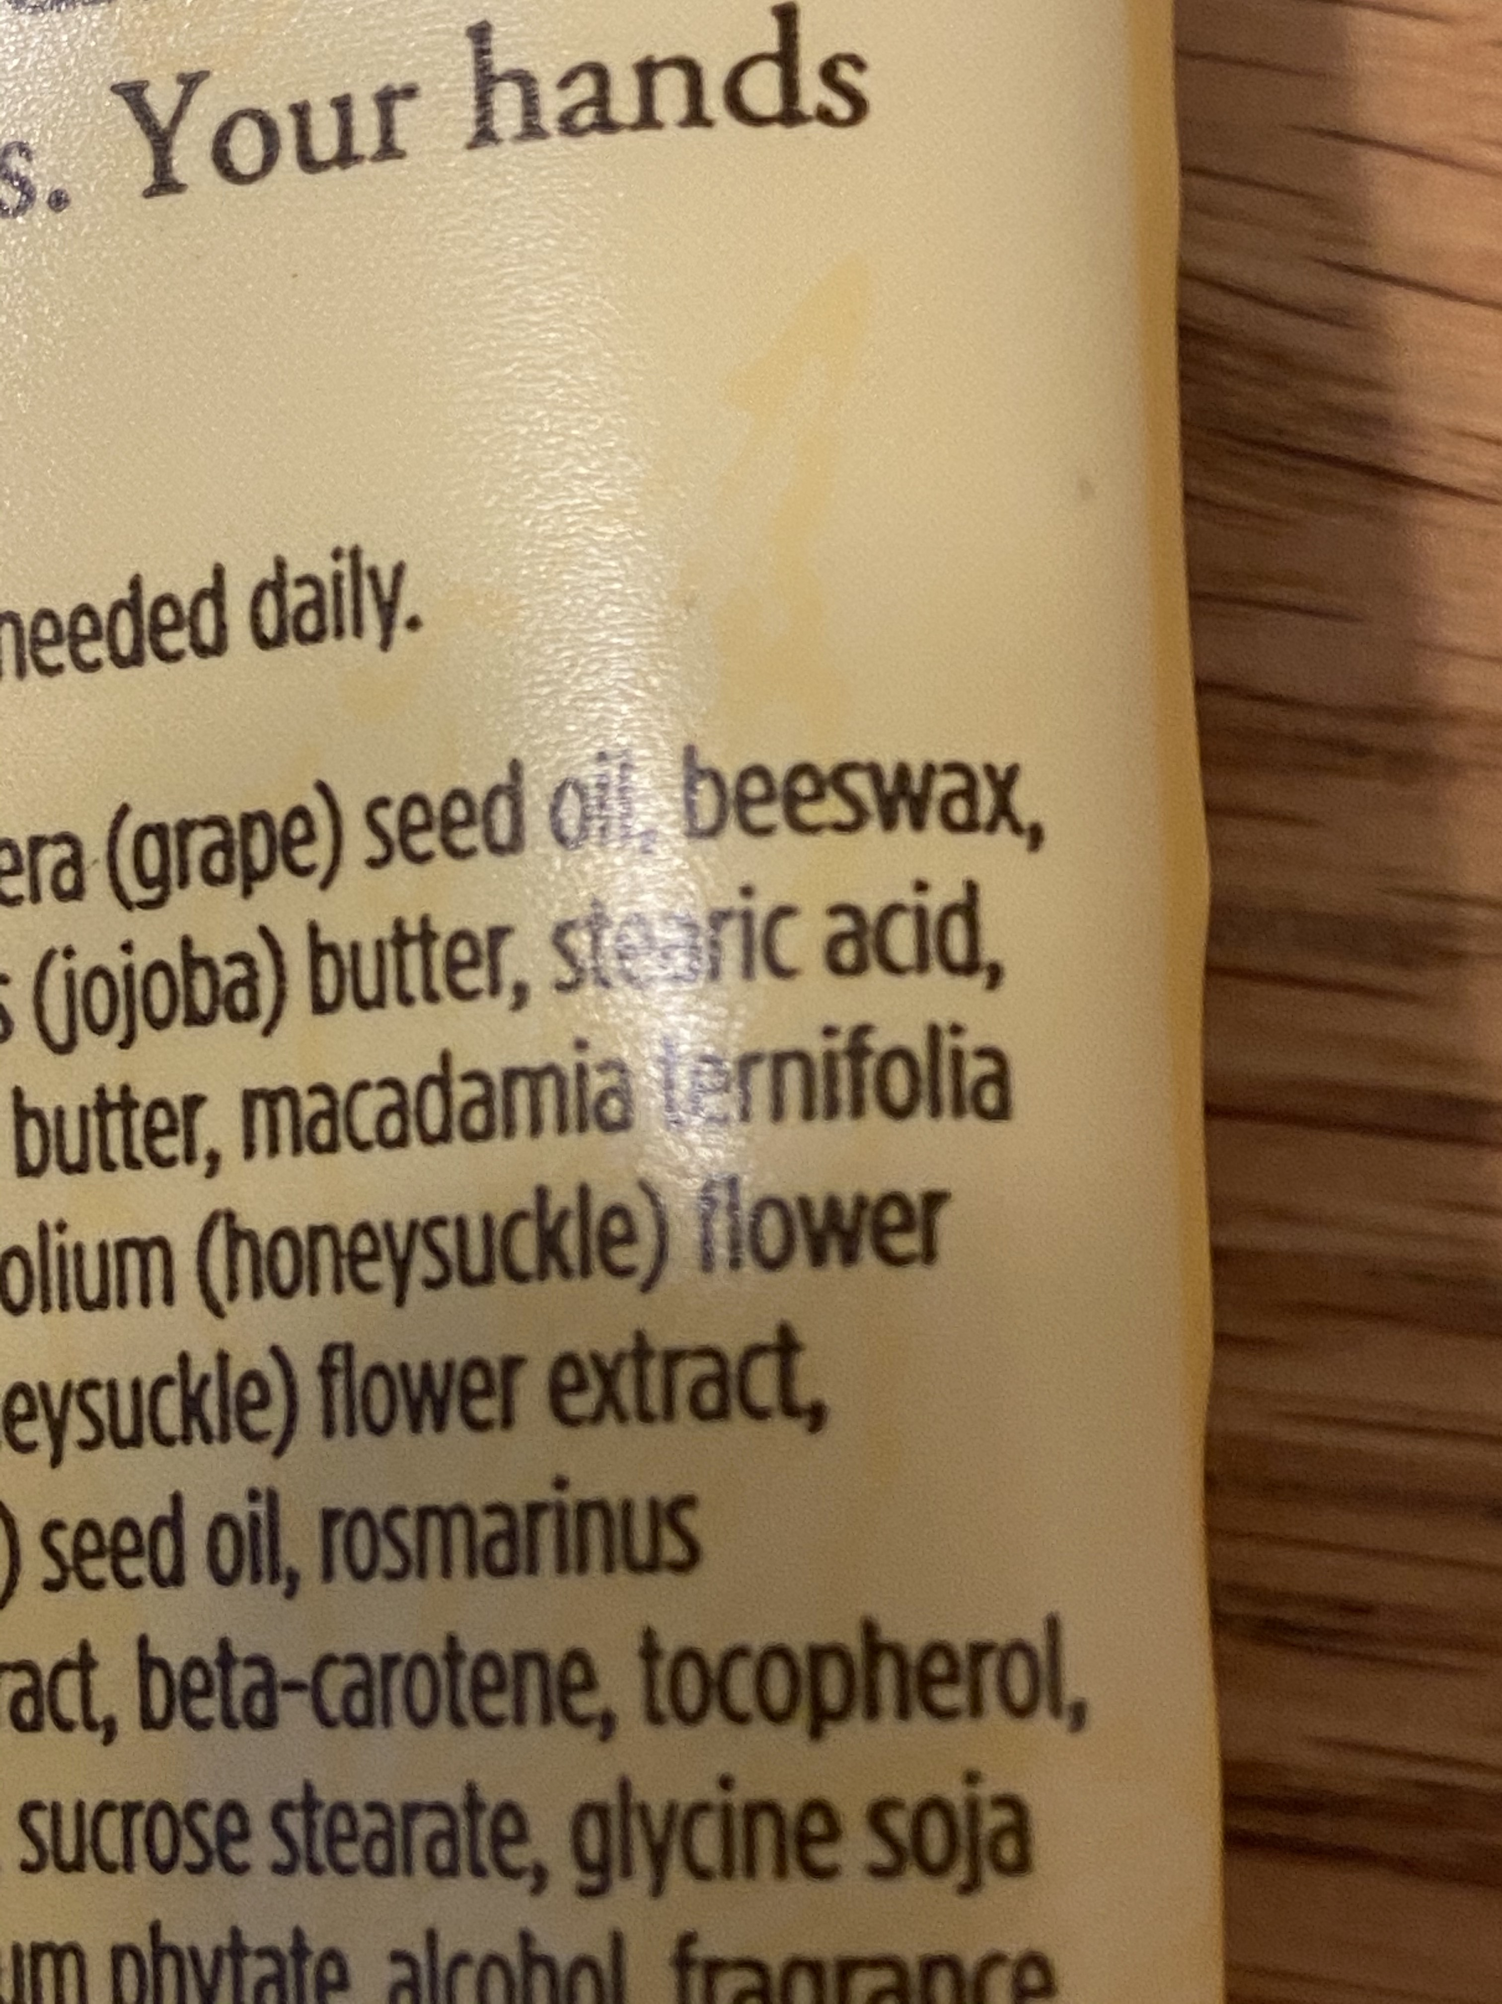
Wax
What else do we use that bees make?

Slide 3
What is the wax for?
Wax surrounds the honey in the honeycomb

Slide 4
Water beads up on wax paper
Water has polar covalent bonds (unequal sharing of electrons). Polar compounds in honey mix with water.
Wax has NONPOLAR covalent bonds (equal sharing of electrons).
Polar and NONPOLAR do NOT mix!

Slide 5
Wax keeps water in
Wax keeps water out
Hand lotion keeps water from leaving your skin
Wax keeps water out of the beehive
Wax paper keeps your sandwich from drying out
A waxy oil keeps water out of your ears
Wax on the surface of plant leaves can keep water from evaporating out of the leaf.
Wax repels water off the surface of your car to prevent water spots
Wax is put on apples and other fruit to keep in the water so they stay crisp.
Surfers put a sticky wax on their board because the surface wet with water is too slippery

Slide 6
https://youtu.be/QEzlsjAqADA
–why do honeybees love hexagons? Ted ed
By Zack Patterson and Andy peterson

