Slide 1
EGG-periment s😜
Doing some chemistry on an egg with vinegar and other household chemicals.
Egg-citing!
https://www.fda.gov/food/buy-store-serve-safe-food/what-you-need-know-about-egg-safety
Sorry for the bad puns

Slide 2
“Make a Naked Egg”
Do not eat the egg
Do experiments
Fill a cup 2/3 full of vinegar. Add an uncooked egg.
Wait
https://www.imaginationstationtoledo.org/educator/activities/how-to-make-a-naked-egg

Slide 3
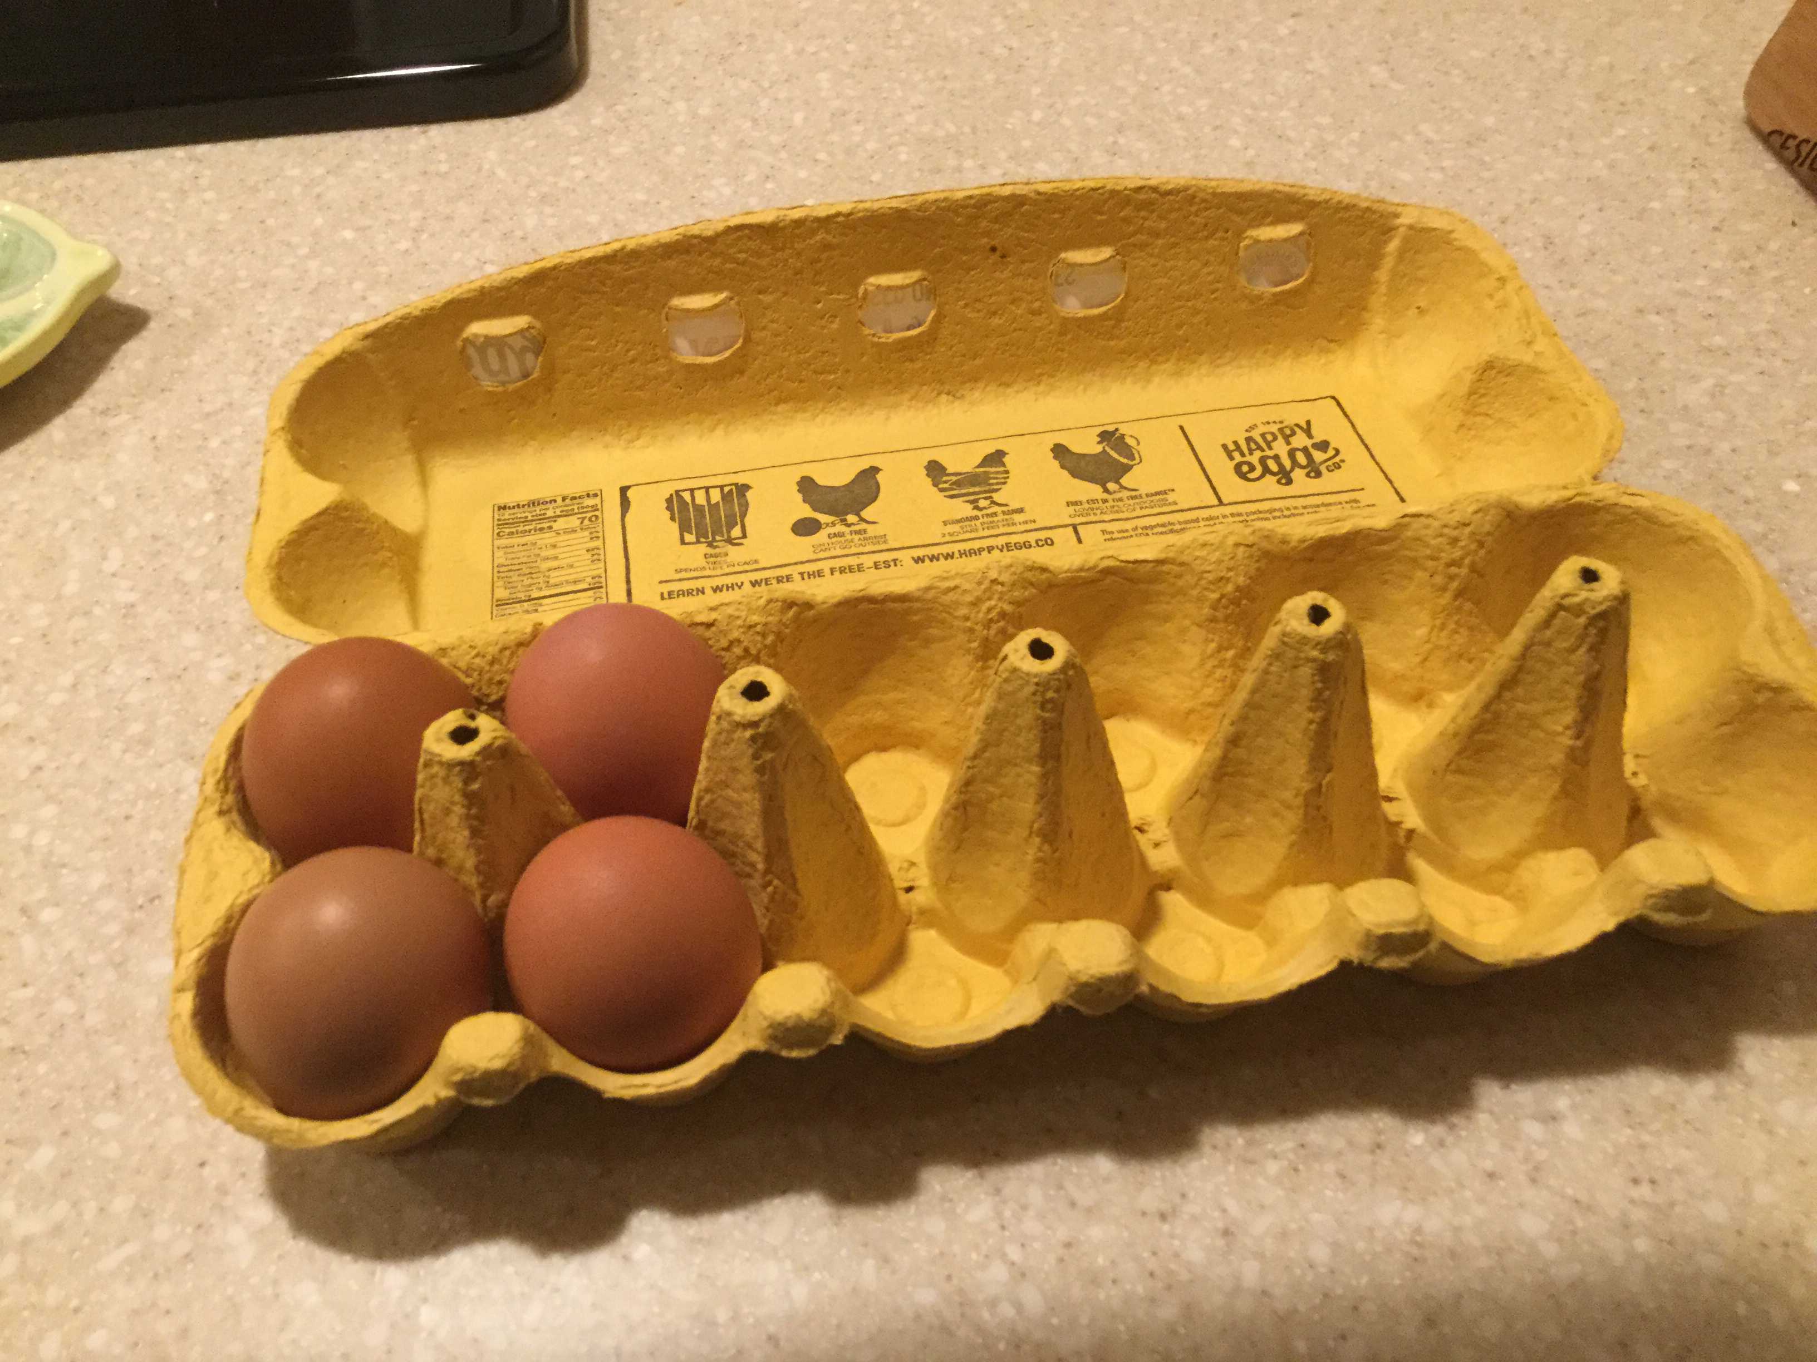
Egg shells are calcium carbonate
Did you know?

Slide 4
Now separate out the egg white.
Test for denaturation by taking a portion of egg white and...
Whipping it
Adding alcohol
Adding lemon juice
Adding soap
Water (control)
If it makes the egg white solid, white, and opaque it denatured the protein

Slide 5
