Slide 1
Fragrance
Or Olfaction
Organic Functional Groups
https://youtu.be/hlXc_eEtBHA

Slide 2
Olfaction- the sense of smell
Mammals are good at smelling compared to other vertebrates.
Humans are number 13 in their ability to distinguish different odors according to Yoshihito Niimura University of Tokyo in Genome Research.
Number one is the elephant. They can smell water twelve miles away.

Slide 3
Floral
compoundchem.com
Many compounds contribute the scent of flowers.
Floral fragrance molecules are organic compounds containing C, H, and O.

Slide 4
Roses fragrance comes from a mixture of many molecules
2-phenolethanol has a benzene ring (aromatic) found in many fragrance molecules and an alcohol (a carbon connected to an oxygen with a hydrogen on it) which usually has a sweet smell.
Beta-ionone, beta-damascenone, and beta-damascone all have a carbon double bonded to an oxygen and single bonded to two carbons called a ketone group. They also have C to C double bonds called alkenes in the molecules.
Nerol, geraniol, and citronellol have alcohol and alkene groups.
(-)-cis-rose oxide has an ether group which has an oxygen bonded to two carbons.

Slide 5
Eugenol- ingredient in oil of cloves, found in carnation
Oil of Cloves
Used in dentistry
Found in cosmetics
Contain an aromatic alcohol (phenol), ether, and alkene functional group.

Slide 6
Fragrance-free consumer products?
Environmental Working Group reports that products hidden fragrance mixtures which do not have to be revealed to consumers may contain chemicals that act as hormone disrupters or other health hazards.
Perfumes used to be made from actual herbs and flowers, but in the 70's and 80's most were changed over to petrochemical sources.

Slide 7
Fruit
Esters are organic compounds that give fruity fragrance
Isoamyl acetate is the scent of bananas

Slide 8
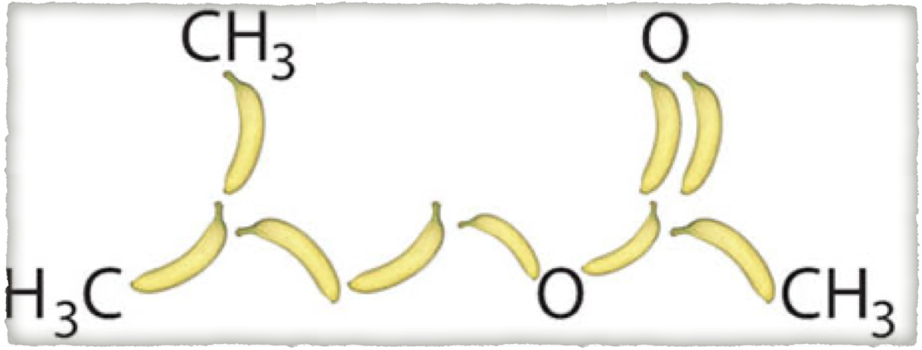
Isoamyl acetate is an ester. Many fruit scents are esters.
Ester
C
Ester
CH
CH
2
CH
2

