Slide 1
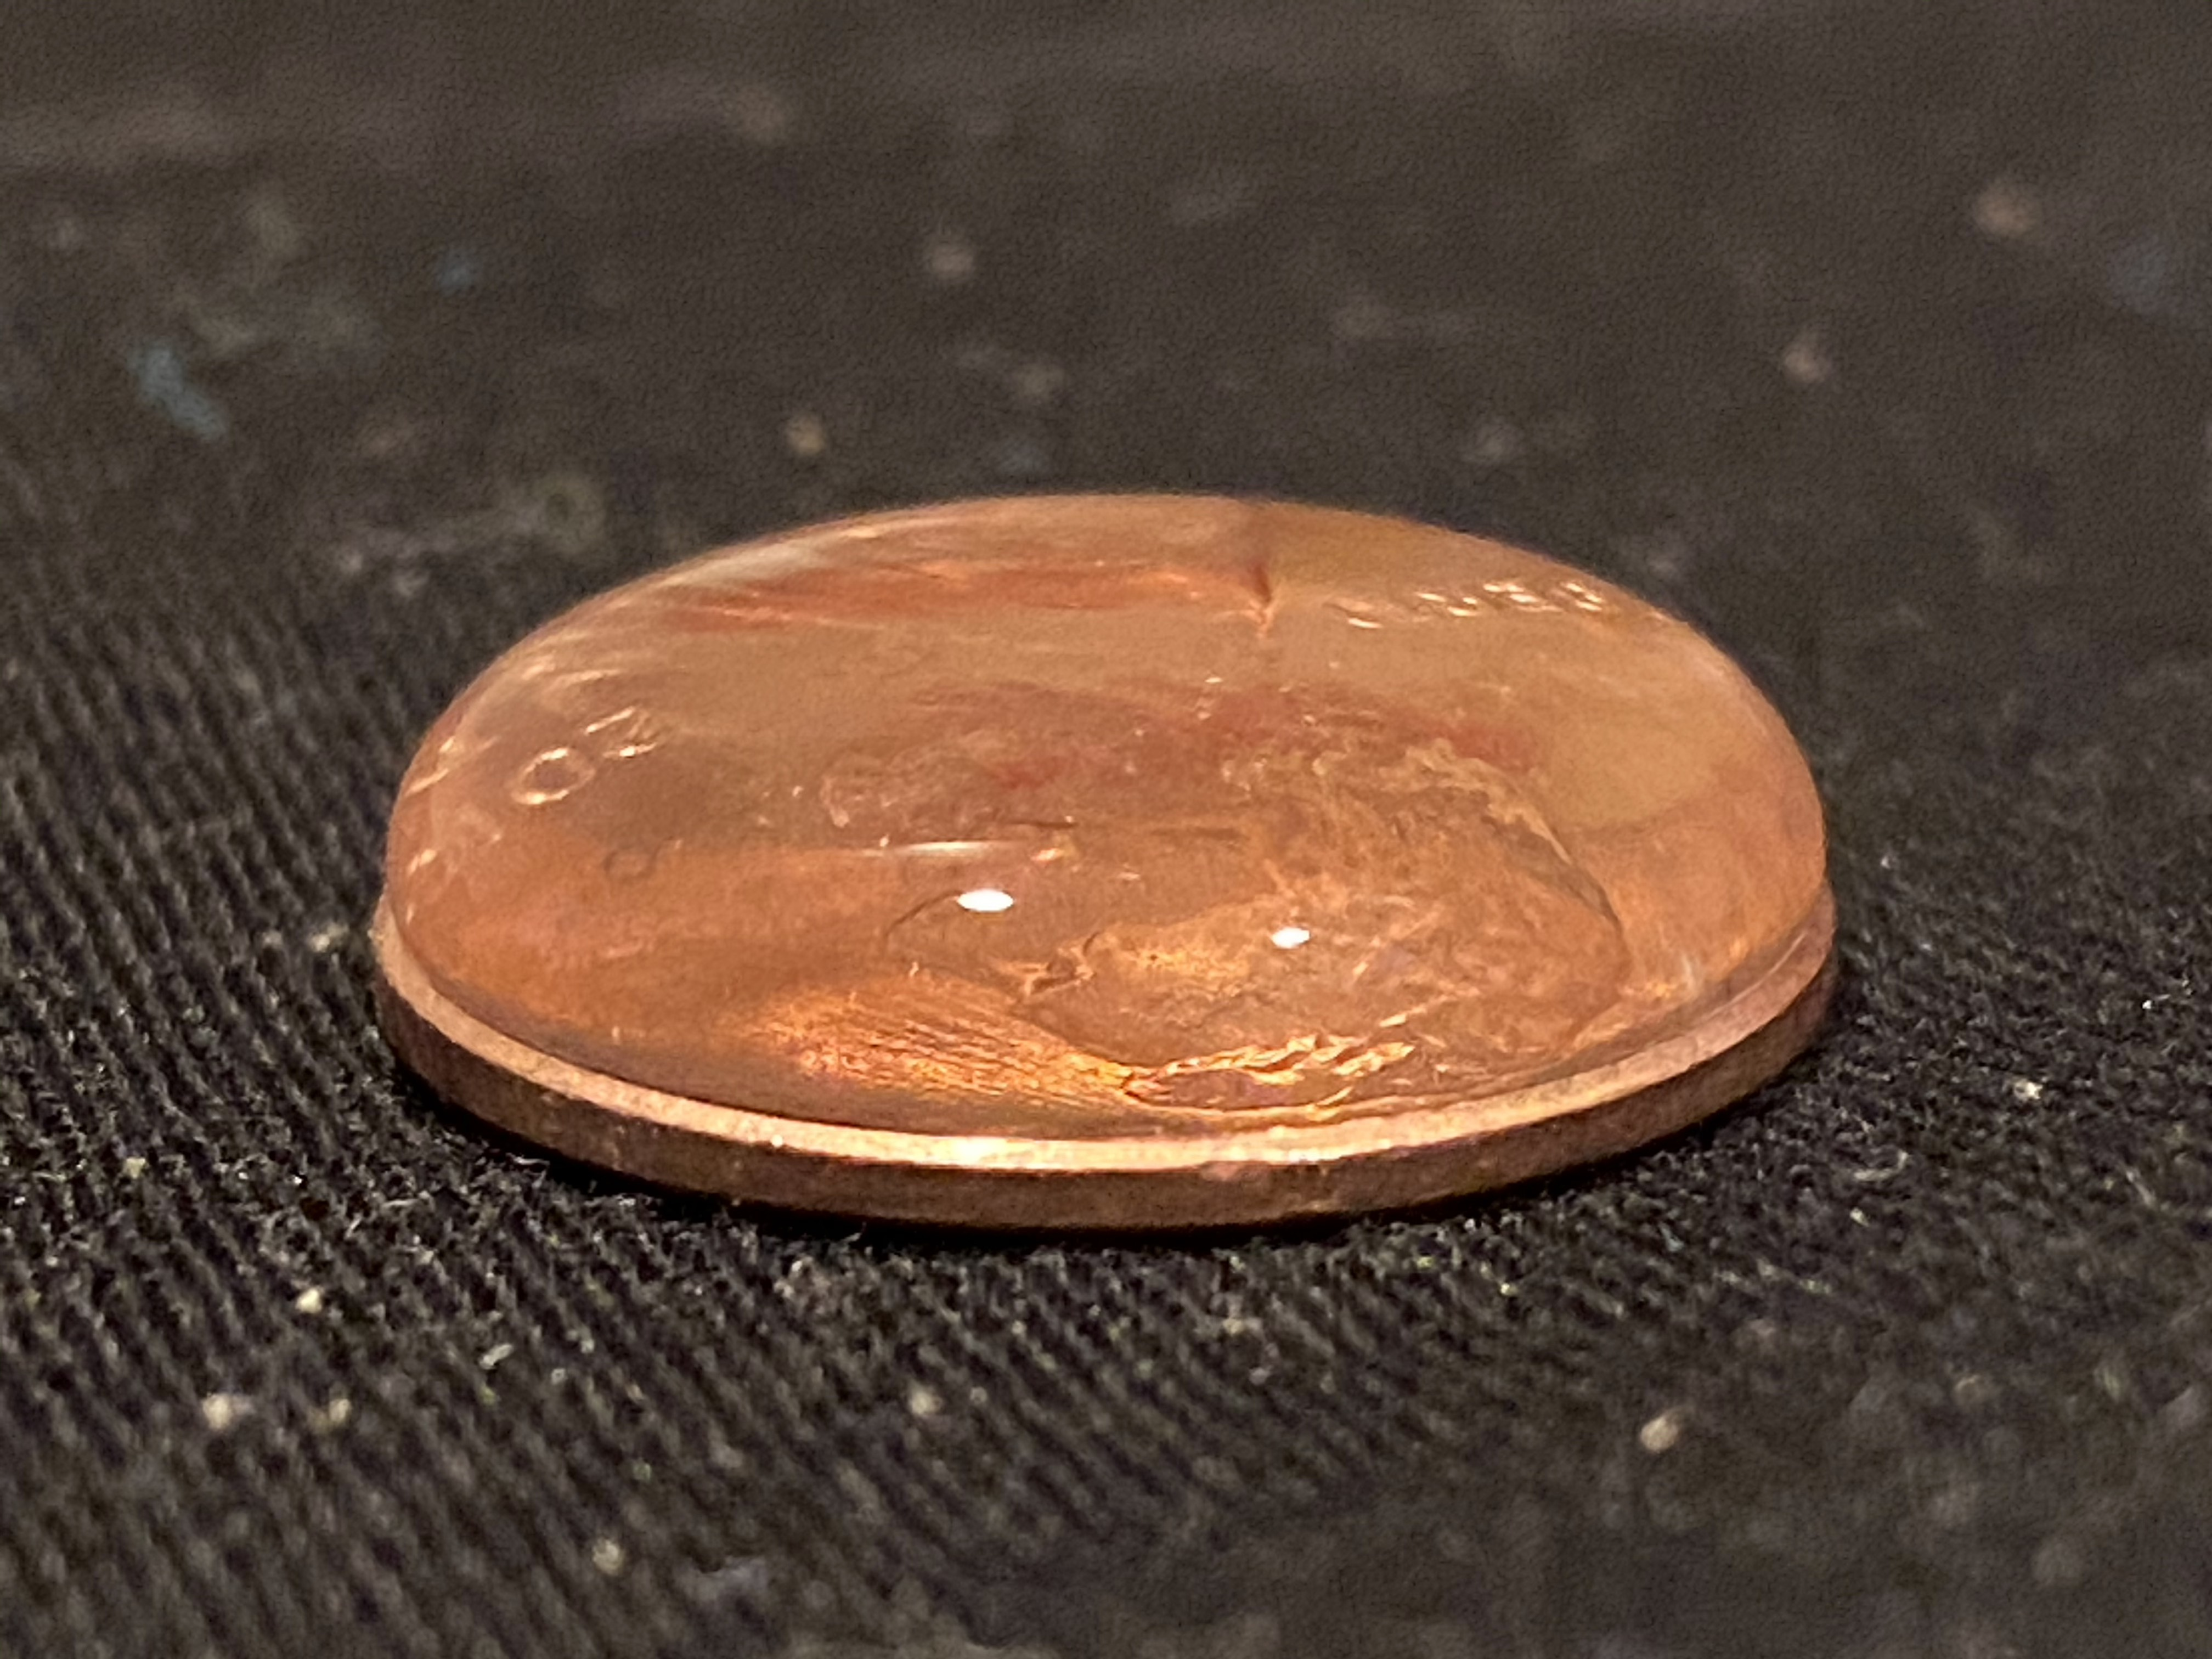
Penny Experiment - click on the speaker for instructions

