Slide 1
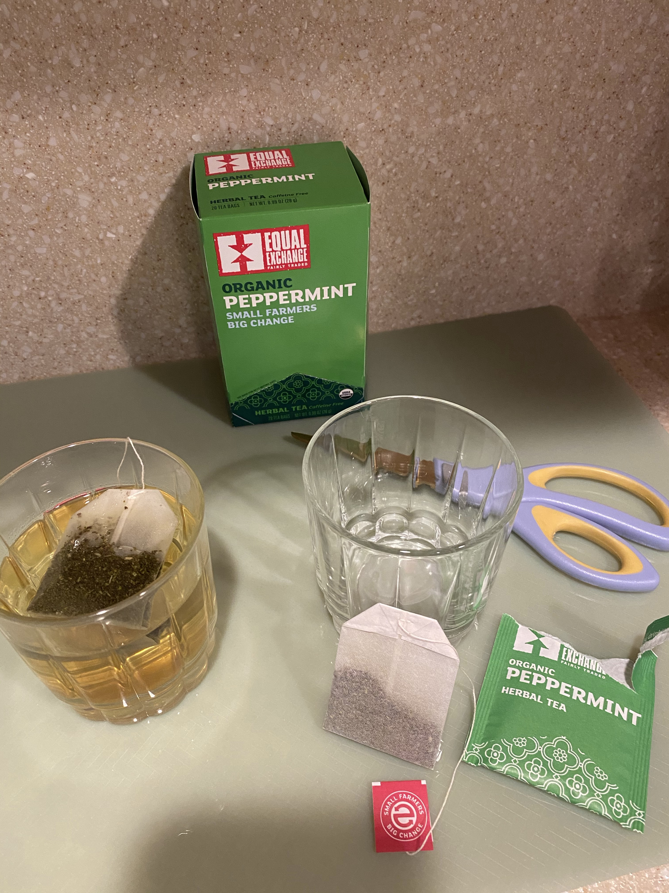
Tea - Solutions and Suspensions
You can use any tea, I just happen to like Peppermint!

Slide 2
Only some of the compounds in the tea dissolve in the water to make a solution.

Slide 3
Solutions are transparent (not cloudy) and all compounds pass through a filter paper.
This contains the water molecules and all of the molecules of compounds that dissolve in water. The particles are very small!

Slide 4
Some people like milk in their tea.
Milk is a colloid, so now the colloid makes it look CLOUDY.
Does milk separate into layers?
Will all of the milk pass through a filter paper?

