Slide 1
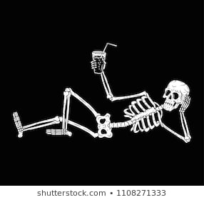
Teeth and bones
Biology and chemistry and physics of

Slide 2
Diane Marsh fractured the top of the Radius in both arms
Bones of the arm

Slide 3
What is bone?
Mostly hydroxyapatite, a mineral containing calcium, phosphate, and hydroxide ions. Found in teeth too!
Collagen, a protein.
Water

Slide 4
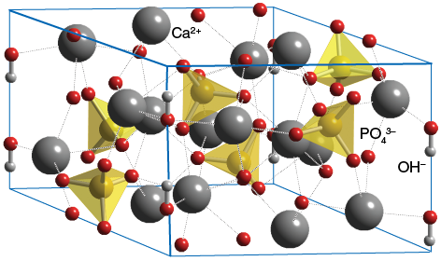
Are teeth bones?
NO! But they are made of the same hydroxyapatite mineral as bone.
Tooth enamel is harder than bone with a MOHS scale rating of 5 which is harder than steel. It is more brittle.
Try the MOHs scale experiment! NOT on your teeth!!!

Slide 5
How are teeth different than bones
Teeth can NOT heal. If you fracture or break a tooth it will not heal like a bone will.
Teeth are NOT covered by muscles and skin.

Slide 6
Types of teeth

Slide 7
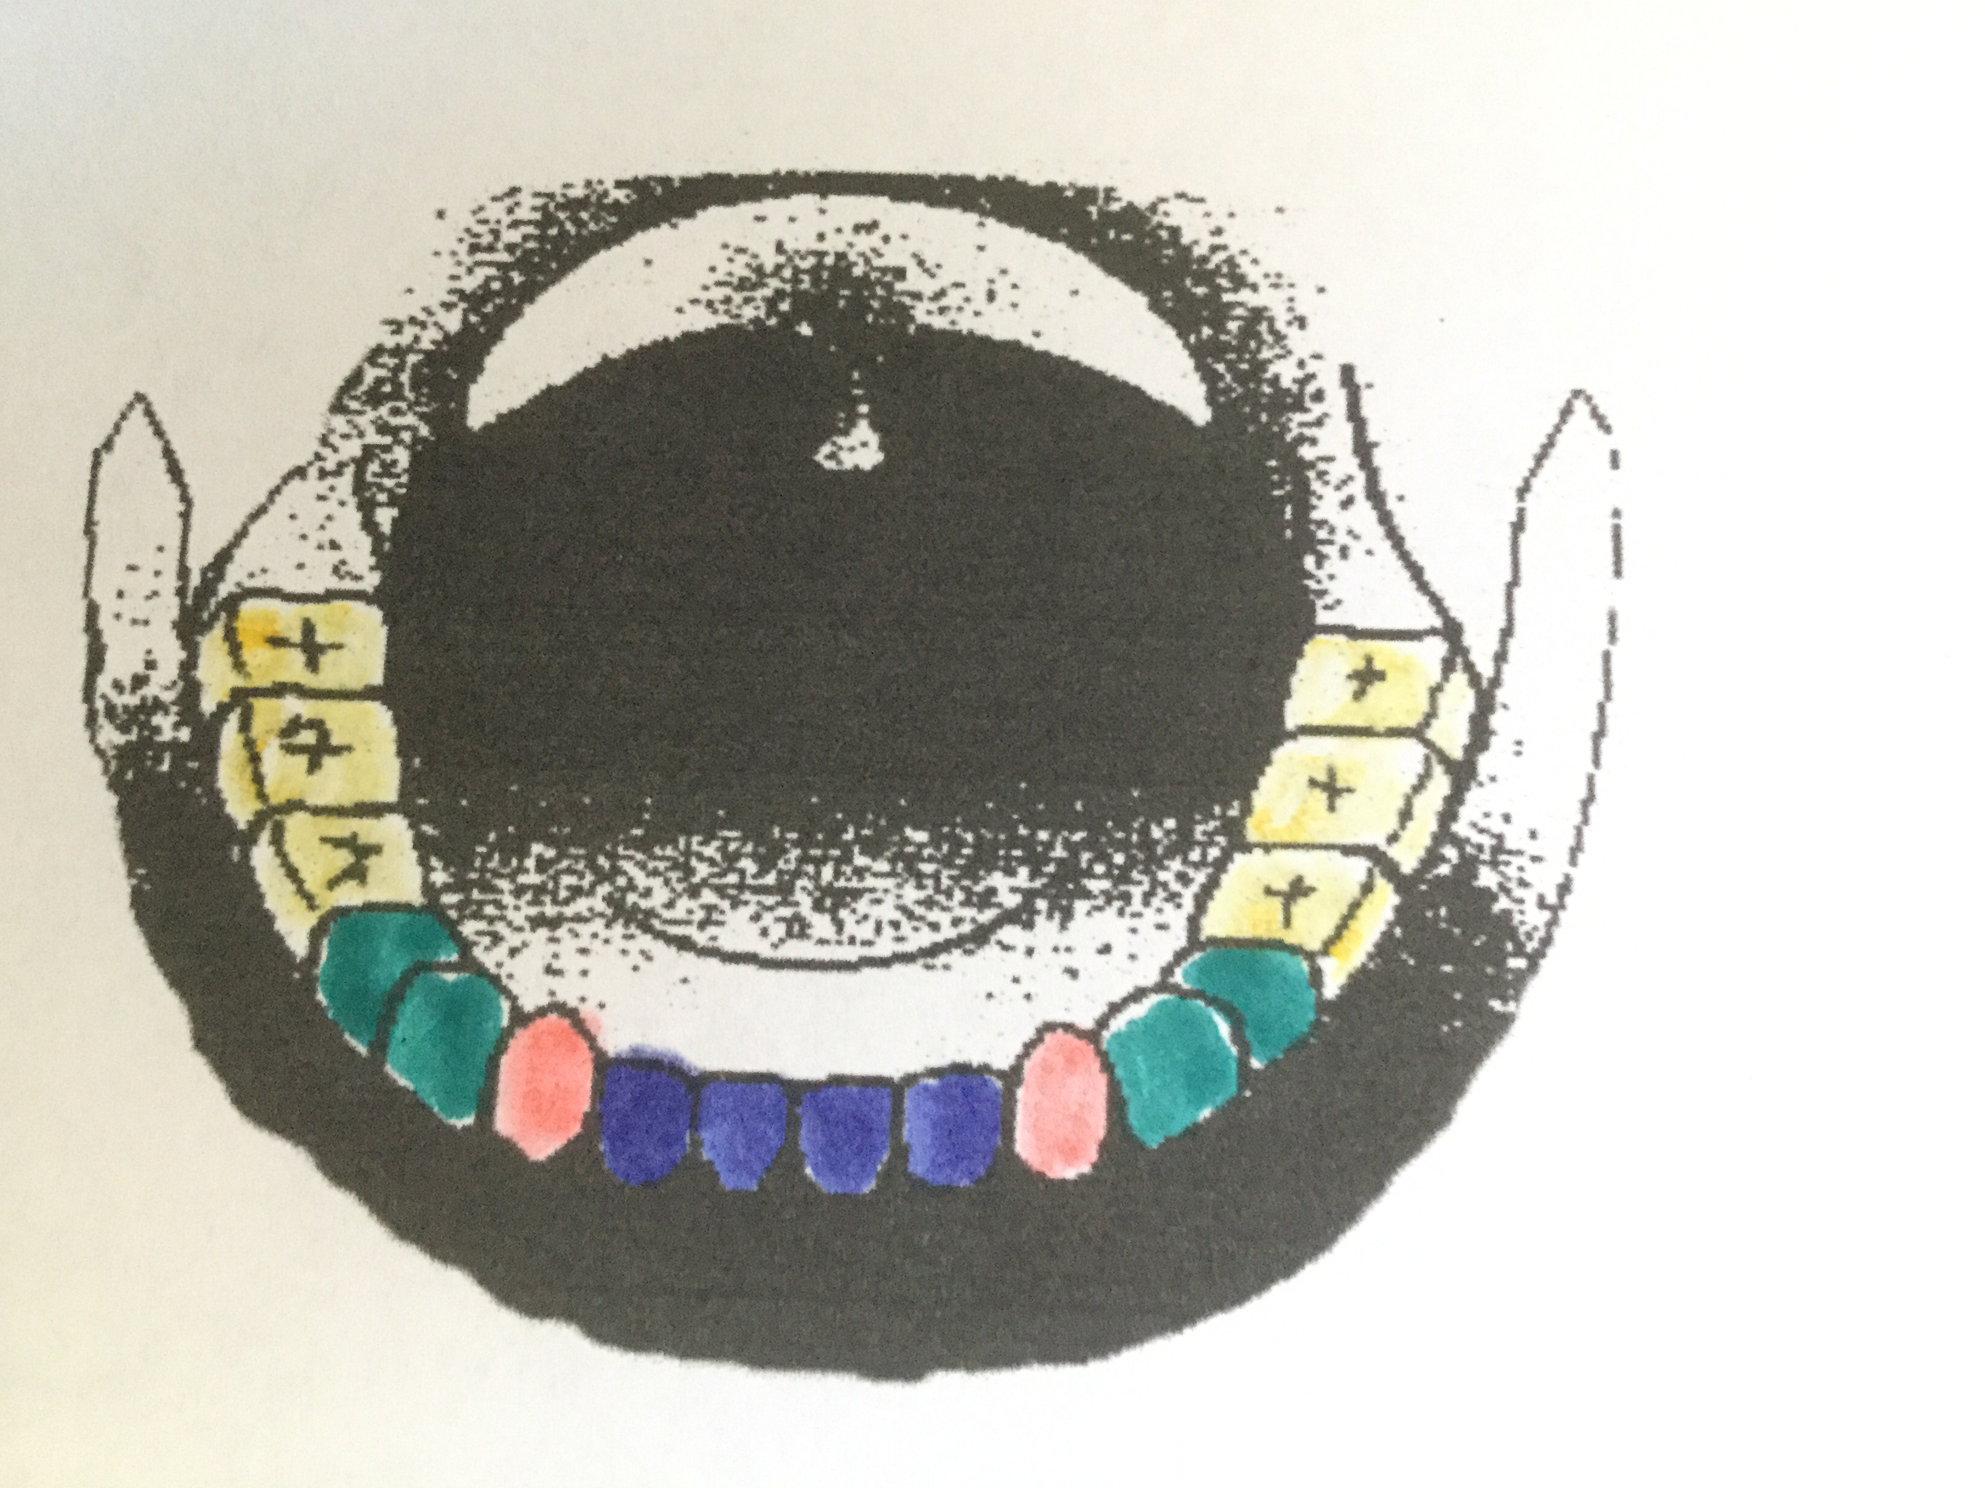

Slide 8
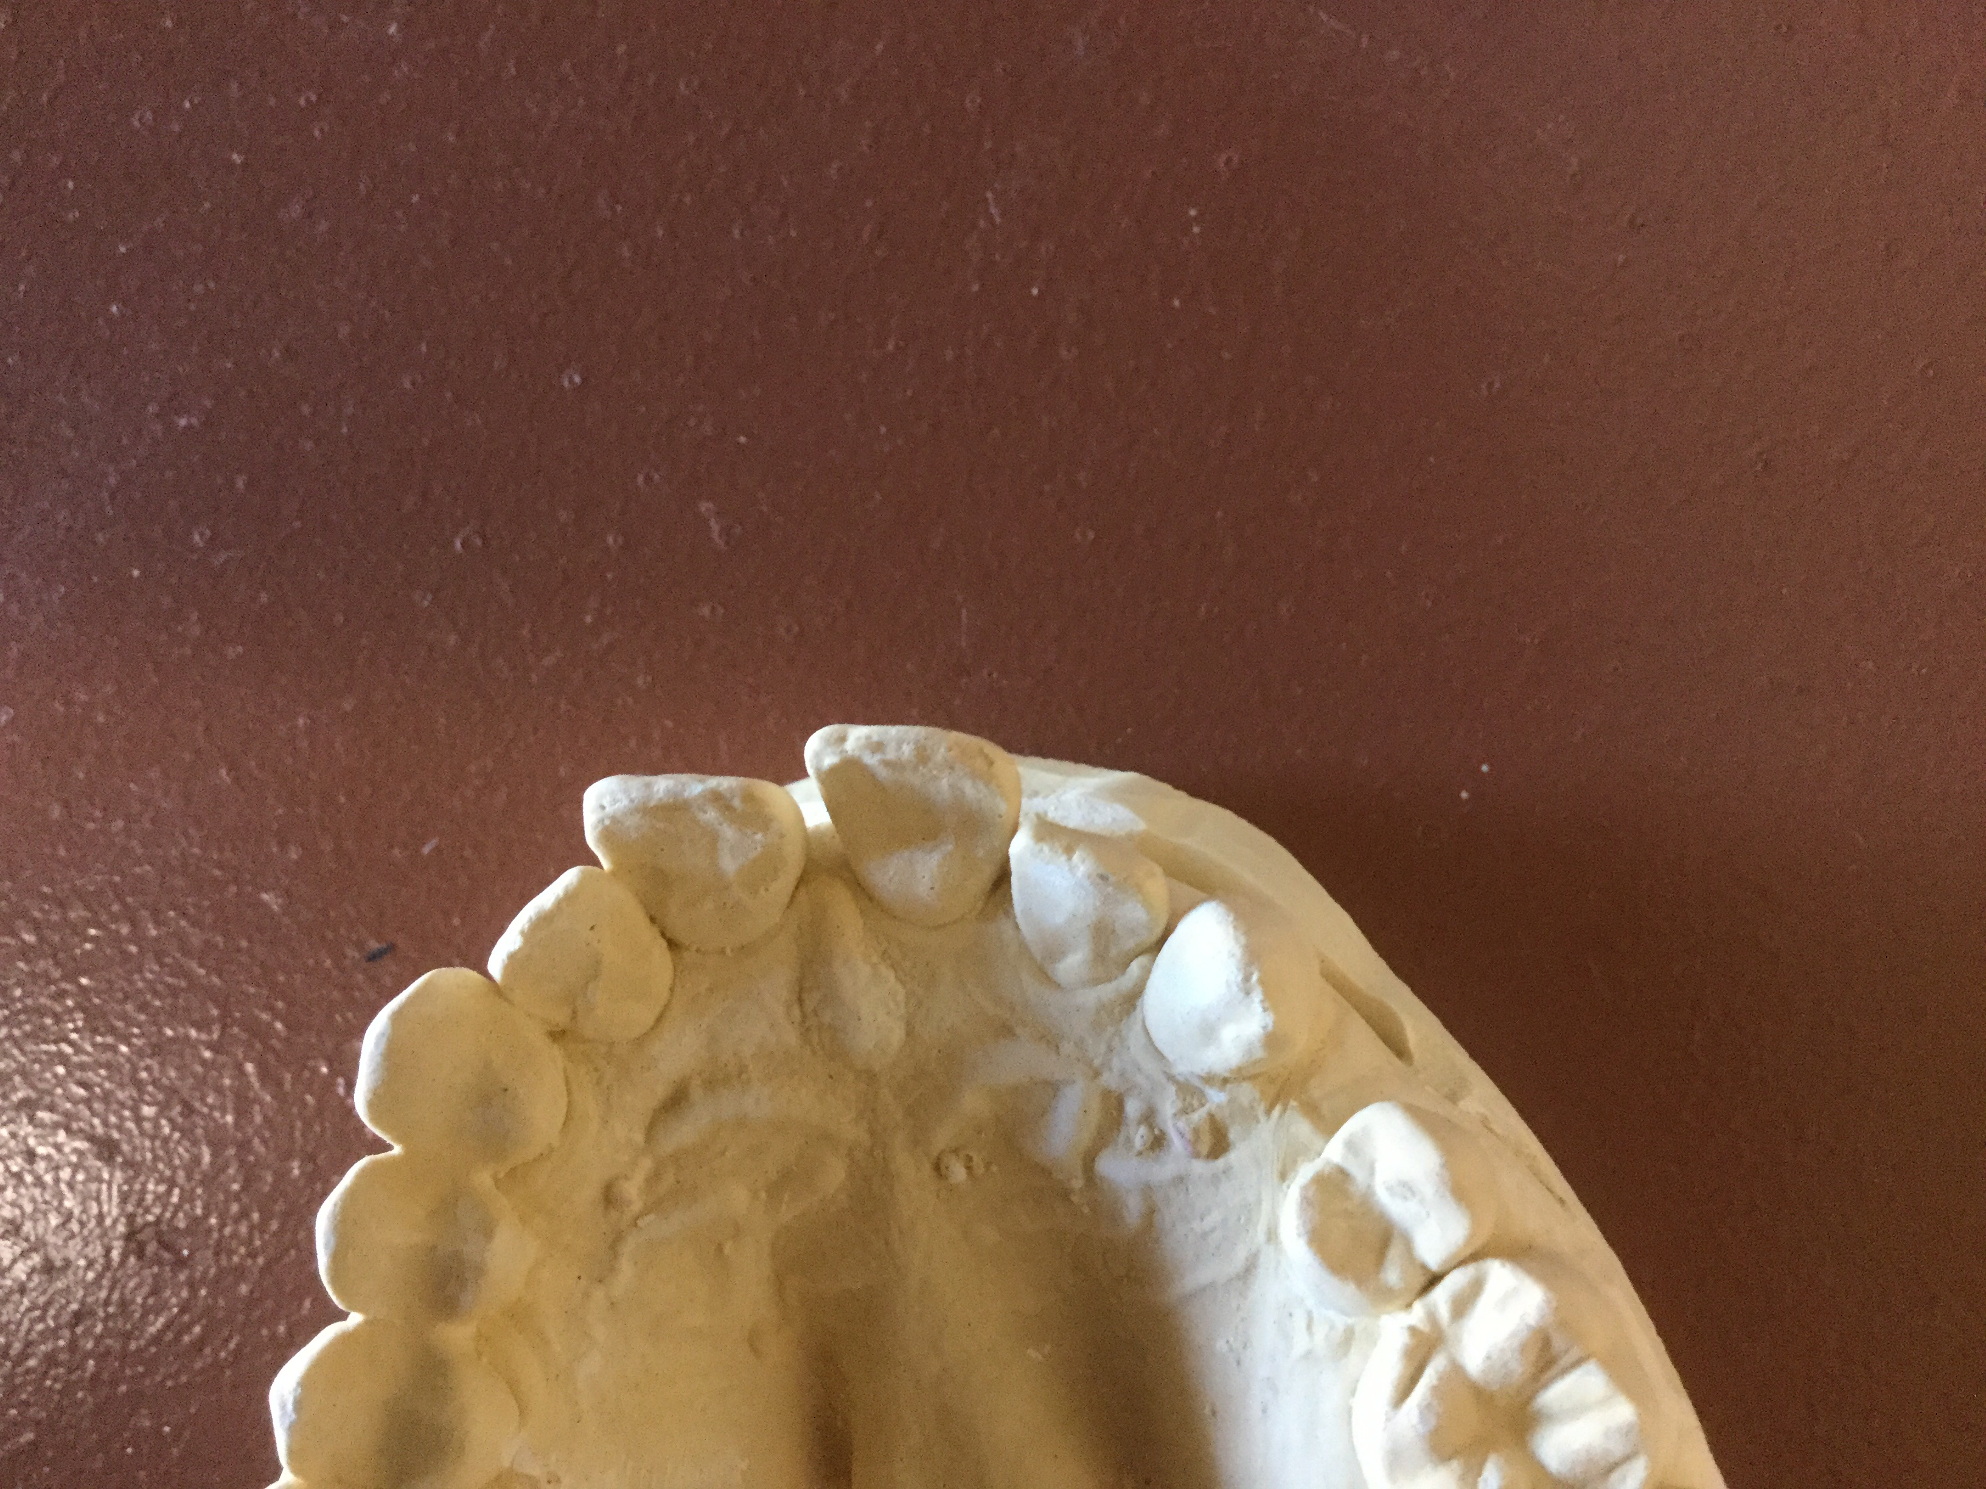

Slide 9
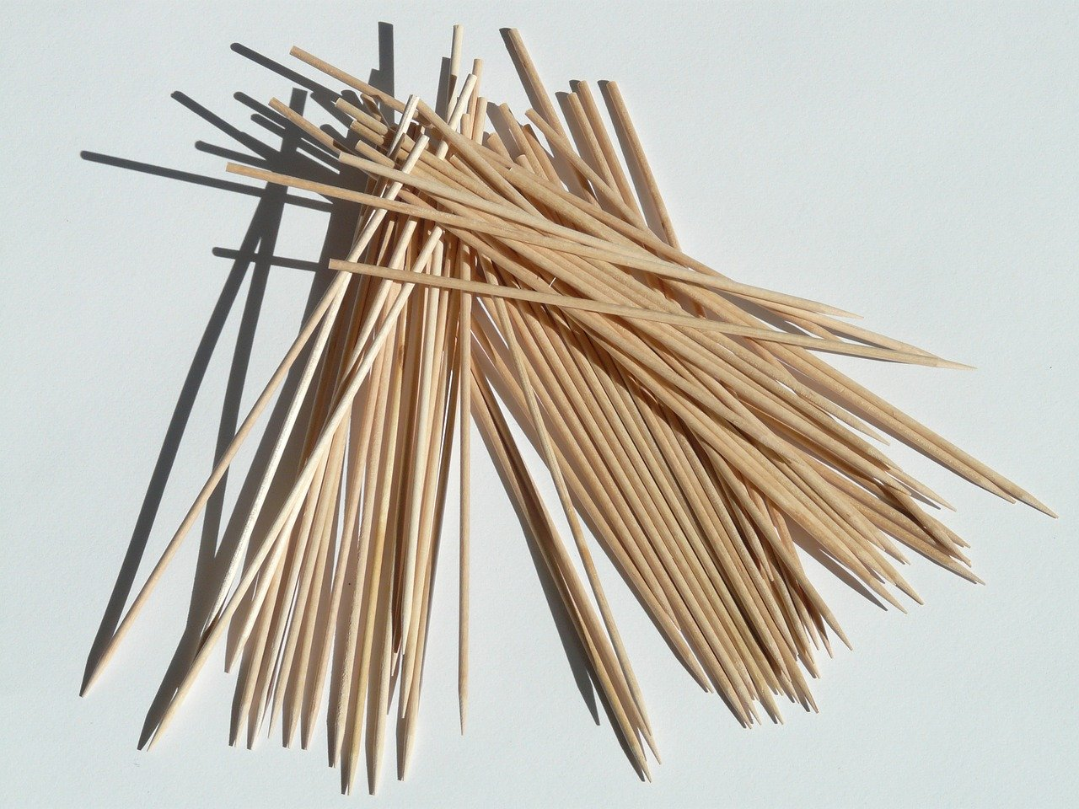

Slide 11
Bibliography
www.mineralogy4kids.org
www.orthinfo.aaos.org
https://media.dent.umich.edu
momjunction.com
radiopedia.org
NationalGeographic.org

Slide 12
Videos about bones and teeth
SciShow Kids. Your Super Skeleton
SciShow Are Broken Bones Stronger after They Heal
SciShow Kids. Why do we have to brush our teeth?

