Slide 1
Viscosity experiment
Comparing honey and water
Learning about experimental design and process:
Controlling Variables
Recording Data
Multiple Trials

Slide 2
How much molecules stick together in a liquid
WHat is viscosity?
You can compare the viscosity of two liquids by measuring how fast they pour or flow.
The rate is the volume of liquid that pours in a certain amount of time in mL/s.
Volume in science is measured in milliliters (mL) for this experiment if you have a mL measuring device available.
Time in seconds.

Slide 3
Variables
Volume
Liquid used
Temperature
Size of opening
Time

Slide 4
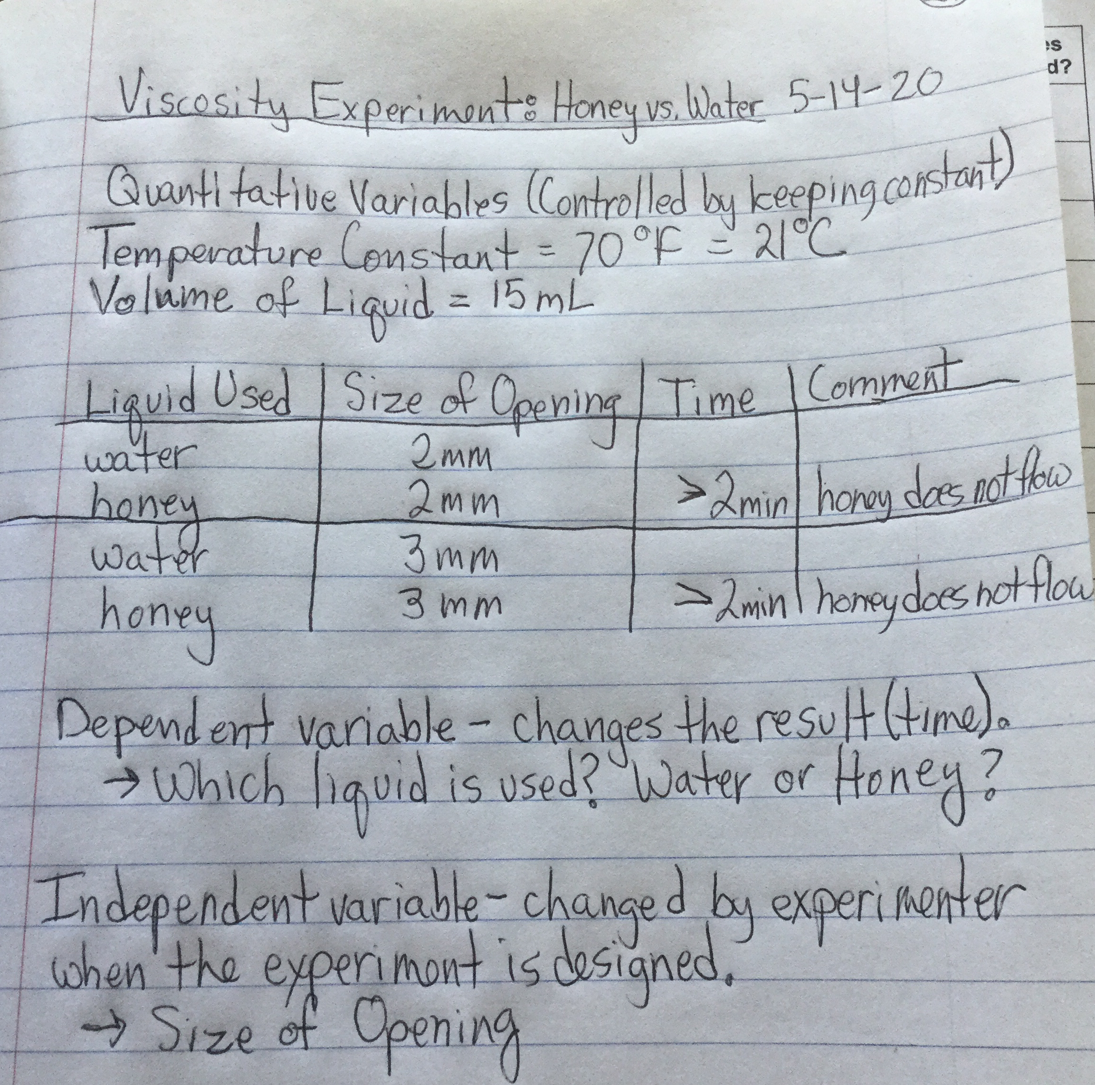
Recording data
Title
Date
Quantitative
Qualitative
Table
What comes next?

Slide 5
Size of Opening. 2mm. 3mm
Time in seconds 106 s. 48 s
Observation: some water remains in the cup (2.5 mL on the 3 mm trial)

Slide 6
Now that I've done the preliminary experiment, We need to:
Determine what size hole in the cup allows the honey to flow through it at a reasonable rate.
Find a way to do the experiment where the cup does not have to empty to have 15 mL flow through.
Think of other possible variables, for example does the brand of honey make a difference?
Do the exactly same experiment several times (multiple trials) to see if we have precision.

Slide 7
Calculating rate of flow
Higher rate of flow is lower viscosity
Rate of flow = mL volume of liquid/ time in seconds
Rate of flow = 12.5 mL/ 48s with the 3 mm opening
Rate of flow = 0.26 mL/s for water at 21 degrees C

Slide 8
Pour it directly out of the cup?
Use different
Equipment?
Can you think of a better
Way to do this experiment?

