Slide 1
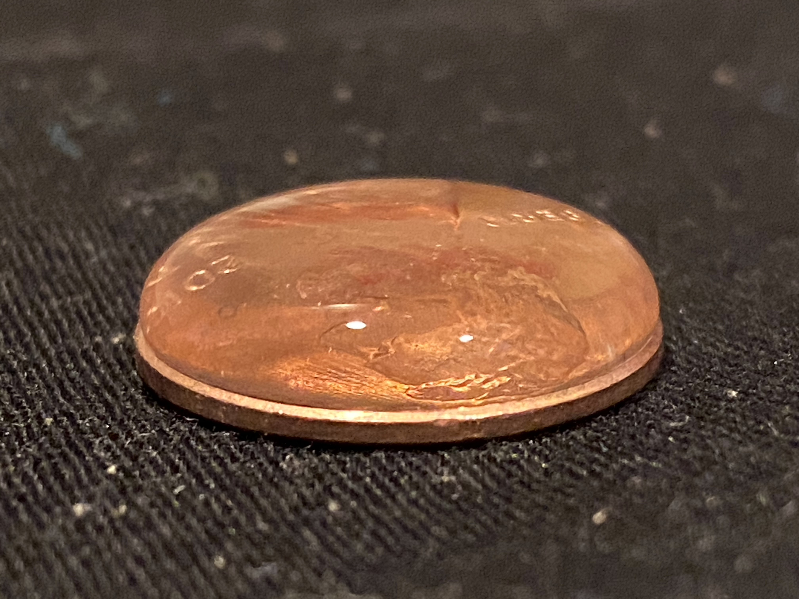

Slide 2
Water forms drops
Water molecules are attracted to each other

Slide 3
Water is made of hydrogen and oxygen atoms
Everything is made of atoms

Slide 4
The COVALENT bond that connects the hydrogens to the oxygen is two shared electrons

Slide 5
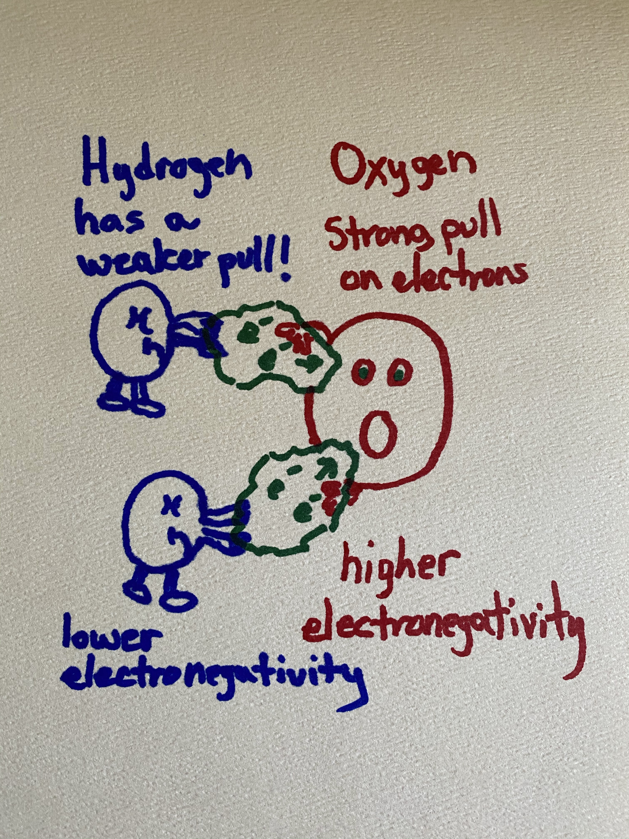
Hydrogen has a weaker pull
Oxygen pulls the electrons away
Higher
Lower
Electronegativity

