Slide 1
Formalistic Approach
A Formalistic approach focuses on form. The analysis stresses items like symbols, images, and structure and how one part of the work relates to other parts and to the whole. Formalist critics believe that all information essential to the interpretation of a work must be found within the work itself; there is no need to bring in outside information about the history, politics, or society of the time, or about the author's life.
How is the work’s structure unified?
How do various elements of the work reinforce its meaning?
What recurring patterns (repeated or related words, images, etc.) can you find? What is the effect of these patterns or motifs?
How does repetition reinforce the theme(s)?
How does the writer’s diction reveal or reflect the work’s meaning?
What is the effect of the plot, and what parts specifically produce that effect?
What figures of speech are used? (metaphors, similes, etc.)
Note the writer’s use of paradox, irony, symbol, plot, characterization, and style of narration. What effects are produced? Do any of these relate to one another or to the theme?
Is there a relationship between the beginning and the end of the story?
What tone and mood are created at various parts of the work?
How does the author create tone and mood? What relationship is there between tone and mood and the effect of the story?
How do the various elements interact to create a unified whole?

Slide 2
Biographical Approach
A Biographical approach focuses on connection of work to author’s personal experiences.
What aspects of the author’s personal life are relevant to this story?
Which of the author’s stated beliefs are reflected in the work?
Does the writer challenge or support the values of her contemporaries?
What seem to be the author’s major concerns? Do they reflect any of the writer’s personal experiences?
Do any of the events in the story correspond to events experienced by the author?
Do any of the characters in the story correspond to real people?

Slide 3
Historical Approach
A Historical Approach focuses on connection of work to the historical period in which it was written; literary historians attempt to connect the historical background of the work to specific aspects of the work.
How does it reflect the time in which it was written?
How accurately does the story depict the time in which it is set?
What literary or historical influences helped to shape the form and content of the work?
How does the story reflect the attitudes and beliefs of the time in which it was written or set? (Consider beliefs and attitudes related to race, religion, politics, gender, society, philosophy, etc.)
What other literary works may have influenced the writer?
What historical events or movements might have influenced this writer?
How would characters and events in this story have been viewed by the writer’s contemporaries?
Does the story reveal or contradict the prevailing values of the time in which it was written?
Does it provide an opposing view of the period’s prevailing values?
How did the public and critics receive the work when it was first published? What factors helped shape this reception?
Did this work have any impact on its society or culture? What was the nature of this impact?
How important is it the historical context (the work’s and the reader’s) to interpreting the work?
What is similar about the perspective of this book and other books written in or about the same era? What is different?
How does this text adhere to the conventions of literature in the era in which it was written? How does this text violate or depart from those conventions?

Slide 4
Psychological Approach
A Psychological approach focuses on the psychology (behaviour and mental processes) of characters. It also examines the relationship between the author of the work and the work itself; psychoanalysts argue that there is always something of the author in the work, whether it be a character, character trait, theme or motif.
What are the traits of the main character? How does the author reveal those traits?
What forces are motivating the characters?
Which behaviors of the characters are conscious ones? Which are unconscious?
What conscious or unconscious conflicts exist between the characters?
Given their backgrounds, how plausible is the characters’ behavior?
Are the theories of Freud or other psychologists applicable to this work? To what degree?
Do any of the characters correspond to the parts of the tripartite self? (Id, ego, superego)
What roles do psychological disorders and dreams play in this story?
Are the characters recognizable psychological types?
What discrepancies exist between a character’s view of him or herself and other characters’ reactions, the author’s portrayal, and/or reader inference?
How do the characters view one another? Is there any discrepancy between a character’s personal opinion of him or herself and how others think about him or her?
How might a psychological approach account for different responses in female and male readers?
How does the work reflect the writer’s personal psychology? What do the characters’ emotions and behaviors reveal about their psychological states?
How does the work reflect the unconscious dimensions of the writer’s mind?
How does the reader’s own psychology affect his response to the work?

Slide 5
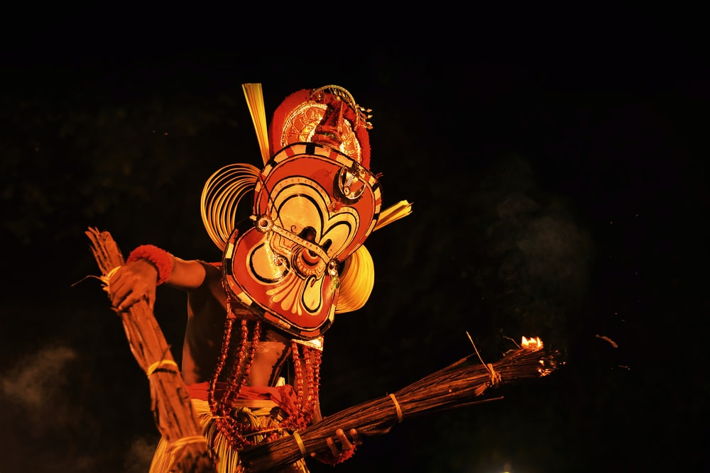
Mythological/Archetypal Approach
A Mythological/ Archetypal approach focuses on connections to other literature, mythological/biblical allusions, archetypal images, symbols, characters, and themes.
How does this story resemble other stories in plot, character, setting, or symbolism?
What universal experiences are depicted?
Are patterns suggested? Are seasons used to suggest a pattern or cycle?
Does the protagonist undergo any kind of transformation, such as movement from innocence to experience, that seems archetypal?
Are the names significant?
Is there a Christ-like figure in the work?
Does the writer allude to biblical or mythological literature? For what purpose?
What aspects of the work create deep universal responses to it?
How does the work reflect the hopes, fears, and expectations of entire cultures (for example, the ancient Greeks)?
How do myths attempt to explain the unexplainable: origin of man? Purpose and destiny of human beings?
What common human concerns are revealed in the story?
How do stories from one culture correspond to those of another? (For example, creation myths, flood myths, etc.)
How does the story reflect the experiences of death and rebirth?
What archetypal events occur in the story? (Quest? Initiation? Scapegoating? Descents into the underworld? Ascents into heaven?)
What archetypal images occur? (Water, rising sun, setting sun, symbolic colors)
What archetypal characters appear in the story? (Mother Earth? Femme Fatal? Wise old man? Wanderer?)
What archetypal settings appear? (Garden? Desert?)
How and why are these archetypes embodied in the work?

Slide 6
Philosophical Approach
A Philosophical approach focuses on themes, view of the world, moral statements, author’s philosophy, etc.
What view of life does the story present? Which character best articulates this viewpoint?
According to this work’s view of life, what is mankind’s relationship to God? To the universe?
What moral statement, if any, does this story make? Is it explicit or implicit?
What is the author’s attitude toward his world? Toward fate? Toward God?
What is the author’s conception of good and evil?
What does the work say about the nature of good or evil?
What does the work say about human nature?

Slide 7
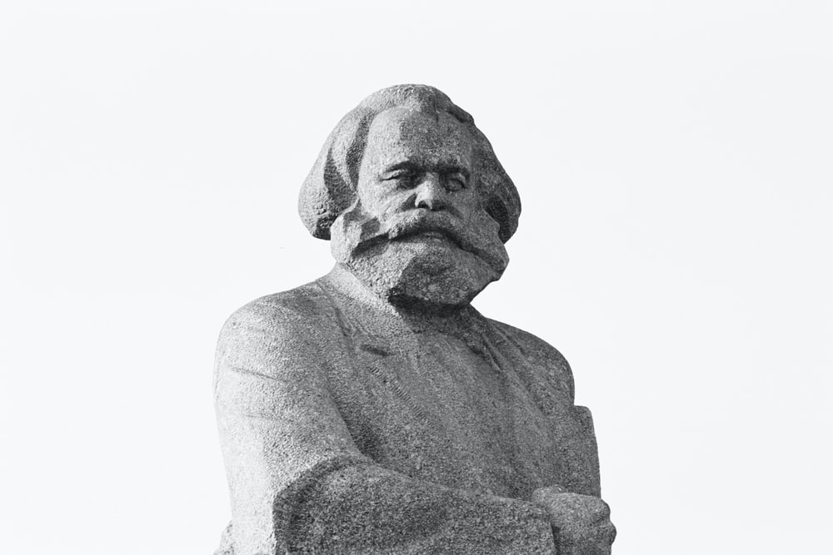
Marxist Criticism
Marxist criticism is a type of criticism in which literary works are viewed as the product of work and whose practitioners emphasize the role of class and ideology as they reflect, propagate, and even challenge the prevailing social order. Marxist critics view texts as material products to be understood in broadly historical terms. In short, literary works are viewed as a product of work (and hence of the realm of production and consumption we call economics).
Who are the powerful people in the text? Who are the powerless? Who receives the most attention?
Why do the powerful have the power? Why are the powerless without power?
Is there alienation and/or fragmentation evident in any of the characters? If so, in whom? The powerful? The powerless?
What role does class play in the work; what is the author’s analysis of class relations?
How do the characters overcome oppression?
Do the powerful in the text suppress the powerless? How? News? Media? Religion? Literature?
In what way does the work serve as propaganda for the status quo; or does it try to undermine it?
What does the society value? Are possessions acquired for their usefulness or their social value?
What does that work say about oppression; or are social conflicts ignored or blamed elsewhere?
Does the work propose some form of utopian vision as a solution to the issues encountered in the work?
What can you infer from the setting about the distribution of wealth?
Is the text itself a product of the society in which it was created? How do you know?
Is the work consistent in its ideologies, or is there an inner conflict?
After reading this text, do you notice any system of oppression that you have accepted? If so, what system, and how do you think you came to accept it?

Slide 8
Feminist Criticism
Feminist Criticism examines images of women and concepts of the feminine in myth and literature; uses the psychological, archetypal, and sociological approaches; often focuses on female characters who have been neglected in previous criticism. Feminist critics attempt to correct or supplement what they regard as a predominantly male-dominated critical perspective.
How are women’s lives portrayed in the work?
Is the form and content of the work influenced by the writer’s gender?
How do male and female characters relate to one another? Are these relationships sources of conflict? Are these conflicts resolved?
Does the work challenge or affirm traditional views of women?
How do the images of women in the story reflect patriarchal social forces that have impeded women’s efforts to achieve full equality with men?
What marital expectations are imposed on the characters? What effect do these expectations have?
What behavioral expectations are imposed on the characters? What effect do these expectations have?
If a female character were male, how would the story be different (and vice versa)?
How does the marital status of a character affect her decisions or happiness?

