Slide 1
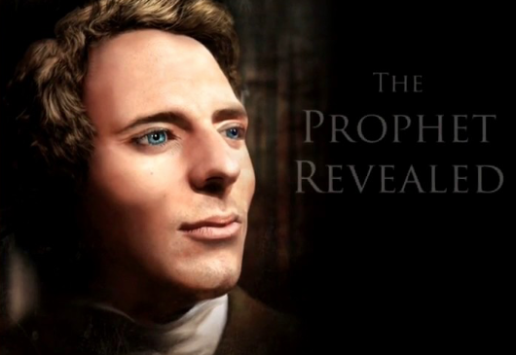

Alta Vista Education Centers
Audio Link
What you can expect
to learn in this website
Questions
Joseph Smith &Emma came to witness of a message for our day
david@simplelivingcenters.com or 818 213 8763
Music Link
Asael Smith link
Notes:
Notes: Alta Vista - funds received in 1989 from relatives of Asael Smith- to my wife. I felt to seek the Lord’s will, and received a vision of two facilities - connected. I felt to leave my profession - and attend BYU and study education - Joseph and Emma and multitudes witness of key events in 2010 - 2000- 2017 key events unfolded to me - of work to come out of the east - be separate yet parallel to the Church - this is for mothers to help prepare the world for the second coming. This website is not an academic exercise, but to be studied over an eight week period, perhaps an hour a week.
Right button reviews 8 week study and a few key expectations regarding health, food, and this foreseen latter-day work.
Music link to “Glorious”.

Slide 2
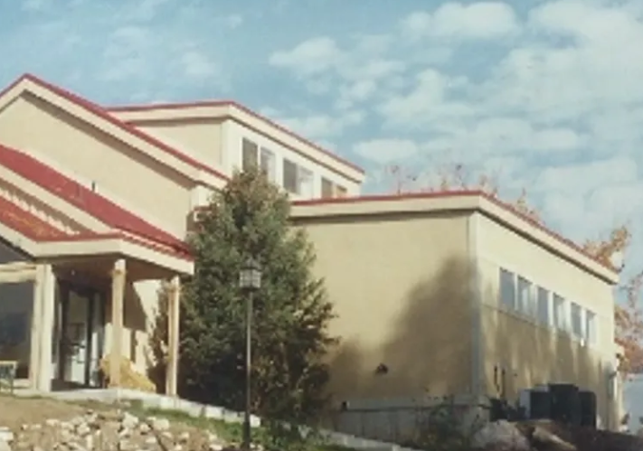
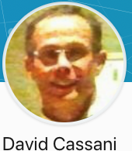
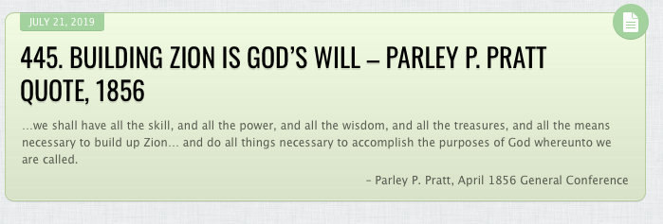
Founder
Alta Vista Education Centers
Currently the LDS motion
picture studio film editing facility
  Linkedin
Music Link
Notes:
This story is as significant to me as when I was a convert coming into the Gospel in 1973
Book of Revelation opened, touching the Book of Mormon.
I was taught for three days a way to see health and life
Linked our family history and our health together
Months later- parallel separate work that would feed nations in last days.

Slide 3
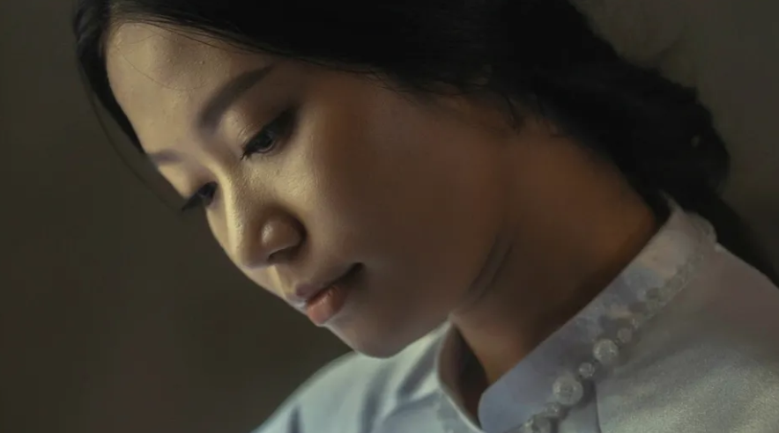
Alta Vista Education Centers
Living a simple higher way -
Notes:
This is a political and educational movement foreseen for our day. A movement toward a local economy …were the larger economy to
fail. We will need over 100,000 supporters to start this work.

Slide 4

Alta Vista Education Centers
Outline of 8 week study
My Story
Hand Curriculum Overview
1. Opposites
2. Receiving God’s Love
3. Peace Joy Trust
4. Simple Living Centers
5. Habitat for Health
6. Family Health Education
7. Find Your Work
8. Sharing with one another
Website Link

Slide 5
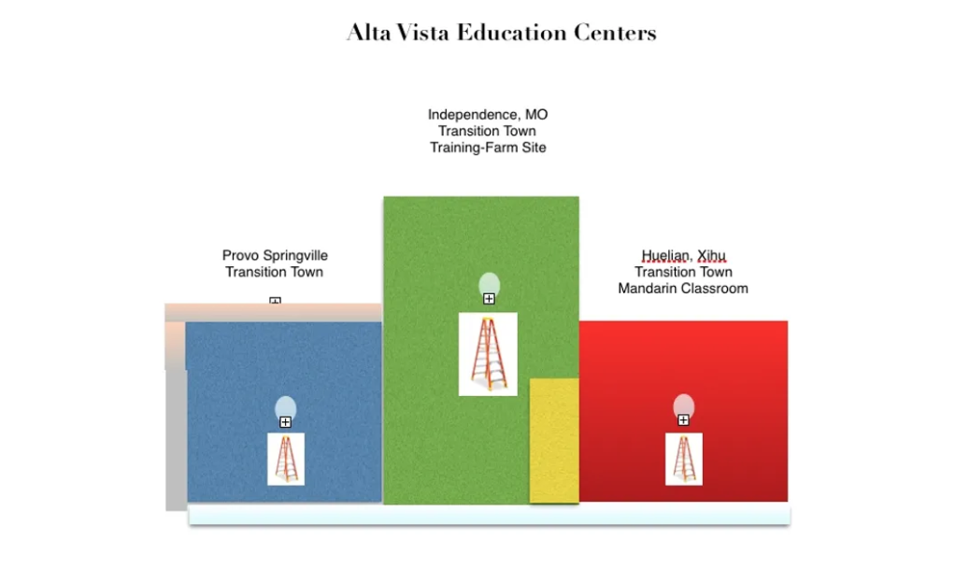
Alta Vista Education Centers
Level 2
Level 1stairway up to Level 2

Slide 6

Notes:
Teachers use time pressure, manipulation with rewards, phrase, external rewards, social pressure, grades to compare students, and often fear of failure to motivate students. These environments are often one of stress for both the teacher and learners, —bullying is often found here, emotionally closed or shutdown students, and anger are often found in these settings. In stressful setting as this individuals are usually drawn to more quick carbohydrates, and refined processed foods, often addictive foods or substances. Over time students pursue careers for fear of money and pleasing others, and not inner peace or their personal mission in life.

Slide 7
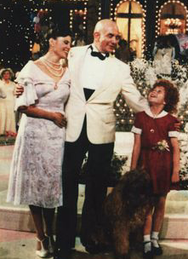
Rising to a higher way
to teach and learn. Moving beyond traditional
teaching methods that often create stress and anxiety.
English
Notes:
Second Level or the Alta Vista Education Centers on line classrooms.s Teacher serve students by provide multiple ways to learn subjects. Music, reflection, different learning environments, and learning without external rewards or grades are often found in this setting. Homes or Classrooms are organized with councils and more teamwork that competition. Individual talents are supported, and each persons unique mission or gifts are a key part of this environment. Emotions are discussed and fears are addressed or seen in ways that result in healthy peaceful inner emotions. Healthier foods are often available in this setting, but learners are often more socially feed as groups, and individual revelation is not received when it may be. Learners may receive promptings to follow a higher way and some will begin to awaken their souls from time to time.

Slide 8
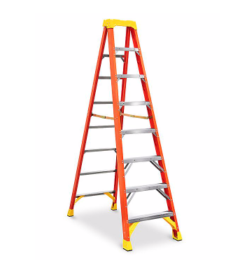
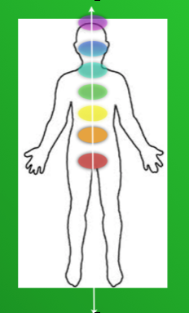
Rising to overcome
the world.
We are here to
receive a body
learn the commandments
and be tested to see if we will receive
all that God wants for us.
Those tests or lessons are within
each of our centers of life.
English
Notes:
Steps if the ladder each have test individualized to the learner. Tests of integrity, moving beyond the unhealthy habits of the family tribe or support systems, learning to honor others and honor self…listening to the bodies needs. As we purify these centers we are pure to receive Gods love in our hearts, and be directed in loving others as God would. Oneness comes with the divine and our desires are Godly desires. With divine love, we can choose the higher way or stay in fears that lead to selfish ways. We can command our minds to seek truth, and hear truth and speak truth. We in the divine timing of heaven learn our work on the earth and the Savior personally comes to us. We learn to discern the natural man designed into our fallen state, and the divine self and quickly make choices to overcome this worldly natural man.
Learners develop a love for learning and service that it may bringing, perhaps raising the level of an entire group or company. Learners involve God and seek inspiration in how to serve in the community. They work with respect with all levels of an organization and with both male and female. The living centers of the body, become a revelatory tool for living a peaceful life. When briefly off of centeredness, these learners can get right back and change their views or receive higher ways through meditation or direct revelation. They are guided to listen to the body and foods their body needs. Healing can involve both generational issues and personal issues. When generational issues, they learn to learn from their pains or experiences, and move forward with joy for their posterity. They become cocreator with God (plural male and female)

Slide 9
Simple
Living Centers
Introduction

Slide 10
Simple
Living Centers
Alta Vista Education
Centers
el
The Church of Jesus Christ
of Latter-day Saints
What is the fullness?
D & C 93 Click here

Slide 11

The Church
or
ecclesiastical
Kingdom of God
The Political
Kingdom of God
The Kingdom of God
within
Notes:
Simple Living Centers
involve key principles
are key to understanding the political Kingdom of God
are key to understanding the Kingdom of God within each of us and key to the fulness.
are key to the work of Elijah and our journey in living a healthy joy filled life for ourselves and passing that influence to generations to come.

Slide 12
The Kingdom of God within
called
Simple
Living Centers
Key to understanding how all things
come into one. Three parallel organizations.

Slide 13
Key to understanding how all things
come into one

Slide 14
Simple
Living Centers
Simple
Living Centers
The Prophet Joseph and others told of a separate work foreseen to come in the last days prior to the second coming. The Saints were not able to fully embrace this.

Slide 15
A work to bring the east and west together- coming from the east
A work to bring the spirit and body together
A work to bring forth a higher level of revelation and trust in God.
Some Biblical researchers say this work will be a theology
Link

Slide 16
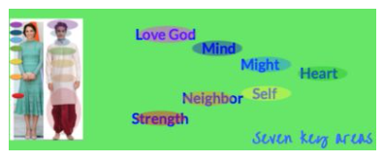
Simple
Living Centers
Simple
Living Centers
The term Chakra appears to first emerge within the Vedas, the most authoritative Hindu text. Did Jesus visit this area of the world anciently?
Did Jesus teach the fullness of the Gospel, or Kingdom within, and did most miss the simple message of the Kingdom of God within all mankind. ?

Slide 17
Simple
Living Centers
Simple
Living Centers
It is necessary
for our faith to be tested and for our lessons to be learned —
that the Church or scriptures
not speak directly of these keys. ..
Is this the great secret Nephi was forbidden to speak of.?

Slide 18
Simple
Living Centers
Simple
Living Centers
This Living Constitution or simple living centers are a term for Chakra in the east
or our spiritual anatomy.
There are simple keys
to our divine nature
and the laws the govern our highest potential. These are vital in overcoming the world, and living in the presence of God as we walk on this earth—and in preparing for the second coming.

Slide 19
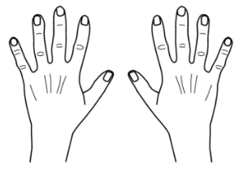
A message for our day
Notes:
This presentation with the hand. is for parents return to a simple language of life. Perhaps unknowingly we have adopted a lower or more corrupt complex language that blocks us from receiving or being open to what we need.
There is a higher way. There is a divine nature within each of us we can experience in new ways.

Slide 20
Simple
Living Centers
Key words for a higher
simple way of life
Health
Centers
Education
Living
for
Health
Work
Return to
Outline
Habitat
Family
Your
Simple
Find
Trust
Joy
Inside-Outside
Peace
Charity-Leadership
Notes:
With these hands - instructive
dreams come often
come to help us
carry out this work.
There is a way to communicate
with those of other cultures.
A simple sign language.
The hand is a simple reminder
of the plan of life.- a more
exalted way of life

Slide 21
Key Events and witnesses in this unfolding work
1973-74 The Book of Revelations is opened to me, and the simple message for the last days.
1978 Roberta White a sister I baptized is told I would have a world wide role for the Lord, but it was not in the Church. She passes away and visits me in 2016 from the spirit world - reminding me of my mission.1978 abt. A speaker on the last days tells of a man whose name is like the House of David will start a movement to prepare for the Savior’s return. David Cassani means small house of david in Italian. I can not imagine such a role and entirely forget the experience until 2010 when the spirit brings it back to my memory. 1980 Holy Ghost witnesses to Adriana Smith Brown to marry David Cassani ( (she is related to Asael Smith- Joseph Smith Jr. Grandfather)
2000 abt. Jan Answer regarding curriculum taught with the hand. I was told to prepare a curriculum taught with the hand that would help mothers prepare their children for the temple.
2000 Jan. Our family travels to China to adopt after a visit from a chinese sister from the spirit world. 2000 For 3 days I am taught how to learn from pains in the bod and how the work of Elijah relates to our health. 2000 Late Spring Vision of a work to start in China with neighborhood buildings. At the same time I am told I will have a parallel role to Church Prophet and that this work would help feed nations.
2010 On a trip to California I am told to ask the name of two organizations and receive Simple Living Centers and Habitat for Health. The spirit impresses to me to do a business plan. I am not sure what a Simple Living Center is. Blessing from Bishop tells me that President Monson would help me.
Notes:
With these hands - instructive
dreams come often
come to help us
carry out this work.
There is a way to communicate
with those of other cultures.
A simple sign language.
The hand is a simple reminder
of the plan of life.- a more
exalted way of life

Slide 22
Key Events and witnesses in this unfolding work
2010 Summer Whispered to me in the temple by someone on the other side… is the Fiscal plan revealed in three key pieces — Winter: I receive multiple witnesses that Simple Living Centers are to be built - to be turned into temples one day. Later I received a revelation on math in temple and how simple and correct it is. This work is rejected by most in my family by many in the Church hear of it and start to receive revelation they tell me. In late winter, I am given a Blessing by the Bishops counselor, after I share this work in part with him and he says that miracles large and small would accompany this work. 2011 I am repeatedly guided to marry Suhsin Tu, convert, return missionary from Taiwan. She receives a witness also. Christopher Roberts Caldwell shows interest in the project and witnesses of it and I am guided to share the project with Elder Osguthorpe.
2014 Ezekiel 34 David role revealed. Advisory board gathers as small miracles accompany this. Hyrum Smith appears to me - dress in white with a message that Hyrum figures would come to me and Chris feels to move by me and support this work just before this visit from Hyrum. 2015 It is revealed that Simple Living Centers are the Seven centers of the body ..called chakras or wheels of light in the east, and it is revealed they are to be taught with the 7th finger.
2016 Directed to teach Simple Living Centers in Taiwan. Chris Caldwell supports us in many ways to do this work. Roberta White comes to me in dream with a message of a worldwide role. Elder Bednar dream, of him coming toward the project then ascending up to lead the Church.
2017 While in Korea Temple, calling confirmed to me by the Savior, dressed in work clothes.
Teaching in Taiwan. Proclamation. We move to Nauvoo for summer and fall. Rejected by the Stake President, but not by three previous stake presidents. John the Revelator comes to me, dressed in work cloths 20018. Transition Town Provo I am told to start. For several month weekly or daily dreams come to myself, family members or those close to the project.
2019 Heavenly Church August 20 to proclaim. Symbolic Vision of Alta Vista Classrooms.
Notes:
With these hands - instructive
dreams come often
come to help us
carry out this work.
There is a way to communicate
with those of other cultures.
A simple sign language.
The hand is a simple reminder
of the plan of life.- a more
exalted way of life

