Slide 1
Simple
Living Centers

Slide 2
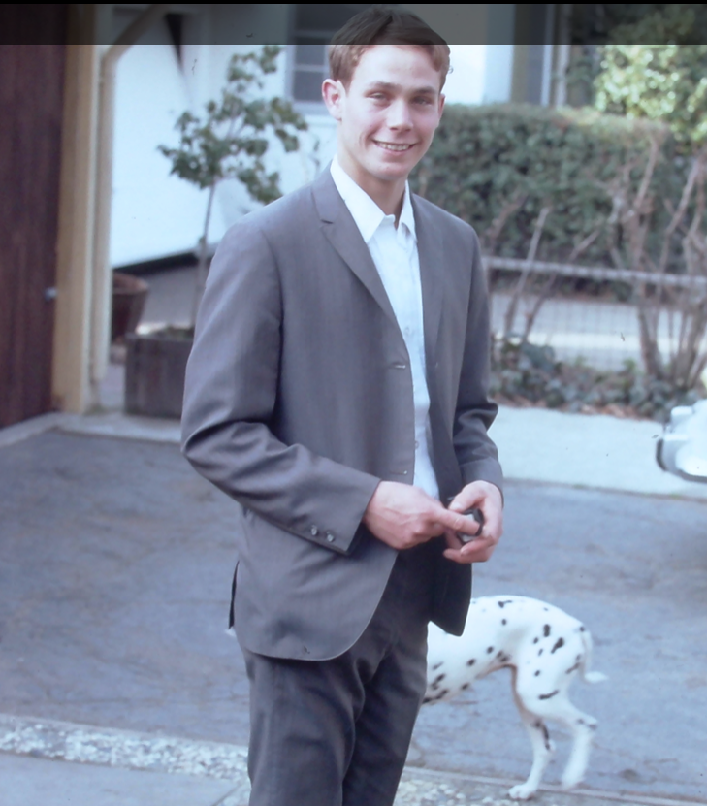
Simple
Living Centers
Type to enter a caption.
Notes:
This presentation is for endowed members of the Church, specifically for mothers in teaching their children about health. Why I am doing this will be clarified, it you can be patience in first learning about this introduction. In the year 1999, after finishing graduate work at BYU in Educational Leadership, I was operating a small private school the Lord inspired me to start. I sought the Lord’s will regarding what curriculum I was to teach at the Alta Vista Education Center. While many private schools claimed to have an LDS curriculum, in studying Church History, I saw no authorized LDS curriculum for private schools, and did not feel comfortable using the claim of being an LDS to educate students about our school. I did however receive an answer. The impression came to develop a curriculum, taught with the hand, that would help mothers prepare their children for the temple. It was to a curriculum about health. My response to that impression was that is the Church’s stewardship, not mine., and I set the impression aside, until I learned how it made sense about ten years later. Let me explain on the next slide.

Slide 3
Simple
Living Centers
Notes:
In 2010, Joseph and Emma Smith and multitudes of those of chinese ancestors came to me- witnessing to me of this work regarding our health. I was told by the spirit to travel to California from Utah, I was told to names of latter-day organizations the Lord was going to bring to the earth and that he wanted endowed women to start help start. One name was Simple Living Centers, and the other as Habitat for Health. I had learned this movement would help feed entire nations as the economic systems of the world fell apart. About 6 years after this event, Iearned of a latter-day work foreseen and spoken of in Church history of a work that would come to the earth before the second coming. It was the political Kingdom of God that Joseph once organized just as he was receiving the endowment in Nauvoo.

Slide 4
Simple
Living Centers
The great secret
Notes:
Joseph came to me completing you might say the clarity of the three Kingdoms of God. It would be taught with the hand. I was told they would be parallel efforts to the Church in the last days, but separate from it, for reasons of agency and for reasons of testing the Saints. The Political Kingdom of God would be symbolically taught on the left hand. Parallel to that, I learned in 2015, the Kingdom of God within each of us is in the center or seven centers of life within us represented with the seventh finger, and the Church was to be taught as the right hand, parallel to the left hand.

Slide 5
Simple
Living Centers
God once was
as man is now.
Notes:
The seven centers of life, or Simple Living Centers were in God, as they are in man, or each of us. Learning how our temple works with regard to our health, was a stewardship of the :Political Kingdom of God, and the Kingdom of God within each of us. This healthy related vision was not the primary stewardship of the Church. We and our ancestors each have unique histories and we might say genetics, and the Lord was bringing forth an organization to fulfill this vision needed prior to the second coming. I learned I was type of the David spoke of in Ezekiel 34, and that I had a work to do on the earth. In the temple many many witnesses came to me regarding the simple fiscal model for this organization and how two small token donations would be used to develop a local fiscal system for producing food and helping those in need. In addition, I had visitations from John who wrote the Book of Revelation, from Hyrum Smith and from the Savior himself regarding his work. I solemnly testify of this reality, and encourage you to consider this work as you attend the temple, and seek to improve the health of your families.

Slide 6
Simple
Living Centers
Just what is the nature of God
and the divinity within man
How are we like God in this mortal realm?

Slide 7
Simple
Living Centers
Added revelation has come
regarding the nature of God and how it relates to our health.
Notes:
In 2010, three months after I received this revelation, I was given a blessing and told President Monson would help me. I sent my story to him of the visit of Joseph and Emma and so many others. While he did not return my letter, three months later the First Presidency release the minutes of the Political Kingdom of God for publication. These records were kept in the possession of the First Presidency since Joseph’s time.

Slide 8
Simple
Living Centers
Who did this come to?
Did it come to our Prophet- President Nelson?
Notes:
In 2010, three months after I received this revelation, I was given a blessing and told President Monson would help me. I sent my story to him of the visit of Joseph and Emma and so many others. While he did not return my letter, three months later the First Presidency release the minutes of the Political Kingdom of God for publication. These records were kept in the possession of the First Presidency since Joseph’s time.

Slide 9
Simple
Living Centers
This understanding started to be unfolded to me in the year 2000. Keys were revealed to understanding our health, the work of Elijah…and how they all come together into one.
Notes:
In 2010, three months after I received this revelation, I was given a blessing and told President Monson would help me. I sent my story to him of the visit of Joseph and Emma and so many others. While he did not return my letter, three months later the First Presidency release the minutes of the Political Kingdom of God for publication. These records were kept in the possession of the First Presidency since Joseph’s time.

Slide 10
Simple
Living Centers
Simple
Living Centers
Simple Living Centers are
Key to understanding the political Kingdom of God
Key to understanding the Kingdom of God within each of us and key to the fulness and the Church of the Firstborn.
They are key to the work of Elijah and our journey in living a healthy joy filled life for ourselves and generations to come.

Slide 11
Simple
Living Centers
Simple
Living Centers
Key to understanding how all things
come into one

Slide 12
Simple
Living Centers
Simple
Living Centers
The Prophet Joseph and others told of a separate work foreseen to come in the last days prior to the second coming

Slide 13
Simple
Living Centers
Simple
Living Centers
A work to bring the east and west together
A work to bring the spirit and body together
A work to bring forth a higher level of revelation and trust in God. Trust needed in these times.

Slide 14
Simple
Living Centers
Simple
Living Centers
In the minutes of the Political Kingdom of God, released in 2010 for publication, Joseph spoke of a LIVING CONSTITUTION
within each of us and in Joseph’s day they
(and perhaps the entire culture in and out of the Church)
could not understand such an idea.

Slide 15
Simple
Living Centers
Simple
Living Centers
Elder Bednar has given hints
in his October 2018 conference talk on
All things coming together into one

Slide 16
Simple
Living Centers
Simple
Living Centers
President Nelson has been given hints of this
by the Lord
with the surprise announcement
of the 7th temple announced that day….
to be in India
an area where Chakras or we say
Simple Living Centers were commonly
accepted.

Slide 17
Simple
Living Centers
Simple
Living Centers
The term Chakra appears to first emerge within the Vedas, the most authoritative Hindu text, though not precisely in the sense of psychic energy centers, rather as chakravartin or the king who "turns the wheel of his empire" in all directions from a center, representing his influence and power.^{[17]} The iconography popular in representing the Chakras, states White, trace back to the five symbols of yajna, the Vedic fire altar: "square, circle, triangle, half moon and dumpling".^{[18]}

Slide 18
Simple
Living Centers
Simple
Living Centers
It is necessary
for our faith to be tested and for our lessons to be learned —
that the Church
not speak directly of these keys.

Slide 19
Simple
Living Centers
Simple
Living Centers
This Living Constitution or our spiritual anatomy
is key
to our nature
and the nature of God.

Slide 20
Simple
Living Centers
Simple
Living Centers
The kingdom within was symbolically taught
by Joseph for those who have eyes to see.
It was sacred or secret in that
we each need to discover how it works
through our own experience and journey to
a higher - more exalted way of life.

Slide 21
Simple
Living Centers
This presentation in not parents to show youth, but for parents to return to a simple language of life.
Perhaps unknowingly we have adopted a lower or more corrupt complex language that blocks us from receiving or being open to what we need.
There is a higher way. There is a divine nature within each of us.

Slide 22
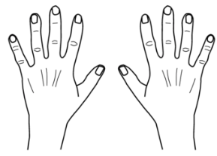
Simple
Living Centers
These slides are for parents to teach their children, -typically mothers or those in mother roles-

Slide 23
Simple
Living Centers
The visual aid for doing this is your hands. This is not intended to be taught with these slides - but through our everyday language with ourselves, with God, and with our children. Discover how the heavens speak this simple language.

Slide 24
Simple
Living Centers
Key words for a higher way of life
With these hands - instructive
dreams come often
come to help us
carry out this work.
There is a way to communicate
with those of other cultures.
A simple sign language.
The hand is a simple reminder
of the plan of life.- a more
exalted way of life
Health
Centers
Education
Living
for
Health
Work
Habitat
Simple
Family
Your
Find
Trust
Inside-outside
Joy
Peace
Charity

Slide 25
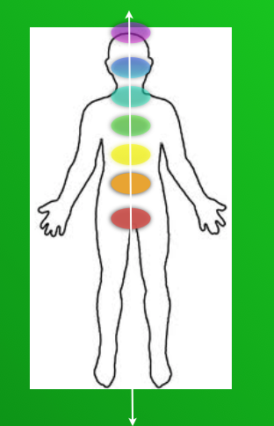
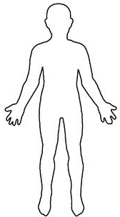
Simple
Living Centers
are for uniting our body and our spirit
common sense keys to health . .
almost lost in today’s world…
Connecting to the universe and earth
where all we need comes.

Slide 26
Simple
Living Centers
We are here to have Joy….

Slide 27
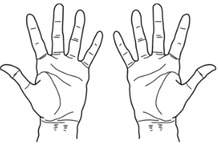
Simple
Living Centers
Parenting
starts with Love

Slide 28
Simple
Living Centers
When we ask… parents can receive pure love
or charity for their children - divinely directed love.
Notes:
Welcome ,,,some will consider us a sister organization to Habitat for Humanity.
They build homes, we bring health to homes and communities. but we really do so much more.
Let me tell you our story...

Slide 29
Simple
Living Centers
When that power comes to their hearts
peace is felt
Notes:
Welcome ,,,some will consider us a sister organization to Habitat for Humanity.
They build homes, we bring health to homes and communities. but we really do so much more.
Let me tell you our story...

Slide 30
Simple
Living Centers
Joy is felt
within children and parents

Slide 31
Simple
Living Centers
From peace and joy-
come inner feelings of
TRUST
Notes:
Welcome ,,,some will consider us a sister organization to Habitat for Humanity.
They build homes, we bring health to homes and communities. but we really do so much more.
Let me tell you our story...

Slide 32
Simple
Living Centers
Trust or bonds
that seal or bind us together
in a higher pure
lasting
love

Slide 33
Simple
Living Centers
Sometimes it helps to see the
the opposite
Notes:
Welcome ,,,some will consider us a sister organization to Habitat for Humanity.
They build homes, we bring health to homes and communities. but we really do so much more.
Let me tell you our story...

Slide 34
Simple
Living Centers
Teaching with force, pressuring with time, manipulation
and control
Notes:
Welcome ,,,some will consider us a sister organization to Habitat for Humanity.
They build homes, we bring health to homes and communities. but we really do so much more.
Let me tell you our story...

Slide 35
Simple
Living Centers
Or helping our children learn
to make choices - within themselves
to learn when guided by the love we receive
from their first parents - God.
Notes:
Welcome ,,,some will consider us a sister organization to Habitat for Humanity.
They build homes, we bring health to homes and communities. but we really do so much more.
Let me tell you our story...

Slide 36
Simple
Living Centers
Receiving pure love leads
to peace within for teachers
and learners
Force leads to stress or anxiety -
perhaps anger
within teachers and learners

Slide 37
Simple
Living Centers
Force leads to stress or anxiety
within teachers and
often students pick that feeling up
Notes:
Welcome ,,,some will consider us a sister organization to Habitat for Humanity.
They build homes, we bring health to homes and communities. but we really do so much more.
Let me tell you our story...

Slide 38
Simple
Living Centers
Or we can follow the path of helping
our children learn
to make choices - within themselves
Notes:
Welcome ,,,some will consider us a sister organization to Habitat for Humanity.
They build homes, we bring health to homes and communities. but we really do so much more.
Let me tell you our story...

Slide 39
Simple
Living Centers
The great secret is now made simple
Notes:
Welcome ,,,some will consider us a sister organization to Habitat for Humanity.
They build homes, we bring health to homes and communities. but we really do so much more.
Let me tell you our story...

Slide 40
Simple
Living Centers
Teaching with the hand
Notes:
Welcome ,,,some will consider us a sister organization to Habitat for Humanity.
They build homes, we bring health to homes and communities. but we really do so much more.
Let me tell you our story...

Slide 41
Simple
Living Centers
Simple
Notes:
Welcome ,,,some will consider us a sister organization to Habitat for Humanity.
They build homes, we bring health to homes and communities. but we really do so much more.
Let me tell you our story...

Slide 42
Simple
Living Centers
Living
Simple
Notes:
Welcome ,,,some will consider us a sister organization to Habitat for Humanity.
They build homes, we bring health to homes and communities. but we really do so much more.
Let me tell you our story...

Slide 43
Simple
Living Centers
Centers
Living
Simple
Notes:
Welcome ,,,some will consider us a sister organization to Habitat for Humanity.
They build homes, we bring health to homes and communities. but we really do so much more.
Let me tell you our story...

Slide 44
Simple
Living Centers
2
3
4
5
7
Centers
1
Living
6
Simple
Notes:
Welcome ,,,some will consider us a sister organization to Habitat for Humanity.
They build homes, we bring health to homes and communities. but we really do so much more.
Let me tell you our story...

Slide 45
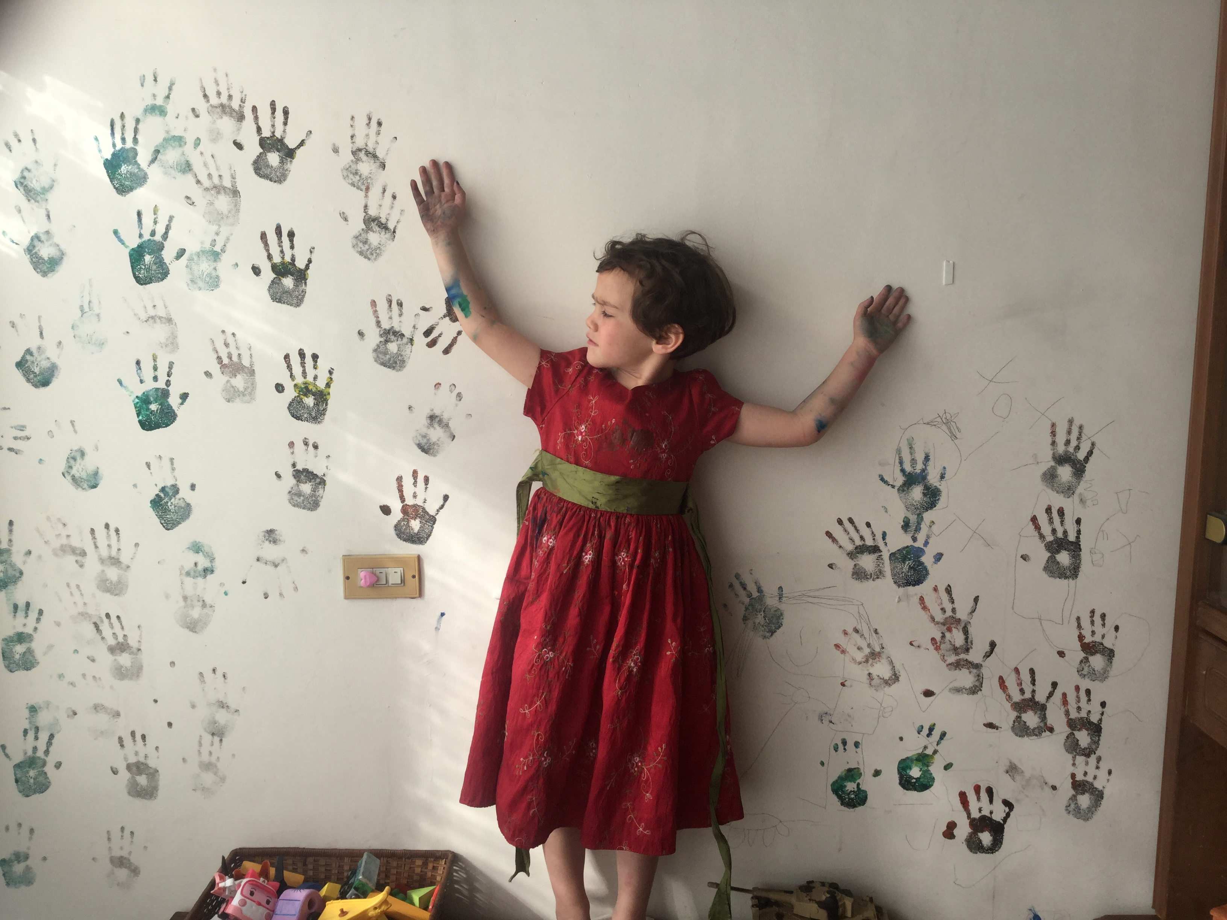
Simple
Living Centers
So many choices on each side of us.
Notes:
Welcome ,,,some will consider us a sister organization to Habitat for Humanity.
They build homes, we bring health to homes and communities. but we really do so much more.
Let me tell you our story...

Slide 46
Simple
Living Centers
So many choices on each side of us.
Notes:
Welcome ,,,some will consider us a sister organization to Habitat for Humanity.
They build homes, we bring health to homes and communities. but we really do so much more.
Let me tell you our story...

Slide 47
Simple
Living Centers
Education means to bring forth from within.
Notes:
Welcome ,,,some will consider us a sister organization to Habitat for Humanity.
They build homes, we bring health to homes and communities. but we really do so much more.
Let me tell you our story...

Slide 48
Simple Living
Centers
Our souls can know. We are each given a path to discovering
seven simple living centers inside of us.
Beginning
Notes:
Welcome ,,,some will consider us a sister organization to Habitat for Humanity.
They build homes, we bring health to homes and communities. but we really do so much more.
Let me tell you our story...

Slide 49
Simple Living
Centers
They are like climbing a ladder of trust,
a path to becoming all we can become.
Beginning
Notes:
Welcome ,,,some will consider us a sister organization to Habitat for Humanity.
They build homes, we bring health to homes and communities. but we really do so much more.
Let me tell you our story...

Slide 50
Simple Living
Centers
We can learn how to listen and discover a higher way of life.
Beginning
Notes:
Welcome ,,,some will consider us a sister organization to Habitat for Humanity.
They build homes, we bring health to homes and communities. but we really do so much more.
Let me tell you our story...

Slide 51
Simple Living
Centers
We progress as we learn by asking honest questions?
Beginning
Notes:
Welcome ,,,some will consider us a sister organization to Habitat for Humanity.
They build homes, we bring health to homes and communities. but we really do so much more.
Let me tell you our story...

Slide 52
Simple Living
Centers
What is an honest question?
Beginning
Notes:
Welcome ,,,some will consider us a sister organization to Habitat for Humanity.
They build homes, we bring health to homes and communities. but we really do so much more.
Let me tell you our story...

Slide 53
Simple Living
Centers
It is learning to talk with God about how we really feel.-
our true desires…
good or bad as they may be.
Beginning
Notes:
Welcome ,,,some will consider us a sister organization to Habitat for Humanity.
They build homes, we bring health to homes and communities. but we really do so much more.
Let me tell you our story...

Slide 54
Simple Living
Centers
He will answer us… in a language the respects our agency.
Beginning
Notes:
Welcome ,,,some will consider us a sister organization to Habitat for Humanity.
They build homes, we bring health to homes and communities. but we really do so much more.
Let me tell you our story...

Slide 55
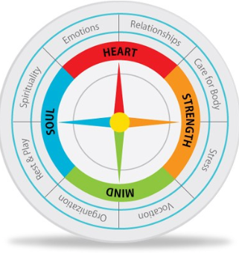
Simple Living
Centers
We may have feelings in one or more of our Simple Living Centers
We may have dreams about our hands..
We may
find each center of life can be like a compass - guiding us,
Notes:
Welcome ,,,some will consider us a sister organization to Habitat for Humanity.
They build homes, we bring health to homes and communities. but we really do so much more.
Let me tell you our story...

Slide 56
Simple Living
Centers
or a way or connection to the heavens and earth.
Notes:
Welcome ,,,some will consider us a sister organization to Habitat for Humanity.
They build homes, we bring health to homes and communities. but we really do so much more.
Let me tell you our story...

Slide 57
Seven Living Centers
Our centers of life are in one of three conditions
each moment of each day.
Notes:
Welcome ,,,some will consider us a sister organization to Habitat for Humanity.
They build homes, we bring health to homes and communities. but we really do so much more.
Let me tell you our story...

Slide 58
Simple Living Centers
7 Living Centers
leading to life or
the living waters
stress, fear
or anger
feelings shut down
or turned off
balanced- centered
in
peace or faith
Understanding these centers of our spiritual anatomy or our living constitution can entirely shift how we view our health, change our language, our connections with others, and our life journey. We can make simple choices that keep us centered in faith, learning and the connection with we need.
Beginning
Notes:
Welcome ,,,some will consider us a sister organization to Habitat for Humanity.
They build homes, we bring health to homes and communities. but we really do so much more.
Let me tell you our story...

Slide 59
Seven Living Centers
Sometimes we feel all over the place
- sick - afraid - or maybe nothing at all.
Outline
Next
Previous
Explore
Back
Beginning
Notes:
Welcome ,,,some will consider us a sister organization to Habitat for Humanity.
They build homes, we bring health to homes and communities. but we really do so much more.
Let me tell you our story...

Slide 60
Seven Living Centers
We can learn how to make choices
and receive from the heavens or earth ways to keep centered in LIFE.
Outline
Next
Previous
Explore
Back
Beginning
Notes:
Welcome ,,,some will consider us a sister organization to Habitat for Humanity.
They build homes, we bring health to homes and communities. but we really do so much more.
Let me tell you our story...

Slide 61
Seven Living Centers
We may be centered in peace. …
-awakened to some form of learning, health, joy, love, or life.
Outline
Next
Previous
Explore
Back
Beginning
Notes:
Welcome ,,,some will consider us a sister organization to Habitat for Humanity.
They build homes, we bring health to homes and communities. but we really do so much more.
Let me tell you our story...

Slide 62
Seven Living Centers
Or we may choose to be in anger, blame or some form of fear.
Outline
Next
Previous
Explore
Back
Beginning
Notes:
Welcome ,,,some will consider us a sister organization to Habitat for Humanity.
They build homes, we bring health to homes and communities. but we really do so much more.
Let me tell you our story...

Slide 63
Seven Living Centers
Or we may decide to not care, turn our feelings off, and feel numb or nothing.
Outline
Next
Previous
Explore
Back
Beginning
Notes:
Welcome ,,,some will consider us a sister organization to Habitat for Humanity.
They build homes, we bring health to homes and communities. but we really do so much more.
Let me tell you our story...

Slide 64
Seven Living Centers
To be awakened
Each center has a test or lesson to learn.
Outline
Next
Previous
Explore
Back
Beginning
Notes:
Welcome ,,,some will consider us a sister organization to Habitat for Humanity.
They build homes, we bring health to homes and communities. but we really do so much more.
Let me tell you our story...

Slide 65
Seven Living Centers
Life is a journey to learn to trust our simple living centers
Outline
Next
Previous
Explore
Back
Beginning
Notes:
Welcome ,,,some will consider us a sister organization to Habitat for Humanity.
They build homes, we bring health to homes and communities. but we really do so much more.
Let me tell you our story...

Slide 66
Seven Living Centers
With our choices
We can learn to turn all of our lights on inside us
Notes:
Welcome ,,,some will consider us a sister organization to Habitat for Humanity.
They build homes, we bring health to homes and communities. but we really do so much more.
Let me tell you our story...

Slide 67
Seven Living Centers
They are like a rainbow
Notes:
Welcome ,,,some will consider us a sister organization to Habitat for Humanity.
They build homes, we bring health to homes and communities. but we really do so much more.
Let me tell you our story...

Slide 68
Seven Living Centers
One of our first lessons to learn or questions to ask ourselves is …
Outline
Next
Previous
Explore
Back
Beginning
Notes:
Welcome ,,,some will consider us a sister organization to Habitat for Humanity.
They build homes, we bring health to homes and communities. but we really do so much more.
Let me tell you our story...

Slide 69
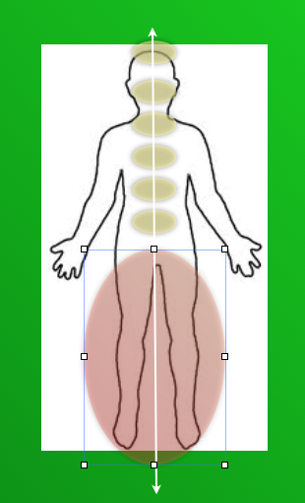
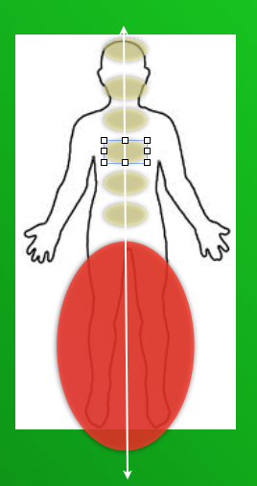
Is my strength from the earth
from choosing healthy foods and turning the lights on
or following the crowd in fear of being different?
Outline
Next
Previous
Explore
Back
Beginning
Notes:
Welcome ,,,some will consider us a sister organization to Habitat for Humanity.
They build homes, we bring health to homes and communities. but we really do so much more.
Let me tell you our story...

Slide 70
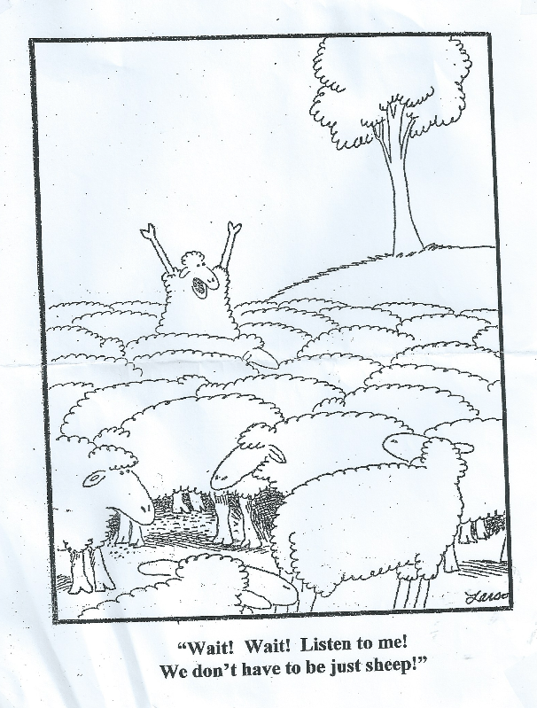
Is my strength from the earth
from choosing healthy foods and turning the lights on
or following the crowd in fear of being different?
Outline
Next
Previous
Explore
Back
Beginning
Notes:
Welcome ,,,some will consider us a sister organization to Habitat for Humanity.
They build homes, we bring health to homes and communities. but we really do so much more.
Let me tell you our story...

Slide 71
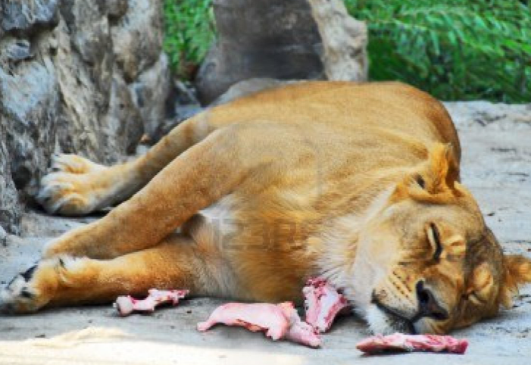
Seven Living Centers
Do I simply not care and turning off my feeling of what I know?
Do our foods make us sleepy?
Outline
Next
Previous
Explore
Back
Beginning
Notes:
Welcome ,,,some will consider us a sister organization to Habitat for Humanity.
They build homes, we bring health to homes and communities. but we really do so much more.
Let me tell you our story...

Slide 72
Seven Living Centers
Am I tired of fighting the crowd?
Outline
Next
Previous
Explore
Back
Beginning
Notes:
Welcome ,,,some will consider us a sister organization to Habitat for Humanity.
They build homes, we bring health to homes and communities. but we really do so much more.
Let me tell you our story...

Slide 73
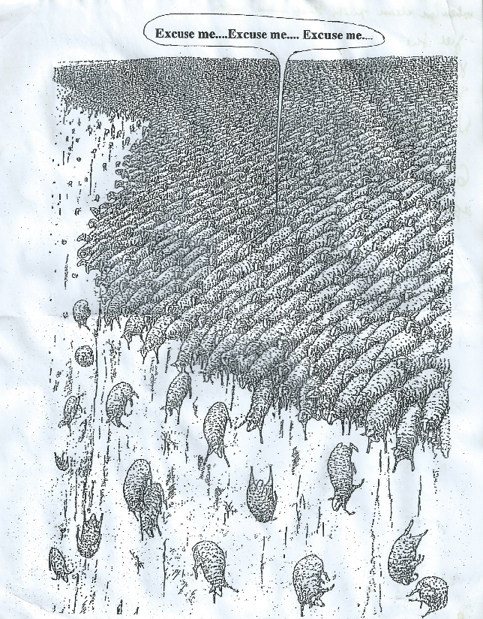
Simple Living Centers
or Stressed.
Outline
Next
Previous
Explore
Back
Beginning
Notes:
Welcome ,,,some will consider us a sister organization to Habitat for Humanity.
They build homes, we bring health to homes and communities. but we really do so much more.
Let me tell you our story...

Slide 74
Seven Living Centers
Is there another way?
Outline
Next
Previous
Explore
Back
Beginning
Notes:
Welcome ,,,some will consider us a sister organization to Habitat for Humanity.
They build homes, we bring health to homes and communities. but we really do so much more.
Let me tell you our story...

Slide 75
Seven Living Centers
We are in one of three states
I DONT CARE
Outline
Next
Previous
Explore
Back
Beginning
Notes:
Welcome ,,,some will consider us a sister organization to Habitat for Humanity.
They build homes, we bring health to homes and communities. but we really do so much more.
Let me tell you our story...

Slide 76
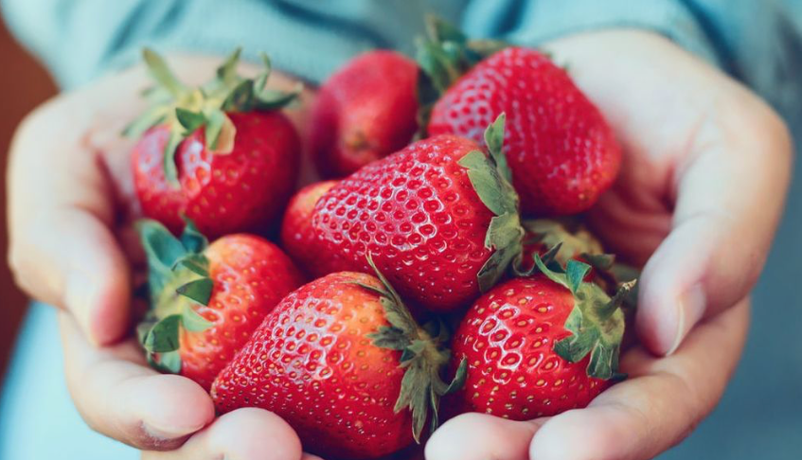
In peace or awakened to listen within to what we need.
Outline
Next
Previous
Explore
Back
Beginning
Notes:
Welcome ,,,some will consider us a sister organization to Habitat for Humanity.
They build homes, we bring health to homes and communities. but we really do so much more.
Let me tell you our story...

Slide 77
Or in some form of stress or fear.
Outline
Next
Previous
Explore
Back
Beginning
Notes:
Welcome ,,,some will consider us a sister organization to Habitat for Humanity.
They build homes, we bring health to homes and communities. but we really do so much more.
Let me tell you our story...

Slide 78
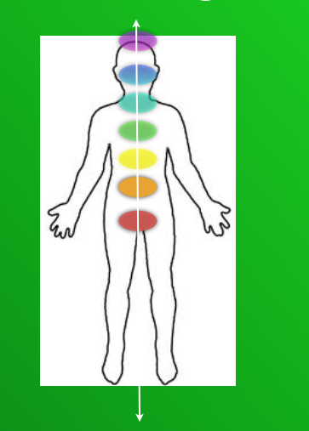
Simple Living Centers
When do our foods bring us strength - awaken us to life
and love and learning?
Outline
Next
Previous
Explore
Back
Beginning
Notes:
Welcome ,,,some will consider us a sister organization to Habitat for Humanity.
They build homes, we bring health to homes and communities. but we really do so much more.
Let me tell you our story...

Slide 79
Seven Living Centers
Do our foods bring a feel of stress, congestion, a running nose, or sickness?
Outline
Next
Previous
Explore
Back
Beginning
Notes:
Welcome ,,,some will consider us a sister organization to Habitat for Humanity.
They build homes, we bring health to homes and communities. but we really do so much more.
Let me tell you our story...

Slide 80
Seven Living Centers
We make choices everyday that matter …that add to our personal wisdom
or bring illness and pain.
Outline
Next
Previous
Explore
Back
Beginning
Notes:
Welcome ,,,some will consider us a sister organization to Habitat for Humanity.
They build homes, we bring health to homes and communities. but we really do so much more.
Let me tell you our story...

Slide 81
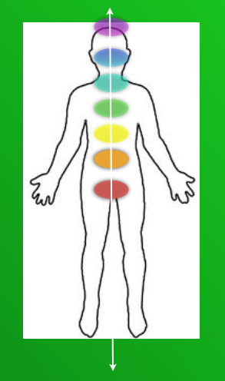
Seven Living Centers
We make choices everyday that matter.—-in higher ways.
Outline
Next
Previous
Explore
Back
Beginning
Notes:
Welcome ,,,some will consider us a sister organization to Habitat for Humanity.
They build homes, we bring health to homes and communities. but we really do so much more.
Let me tell you our story...

Slide 82
Seven Living Centers
Choices that can turn all our lights on.
Outline
Next
Previous
Explore
Back
Beginning
Notes:
Welcome ,,,some will consider us a sister organization to Habitat for Humanity.
They build homes, we bring health to homes and communities. but we really do so much more.
Let me tell you our story...

Slide 83
Seven Living Centers
We make choices that turn the lights off
Outline
Next
Previous
Explore
Back
Beginning
Notes:
Welcome ,,,some will consider us a sister organization to Habitat for Humanity.
They build homes, we bring health to homes and communities. but we really do so much more.
Let me tell you our story...

Slide 84
Seven Living Centers
When we pass or first test or learn our first lesson,
Beginning
Notes:
Welcome ,,,some will consider us a sister organization to Habitat for Humanity.
They build homes, we bring health to homes and communities. but we really do so much more.
Let me tell you our story...

Slide 85
Seven Living Centers
Making healthy choices… begins with our connection to the earth.
What are we connected to.
Beginning
Notes:
Welcome ,,,some will consider us a sister organization to Habitat for Humanity.
They build homes, we bring health to homes and communities. but we really do so much more.
Let me tell you our story...

Slide 86
Seven Living Centers
How do we honor others
when we seek God’s will or inner peace with healthy choices?
Beginning
Notes:
Welcome ,,,some will consider us a sister organization to Habitat for Humanity.
They build homes, we bring health to homes and communities. but we really do so much more.
Let me tell you our story...

Slide 87
Seven Living Centers
Do we turn our feelings off. We don’t care about others?
Beginning
Notes:
Welcome ,,,some will consider us a sister organization to Habitat for Humanity.
They build homes, we bring health to homes and communities. but we really do so much more.
Let me tell you our story...

Slide 88
Seven Living Centers
Do we feel we are better than others? Feel we need to control them?
Beginning
Notes:
Welcome ,,,some will consider us a sister organization to Habitat for Humanity.
They build homes, we bring health to homes and communities. but we really do so much more.
Let me tell you our story...

Slide 89
Seven Living Centers
Our do we have the inner peace to just quietly lead, by example and faith in God’s timing or the timing of the universe?
Our tests or lessons may be very personal to us
If we listen within.
Beginning
Notes:
Welcome ,,,some will consider us a sister organization to Habitat for Humanity.
They build homes, we bring health to homes and communities. but we really do so much more.
Let me tell you our story...

Slide 90
Seven Living Centers
Our our healthy choices become a way to be better than others?
Can pride get in the way and get us off the center.
Beginning
Notes:
Welcome ,,,some will consider us a sister organization to Habitat for Humanity.
They build homes, we bring health to homes and communities. but we really do so much more.
Let me tell you our story...

Slide 91
Seven Living Centers
Or can we simply keep our focus on making healthy choices to better love and serve God or the higher good?
Beginning
Notes:
Welcome ,,,some will consider us a sister organization to Habitat for Humanity.
They build homes, we bring health to homes and communities. but we really do so much more.
Let me tell you our story...

Slide 92
Seven Living Centers
Honor self
Outline
Next
Previous
Explore
Back
Beginning
Notes:
Welcome ,,,some will consider us a sister organization to Habitat for Humanity.
They build homes, we bring health to homes and communities. but we really do so much more.
Let me tell you our story...

Slide 93
Seven Living Centers
Love Self- listen to self
Outline
Next
Previous
Explore
Back
Beginning
Notes:
Welcome ,,,some will consider us a sister organization to Habitat for Humanity.
They build homes, we bring health to homes and communities. but we really do so much more.
Let me tell you our story...

Slide 94
Seven Living Centers
As we listen to our self, more inspiration or light comes
Outline
Next
Previous
Explore
Back
Beginning
Notes:
Welcome ,,,some will consider us a sister organization to Habitat for Humanity.
They build homes, we bring health to homes and communities. but we really do so much more.
Let me tell you our story...

Slide 95
Seven Living Centers
A piece at a time.
Outline
Next
Previous
Explore
Back
Beginning
Notes:
Welcome ,,,some will consider us a sister organization to Habitat for Humanity.
They build homes, we bring health to homes and communities. but we really do so much more.
Let me tell you our story...

Slide 96
Seven Living Centers
For healthy living, do we listen to this area of our body.
Outline
Next
Previous
Explore
Back
Beginning
Notes:
Welcome ,,,some will consider us a sister organization to Habitat for Humanity.
They build homes, we bring health to homes and communities. but we really do so much more.
Let me tell you our story...

Slide 97
Seven Living Centers
Our do we make choices that we do not care.
Outline
Next
Previous
Explore
Back
Beginning
Notes:
Welcome ,,,some will consider us a sister organization to Habitat for Humanity.
They build homes, we bring health to homes and communities. but we really do so much more.
Let me tell you our story...

Slide 98
Seven Living Centers
Or make choices from fear to run too fast or work too hard to get what we need.
Outline
Next
Previous
Explore
Back
Beginning
Notes:
Welcome ,,,some will consider us a sister organization to Habitat for Humanity.
They build homes, we bring health to homes and communities. but we really do so much more.
Let me tell you our story...

Slide 99
Seven Living Centers
Listening to each center of life will help awaken the next center of life.
Outline
Next
Previous
Explore
Back
Beginning
Notes:
Welcome ,,,some will consider us a sister organization to Habitat for Humanity.
They build homes, we bring health to homes and communities. but we really do so much more.
Let me tell you our story...

Slide 100
Seven Living Centers
Listening to each center of life will help awaken the next.
Outline
Next
Previous
Explore
Back
Beginning
Notes:
Welcome ,,,some will consider us a sister organization to Habitat for Humanity.
They build homes, we bring health to homes and communities. but we really do so much more.
Let me tell you our story...

Slide 101
Seven Living Centers
In this center of life, we receive divine directed love.
Outline
Next
Previous
Explore
Back
Beginning
Notes:
Welcome ,,,some will consider us a sister organization to Habitat for Humanity.
They build homes, we bring health to homes and communities. but we really do so much more.
Let me tell you our story...

Slide 102
Seven Living Centers
Not man’s lustful nature - some call love
Outline
Next
Previous
Explore
Back
Beginning
Notes:
Welcome ,,,some will consider us a sister organization to Habitat for Humanity.
They build homes, we bring health to homes and communities. but we really do so much more.
Let me tell you our story...

Slide 103
Seven Living Centers
Or choices to control others, stressful ways, or anxious efforts that get us off the path.
Outline
Next
Previous
Explore
Back
Beginning
Notes:
Welcome ,,,some will consider us a sister organization to Habitat for Humanity.
They build homes, we bring health to homes and communities. but we really do so much more.
Let me tell you our story...

Slide 104
Seven Living Centers
Receiving divinely directed love can change everything if we will listen to what comes.
Outline
Next
Previous
Explore
Back
Beginning
Notes:
Welcome ,,,some will consider us a sister organization to Habitat for Humanity.
They build homes, we bring health to homes and communities. but we really do so much more.
Let me tell you our story...

Slide 105
Seven Living Centers
The next level or lesson comes to seek a higher will or use our life for selfish ways.
Outline
Next
Previous
Explore
Back
Beginning
Notes:
Welcome ,,,some will consider us a sister organization to Habitat for Humanity.
They build homes, we bring health to homes and communities. but we really do so much more.
Let me tell you our story...

Slide 106
Seven Living Centers
Are we just concerned for our self? Turning off feelings of a higher way?
Outline
Next
Previous
Explore
Back
Beginning
Notes:
Welcome ,,,some will consider us a sister organization to Habitat for Humanity.
They build homes, we bring health to homes and communities. but we really do so much more.
Let me tell you our story...

Slide 107
Seven Living Centers
Or working and stressed by our own ambition and own timing?
Outline
Next
Previous
Explore
Back
Beginning
Notes:
Welcome ,,,some will consider us a sister organization to Habitat for Humanity.
They build homes, we bring health to homes and communities. but we really do so much more.
Let me tell you our story...

Slide 108
Seven Living Centers
Or working and stressed by our own ambition and own timing?
Outline
Next
Previous
Explore
Back
Beginning
Notes:
Welcome ,,,some will consider us a sister organization to Habitat for Humanity.
They build homes, we bring health to homes and communities. but we really do so much more.
Let me tell you our story...

Slide 109
Seven Living Centers
Learning to trust in divine timing as we are directed to a higher way can bring new light
and understanding.
Outline
Next
Previous
Explore
Back
Beginning
Notes:
Welcome ,,,some will consider us a sister organization to Habitat for Humanity.
They build homes, we bring health to homes and communities. but we really do so much more.
Let me tell you our story...

Slide 110
Seven Living Centers
New living foods to help us heal?
Outline
Next
Previous
Explore
Back
Beginning
Notes:
Welcome ,,,some will consider us a sister organization to Habitat for Humanity.
They build homes, we bring health to homes and communities. but we really do so much more.
Let me tell you our story...

Slide 111
Seven Living Centers
New living foods that bring us strength, life, and learning.
Outline
Next
Previous
Explore
Back
Beginning
Notes:
Welcome ,,,some will consider us a sister organization to Habitat for Humanity.
They build homes, we bring health to homes and communities. but we really do so much more.
Let me tell you our story...

Slide 112
Seven Living Centers
We will decide to follow and learn truth?
Outline
Next
Previous
Explore
Back
Beginning
Notes:
Welcome ,,,some will consider us a sister organization to Habitat for Humanity.
They build homes, we bring health to homes and communities. but we really do so much more.
Let me tell you our story...

Slide 113
Seven Living Centers
Or decide we do not care what is true?
Outline
Next
Previous
Explore
Back
Beginning
Notes:
Welcome ,,,some will consider us a sister organization to Habitat for Humanity.
They build homes, we bring health to homes and communities. but we really do so much more.
Let me tell you our story...

Slide 114
Seven Living Centers
Will we pursue learning to the point of stress and anxiety? Fearful of what other say or how they judge us?
Outline
Next
Previous
Explore
Back
Beginning
Notes:
Welcome ,,,some will consider us a sister organization to Habitat for Humanity.
They build homes, we bring health to homes and communities. but we really do so much more.
Let me tell you our story...

Slide 115
Seven Living Centers
Or will we decide to trust in revelation and inspiration that comes and where it takes us?
Outline
Next
Previous
Explore
Back
Beginning
Notes:
Welcome ,,,some will consider us a sister organization to Habitat for Humanity.
They build homes, we bring health to homes and communities. but we really do so much more.
Let me tell you our story...

Slide 116
Seven Living Centers
As we learn each lesson or pass our individual tests, we can awaken and be in the presence of divinity.
Outline
Next
Previous
Explore
Back
Beginning
Notes:
Welcome ,,,some will consider us a sister organization to Habitat for Humanity.
They build homes, we bring health to homes and communities. but we really do so much more.
Let me tell you our story...

Slide 117
Seven Living Centers
We can receive of God’s love, healthy simple ways, or purpose.
We can receive all we need each moment.
Live in the present.
Outline
Next
Previous
Explore
Back
Beginning
Notes:
Welcome ,,,some will consider us a sister organization to Habitat for Humanity.
They build homes, we bring health to homes and communities. but we really do so much more.
Let me tell you our story...

Slide 118
Seven Living Centers
And Presence of God - the presence of love.
We can learn that we receive or block love.
Outline
Next
Previous
Explore
Back
Beginning
Notes:
Welcome ,,,some will consider us a sister organization to Habitat for Humanity.
They build homes, we bring health to homes and communities. but we really do so much more.
Let me tell you our story...

Slide 119
Seven Living Centers
With all our heart.
When we open our hearts to all God or divinity of the universe has to send us -
we truly learn to love others in God’s way or a higher way.
Outline
Next
Previous
Explore
Back
Beginning
Notes:
Welcome ,,,some will consider us a sister organization to Habitat for Humanity.
They build homes, we bring health to homes and communities. but we really do so much more.
Let me tell you our story...

Slide 120
Seven Living Centers
With all our might.
Outline
Next
Previous
Explore
Back
Beginning
Notes:
Welcome ,,,some will consider us a sister organization to Habitat for Humanity.
They build homes, we bring health to homes and communities. but we really do so much more.
Let me tell you our story...

Slide 121
Seven Living Centers
With all our mind.
Outline
Next
Previous
Explore
Back
Beginning
Notes:
Welcome ,,,some will consider us a sister organization to Habitat for Humanity.
They build homes, we bring health to homes and communities. but we really do so much more.
Let me tell you our story...

Slide 122
Seven Living Centers
With all our strength.
Outline
Next
Previous
Explore
Back
Beginning
Notes:
Welcome ,,,some will consider us a sister organization to Habitat for Humanity.
They build homes, we bring health to homes and communities. but we really do so much more.
Let me tell you our story...

Slide 123
Seven Living Centers
To honor and love others.
Outline
Next
Previous
Explore
Back
Beginning
Notes:
Welcome ,,,some will consider us a sister organization to Habitat for Humanity.
They build homes, we bring health to homes and communities. but we really do so much more.
Let me tell you our story...

Slide 124
Seven Living Centers
To honor and love self.
Outline
Next
Previous
Explore
Back
Beginning
Notes:
Welcome ,,,some will consider us a sister organization to Habitat for Humanity.
They build homes, we bring health to homes and communities. but we really do so much more.
Let me tell you our story...

Slide 125
Seven Living Centers
Full - healthy joy-filled living.
Outline
Next
Previous
Explore
Back
Beginning
Notes:
Welcome ,,,some will consider us a sister organization to Habitat for Humanity.
They build homes, we bring health to homes and communities. but we really do so much more.
Let me tell you our story...

Slide 126
Simple Living Centers
7 Living Centers
Consider that each of these centers
store our personal and family emotional histories
- as our biographies are influenced to become
our biologies.
7.Connecting to a higher purpose or higher self. - finding your work or mission. (Love God)
6.Seeking and speaking truth (Mind)
5. Choosing a higher will over
selfish fear based desires. (Might)
4. Charity for all- and learning to forgive and love our enemies with proper virtuous principles. (Heart)
3.Honor self
2. Honor others
1. All sufficient needs are provided. (strength)
This begins with our connection and trust with mother and “mother earth”, and a peace that comes through the atonement, taught with the proper use of authority while providing living foods that bring peace, joy or emotional trust - a unity of our spirit and body.
The two great commandments
are common to all major religions.
Love God with all our heart, might, mind and strength,
and love our neighbors as ourselves.
Notes:
Welcome ,,,some will consider us a sister organization to Habitat for Humanity.
They build homes, we bring health to homes and communities. but we really do so much more.
Let me tell you our story...

Slide 127
Simple Living Centers
7 Living Centers
7.Connecting to a higher purpose or higher self. - finding your work or mission.
6.Seeking and speaking truth
5. Choosing a higher will over
selfish fear based desires.
4. Charity for all- and learning to forgive and love our enemies with proper virtuous principles.
3.Honor self
2. Honor others
1.One with the earth and mankind- that all sufficient needs are provided.
This begins with our connection and trust with mother and “mother earth”, and a peace that comes through the atonement, taught with the proper use of authority while providing living foods that bring peace, joy or emotional trust - a unity of our spirit and body.
These are common to all major religions.
Each of these centers
store our personal and family emotional histories
- as our biographies are influenced to become
our biologies.
Our bodies physical center is at the navel or 3rd center- meaning honor or care for self.
Learning to listen to this center is key to begining to understand our health. We honor each other when we help each other listen to this center.
Outline
Next
Previous
Explore
Back
Beginning
Notes:
Welcome ,,,some will consider us a sister organization to Habitat for Humanity.
They build homes, we bring health to homes and communities. but we really do so much more.
Let me tell you our story...

Slide 128
Simple Living Centers
7 Living Centers
7.Connecting to a higher purpose or higher self. - finding your work or mission.
6.Seeking and speaking truth
5. Choosing a higher will over
selfish fear based desires.
4. Charity for all- and learning to forgive and love our enemies with proper virtuous principles.
3.Honor self
2. Honor others
1. All sufficient needs are provided.
This begins with our connection and trust with mother and “mother earth”, and a peace that comes through the atonement, taught with the proper use of authority while providing living foods that bring peace, joy or emotional trust - a unity of our spirit and body.
These are common to all major religions.
Each of these centers
store our personal and family emotional histories
- as our biographies are influenced to become
our biologies.
Our bodies physical center is at the navel or 3rd center- meaning honor or care for self.
Learning to listen to this center is key to health. We honor each other when we help each other listen to this center.
Our bodies are designed to know what foods they need. We often
tell others what they will eat and fail to listen to one another’s healthy desires or ask simple questions. Trust between parents and children can suffer at times. Anxiety or fears can develop when we fail to listen.
Outline
Next
Previous
Explore
Back
Beginning
Notes:
Welcome ,,,some will consider us a sister organization to Habitat for Humanity.
They build homes, we bring health to homes and communities. but we really do so much more.
Let me tell you our story...

Slide 129
Simple Living Centers
7 Living Centers
Each of these centers
store our personal and family emotional histories
- as our biographies are influenced to become
our biologies.
7.Connecting to a higher purpose or higher self. - finding your work or mission.
6.Seeking and speaking truth
5. Choosing a higher will over
selfish fear based desires.
4. Charity for all- and learning to forgive and love our enemies with proper virtuous principles.
3.Honor self
2. Honor others
1. All sufficient needs are provided.
This begins with our connection and trust with mother and “mother earth”, and a peace that comes through the atonement, taught with the proper use of authority while providing living foods that bring peace, joy or emotional trust - a unity of our spirit and body.
These are common to all major religions.
Reflecting on these simple centers and choices we make can help us understand new foundations for creating healthy living.
Our bodies physical center is at the navel or 3rd center- meaning honor or care for self.
Our spiritual center is the heart or 4th center. Both vital and working together.
Outline
Next
Previous
Explore
Back
Beginning
Notes:
Welcome ,,,some will consider us a sister organization to Habitat for Humanity.
They build homes, we bring health to homes and communities. but we really do so much more.
Let me tell you our story...

Slide 130
Simple Living Centers
7 Living Centers
7.Connecting to a higher purpose or higher self. - finding your work or mission.
6.Seeking and speaking truth
5. Choosing a higher will over
selfish fear based desires.
4. Charity for all- and learning to love our enemies with proper virtuous principles.
3. Honor self
2. Honor others
1. All sufficient needs are provided.
This begins with our connection and trust with mother and “mother earth”, and a peace that comes through the atonement, taught with the proper use of authority while providing living foods that bring peace, joy or emotional trust - a unity of our spirit and body.
These are common to all major religions -laws that govern each center.
leading to life or
the living waters
Explore your biographies and how they influence your biologies. At each moment each center is in fear, faith or shutdown (shutdown meaning - past feeling- or turning feelings off).
stress, fear
or anger
feelings shut down
or turned off
balanced- centered
in
peace or faith
Outline
Next
Previous
Explore
Back
Beginning
Notes:
Welcome ,,,some will consider us a sister organization to Habitat for Humanity.
They build homes, we bring health to homes and communities. but we really do so much more.
Let me tell you our story...

Slide 131
Simple Living Centers
7 Living Centers
leading to life or
the living waters
stress, fear
or anger
feelings shut down
or turned off
balanced- centered
in
peace or faith
Understanding these centers of our spiritual anatomy or our living constitution can entirely shift how we view our health, change our language, our connections with others, and our life journey. We can make simple choices that keep us centered in faith, learning and the connection with we need.
Notes:
Welcome ,,,some will consider us a sister organization to Habitat for Humanity.
They build homes, we bring health to homes and communities. but we really do so much more.
Let me tell you our story...

Slide 132
Simple
Living Centers
A Quiet Grass Roots Effort:
Films and quality teaching materials will be developed using these basic guidelines. Those familiar with this work may want to assist in developing what you can for this effort.
.
Notes:
Welcome ,,,some will consider us a sister organization to Habitat for Humanity.
They build homes, we bring health to homes and communities. but we really do so much more.
Let me tell you our story...

