Slide 1
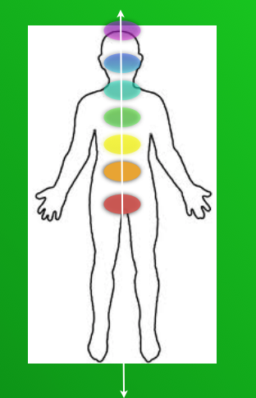
Increase your capacity
to receive revelation
for uniting our body and our spirit
common sense keys to health . .
almost lost in today’s world…
Connecting to the universe and earth
where all we need comes.

