Slide 1
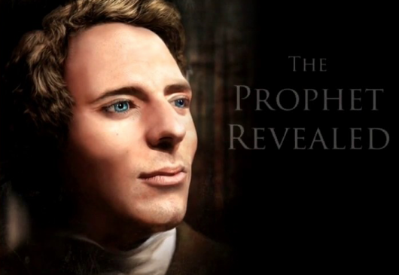
Alta Vista Education Centers
Notes:
Transition Town is an international movement to empower local communities to produce local needs and create sustainable communities. It started in the UK after World Two when the infrastructure was damaged, and local communities needed to feed themselves.
This website is one model for such Transition . An approach that came by inspiration and revelation - intended for endowed mothers of the Church of Jesus Christ of Latter-day Saints. This is a separate work from the Church we believe was foreseen by the Prophet Joseph for our day..
This grass roots movement begins in the home.
This is a call from the Political Kingdom of God ...to all LDS endowed Sisters to work together on the start up of what the Lord has revealed is to be called Habitat for Health.
This start up international non profit will support town wide fundraising to build Simple Living Centers in neighborhoods around the world. These facilities are to evolve from the home, to neighborhood facilities, to permanent structures for for health education, and are both an educational, and local political movement.. This work shows how you can increase
your capacity to receive revelation, develop a low cost or no cost education system, and help those in need. ..becoming as leaders (queens and kings) for your neighborhood, or town.
For many members of communities, this will be a way to develop local food safety, food security, and simple approaches to health. For others this is deeper, This work is needed as we prepare for another way of life needed to survive the trials of these last times.
This work was foreseen by the Prophet Joseph Smith..........to create Zion communities, a work I believe many in Church history foresaw to be separate from but parallel to the Church
Sisters, I solemnly share my witness that Joseph and Emma, and many other have come in our day to witness of this work. I am your brother and the Lord's servant in this cause.

Slide 2
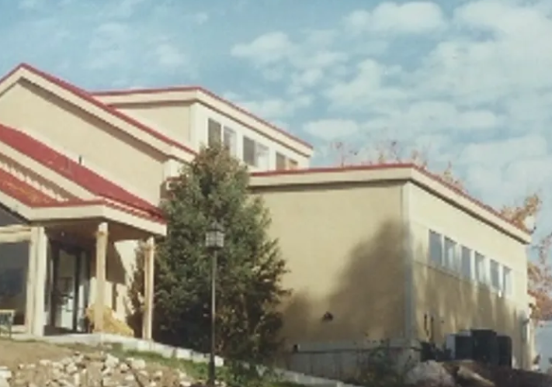
Founder

Slide 3
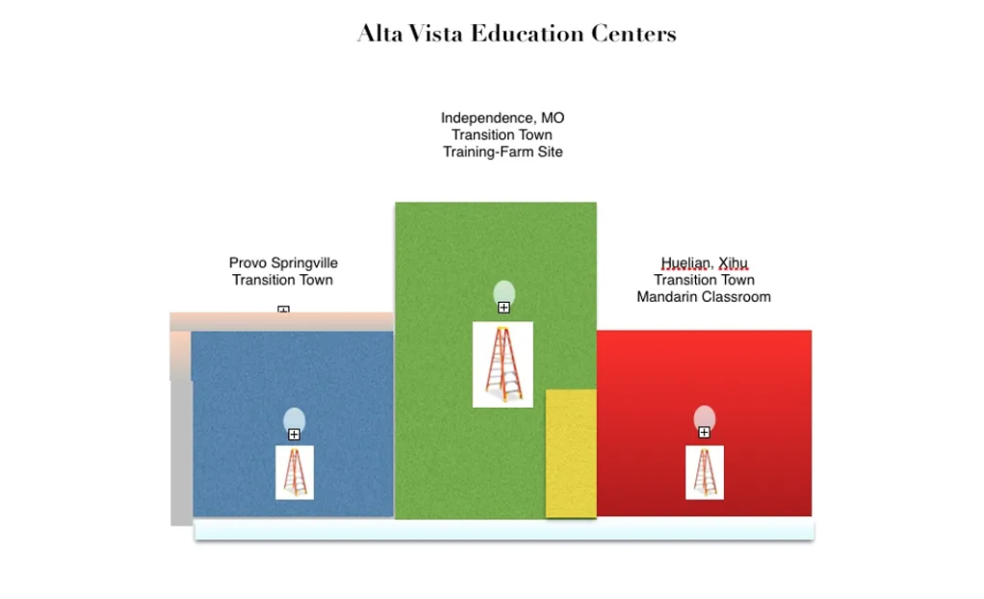
Alta Vista Education Centers

