Slide 1
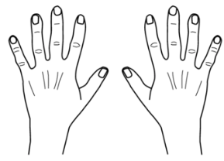
Simple
Living Centers
The visual aid for doing this is your hands. This is not intended to be taught with these slides - but through our everyday language with ourselves, with God, and with our children. Discover how the heavens speak this simple language.

Slide 2
Simple
Living Centers
Key words for a higher way of life
With these hands - instructive
dreams come often
come to help us
carry out this work.
There is a way to communicate
with those of other cultures.
A simple sign language.
The hand is a simple reminder
of the plan of life.- a more
exalted way of life
Health
Centers
Education
Living
for
Health
Work
Habitat
Simple
Family
Your
Find
Trust
Inside-outside
Joy
Peace
Charity

Slide 3
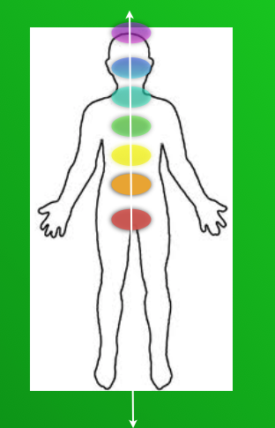
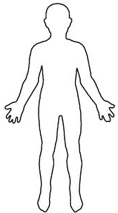
Simple
Living Centers
are for uniting our body and our spirit
common sense keys to health . .
almost lost in today’s world…
Connecting to the universe and earth
where all we need comes.

Slide 4
Simple
Living Centers
We are here to have Joy….

Slide 5
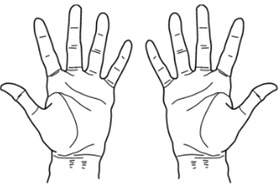
Simple
Living Centers
Parenting
starts with Love

Slide 6
Simple
Living Centers
When we ask… parents can receive pure love
or charity for their children - divinely directed love.
Notes:
Welcome ,,,some will consider us a sister organization to Habitat for Humanity.
They build homes, we bring health to homes and communities. but we really do so much more.
Let me tell you our story...

Slide 7
Simple
Living Centers
When that power comes to their hearts
peace is felt
Notes:
Welcome ,,,some will consider us a sister organization to Habitat for Humanity.
They build homes, we bring health to homes and communities. but we really do so much more.
Let me tell you our story...

Slide 8
Simple
Living Centers
Joy is felt
within children and parents

Slide 9
Simple
Living Centers
From peace and joy-
come inner feelings of
TRUST
Notes:
Welcome ,,,some will consider us a sister organization to Habitat for Humanity.
They build homes, we bring health to homes and communities. but we really do so much more.
Let me tell you our story...

Slide 10
Simple
Living Centers
Trust or bonds
that seal or bind us together
in a higher pure
lasting
love

Slide 11
Simple
Living Centers
Sometimes it helps to see the
the opposite
Notes:
Welcome ,,,some will consider us a sister organization to Habitat for Humanity.
They build homes, we bring health to homes and communities. but we really do so much more.
Let me tell you our story...

Slide 12
Simple
Living Centers
Teaching with force, pressuring with time, manipulation
and control
Notes:
Welcome ,,,some will consider us a sister organization to Habitat for Humanity.
They build homes, we bring health to homes and communities. but we really do so much more.
Let me tell you our story...

Slide 13
Simple
Living Centers
Or helping our children learn
to make choices - within themselves
to learn when guided by the love we receive
from their first parents - God.
Notes:
Welcome ,,,some will consider us a sister organization to Habitat for Humanity.
They build homes, we bring health to homes and communities. but we really do so much more.
Let me tell you our story...

Slide 14
Simple
Living Centers
Receiving pure love leads
to peace within for teachers
and learners
Force leads to stress or anxiety -
perhaps anger
within teachers and learners

Slide 15
Simple
Living Centers
Force leads to stress or anxiety
within teachers and
often students pick that feeling up
Notes:
Welcome ,,,some will consider us a sister organization to Habitat for Humanity.
They build homes, we bring health to homes and communities. but we really do so much more.
Let me tell you our story...

Slide 16
Simple
Living Centers
Or we can follow the path of helping
our children learn
to make choices - within themselves
Notes:
Welcome ,,,some will consider us a sister organization to Habitat for Humanity.
They build homes, we bring health to homes and communities. but we really do so much more.
Let me tell you our story...

Slide 17
Simple
Living Centers
The great secret is now made simple
Notes:
Welcome ,,,some will consider us a sister organization to Habitat for Humanity.
They build homes, we bring health to homes and communities. but we really do so much more.
Let me tell you our story...

Slide 18
Simple
Living Centers
Teaching with the hand
Notes:
Welcome ,,,some will consider us a sister organization to Habitat for Humanity.
They build homes, we bring health to homes and communities. but we really do so much more.
Let me tell you our story...

Slide 19
Simple
Living Centers
Simple
Notes:
Welcome ,,,some will consider us a sister organization to Habitat for Humanity.
They build homes, we bring health to homes and communities. but we really do so much more.
Let me tell you our story...

Slide 20
Simple
Living Centers
Living
Simple
Notes:
Welcome ,,,some will consider us a sister organization to Habitat for Humanity.
They build homes, we bring health to homes and communities. but we really do so much more.
Let me tell you our story...

Slide 21
Simple
Living Centers
Centers
Living
Simple
Notes:
Welcome ,,,some will consider us a sister organization to Habitat for Humanity.
They build homes, we bring health to homes and communities. but we really do so much more.
Let me tell you our story...

Slide 22
Simple
Living Centers
2
3
4
5
7
Centers
1
Living
6
Simple
Notes:
Welcome ,,,some will consider us a sister organization to Habitat for Humanity.
They build homes, we bring health to homes and communities. but we really do so much more.
Let me tell you our story...

Slide 23
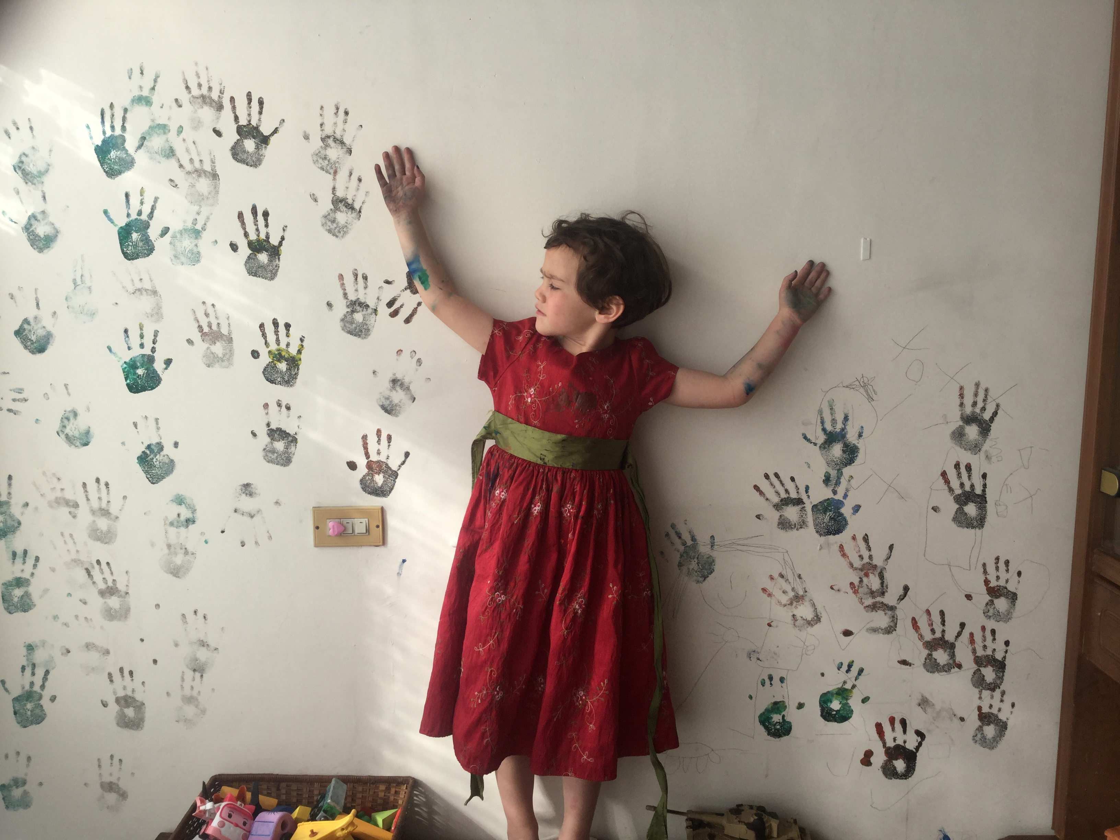
Simple
Living Centers
So many choices on each side of us.
Notes:
Welcome ,,,some will consider us a sister organization to Habitat for Humanity.
They build homes, we bring health to homes and communities. but we really do so much more.
Let me tell you our story...

Slide 24
Simple
Living Centers
So many choices on each side of us.
Notes:
Welcome ,,,some will consider us a sister organization to Habitat for Humanity.
They build homes, we bring health to homes and communities. but we really do so much more.
Let me tell you our story...

Slide 25
Simple
Living Centers
Education means to bring forth from within.
Notes:
Welcome ,,,some will consider us a sister organization to Habitat for Humanity.
They build homes, we bring health to homes and communities. but we really do so much more.
Let me tell you our story...

Slide 26
Simple Living
Centers
Our souls can know. We are each given a path to discovering
seven simple living centers inside of us.
Beginning
Notes:
Welcome ,,,some will consider us a sister organization to Habitat for Humanity.
They build homes, we bring health to homes and communities. but we really do so much more.
Let me tell you our story...

Slide 27
Simple Living
Centers
They are like climbing a ladder of trust,
a path to becoming all we can become.
Beginning
Notes:
Welcome ,,,some will consider us a sister organization to Habitat for Humanity.
They build homes, we bring health to homes and communities. but we really do so much more.
Let me tell you our story...

Slide 28
Simple Living
Centers
We can learn how to listen and discover a higher way of life.
Beginning
Notes:
Welcome ,,,some will consider us a sister organization to Habitat for Humanity.
They build homes, we bring health to homes and communities. but we really do so much more.
Let me tell you our story...

Slide 29
Simple Living
Centers
We progress as we learn by asking honest questions?
Beginning
Notes:
Welcome ,,,some will consider us a sister organization to Habitat for Humanity.
They build homes, we bring health to homes and communities. but we really do so much more.
Let me tell you our story...

Slide 30
Simple Living
Centers
What is an honest question?
Beginning
Notes:
Welcome ,,,some will consider us a sister organization to Habitat for Humanity.
They build homes, we bring health to homes and communities. but we really do so much more.
Let me tell you our story...

Slide 31
Simple Living
Centers
It is learning to talk with God about how we really feel.-
our true desires…
good or bad as they may be.
Beginning
Notes:
Welcome ,,,some will consider us a sister organization to Habitat for Humanity.
They build homes, we bring health to homes and communities. but we really do so much more.
Let me tell you our story...

Slide 32
Simple Living
Centers
He will answer us… in a language the respects our agency.
Beginning
Notes:
Welcome ,,,some will consider us a sister organization to Habitat for Humanity.
They build homes, we bring health to homes and communities. but we really do so much more.
Let me tell you our story...

Slide 33
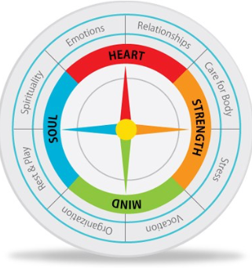
Simple Living
Centers
We may have feelings in one or more of our Simple Living Centers
We may have dreams about our hands..
We may
find each center of life can be like a compass - guiding us,
Notes:
Welcome ,,,some will consider us a sister organization to Habitat for Humanity.
They build homes, we bring health to homes and communities. but we really do so much more.
Let me tell you our story...

Slide 34
Simple Living
Centers
or a way or connection to the heavens and earth.
Notes:
Welcome ,,,some will consider us a sister organization to Habitat for Humanity.
They build homes, we bring health to homes and communities. but we really do so much more.
Let me tell you our story...

Slide 35
Seven Living Centers
Our centers of life are in one of three conditions
each moment of each day.
Notes:
Welcome ,,,some will consider us a sister organization to Habitat for Humanity.
They build homes, we bring health to homes and communities. but we really do so much more.
Let me tell you our story...

Slide 36
Simple Living Centers
7 Living Centers
leading to life or
the living waters
stress, fear
or anger
feelings shut down
or turned off
balanced- centered
in
peace or faith
Understanding these centers of our spiritual anatomy or our living constitution can entirely shift how we view our health, change our language, our connections with others, and our life journey. We can make simple choices that keep us centered in faith, learning and the connection with we need.
Beginning
Notes:
Welcome ,,,some will consider us a sister organization to Habitat for Humanity.
They build homes, we bring health to homes and communities. but we really do so much more.
Let me tell you our story...

Slide 37
Seven Living Centers
Sometimes we feel all over the place
- sick - afraid - or maybe nothing at all.
Outline
Next
Previous
Explore
Back
Beginning
Notes:
Welcome ,,,some will consider us a sister organization to Habitat for Humanity.
They build homes, we bring health to homes and communities. but we really do so much more.
Let me tell you our story...

Slide 38
Seven Living Centers
We can learn how to make choices
and receive from the heavens or earth ways to keep centered in LIFE.
Outline
Next
Previous
Explore
Back
Beginning
Notes:
Welcome ,,,some will consider us a sister organization to Habitat for Humanity.
They build homes, we bring health to homes and communities. but we really do so much more.
Let me tell you our story...

Slide 39
Seven Living Centers
We may be centered in peace. …
-awakened to some form of learning, health, joy, love, or life.
Outline
Next
Previous
Explore
Back
Beginning
Notes:
Welcome ,,,some will consider us a sister organization to Habitat for Humanity.
They build homes, we bring health to homes and communities. but we really do so much more.
Let me tell you our story...

Slide 40
Seven Living Centers
Or we may choose to be in anger, blame or some form of fear.
Outline
Next
Previous
Explore
Back
Beginning
Notes:
Welcome ,,,some will consider us a sister organization to Habitat for Humanity.
They build homes, we bring health to homes and communities. but we really do so much more.
Let me tell you our story...

Slide 41
Seven Living Centers
Or we may decide to not care, turn our feelings off, and feel numb or nothing.
Outline
Next
Previous
Explore
Back
Beginning
Notes:
Welcome ,,,some will consider us a sister organization to Habitat for Humanity.
They build homes, we bring health to homes and communities. but we really do so much more.
Let me tell you our story...

Slide 42
Seven Living Centers
To be awakened
Each center has a test or lesson to learn.
Outline
Next
Previous
Explore
Back
Beginning
Notes:
Welcome ,,,some will consider us a sister organization to Habitat for Humanity.
They build homes, we bring health to homes and communities. but we really do so much more.
Let me tell you our story...

Slide 43
Seven Living Centers
Life is a journey to learn to trust our simple living centers
Outline
Next
Previous
Explore
Back
Beginning
Notes:
Welcome ,,,some will consider us a sister organization to Habitat for Humanity.
They build homes, we bring health to homes and communities. but we really do so much more.
Let me tell you our story...

Slide 44
Seven Living Centers
With our choices
We can learn to turn all of our lights on inside us
Notes:
Welcome ,,,some will consider us a sister organization to Habitat for Humanity.
They build homes, we bring health to homes and communities. but we really do so much more.
Let me tell you our story...

Slide 45
Seven Living Centers
They are like a rainbow
Notes:
Welcome ,,,some will consider us a sister organization to Habitat for Humanity.
They build homes, we bring health to homes and communities. but we really do so much more.
Let me tell you our story...

Slide 46
Seven Living Centers
One of our first lessons to learn or questions to ask ourselves is …
Outline
Next
Previous
Explore
Back
Beginning
Notes:
Welcome ,,,some will consider us a sister organization to Habitat for Humanity.
They build homes, we bring health to homes and communities. but we really do so much more.
Let me tell you our story...

Slide 47
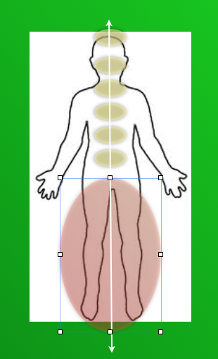
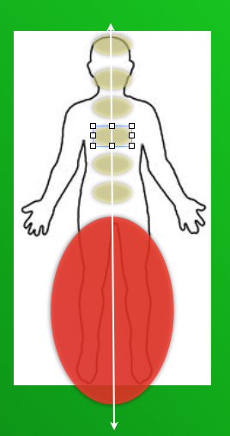
Is my strength from the earth
from choosing healthy foods and turning the lights on
or following the crowd in fear of being different?
Outline
Next
Previous
Explore
Back
Beginning
Notes:
Welcome ,,,some will consider us a sister organization to Habitat for Humanity.
They build homes, we bring health to homes and communities. but we really do so much more.
Let me tell you our story...

Slide 48
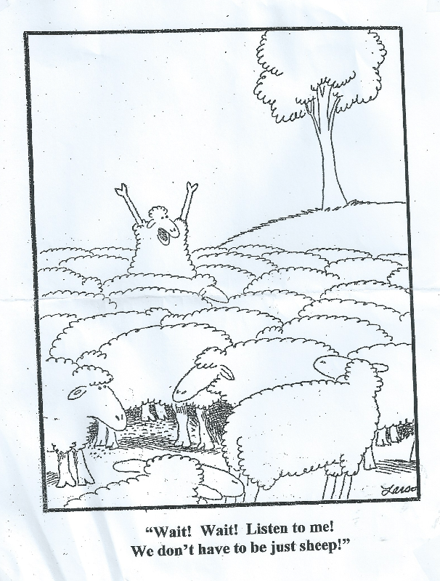
Is my strength from the earth
from choosing healthy foods and turning the lights on
or following the crowd in fear of being different?
Outline
Next
Previous
Explore
Back
Beginning
Notes:
Welcome ,,,some will consider us a sister organization to Habitat for Humanity.
They build homes, we bring health to homes and communities. but we really do so much more.
Let me tell you our story...

Slide 49
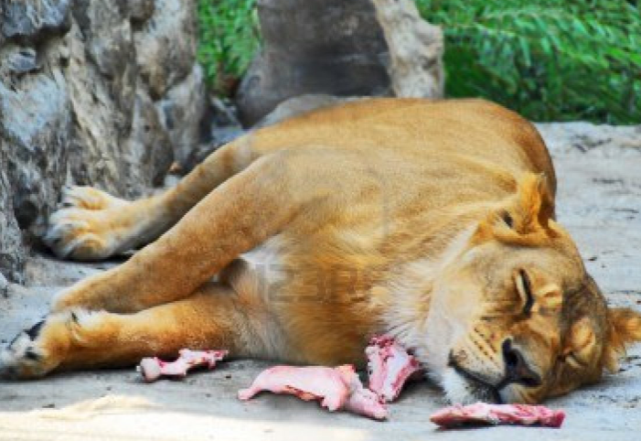
Seven Living Centers
Do I simply not care and turning off my feeling of what I know?
Do our foods make us sleepy?
Outline
Next
Previous
Explore
Back
Beginning
Notes:
Welcome ,,,some will consider us a sister organization to Habitat for Humanity.
They build homes, we bring health to homes and communities. but we really do so much more.
Let me tell you our story...

Slide 50
Seven Living Centers
Am I tired of fighting the crowd?
Outline
Next
Previous
Explore
Back
Beginning
Notes:
Welcome ,,,some will consider us a sister organization to Habitat for Humanity.
They build homes, we bring health to homes and communities. but we really do so much more.
Let me tell you our story...

Slide 51
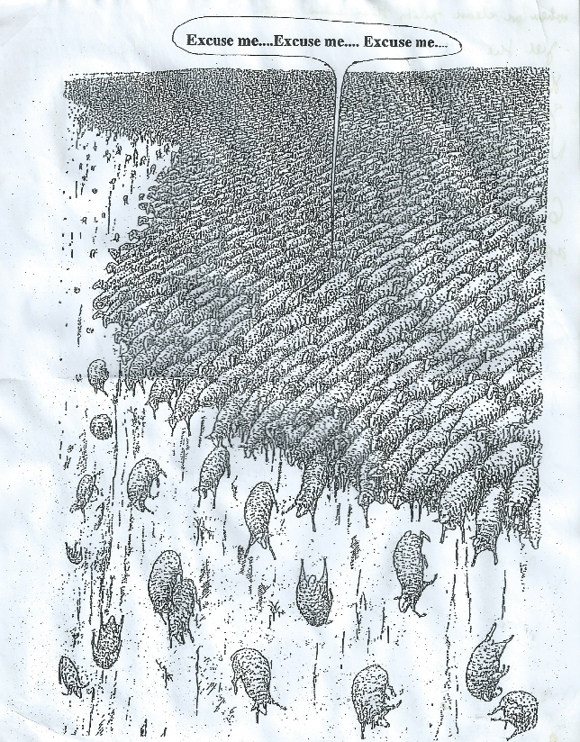
Simple Living Centers
or Stressed.
Outline
Next
Previous
Explore
Back
Beginning
Notes:
Welcome ,,,some will consider us a sister organization to Habitat for Humanity.
They build homes, we bring health to homes and communities. but we really do so much more.
Let me tell you our story...

Slide 52
Seven Living Centers
Is there another way?
Outline
Next
Previous
Explore
Back
Beginning
Notes:
Welcome ,,,some will consider us a sister organization to Habitat for Humanity.
They build homes, we bring health to homes and communities. but we really do so much more.
Let me tell you our story...

Slide 53
Seven Living Centers
We are in one of three states
I DONT CARE
Outline
Next
Previous
Explore
Back
Beginning
Notes:
Welcome ,,,some will consider us a sister organization to Habitat for Humanity.
They build homes, we bring health to homes and communities. but we really do so much more.
Let me tell you our story...

Slide 54
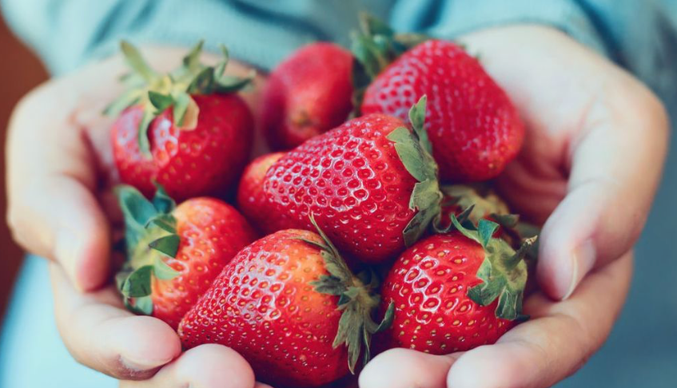
In peace or awakened to listen within to what we need.
Outline
Next
Previous
Explore
Back
Beginning
Notes:
Welcome ,,,some will consider us a sister organization to Habitat for Humanity.
They build homes, we bring health to homes and communities. but we really do so much more.
Let me tell you our story...

Slide 55
Or in some form of stress or fear.
Outline
Next
Previous
Explore
Back
Beginning
Notes:
Welcome ,,,some will consider us a sister organization to Habitat for Humanity.
They build homes, we bring health to homes and communities. but we really do so much more.
Let me tell you our story...

Slide 56
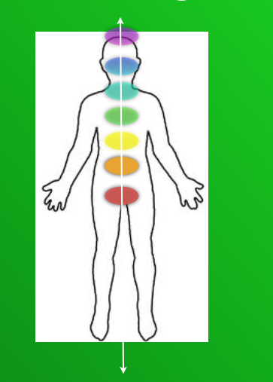
Simple Living Centers
When do our foods bring us strength - awaken us to life
and love and learning?
Outline
Next
Previous
Explore
Back
Beginning
Notes:
Welcome ,,,some will consider us a sister organization to Habitat for Humanity.
They build homes, we bring health to homes and communities. but we really do so much more.
Let me tell you our story...

Slide 57
Seven Living Centers
Do our foods bring a feel of stress, congestion, a running nose, or sickness?
Outline
Next
Previous
Explore
Back
Beginning
Notes:
Welcome ,,,some will consider us a sister organization to Habitat for Humanity.
They build homes, we bring health to homes and communities. but we really do so much more.
Let me tell you our story...

Slide 58
Seven Living Centers
We make choices everyday that matter …that add to our personal wisdom
or bring illness and pain.
Outline
Next
Previous
Explore
Back
Beginning
Notes:
Welcome ,,,some will consider us a sister organization to Habitat for Humanity.
They build homes, we bring health to homes and communities. but we really do so much more.
Let me tell you our story...

Slide 59
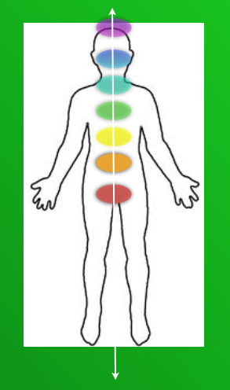
Seven Living Centers
We make choices everyday that matter.—-in higher ways.
Outline
Next
Previous
Explore
Back
Beginning
Notes:
Welcome ,,,some will consider us a sister organization to Habitat for Humanity.
They build homes, we bring health to homes and communities. but we really do so much more.
Let me tell you our story...

Slide 60
Seven Living Centers
Choices that can turn all our lights on.
Outline
Next
Previous
Explore
Back
Beginning
Notes:
Welcome ,,,some will consider us a sister organization to Habitat for Humanity.
They build homes, we bring health to homes and communities. but we really do so much more.
Let me tell you our story...

Slide 61
Seven Living Centers
We make choices that turn the lights off
Outline
Next
Previous
Explore
Back
Beginning
Notes:
Welcome ,,,some will consider us a sister organization to Habitat for Humanity.
They build homes, we bring health to homes and communities. but we really do so much more.
Let me tell you our story...

Slide 62
Seven Living Centers
When we pass or first test or learn our first lesson,
Beginning
Notes:
Welcome ,,,some will consider us a sister organization to Habitat for Humanity.
They build homes, we bring health to homes and communities. but we really do so much more.
Let me tell you our story...

Slide 63
Seven Living Centers
Making healthy choices… begins with our connection to the earth.
What are we connected to.
Beginning
Notes:
Welcome ,,,some will consider us a sister organization to Habitat for Humanity.
They build homes, we bring health to homes and communities. but we really do so much more.
Let me tell you our story...

Slide 64
Seven Living Centers
How do we honor others
when we seek God’s will or inner peace with healthy choices?
Beginning
Notes:
Welcome ,,,some will consider us a sister organization to Habitat for Humanity.
They build homes, we bring health to homes and communities. but we really do so much more.
Let me tell you our story...

Slide 65
Seven Living Centers
Do we turn our feelings off. We don’t care about others?
Beginning
Notes:
Welcome ,,,some will consider us a sister organization to Habitat for Humanity.
They build homes, we bring health to homes and communities. but we really do so much more.
Let me tell you our story...

Slide 66
Seven Living Centers
Do we feel we are better than others? Feel we need to control them?
Beginning
Notes:
Welcome ,,,some will consider us a sister organization to Habitat for Humanity.
They build homes, we bring health to homes and communities. but we really do so much more.
Let me tell you our story...

Slide 67
Seven Living Centers
Our do we have the inner peace to just quietly lead, by example and faith in God’s timing or the timing of the universe?
Our tests or lessons may be very personal to us
If we listen within.
Beginning
Notes:
Welcome ,,,some will consider us a sister organization to Habitat for Humanity.
They build homes, we bring health to homes and communities. but we really do so much more.
Let me tell you our story...

Slide 68
Seven Living Centers
Our our healthy choices become a way to be better than others?
Can pride get in the way and get us off the center.
Beginning
Notes:
Welcome ,,,some will consider us a sister organization to Habitat for Humanity.
They build homes, we bring health to homes and communities. but we really do so much more.
Let me tell you our story...

Slide 69
Seven Living Centers
Or can we simply keep our focus on making healthy choices to better love and serve God or the higher good?
Beginning
Notes:
Welcome ,,,some will consider us a sister organization to Habitat for Humanity.
They build homes, we bring health to homes and communities. but we really do so much more.
Let me tell you our story...

Slide 70
Seven Living Centers
Honor self
Outline
Next
Previous
Explore
Back
Beginning
Notes:
Welcome ,,,some will consider us a sister organization to Habitat for Humanity.
They build homes, we bring health to homes and communities. but we really do so much more.
Let me tell you our story...

Slide 71
Seven Living Centers
Love Self- listen to self
Outline
Next
Previous
Explore
Back
Beginning
Notes:
Welcome ,,,some will consider us a sister organization to Habitat for Humanity.
They build homes, we bring health to homes and communities. but we really do so much more.
Let me tell you our story...

Slide 72
Seven Living Centers
As we listen to our self, more inspiration or light comes
Outline
Next
Previous
Explore
Back
Beginning
Notes:
Welcome ,,,some will consider us a sister organization to Habitat for Humanity.
They build homes, we bring health to homes and communities. but we really do so much more.
Let me tell you our story...

Slide 73
Seven Living Centers
A piece at a time.
Outline
Next
Previous
Explore
Back
Beginning
Notes:
Welcome ,,,some will consider us a sister organization to Habitat for Humanity.
They build homes, we bring health to homes and communities. but we really do so much more.
Let me tell you our story...

Slide 74
Seven Living Centers
For healthy living, do we listen to this area of our body.
Outline
Next
Previous
Explore
Back
Beginning
Notes:
Welcome ,,,some will consider us a sister organization to Habitat for Humanity.
They build homes, we bring health to homes and communities. but we really do so much more.
Let me tell you our story...

Slide 75
Seven Living Centers
Our do we make choices that we do not care.
Outline
Next
Previous
Explore
Back
Beginning
Notes:
Welcome ,,,some will consider us a sister organization to Habitat for Humanity.
They build homes, we bring health to homes and communities. but we really do so much more.
Let me tell you our story...

Slide 76
Seven Living Centers
Or make choices from fear to run too fast or work too hard to get what we need.
Outline
Next
Previous
Explore
Back
Beginning
Notes:
Welcome ,,,some will consider us a sister organization to Habitat for Humanity.
They build homes, we bring health to homes and communities. but we really do so much more.
Let me tell you our story...

Slide 77
Seven Living Centers
Listening to each center of life will help awaken the next center of life.
Outline
Next
Previous
Explore
Back
Beginning
Notes:
Welcome ,,,some will consider us a sister organization to Habitat for Humanity.
They build homes, we bring health to homes and communities. but we really do so much more.
Let me tell you our story...

Slide 78
Seven Living Centers
Listening to each center of life will help awaken the next.
Outline
Next
Previous
Explore
Back
Beginning
Notes:
Welcome ,,,some will consider us a sister organization to Habitat for Humanity.
They build homes, we bring health to homes and communities. but we really do so much more.
Let me tell you our story...

Slide 79
Seven Living Centers
In this center of life, we receive divine directed love.
Outline
Next
Previous
Explore
Back
Beginning
Notes:
Welcome ,,,some will consider us a sister organization to Habitat for Humanity.
They build homes, we bring health to homes and communities. but we really do so much more.
Let me tell you our story...

Slide 80
Seven Living Centers
Not man’s lustful nature - some call love
Outline
Next
Previous
Explore
Back
Beginning
Notes:
Welcome ,,,some will consider us a sister organization to Habitat for Humanity.
They build homes, we bring health to homes and communities. but we really do so much more.
Let me tell you our story...

Slide 81
Seven Living Centers
Or choices to control others, stressful ways, or anxious efforts that get us off the path.
Outline
Next
Previous
Explore
Back
Beginning
Notes:
Welcome ,,,some will consider us a sister organization to Habitat for Humanity.
They build homes, we bring health to homes and communities. but we really do so much more.
Let me tell you our story...

Slide 82
Seven Living Centers
Receiving divinely directed love can change everything if we will listen to what comes.
Outline
Next
Previous
Explore
Back
Beginning
Notes:
Welcome ,,,some will consider us a sister organization to Habitat for Humanity.
They build homes, we bring health to homes and communities. but we really do so much more.
Let me tell you our story...

Slide 83
Seven Living Centers
The next level or lesson comes to seek a higher will or use our life for selfish ways.
Outline
Next
Previous
Explore
Back
Beginning
Notes:
Welcome ,,,some will consider us a sister organization to Habitat for Humanity.
They build homes, we bring health to homes and communities. but we really do so much more.
Let me tell you our story...

Slide 84
Seven Living Centers
Are we just concerned for our self? Turning off feelings of a higher way?
Outline
Next
Previous
Explore
Back
Beginning
Notes:
Welcome ,,,some will consider us a sister organization to Habitat for Humanity.
They build homes, we bring health to homes and communities. but we really do so much more.
Let me tell you our story...

Slide 85
Seven Living Centers
Or working and stressed by our own ambition and own timing?
Outline
Next
Previous
Explore
Back
Beginning
Notes:
Welcome ,,,some will consider us a sister organization to Habitat for Humanity.
They build homes, we bring health to homes and communities. but we really do so much more.
Let me tell you our story...

Slide 86
Seven Living Centers
Or working and stressed by our own ambition and own timing?
Outline
Next
Previous
Explore
Back
Beginning
Notes:
Welcome ,,,some will consider us a sister organization to Habitat for Humanity.
They build homes, we bring health to homes and communities. but we really do so much more.
Let me tell you our story...

Slide 87
Seven Living Centers
Learning to trust in divine timing as we are directed to a higher way can bring new light
and understanding.
Outline
Next
Previous
Explore
Back
Beginning
Notes:
Welcome ,,,some will consider us a sister organization to Habitat for Humanity.
They build homes, we bring health to homes and communities. but we really do so much more.
Let me tell you our story...

Slide 88
Seven Living Centers
New living foods to help us heal?
Outline
Next
Previous
Explore
Back
Beginning
Notes:
Welcome ,,,some will consider us a sister organization to Habitat for Humanity.
They build homes, we bring health to homes and communities. but we really do so much more.
Let me tell you our story...

Slide 89
Seven Living Centers
New living foods that bring us strength, life, and learning.
Outline
Next
Previous
Explore
Back
Beginning
Notes:
Welcome ,,,some will consider us a sister organization to Habitat for Humanity.
They build homes, we bring health to homes and communities. but we really do so much more.
Let me tell you our story...

Slide 90
Seven Living Centers
We will decide to follow and learn truth?
Outline
Next
Previous
Explore
Back
Beginning
Notes:
Welcome ,,,some will consider us a sister organization to Habitat for Humanity.
They build homes, we bring health to homes and communities. but we really do so much more.
Let me tell you our story...

Slide 91
Seven Living Centers
Or decide we do not care what is true?
Outline
Next
Previous
Explore
Back
Beginning
Notes:
Welcome ,,,some will consider us a sister organization to Habitat for Humanity.
They build homes, we bring health to homes and communities. but we really do so much more.
Let me tell you our story...

Slide 92
Seven Living Centers
Will we pursue learning to the point of stress and anxiety? Fearful of what other say or how they judge us?
Outline
Next
Previous
Explore
Back
Beginning
Notes:
Welcome ,,,some will consider us a sister organization to Habitat for Humanity.
They build homes, we bring health to homes and communities. but we really do so much more.
Let me tell you our story...

Slide 93
Seven Living Centers
Or will we decide to trust in revelation and inspiration that comes and where it takes us?
Outline
Next
Previous
Explore
Back
Beginning
Notes:
Welcome ,,,some will consider us a sister organization to Habitat for Humanity.
They build homes, we bring health to homes and communities. but we really do so much more.
Let me tell you our story...

Slide 94
Seven Living Centers
As we learn each lesson or pass our individual tests, we can awaken and be in the presence of divinity.
Outline
Next
Previous
Explore
Back
Beginning
Notes:
Welcome ,,,some will consider us a sister organization to Habitat for Humanity.
They build homes, we bring health to homes and communities. but we really do so much more.
Let me tell you our story...

Slide 95
Seven Living Centers
We can receive of God’s love, healthy simple ways, or purpose.
We can receive all we need each moment.
Live in the present.
Outline
Next
Previous
Explore
Back
Beginning
Notes:
Welcome ,,,some will consider us a sister organization to Habitat for Humanity.
They build homes, we bring health to homes and communities. but we really do so much more.
Let me tell you our story...

Slide 96
Seven Living Centers
And Presence of God - the presence of love.
We can learn that we receive or block love.
Outline
Next
Previous
Explore
Back
Beginning
Notes:
Welcome ,,,some will consider us a sister organization to Habitat for Humanity.
They build homes, we bring health to homes and communities. but we really do so much more.
Let me tell you our story...

Slide 97
Seven Living Centers
With all our heart.
When we open our hearts to all God or divinity of the universe has to send us -
we truly learn to love others in God’s way or a higher way.
Outline
Next
Previous
Explore
Back
Beginning
Notes:
Welcome ,,,some will consider us a sister organization to Habitat for Humanity.
They build homes, we bring health to homes and communities. but we really do so much more.
Let me tell you our story...

