Slide 1
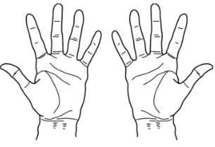

Simple
Living Centers
Notes:
When we ask… parents can receive pure love
or charity for their children - divinely directed love.

Slide 2
Simple
Living Centers
When that power comes to their hearts
peace comes

Slide 3
Simple
Living Centers
Joy is felt
within children and parents

Slide 4
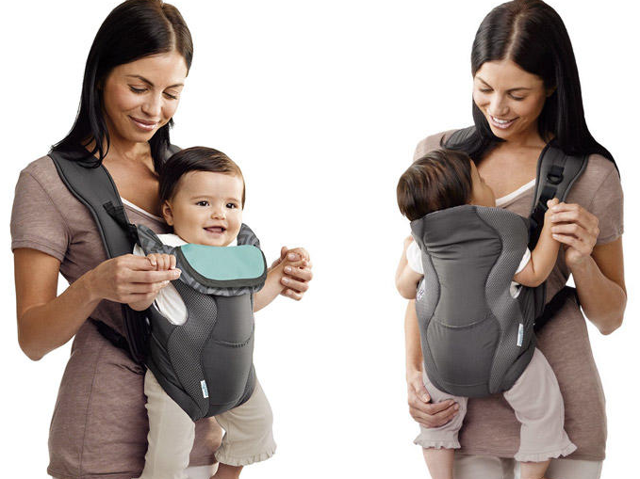
Simple
Living Centers
From peace and joy-
come inner feelings of
TRUST

Slide 5
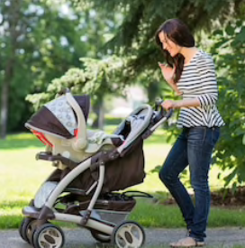
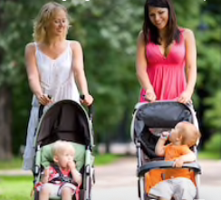
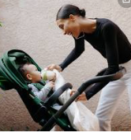
Simple
Living Centers
From peace and joy-
come inner feelings of
TRUST- Bonding to mother
in early years where patterns
of inner peace develop

Slide 6
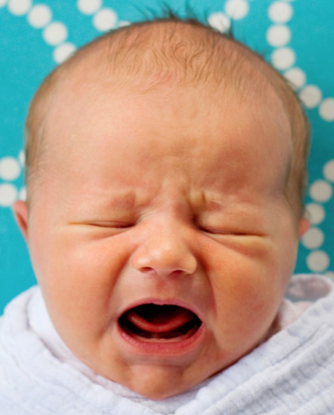
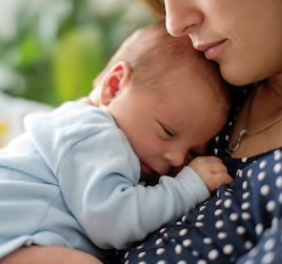
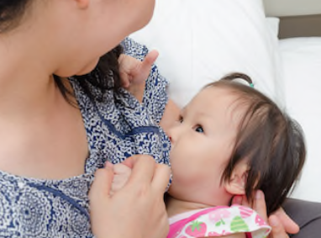
Simple
Living Centers
The bonding cycle

Slide 7
Simple
Living Centers
Trust or bonds
that seal or bind us together
in a higher pure
lasting
love

Slide 8
Simple
Living Centers
Sometimes it helps to see the
the opposite

Slide 9
Simple
Living Centers
Teaching with force, pressuring with time, manipulation
and control
Notes:
Welcome ,,,some will consider us a sister organization to Habitat for Humanity.
They build homes, we bring health to homes and communities. but we really do so much more.
Let me tell you our story...

Slide 10
Simple
Living Centers
Or helping our children learn
to make choices - within themselves
to learn when guided by the love we receive
from their first parents - God.

Slide 11
Simple
Living Centers
Receiving pure love leads
to peace within for teachers
and learners
Force leads to stress or anxiety -
perhaps anger
within teachers and learners

Slide 12
Simple
Living Centers
Force leads to stress or anxiety
within teachers and
often students pick that feeling up
Notes:
Welcome ,,,some will consider us a sister organization to Habitat for Humanity.
They build homes, we bring health to homes and communities. but we really do so much more.
Let me tell you our story...

Slide 13
Simple
Living Centers
Or we can follow the path of helping
our children learn
to make choices - within themselves and discern between peace and force. Building trust.

