Slide 1
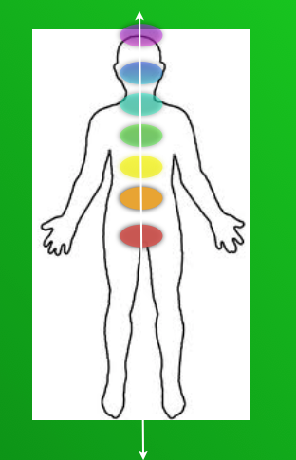
Simple
Living Centers
Notes:
The great secret is now made simple

Slide 2
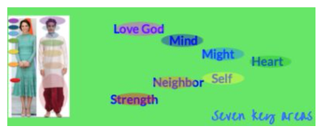

Simple
Living Centers
The Kingdom of God
within Connecting
to the heavenly Church of Jesus Christ
The Kingdom of God
The Political Kingdom
The Kingdom of God
The Church of Jesus Christ of
Latter-day Saints
Notes:
The great secret is now made simple

Slide 3
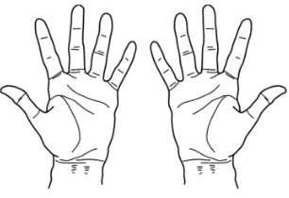
Simple
Living Centers
Simple

Slide 4
Simple
Living Centers
  Living
Simple
Notes:
Welcome ,,,some will consider us a sister organization to Habitat for Humanity.
They build homes, we bring health to homes and communities. but we really do so much more.
Let me tell you our story...

Slide 5
Simple
Living Centers
Centers
  Living
Simple
Notes:
Welcome ,,,some will consider us a sister organization to Habitat for Humanity.
They build homes, we bring health to homes and communities. but we really do so much more.
Let me tell you our story...

Slide 6
Simple
Living Centers
2
3
4
5
7
Centers
1
  Living
6
Simple
Notes:
Welcome ,,,some will consider us a sister organization to Habitat for Humanity.
They build homes, we bring health to homes and communities. but we really do so much more.
Let me tell you our story...

Slide 7
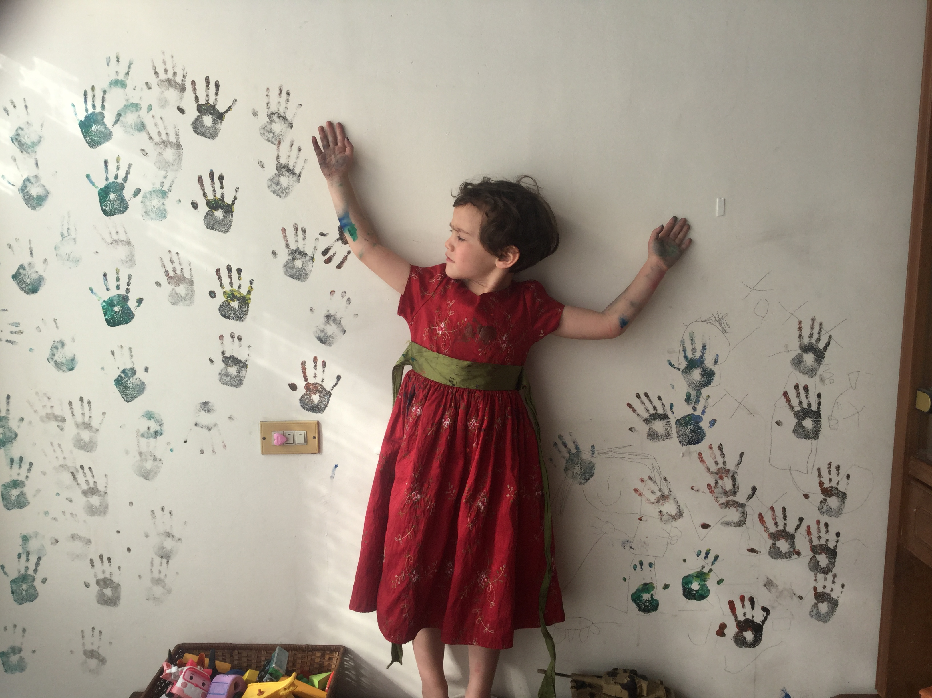
Simple
Living Centers
Link
So many choices on each side of us.
Notes:
link to Proclamation

Slide 8
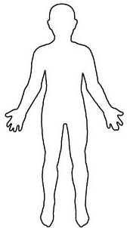
Simple Living
Centers
Our souls can know. We are each given a path to discovering
seven simple living centers inside of us.
Beginning

Slide 9
Simple Living
Centers
We can learn how to listen and discover a higher way of life.
Beginning

Slide 10
Simple Living
Centers
We progress as we learn by asking honest questions and having complete integrity.
Beginning

Slide 11
Simple Living
Centers
Honest questions regarding honest feelings we may have?
Beginning

Slide 12
Simple Living
Centers
It is learning to talk with God about how we really feel.-
our true desires…
good or bad as they may be.
Beginning

