Slide 1
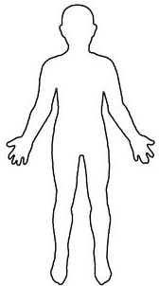

Simple Living
Centers
We can increase our capacity to receive revelation.
Beginning

Slide 2
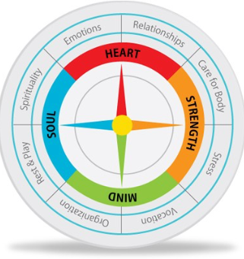
Simple Living
Centers
We may have feelings in one or more of our Simple Living Centers
We may have dreams about our hands..
We may
find each center of life can be like a compass - guiding us,

Slide 3

Simple Living
Centers
or a way or connection to the heavens and earth.

Slide 4
Seven Living Centers
Our centers of life are in one of three conditions
each moment of each day.

Slide 5
Simple Living Centers
7 Living Centers
leading to life or
the living waters
stress, fear
or anger
feelings shut down
or turned off
balanced- centered
in
peace or faith
Understanding these centers of our spiritual anatomy or our living constitution can entirely shift how we view our health, change our language, our connections with others, and our life journey. We can make simple choices
Beginning
Notes:
Welcome ,,,some will consider us a sister organization to Habitat for Humanity.
They build homes, we bring health to homes and communities. but we really do so much more.
Let me tell you our story...

Slide 6
Seven Living Centers
Sometimes we feel all over the place
- sick - afraid - or maybe nothing at all.
Notes:
Welcome ,,,some will consider us a sister organization to Habitat for Humanity.
They build homes, we bring health to homes and communities. but we really do so much more.
Let me tell you our story...

Slide 7
Seven Living Centers
We can learn how to make choices
and receive from the heavens or earth ways to keep centered in LIFE.
Notes:
Welcome ,,,some will consider us a sister organization to Habitat for Humanity.
They build homes, we bring health to homes and communities. but we really do so much more.
Let me tell you our story...

Slide 8
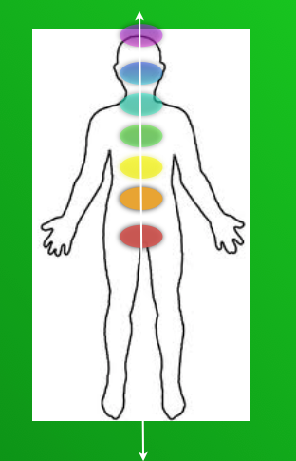
Seven Living Centers
We may be centered in peace. …
-awakened to some form of learning, health, joy, love, or life.
Outline
Notes:
Welcome ,,,some will consider us a sister organization to Habitat for Humanity.
They build homes, we bring health to homes and communities. but we really do so much more.
Let me tell you our story...

Slide 9
Seven Living Centers
Or we may choose to be in anger, blame or some form of fear.
Notes:
Welcome ,,,some will consider us a sister organization to Habitat for Humanity.
They build homes, we bring health to homes and communities. but we really do so much more.
Let me tell you our story...

Slide 10
Seven Living Centers
Or we may decide to not care, turn our feelings off, and feel numb or nothing.
Notes:
Welcome ,,,some will consider us a sister organization to Habitat for Humanity.
They build homes, we bring health to homes and communities. but we really do so much more.
Let me tell you our story...

Slide 11
Seven Living Centers
To be awakened
Each center has a test or lesson to learn.
Outline
Next
Previous
Explore
Back
Beginning
Notes:
Welcome ,,,some will consider us a sister organization to Habitat for Humanity.
They build homes, we bring health to homes and communities. but we really do so much more.
Let me tell you our story...

Slide 12
Seven Living Centers
Life is a journey to learn to trust our simple living centers
Outline
Next
Previous
Explore
Back
Beginning
Notes:
Welcome ,,,some will consider us a sister organization to Habitat for Humanity.
They build homes, we bring health to homes and communities. but we really do so much more.
Let me tell you our story...

