Slide 1

Simple
Living Centers
Habitat for Health
working with
Habitat for Humanity for a new generation of neighborhood homes.

Slide 2

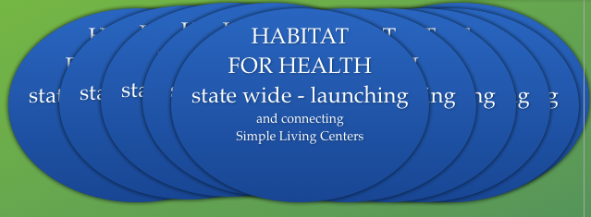
Councils of 50
or Neighborhood Councils
Councils of 50
or Neighborhood Councils
Councils of 50
or Neighborhood Councils
councils of 50
Councils of 50
or Neighborhood Councils
Councils of 50
or Neighborhood Councils
Habitat For Health
International
t

Slide 3
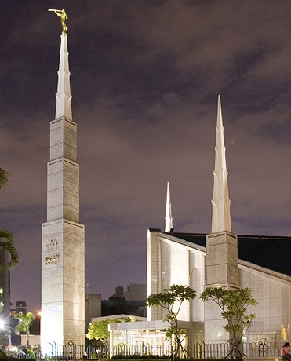
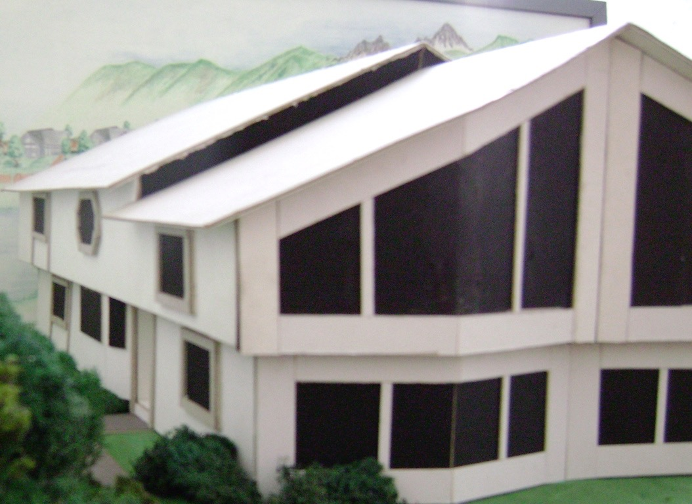
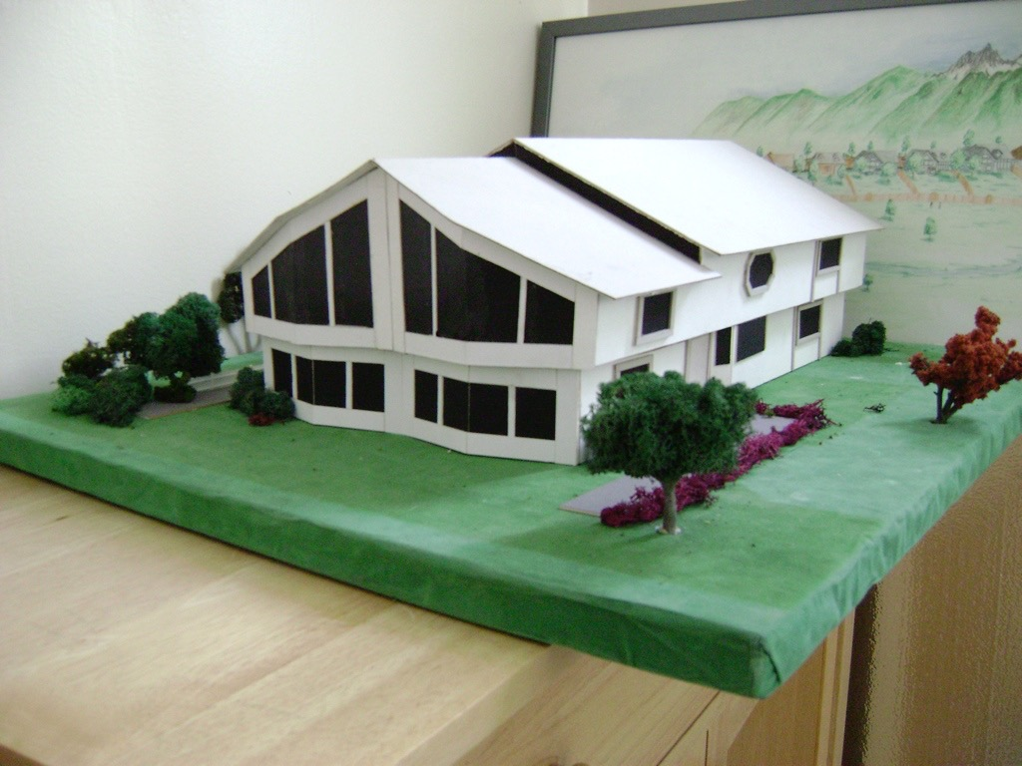
Simple Living Centers
Reflective Learning
Rooms
20x40
or 800sf
Tools for Searching how
health and
our personal and family histories
connect
20x40 or 800sf
Film
rooms
supporting
agency education and emotional health education
20x40
or 800sf
20x40
or 800sf
Activity Center
Working space for Creating, Producing
Storing and enjoying
Living and whole Foods and herbs
20x40 or 800sf
Offices and- or Caretaker Quarters
20x40 or 800sf

Slide 4
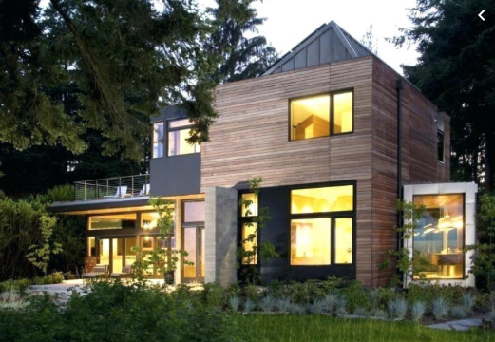
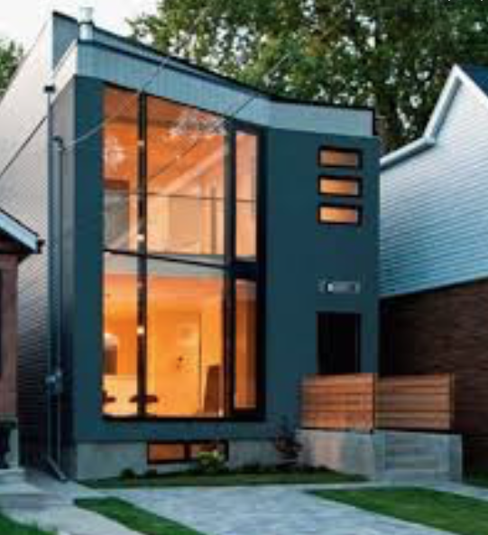
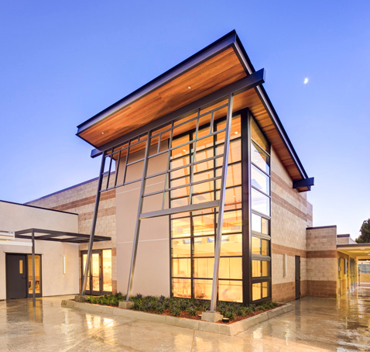
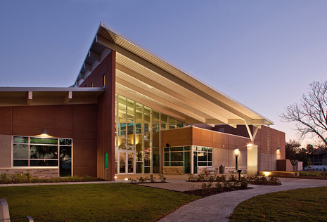
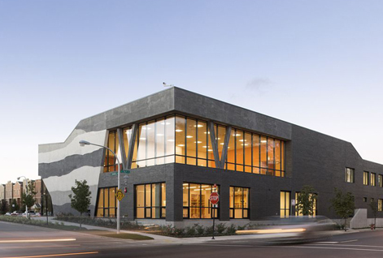
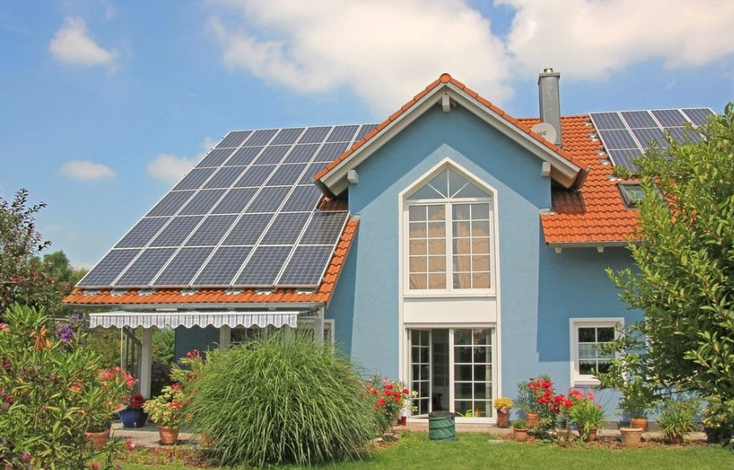
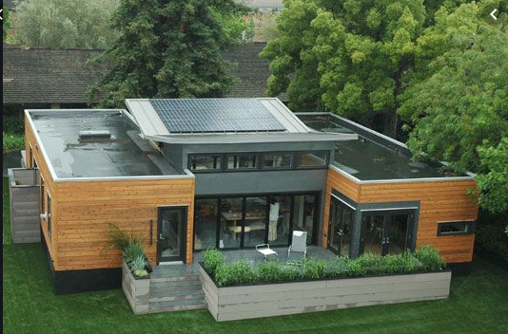
Notes:
Once the board is in place and elected by our local leaders, plans are to seek approval to call our international support organization “Habitat for Health. ” The mission of this organization is to raise funds to support primarily - local plant based food production and the construction of Simple Living Centers in interested neighborhoods, along with collecting and developing educational materials to support these centers and local projects.

Slide 5
Habitat for Humanity
“Counsels of 50” or neighborhood councils
working with town wide and international fundraising
to build neighborhood Simple Living Centers
and support local CSA’s
Community Supported Agriculture
Notes:
“Counsels of 50” and funding these efforts.
You are encouraged to pledge the monthly $3 token donation on line: Remember; 90% will be committed to your community “Counsel”, and 10% to the international organization (Habitat for Health) to support local food production town wide with the building of sustainable, potentially off the grid facilities called Simple Living Centers. There are three key aspects of funding for Simple Living Centers.
This was given to me while in the temple in the Summer of 2010.

Slide 6
Part 1 as revealed
$3/month donations:
Habitat for Healt has been given fiscal model for fundraising in communities beginning with $3/month donations or about the cost of one meal a month.
It was revealed the organization is to be patterned after Habitat for Humanity
meaning…
90% of these funds remain local
10% go to Habitat International
Outline
Next
Previous
Explore
Back
Beginning
Notes:
Welcome ,,,some will consider us a sister organization to Habitat for Humanity.
They build homes, we bring health to homes and communities. but we really do so much more.
Let me tell you our story...

Slide 7
Part II
Education in neighborhood councils….
$1 a day for 8 weeks
or
barter for needs in the community
Key area are organized
with the Hand Curriculum.
Notes:
I was given the economic model in the summer of 2010. I was told John was bringing this economic system forth, and I believe those who understand will receive ministering also.
This is a way to transition to a low cost or no cost educational movement. This website with a speciality focus can be taught by those who would like to hold a class. For example some specialities may be from a master herbalist, a film maker, perhaps a writer, or an organic farmer- or specialist with children and helping to foster an education that brings forth within, what gifts youth are given.

Slide 8
Part 3
A Locally Managed Micro Loan Program
Simple Living Centers each organize neighborhood councils once called “Councils of 50” Their Living Constitution guides them to decide on uses of monthly donations - along developing a neighborhood education program…with barter and micro loan system for those in need.
Outline
Next
Previous
Explore
Back
Beginning
Notes:
Welcome ,,,some will consider us a sister organization to Habitat for Humanity.
They build homes, we bring health to homes and communities. but we really do so much more.
Let me tell you our story...

