Slide 1
Alta Vista Education Centers

Slide 2
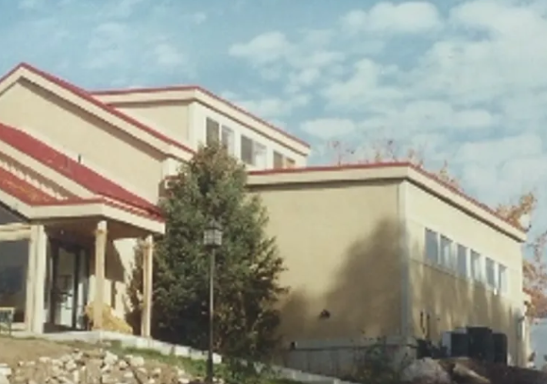
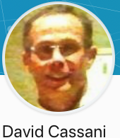
Founder

Slide 3
Alta Vista Education Centers
Outline
My Story
Hand Curriculum Overview
Peace Joy Trust
Simple Living Centers
Habitat for Health
Family Health Education
Find Your Work

Slide 4
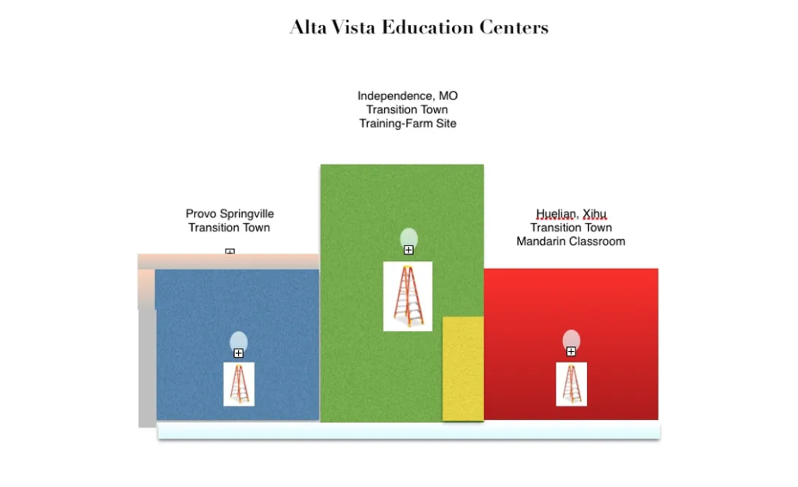
Alta Vista Education Centers
English

Slide 5
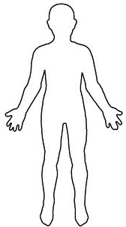
Simple Living Centers
leading to life or
the living waters
stress, fear
or anger
feelings shut down
or turned off
balanced- centered
in
peace or faith
Notes:
Understanding these centers of our spiritual anatomy or our living constitution can entirely shift how we view our health, change our language, our connections with others, and our life journey. We can make simple choices that keep us centered in faith, learning and the connection with we need.

