Slide 1
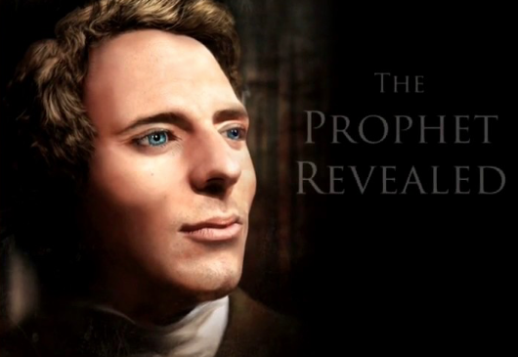

Alta Vista Education Centers
YouTube
YouTube
Learn why Joseph Smith came in our day
Notes:
How to learn over two months
Our main audience is endowed mothers. Our intentions are to help families in their home
support a simple language of life, and foundation for learning.
Our family was given funds and in 1989 I received a vision of two garages connected
I left my job at the college to teaching in public schools, later leaving public school teaching to bring move out of stressful approaches to education for the home.
Graduate work at BYU in Educational Leadership - Church schools LDS curriculum =
Answer to prayer about curriculum -

Slide 2
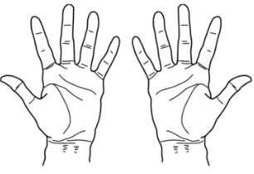
Simple
Living Centers
Find your work

Slide 3
Simple
Living Centers
Work
  Your
  Find
Notes:
Welcome ,,,some will consider us a sister organization to Habitat for Humanity.
They build homes, we bring health to homes and communities. but we really do so much more.
Let me tell you our story...

Slide 4
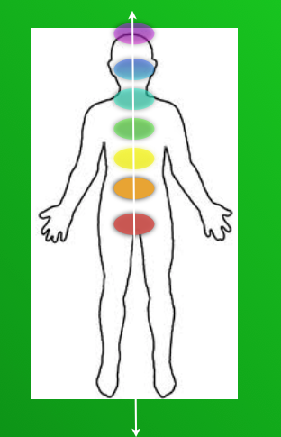
Simple
Living Centers
2
3
4
5
7
Centers
1
  Living
6
Simple
Notes:
Welcome ,,,some will consider us a sister organization to Habitat for Humanity.
They build homes, we bring health to homes and communities. but we really do so much more.
Let me tell you our story...

Slide 5
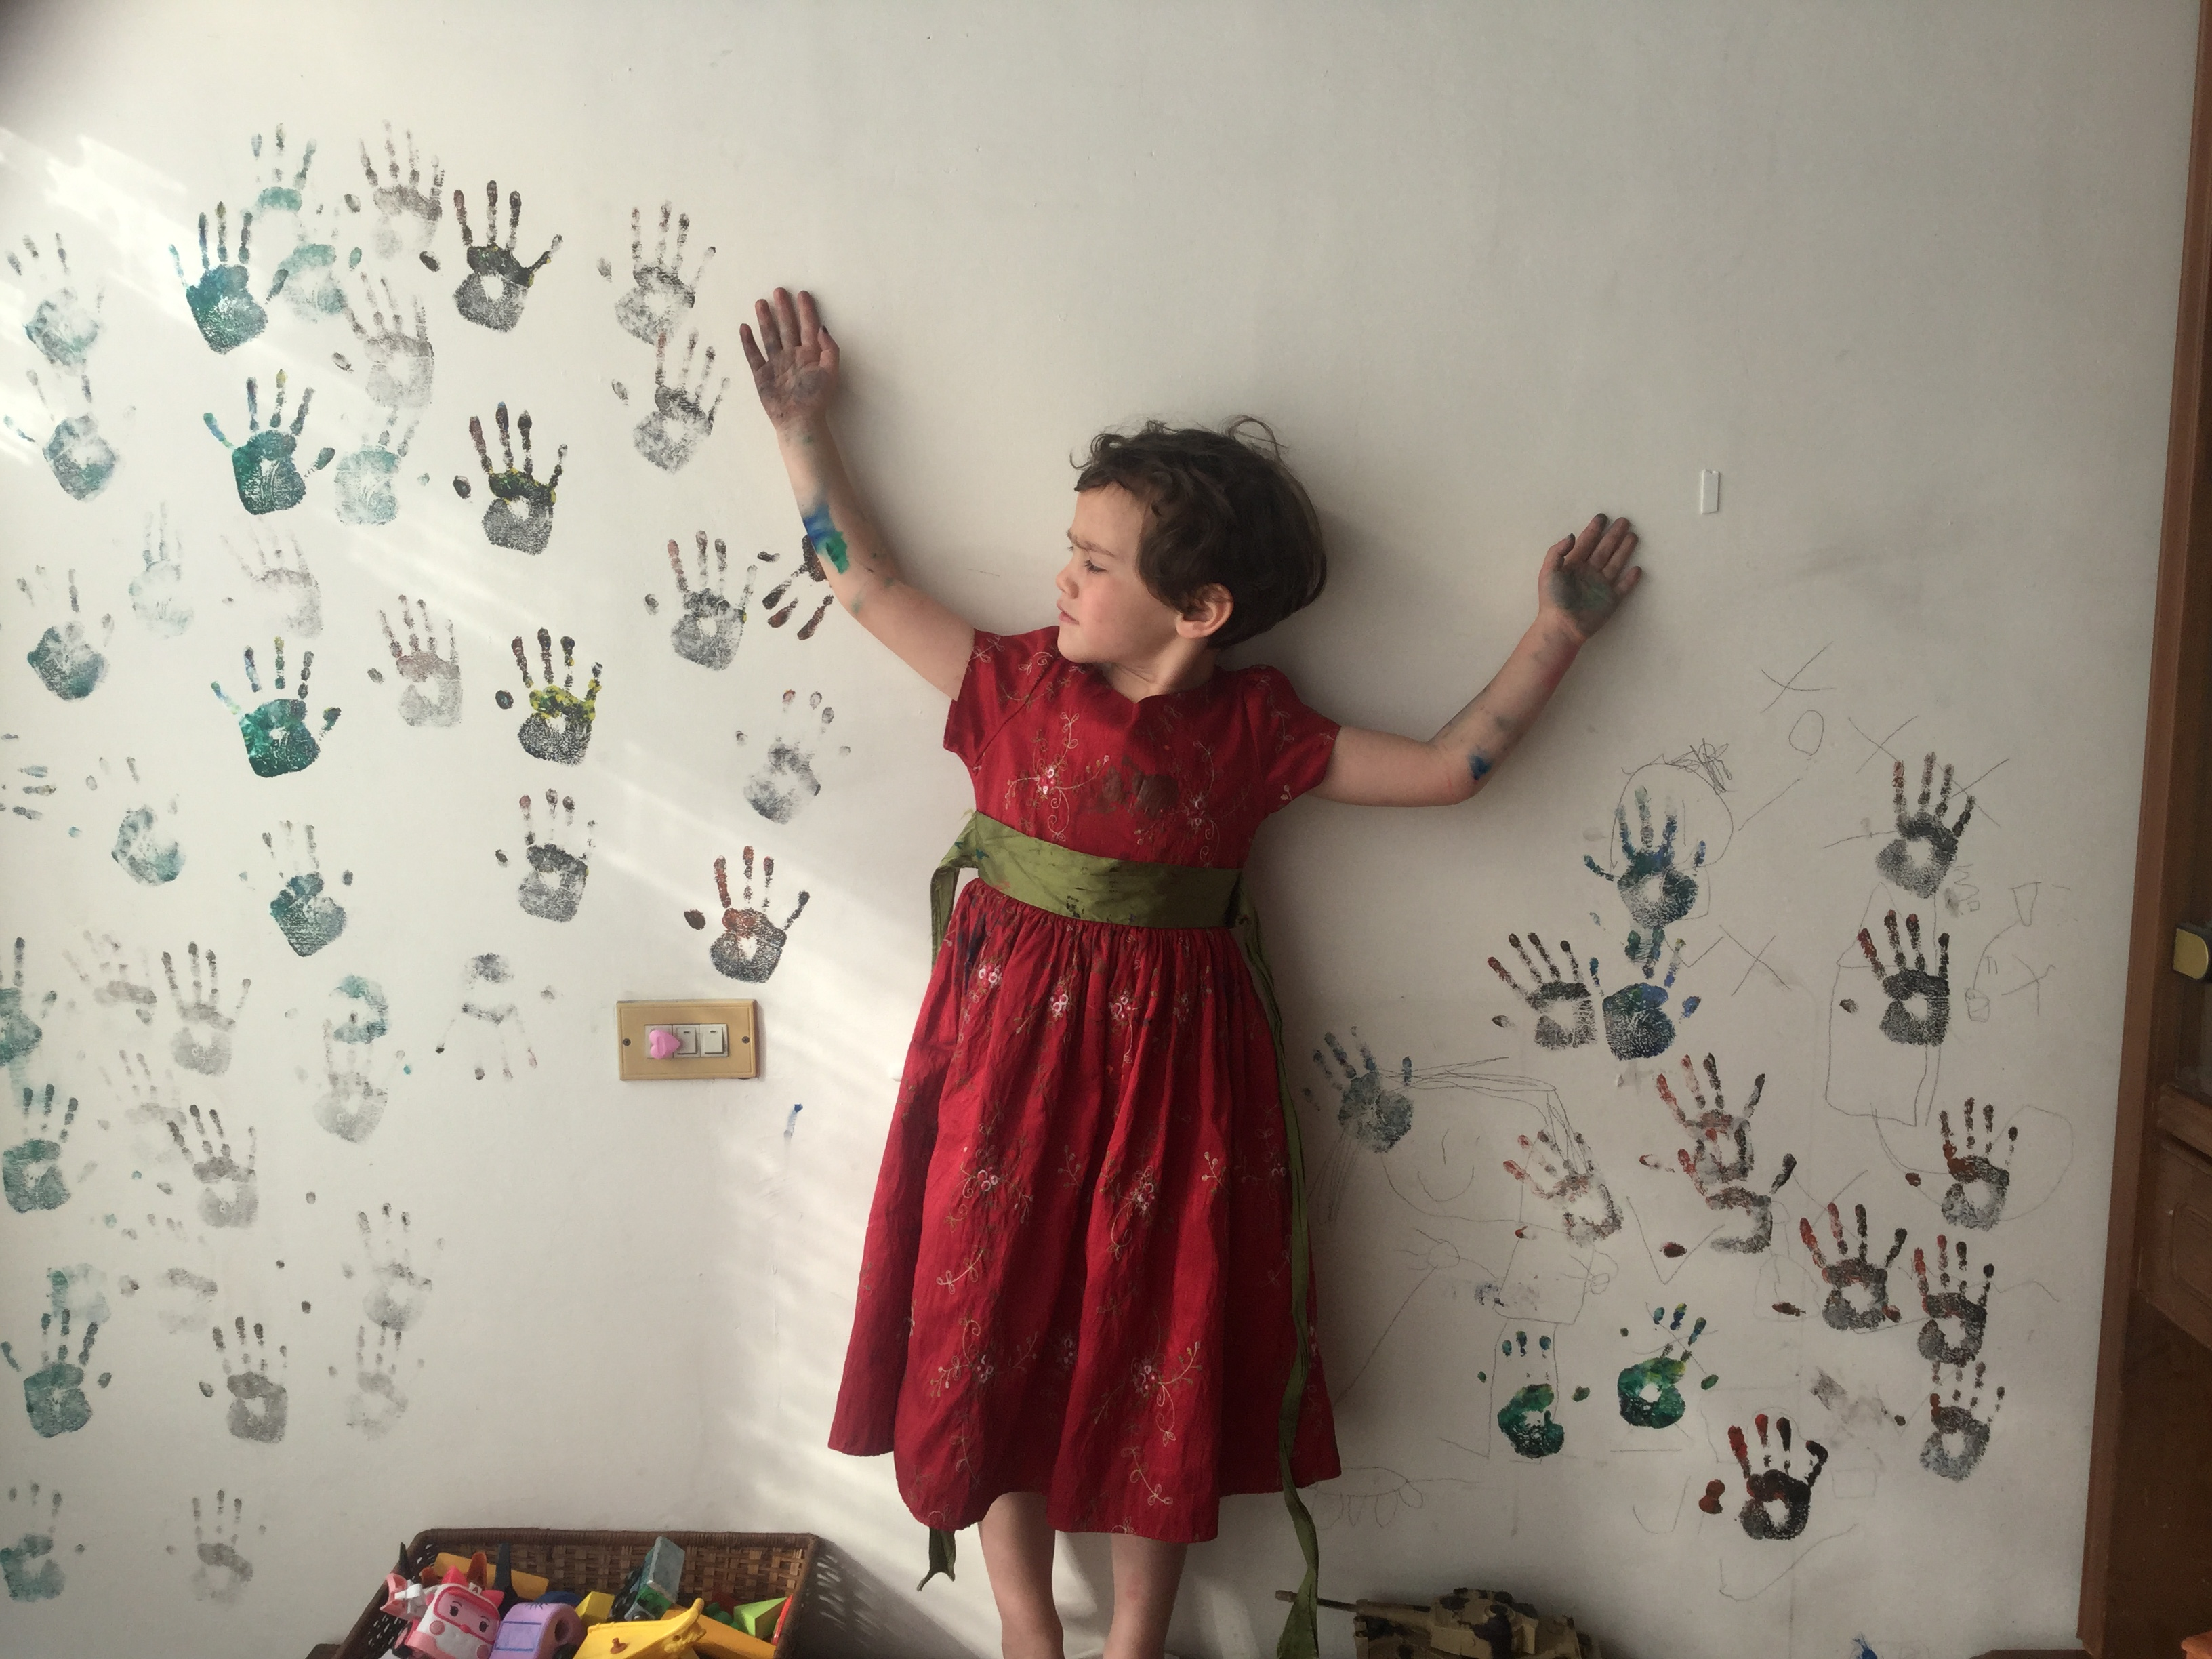
Simple
Living Centers
So many choices on each side of us.

