Slide 1
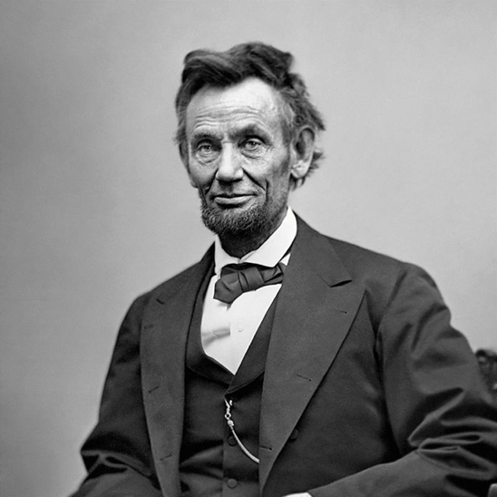
Leadership Monday - Abraham Lincoln
8 November -1864 – Northern voters overwhelmingly endorse the leadership and policies of Republican President Abraham Lincoln and elect him to a second term. With his reelection, the fate of the Confederacy was sealed and any hope for a negotiated settlement vanished.
In 1864, Lincoln faced many challenges to his presidency. The war was now in its 4th year, and many were questioning if the South could ever be fully conquered militarily. Gen Ulysses S. Grant mounted a massive campaign in the spring of that year to finally defeat the Confederate army of Gen Robert E. Lee, but after sustaining horrifying losses at the Wilderness, Spotsylvania, and Cold Harbor, the Yankees bogged down around Petersburg. As the fall approached, Grant seemed no closer to defeating Lee than his predecessors.
In the West, Gen William T. Sherman was planted outside of Atlanta, but he could not take that city. Some of the Radical Republicans were unhappy with Lincoln’s conciliatory plan for reconstruction of the South. And many Northerners had never been happy with Lincoln’s 1862 Emancipation Proclamation, which converted the war from one of reunion to a crusade to destroy slavery. Weariness with the war fueled calls for a compromise with the seceded states.
Eaton Solutions, Inc.

Slide 2
Leadership Monday - Abraham Lincoln
The Democrats nominated George B. McClellan, the former commander of the Union Army of the Potomac. McClellan was widely regarded as brilliant in organizing and training the army, but he had failed to defeat Confederate Gen Robert E. Lee in Virginia. He and Lincoln quarreled constantly during his tenure as general in chief of the army, and Lincoln replaced him when McClellan failed to pursue Lee into Virginia after the Battle of Antietam in September 1862.
In the months leading up to the election, the military situation changed dramatically. While Grant remained stalled at Petersburg, Mobile Bay fell to the Federal navy in August, Sherman captured Atlanta in September, and Gen Philip Sheridan secured Virginia’s Shenandoah Valley in October.
On election day, Lincoln carried all but three states (Kentucky, New Jersey, and Delaware), and won 55 percent of the vote. He won 212 electoral votes to McCellan’s 21. Most significant, 78 percent of the Union troops voted for their commander in chief, including 71 percent of McClellan’s old command, the Army of the Potomac. Perhaps most important was the fact that the election was held at all as prior to World War II, no country had ever held elections during military emergencies.
Lincoln himself said, “We cannot have free government without elections; and if the rebellion could force us to forego, or postpone a national election, it might fairly claim to have already conquered and ruined us.” Five months after Lincoln’s reelection, the collapse of the Confederacy was complete, and the Union saved.
Eaton Solutions, Inc.

Slide 3
NASA – SEWP ( Solutions for Enterprise-Wide Procurements) VI Government-Wide Acquisition Contract Update
The National Aeronautics and Space Administration (NASA) announced several major changes to its Solution for Enterprise-Wide Procurement (SEWP) VI Government-Wide Acquisition contract.
The SEWP VI GWAC aims to provide federal agencies with a comprehensive acquisition vehicle for IT products and services. The contract will allow various order types, including Firm Fixed Price, Time and Material, and Fixed Price Economic Price Adjustment orders.
Eaton Solutions, Inc.

Slide 4
Minimum Experience Thresholds Clarified
NASA clarified the minimum thresholds to qualify for Relevant Experience Projects (REPs) for both Small and Large Businesses within Categories B, and C. Notably, for Categories B and C, the minimum threshold for small businesses is now $2M per project, not $30M as is stated in the draft RFP. The requirements will now include:
Category B: Enterprise-wide IT Solutions (Products and Service Solutions)
  Business Size REPs Minimum Amount
  Large Business 4 REPs (from 4 of 10 Mandatory areas) $30M
  Small Business 3 REPs (from 3 of 10 Mandatory areas) $5M
Category C: IT Professional Services (ICT and AV Services)
  Business Size REPs Minimum Amount
  Small Business 3 REPs (from 3 of 10 Mandatory areas) $2M
  HUBZone, SDVOSB, EDWOSB 2 REPs (from 2 of 10 Mandatory areas) $2M
Category C “Reserved” Provision: A Reserved Contract category is in place for Category C Contract Holders to accommodate small businesses that become large businesses during the life of the SEWP VI contract.
Eaton Solutions, Inc.

Slide 5
Details
Contract Value: Over $100 billion across 10 years
Timeline:
  Draft RFP Released: September 18, 2023
  Response Date: October 23, 2023
  RFP Release Date: March 2024 (Before End of Winter)
  Proposal Due Date: Release Date + 60-90 Days (projected)
  Award Date: Q1 FY2025 (Desired, no later than Q3 FY2025)
Competency Primary: Value Added Reseller (VAR) Services Contract IT Professional Services
Competition: Unrestricted/Small Business
Awards: 140 total awards, with 100 for small businesses
Contract Term: 10 years
Location: CONUS, OCONUS, and Washington DC
NAICS Code: 541512 (Computer Systems Design Services), but not restricted to this code

Slide 6
How We Can Help
We have won Government contracts valued as small as $1 million, and well over a billion dollars.
Won previous Army RD&E bids.
Former Army RD&E Executive.
Served on Federal Acquisition teams and know and understand the inside mechanisms.
Strategized and submitted winning bids after RFP release.
Eaton Solutions, Inc.

Slide 7
Open for a Chat?
How about a free 30-minute strategic review?
Direct Message me or email me at bailey@eatonsolutionsinc.com.
Or feel free to call me at 571.473.8209.
Check Out Website. Eaton Solutions, Inc. (eatonsolutionsinc.com)
“He helped us win the largest contract we have ever had and set us up to properly execute it.”
- Government Contractor Client
Eaton Solutions, Inc.

